Slide 1
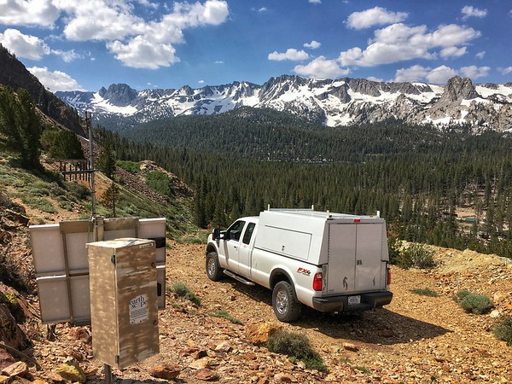
Present-day motion of the Sierra Nevada Block and some tectonic implications for the basin and range province, North American cordillera
Photo courtesy of UNAVCO
Presentation by:
Nolan Dellerman

Slide 2
Intro
Author argues that the Sierra Nevada block appears to behave similarly to oceanic lithosphere.
i.e. motion is characterized by narrow deformation zones between rigid blocks.
The motion of a rigid block on a sphere can be described by a given Euler vector, so the author tested velocity data from sites on the Sierra Nevada block against other observations.

Slide 3
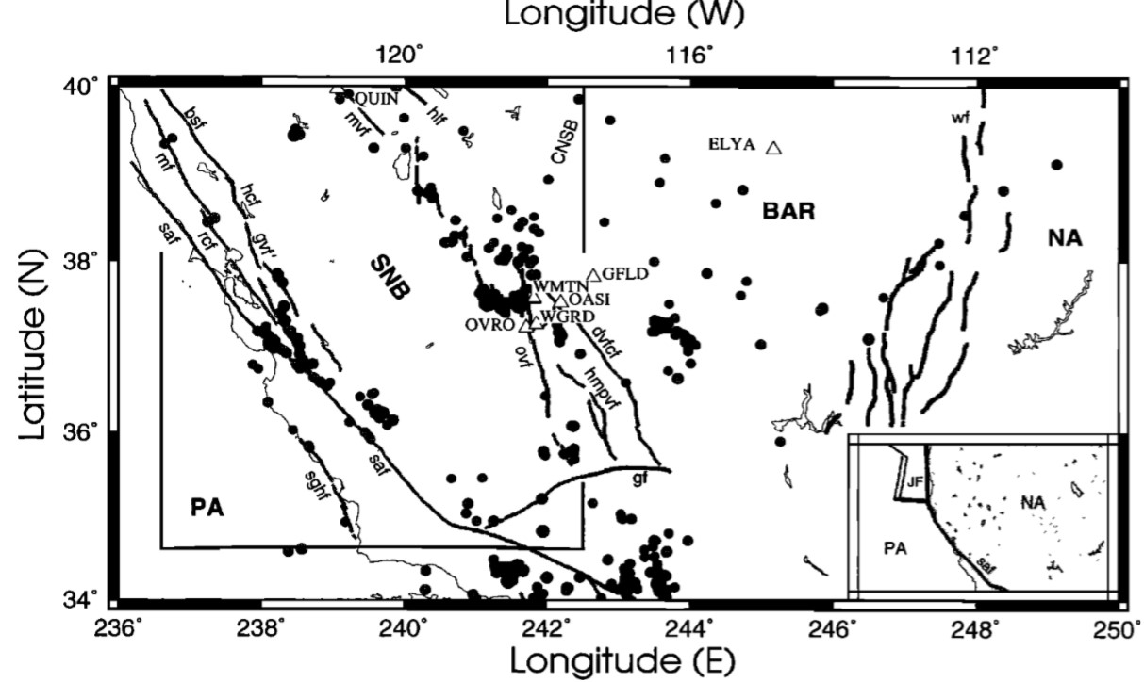
Notes:
Seismic events shown are post 1960, >4.5, shallower than 30km

Slide 4
Motivation?
To test if the Sierra Nevada block is rigid or not.
Or if there is strain accumulation on a few locked faults.
Motion of the block can help understand the Pacific-North American plate boundary better.

Slide 5
Methodology
Sites located on the interior of the SN block, on the E margin, and in the B and R were measured with GPS campaigns during August-Sept from 1993-1998.
Semi permanent sites (none operating <2years)were also measured continuously on or near the SN block.
16 semi permanent continuously recording stations in eastern and central N. America were measured to define a stable reference.
Notes:
Not all campaign sites were measured every year

Slide 6
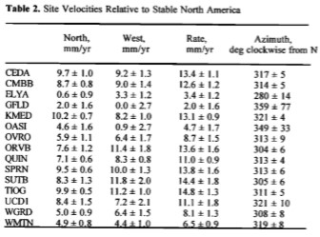
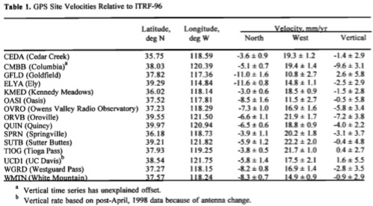
Table of site velocities relative to ITRF-96 (global reference frame)
Table of site velocities relative to stable N. America

Slide 7
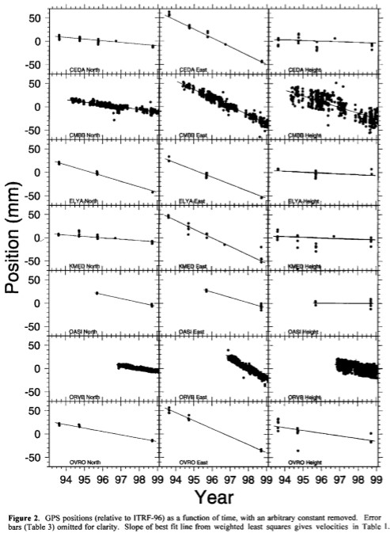
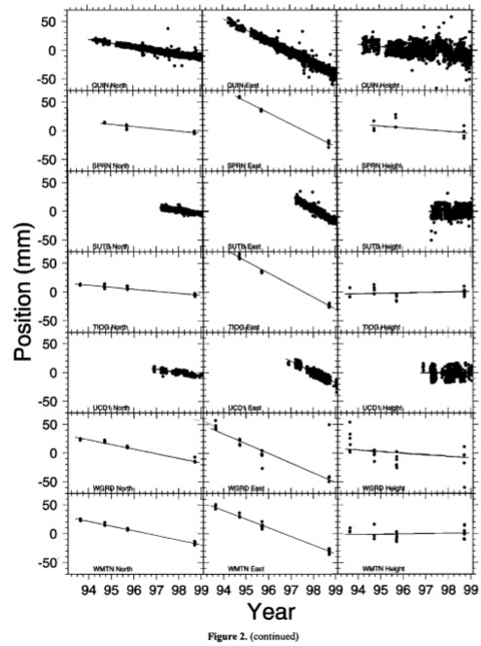

Slide 8
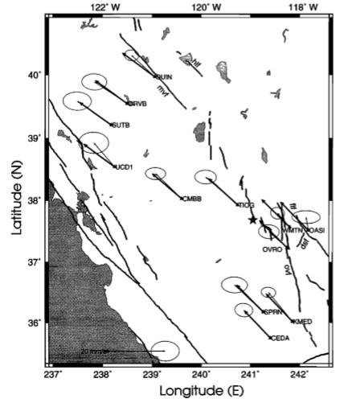
Note than sites within stable block interior fit predicted velocity within the uncertainty ellipses
Those on the block margin do not

Slide 9
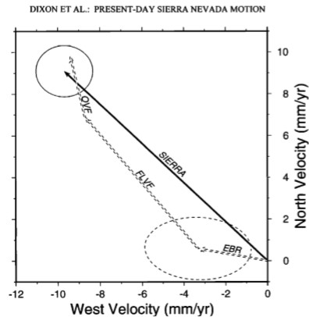
Discussion
GPS velocities for all sites on the Sierra NV block are consistent with the rigid block model within error
i.e. motion of the SN block can be described by the rotation of a rigid block on a sphere
SIERRA line shows motion of Sierra NV block relative to stable
N. America (SNA)
EBR line represents motion of the eastern B and R relative to
SNA
Vector difference between SIERRA and EBR represents motion
0n the ECSZ plus additional deformation in B and R interior
FLVF (Fish Lake Valley fault zone) and OVF ( Owens Valley
fault zone) are zones of right lateral shear included in ECSZ
deformation
The point of these two fault zones is that their total measured
motion matches the total motion b/w central Sierra Nevada and
the Basin and Range
This implies that this transect isn’t missing any
significant motion

Slide 10
Conclusion
First Euler vector describing present day motion of Sierra Nevada block
Also the block is rigid
Also it is moving faster than prior estimates
No vertical motion except within Owens valley which may be subsiding
Rotation is not around a proximal pole, but rather parallel to the overall plate motion
Why does this matter?
This Euler vector can be used as a kinematic constraint for regional tectonic problems
Questions?

