Slide 1
Refined kinematics of the Eastern California shear zone from GPS observations, 1993-1998
Miller, M.M., Johnson, D.J., Dixon, T.H., Dokka, R.K., 2001. Refined kinematics of the Eastern California shear zone from GPS observations, 1993-1998. Journal of Geophysical Research-Solid Earth 106, 2245-2263.
Presentation: Kurt Kraal

Slide 2
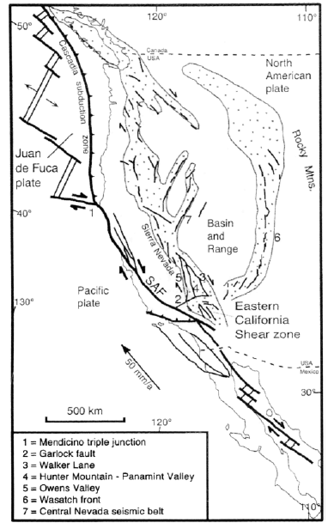
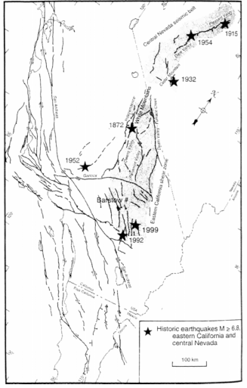
Background
San Andreas fault system forms the transform plate boundary between the Pacific Plate and North America at this latitude
Deformation occurs over a larger zone than just the San Andreas fault:
Relative plate motion of southern California ~50 mm/yr, San Andreas ~35 mm/yr
Eastern California Shear zone (ECSZ) plays a major role in balancing the “discrepancy” between plate motion and SA slip rate
ECSZ describes the faults in the Mojave and the faults that penetrate across the Garlock Fault to the North
A number of historic large earthquakes on these faults
This study presents new GPS constraints on deformation in ECSZ, in order to investigate its role in plate margin deformation
GPS velocities are also integrated into a geologically constrained model, in order to relate short term GPS velocity field with long-term geologic deformation

Slide 3
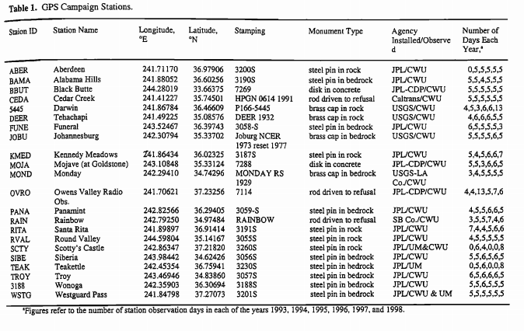
Goals and Methods:
1991 GPS Geodetic Network
The goal was to measure the secular strain associated with a complex continental transform margin, where slip is partitioned from the San Andreas fault northeastward through the Mojave Desert via the Eastern California shear zone to the Walker Lane
GPS stations >

Slide 4
Methods 2
Equation used to estimate uncertanitie
Data analysis included the use of error estimation strategies to treat day-to-day uncertainties
Error can come from both white noise and time-correlated noise
Correlated noise includes monument motion unrelated to tectonic deformation
Also uncertainty in the satellite orbit parameters and local atmospheric and environmental effects
New data was also compared to previous data sets to see if they agree, which they mostly do (but new data was considered better by the authors)

Slide 5
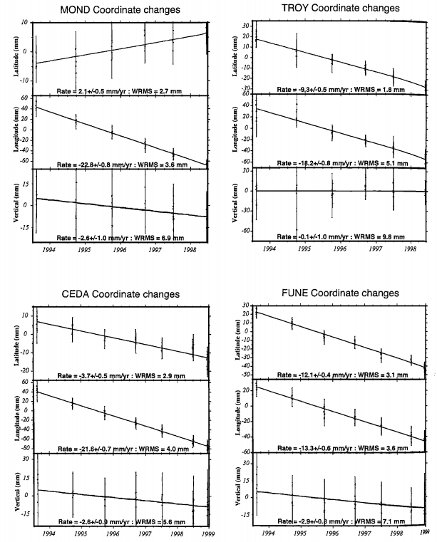
Methods 3
Example representative time seris for GPS stations in the network
Figure Includes the white noise error estimation model, which estimates uncertainties

Slide 6
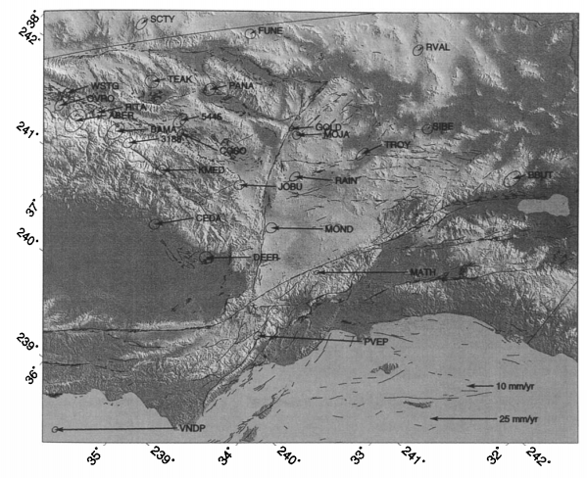
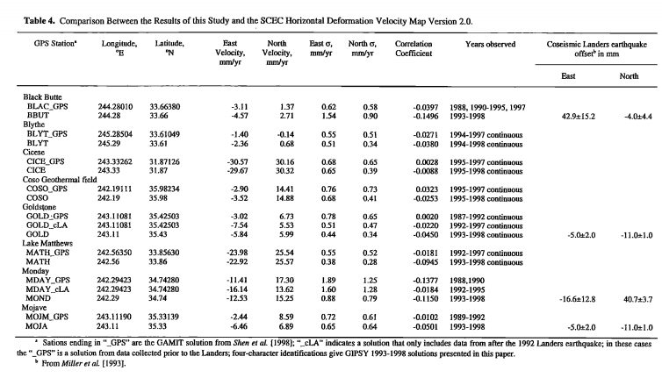
Results
GPS determined velocity field of ECSZ 1993-1998
Velocity field is set relative to nominal North America, which lies east of all Cordilleran deformation

Slide 7
Results
Right Lateral Shear
(increasing parallel velocity vectors)
Change in orientation
GPS determined velocity field of ECSZ 1993-1998
Velocity field is set relative to nominal North America, which lies east of all Cordilleran deformation

Slide 8
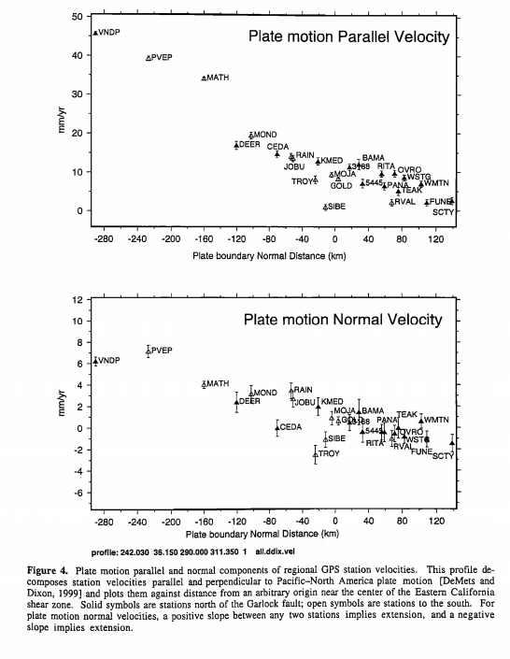
Plate Motion Parallel and Normal Velocity to Pacific-North American Plate motion
Plots them against distance from an arbitrary origin near the center of ECSZ
Solid symbols are north of Garlock fault, open are stations to the south
“For plate motion normal velocities, a positive slope between any two station implies extension and negative slope implies extension”
Deformation concentrated nearer the San Andreas Fault
Dextral deformation in stations north of Garlock fault are concentrated more towards the northeast. Away from the fault
This shift in the locus of deformation is also apparent in the normal motion
ECSZ fault strike more northerly than the plate motion direction, thus extension is a consequence of the northwest oblique motion on north to north-northwest striking faults
These patterns conform with our ideas of the Sierra Nevada as a structural block and the inland penetration of the shear zone.
Also emphasizes the role of sinestral motion on the garlock fault to accommodate different styles of deformation oblique to Pacific-North America motion in adjacent structural domains.

Slide 9
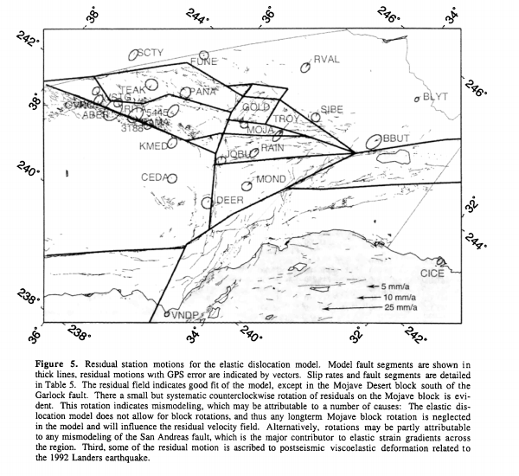
Fault Model
GPS velocities are only averaged over several years
To compare with fault slip rates from faults and other long-term geologic data, they built this fault model.
The model for the most part fit the data except in the southeast, which may be due to some rotation in the Mojave, which was not modelled.

Slide 10
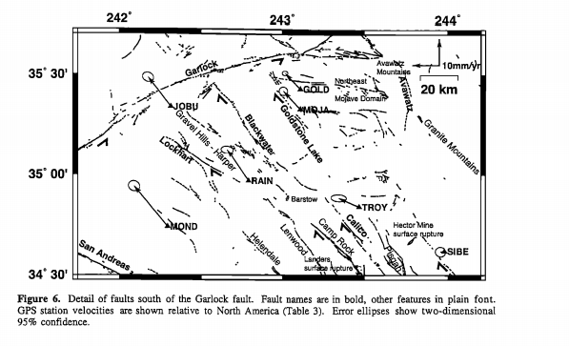
South of Garlock Fault Mojave Desert Block
Slip budget in Mojave block ~14 mm/yr
Geologic offsets and sliprate estimates suggest ECSZ has been active 10 myr or longer
Northern part of this map, most deformation steps east of Goldstone
South of Barstow, most deformation occurs in central ECSZ

Slide 11
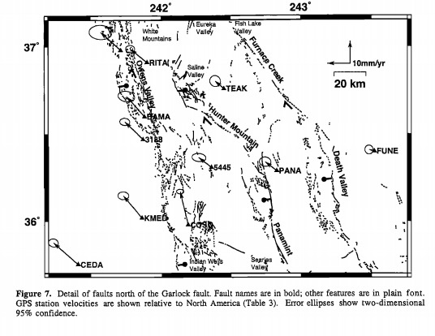
North of Garlock Fault
~ 13 mm/yr between eastern flank of Death Valley and western flank of Sierra Nevaad
Half the modern slip occurs on faults within Owen’s valley (~8 mm/yr)
6mm/yr are on faults within Panamint Valley and Death Valley
Azimuth of the cumulative relative motion lies counterclockwise from the strike of local faults, therefore creating Basin and Range topography

Slide 12
Garlock Fault
Due to differences between northern and southern ECSZ, Garlock fault is likely important for accommodating varying structural regimes

Slide 13
Summary and conclusions
ECSZ accomadates about 28-29% of relative motion between NA and Pacific Plate
There are along strike variations between northern and southern ECSZ, suggesting that the garlock fault separates 2 different structural domains. - possible clockwise rotation of eastern garlock fault

