Slide 1
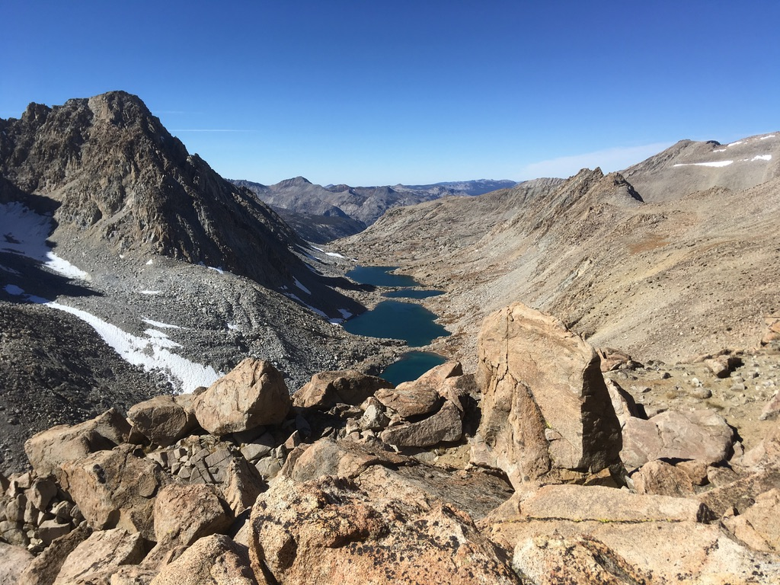
The uplift of the Sierra Nevada and implication for late Cenozoic epeirogeny in the western Cordillera
J. R. Unruh 1991
Presented by Luke J Schranz

Slide 2
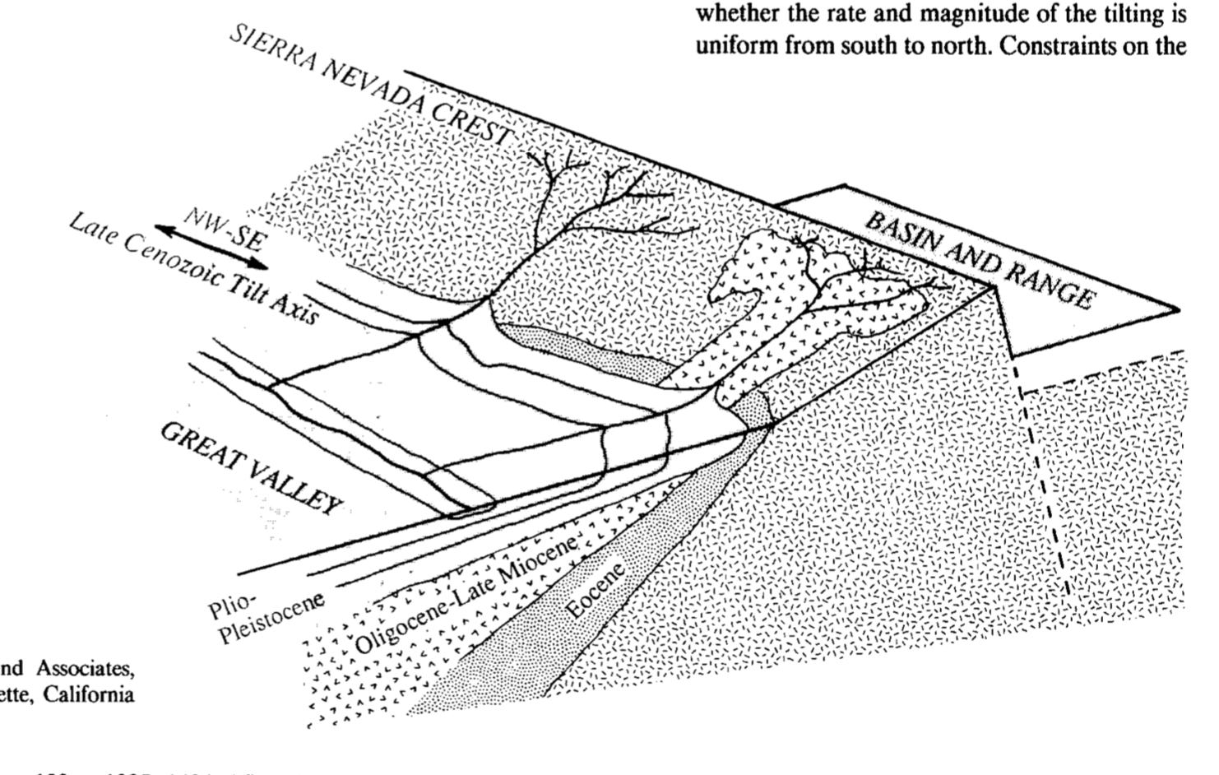
“The timing, magnitude, and mechanics of the late Cenozoic uplift of the Sierra Nevada range have been a matter of continuing controversy.”

Slide 3
The Problem
When, precisely did westward tilting occur?
Did tilting begin uniformly throughout the Sierra Nevada?
Are uplift rates and magnitudes uniform from north to south across the range?

Slide 4
Why do we care?
“Constraints on timing and kinematics of tilting are crucial for testing models that relate the deformation to time-transgressive events such as the northward migration of the Mendocino triple junction.”

Slide 5
Uplift has occurred within the last 10 m.y.
Grant and others in 1977 inferred the rate and timing of uplift from progressive tilting of Tertiary strata
Unconformities
Basic principal of this study

Slide 6
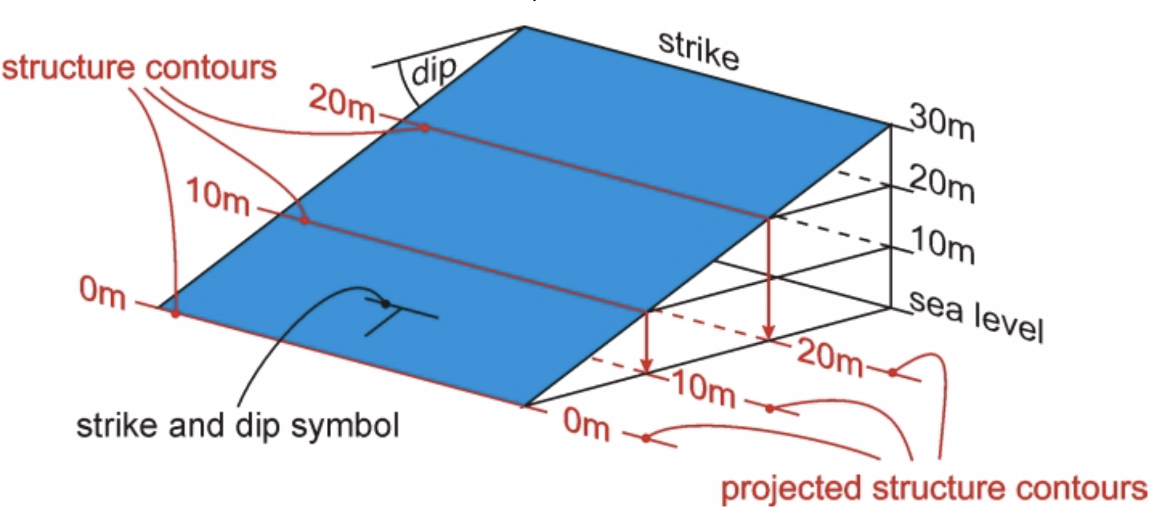
Methods
Draw structure contours on marker horizons in Cenozoic units or on tilted geomorphic surfaces above units
Well log correlation of marker units
Mapping Tertiary channel deposits and reconstructing gradients of ancient rivers east of the Great Valley
https://www.fault-analysis-group.ucd.ie/structurecontours/contours/struc.html

Slide 7
“…westward tilting of the Sierra Nevada has also tilted Cenozoic strata in the eastern Great Valley…”

Slide 8
Assumptions
Dips must be considered maximum estimates of tilting
Central Sierra (Feather River to Kings River) assumed to tilt as a rigid block about a single axis
Hinge line is west of the Sierra foothills and lies in the eastern Great Valley
Dips of Cenozoic strata in excess of Holocene depositional surface slopes interpreted to reflect uplift and westward tilting of the Sierra

Slide 9
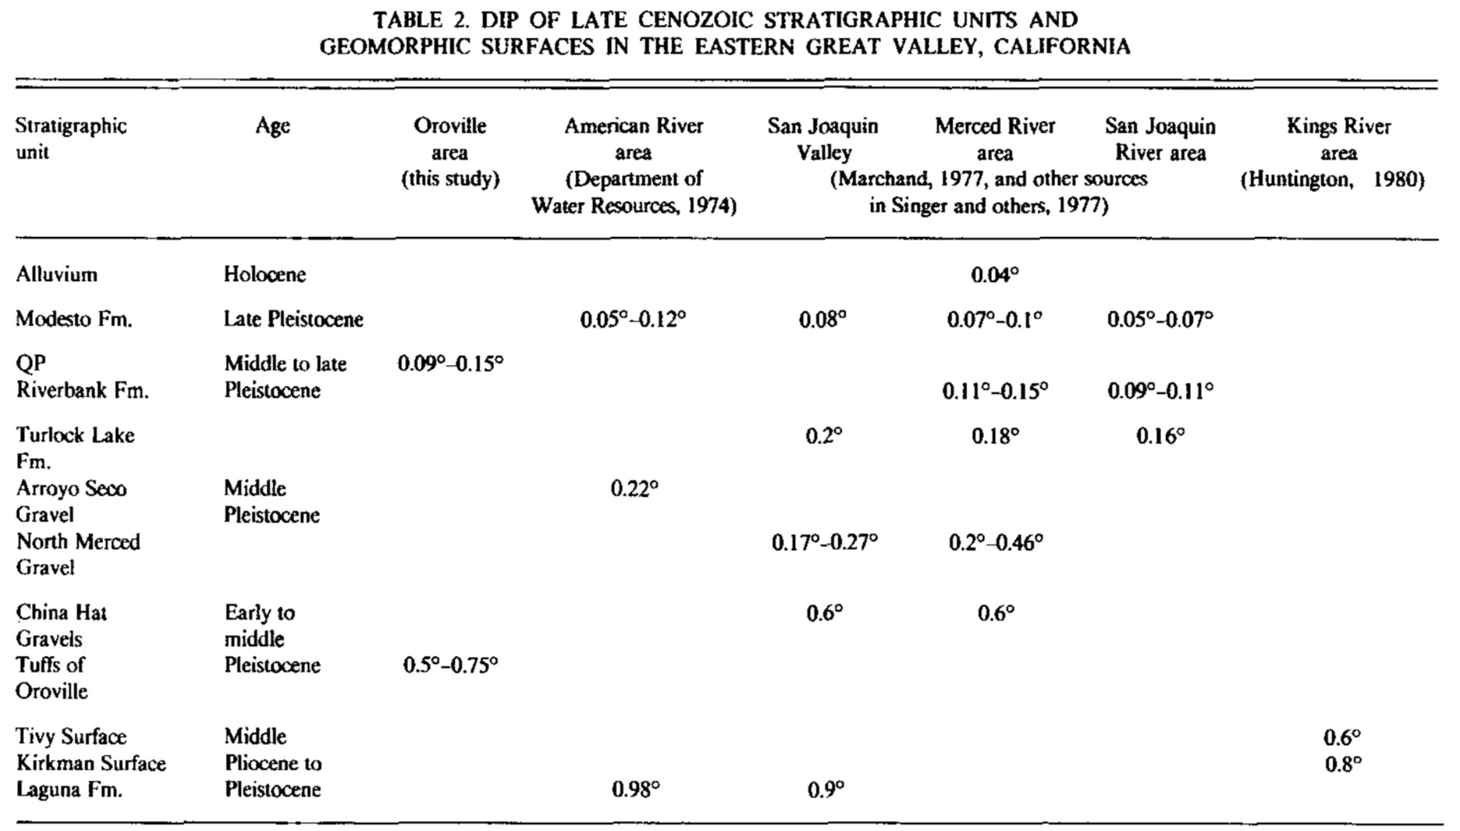
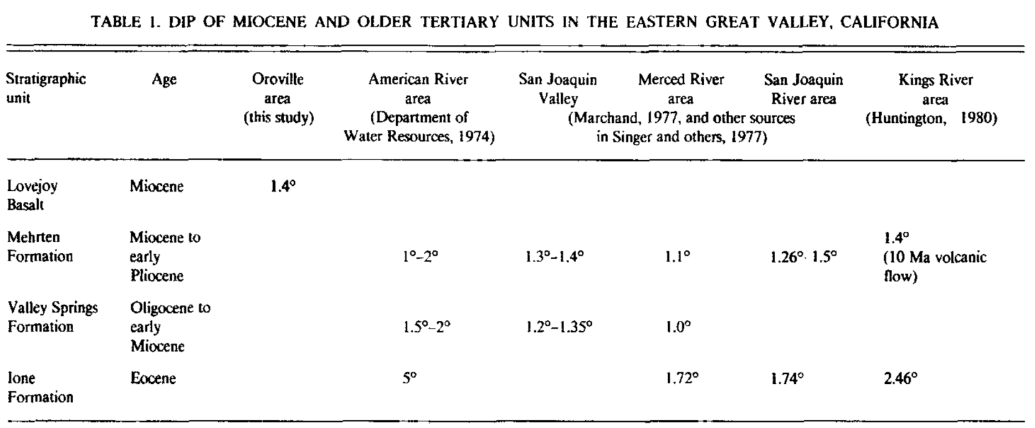

Slide 10
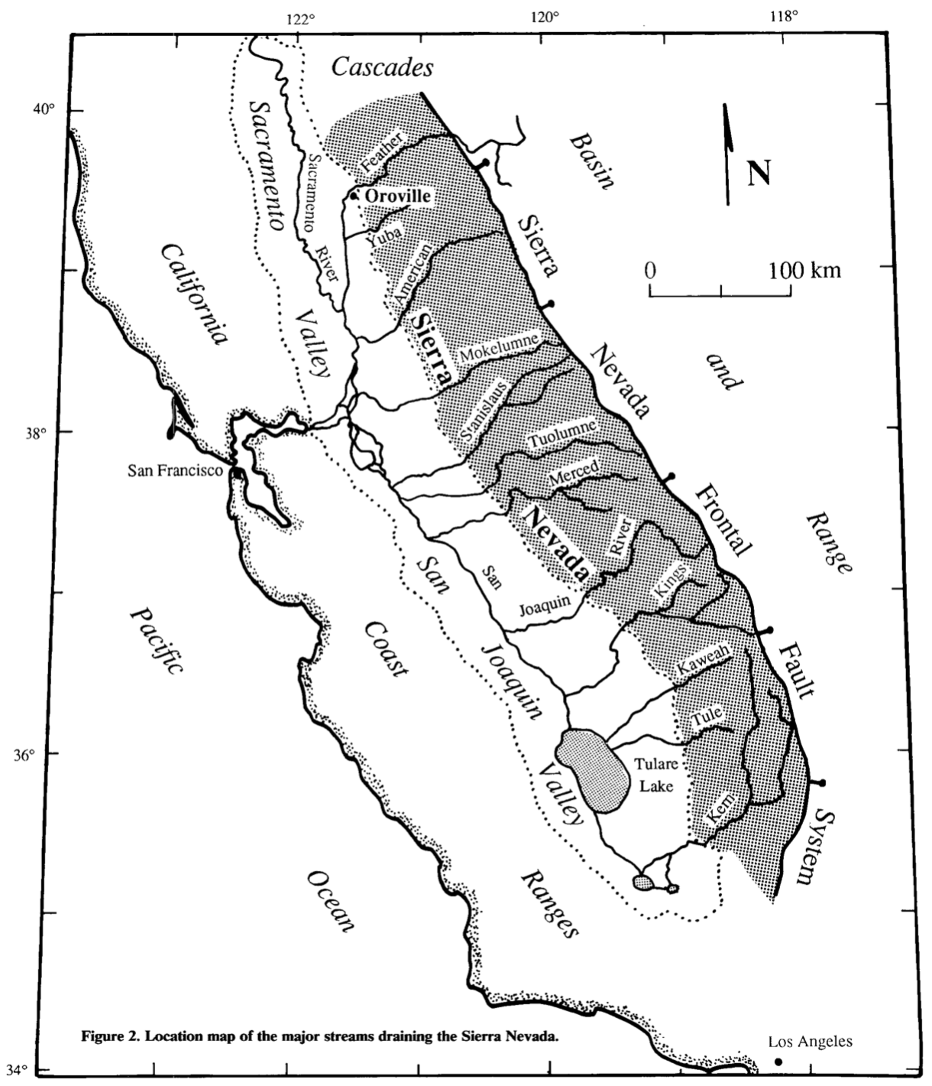

Slide 11
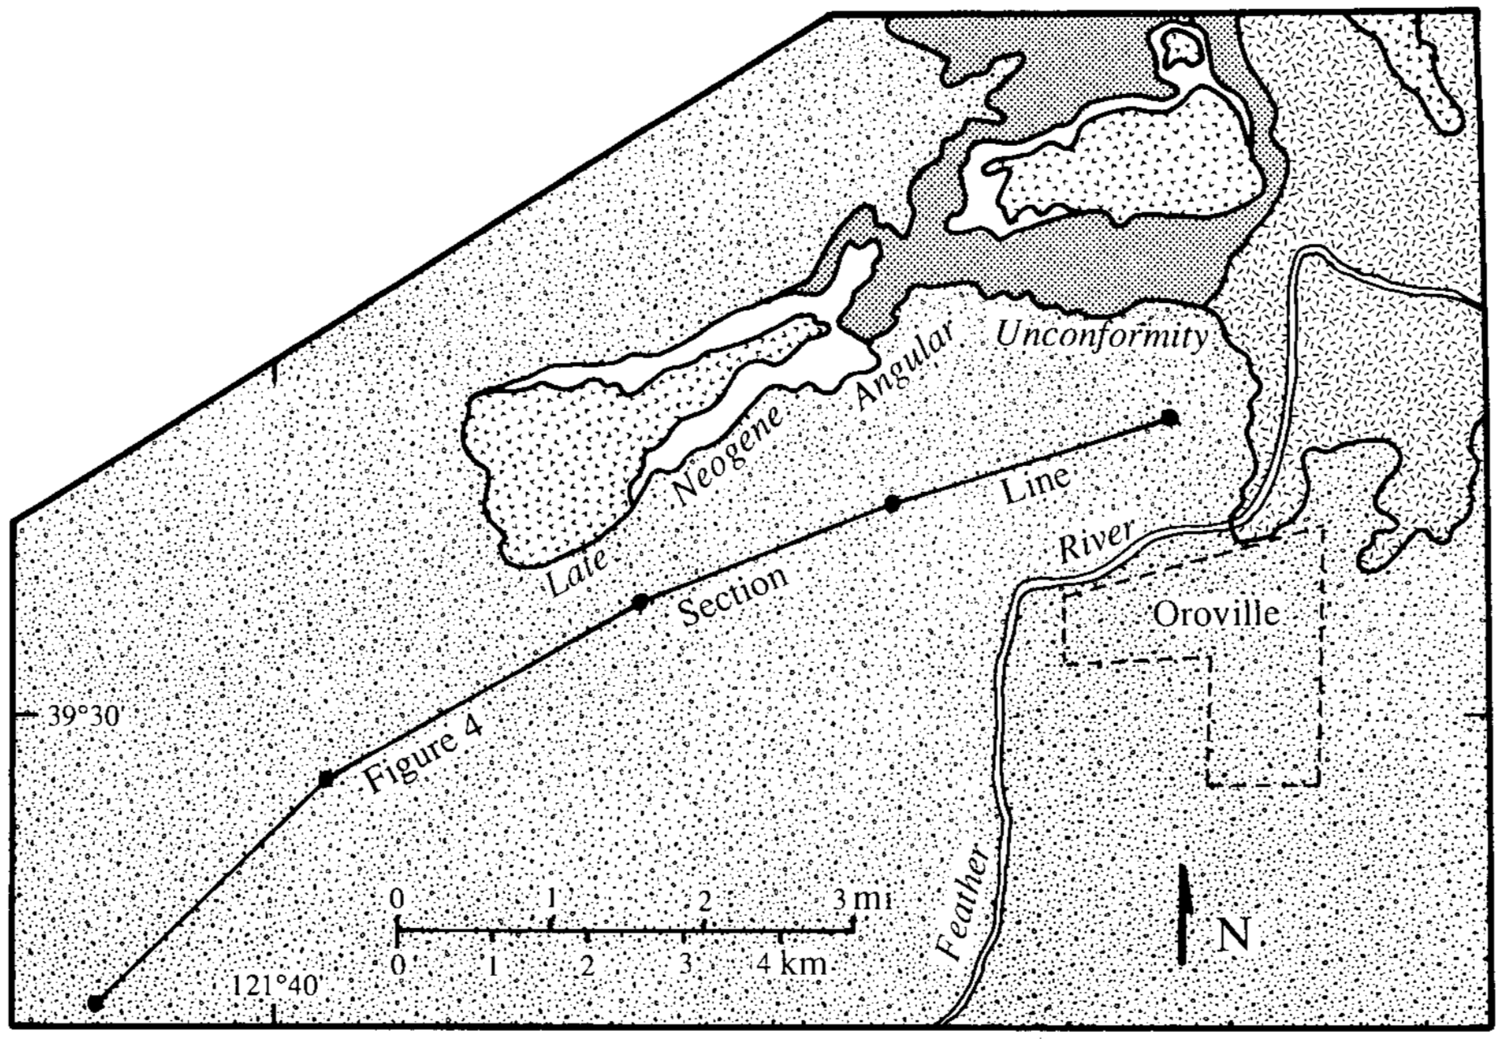
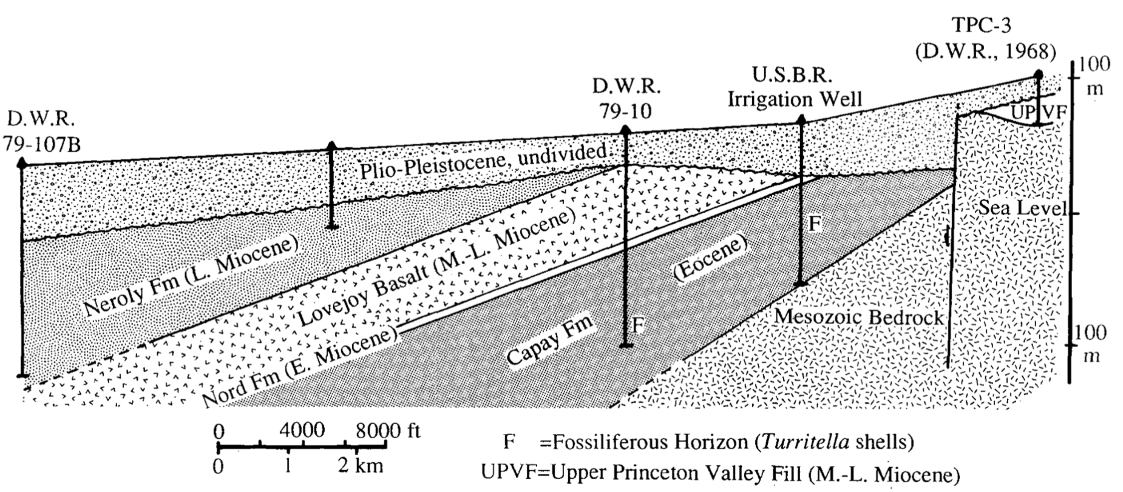
late Miocene
early Miocene
Mesozoic
Eocene
late Miocene
Pliocene-Pleistocene

Slide 12
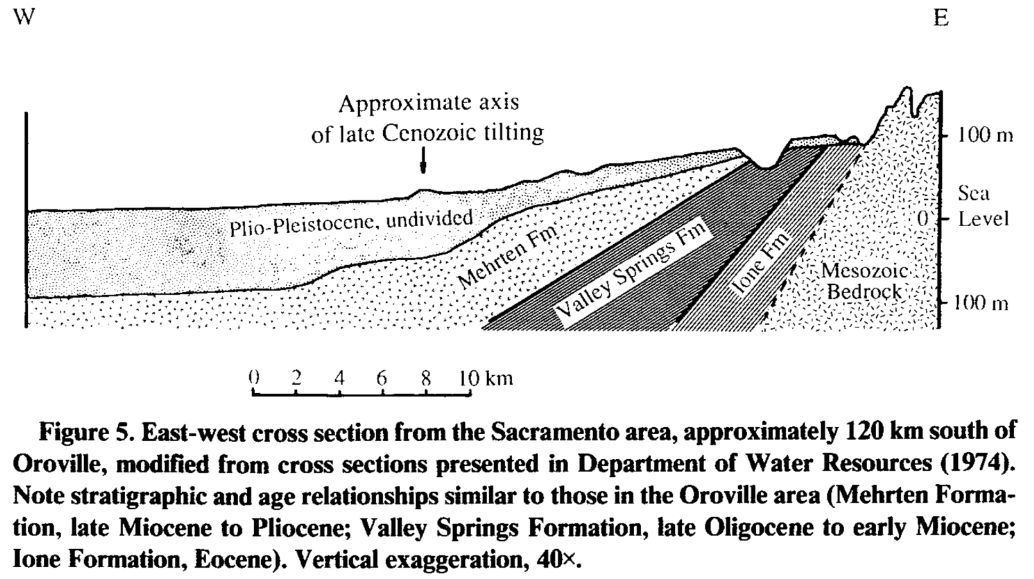

Slide 13
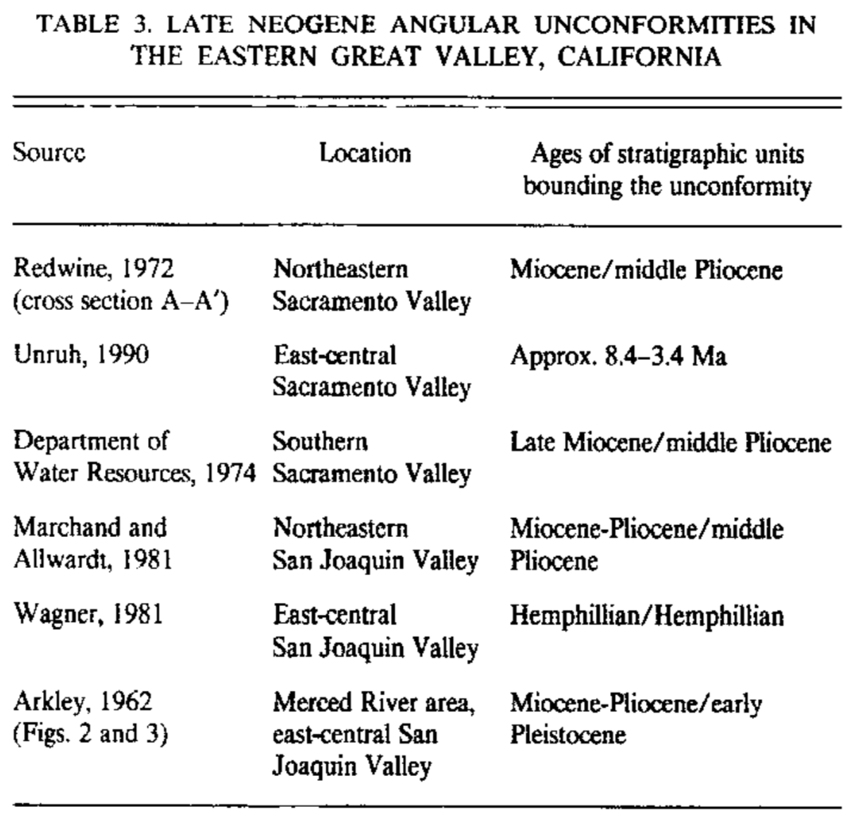
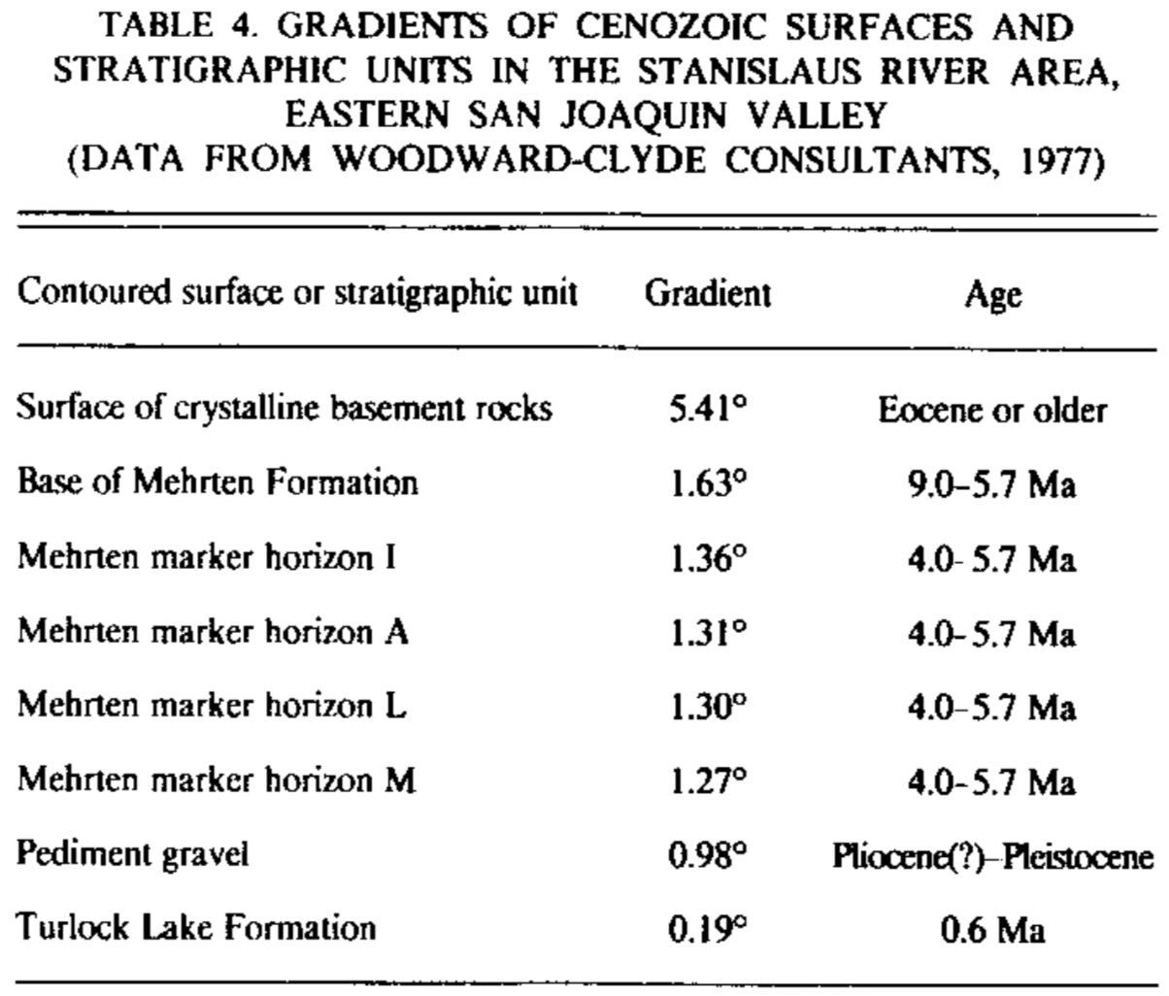
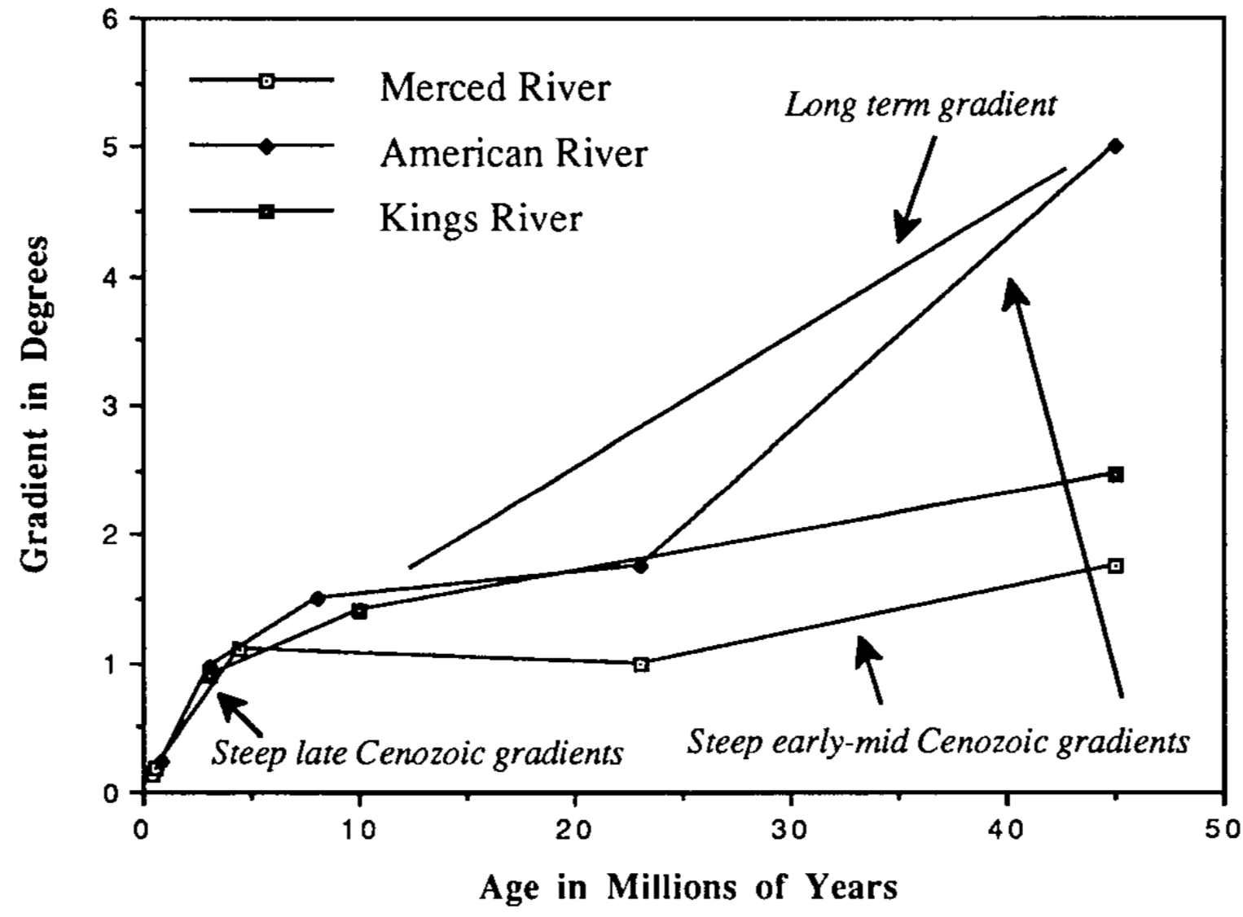

Slide 14
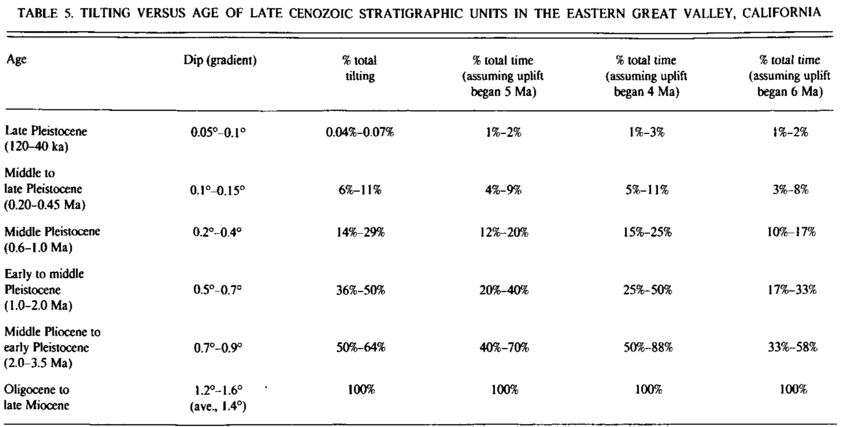

Slide 15
Implications
Sierran uplift can’t be triggered by northward migration of Mendocino Triple Junction - no time transgressive deformation, Sierra was uplifted at once
Not delayed isostatic compensation from Mesozoic, tilting magnitude is much less than pre-Eocene uplift
Uplift of the Sierra is likely a response to thinning of mantle lithosphere.

Slide 16
