Slide 1
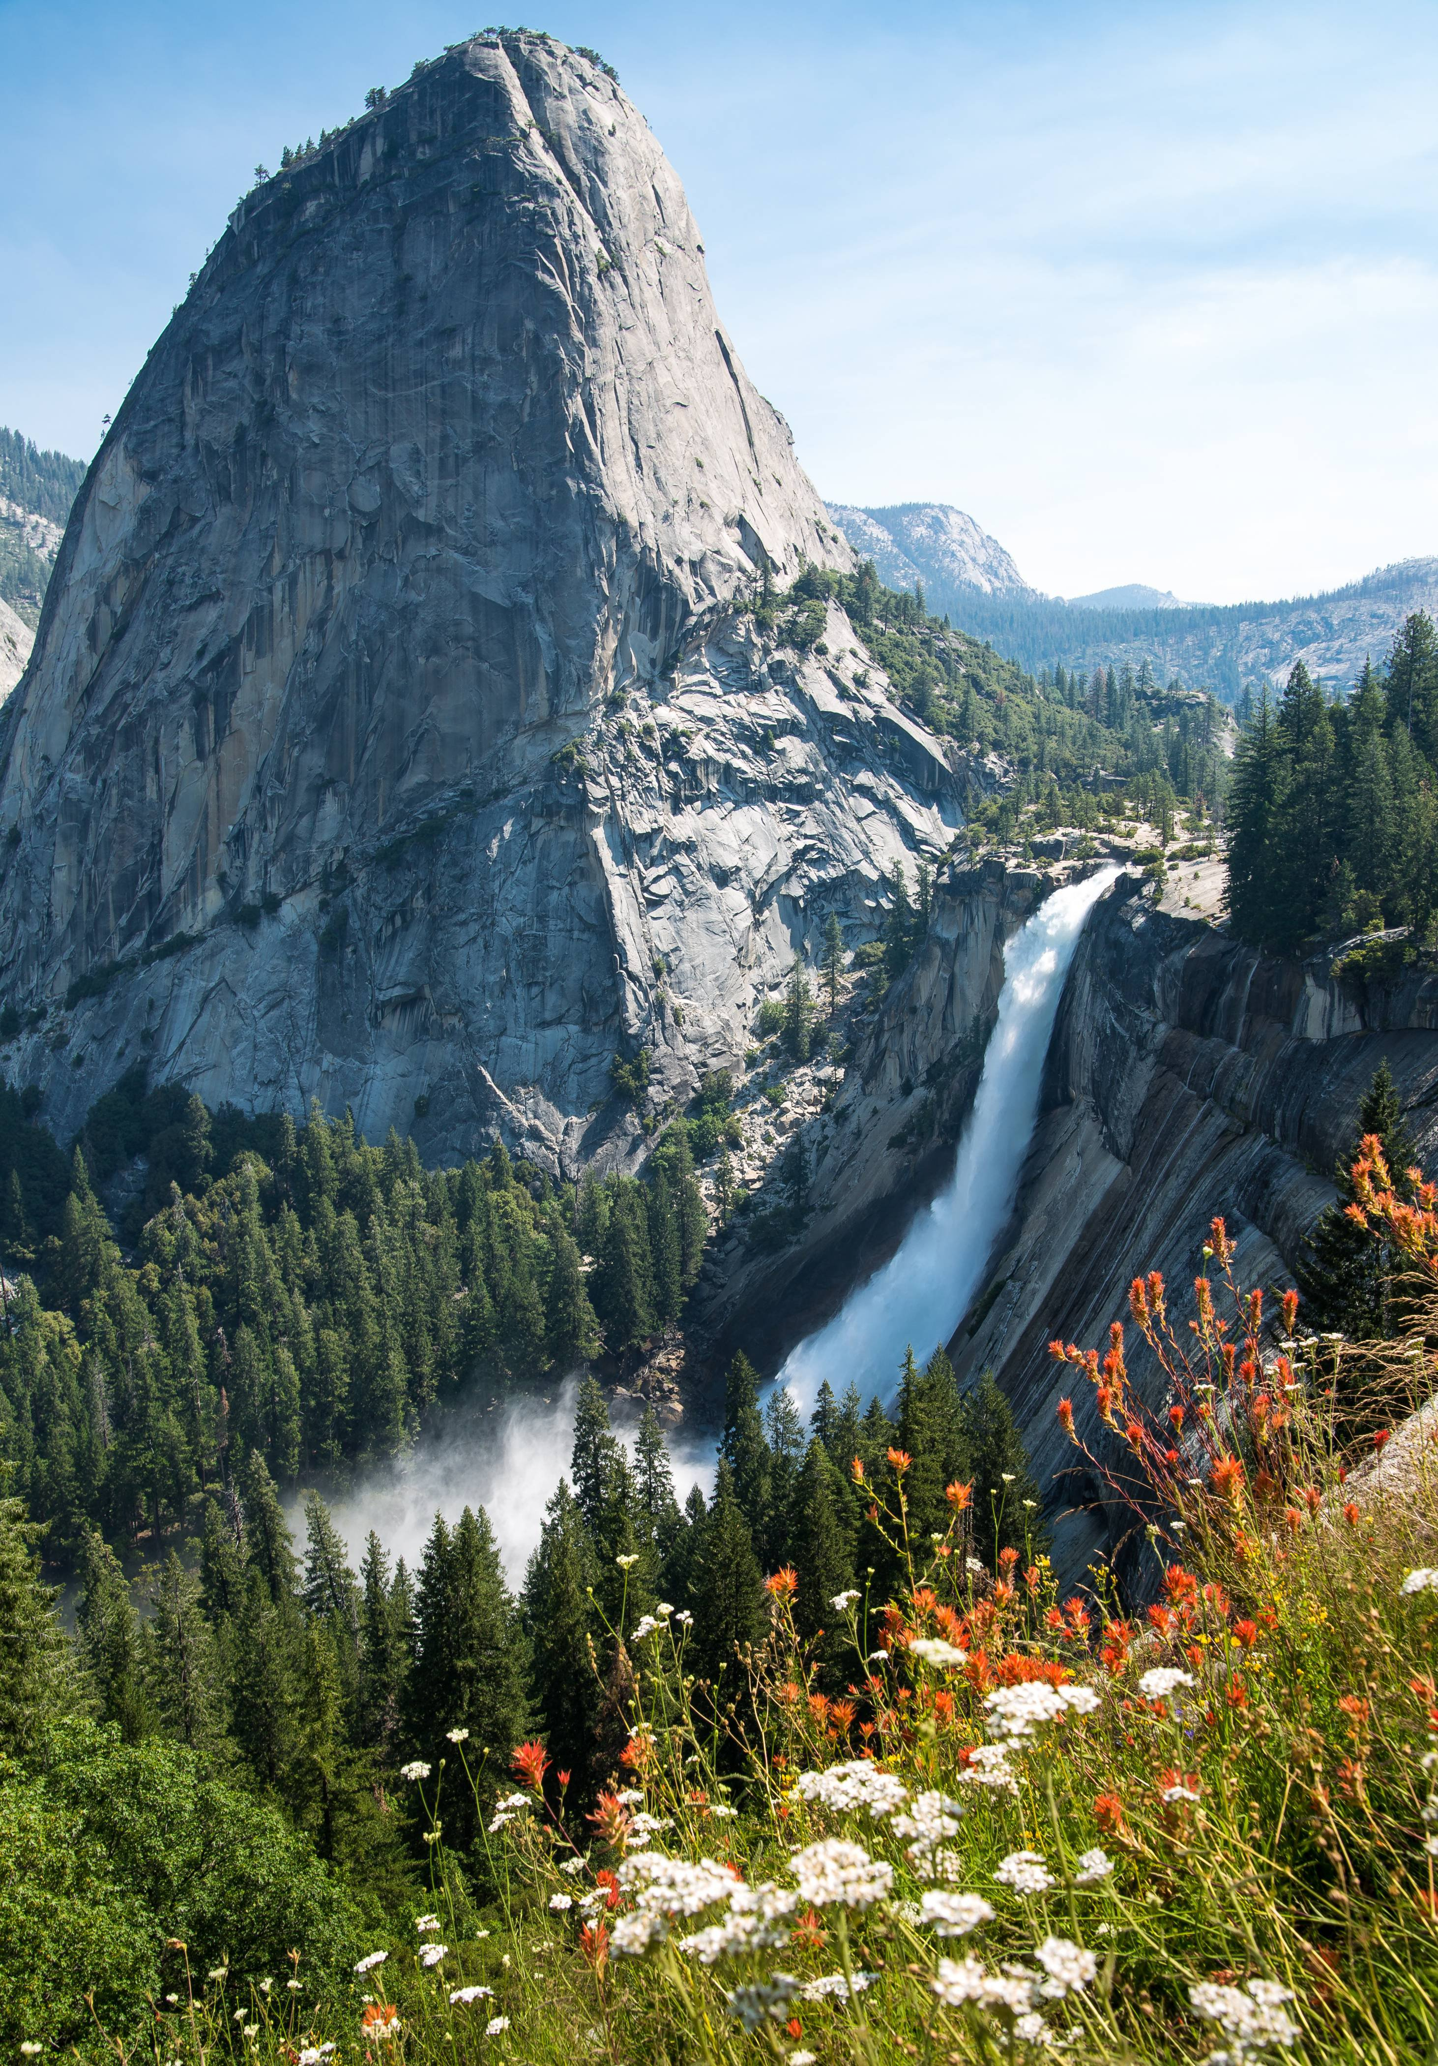
Stream incision, tectonics, uplift, and evolution of topography of the Sierra Nevada, california
Photo courtesy of UNAVCO
Wakabayashi, J. and T. L. Sawyer, 2001, Stream incision, tectonics, uplift, and evolution of topography of the Sierra Nevada, California, Journal of Geology, 109, 5, 539-562
Presentation by:
Nolan Dellerman

Slide 2
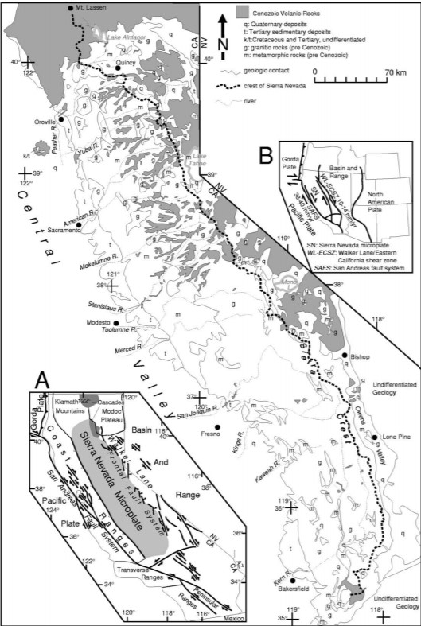
Introduction
600km long Sierra Nevada range and Central Valley of CA are part of the Sierra Nevada microplate
Microplate moves dextral to stable NA at ~10-14mm/yr
Bounded on the W by the active fold thrust belt marking the Eastern edge of the Coast Range province, and bounded on the E edge by the Walker Lane
Before transform plate margin was dominant, arc magmatism emplaced the Sierra Nevada batholith at ~85Ma
Further volcanism (ancestral cascades arc) blanketed much of the SN from ~35-5Ma
Sierra Nevada slopes gently westward, and abruptly eastward
Notes:
Cenozoic deposits limited to area north of Tuolumne river
Important as these are deposits used to constrain incision rates
Oldest = Eocene gravels
Middle = 30-34 Ma rhyolite tuffs
Youngest = 4-14 Ma andesites, andesitic mudflows, and volcanic seds
Mehrten formation

Slide 3
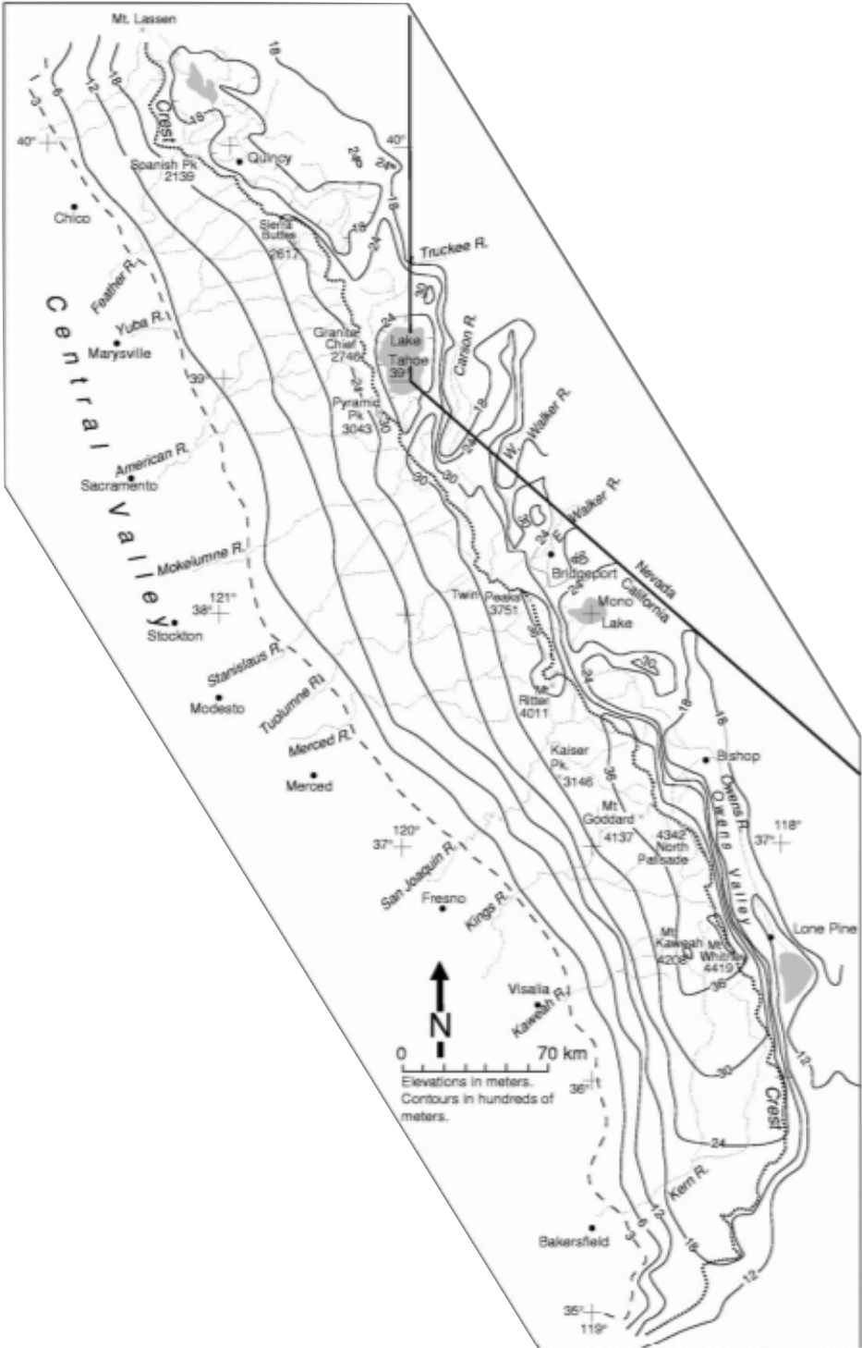
Motivation
Show the neotectonic evolution of the Sierra, focus on the eastern boundary evolution
Show how faulting, tilting, and stream incision affect uplift in the Sierra
Show how the present-day topography of the Sierra is due to two major uplift events (Late Cenozoic and one occurring at least 50 myr earlier)
For this class, this paper will give an idea of the timing of uplift of the Sierra Nevada range

Slide 4
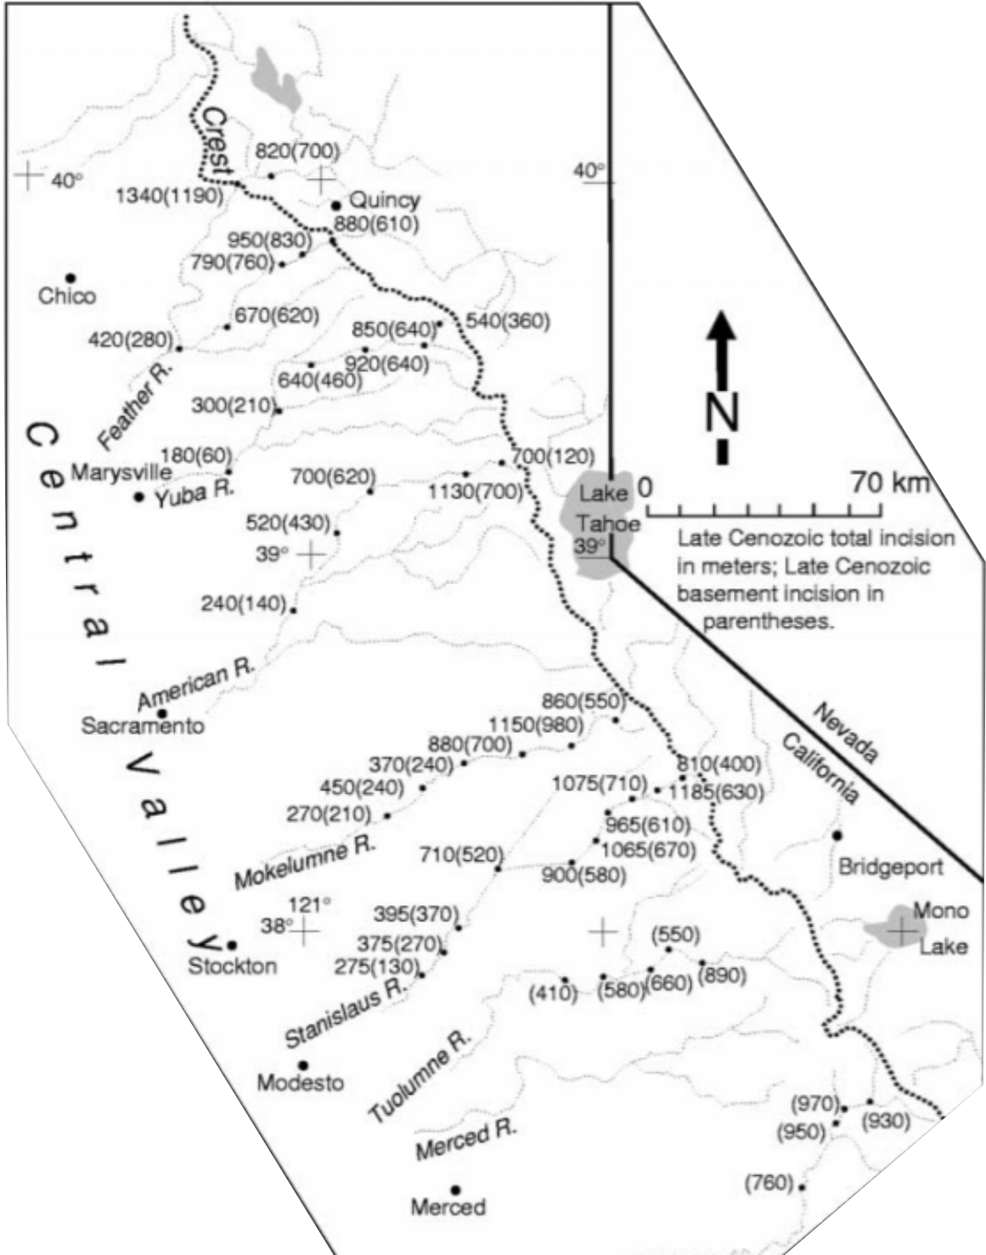
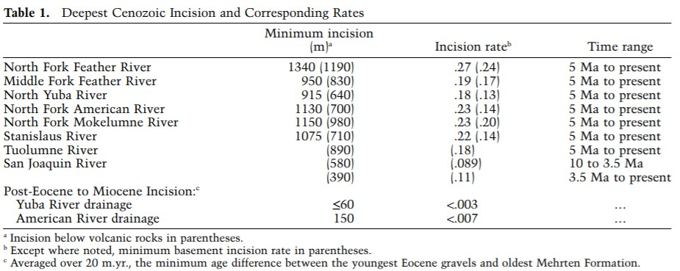
Incision rates are mm/yr
Minimum basement incision rates come from the difference between the bottom of late Cenozoic volcanics and the present canyon bottom
Total incision is estimated simply by the difference b/w the tops of Cenozoic deposits and canyon bottoms
Said deposits blanketed most of Sierra north of the Tuolumne river ~5Ma, and any stream in this area must have incised them

Slide 5
Notes:
Diagram shows relationship b/w Tilted paleochannels, stream gradients, modern stream gradients, and erosion and uplift

Slide 6
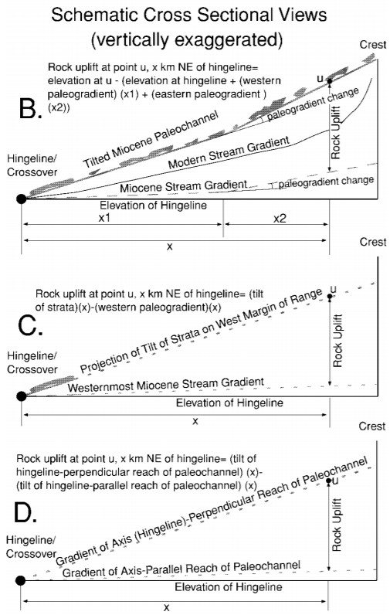
How to get at rock uplift using stream gradients
B = Using Cenozoic deposits spanning the range
C = Projecting tilts of strata eastward from the westernmost part of the range
D = Based on different tilts of hingeline perpendicular (full late Cenozoic tilt) and hingeline parallel (untilted)

Slide 7
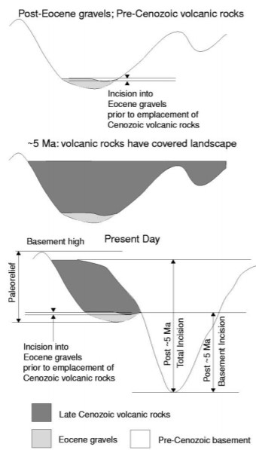
Paleorelief map
And schematic showing typical evolution of a Sierra Nevada Canyon

Slide 8
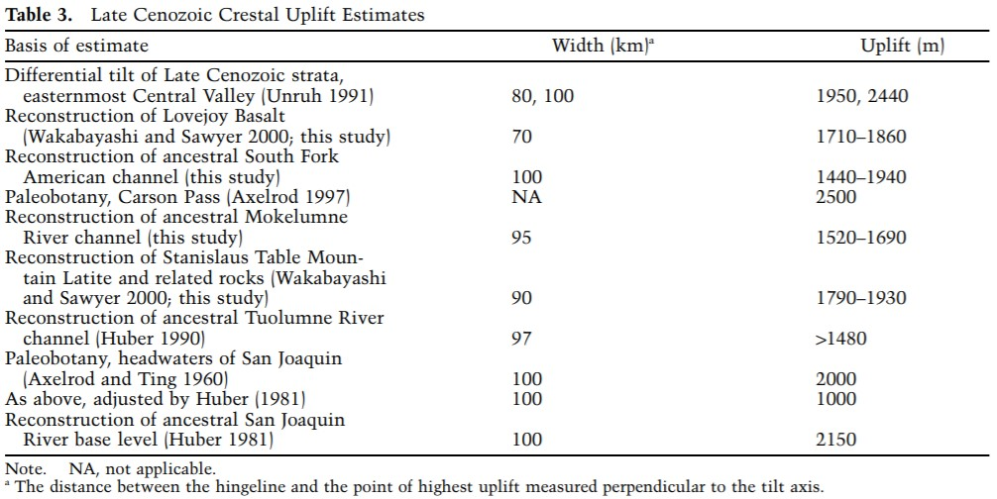

Slide 9
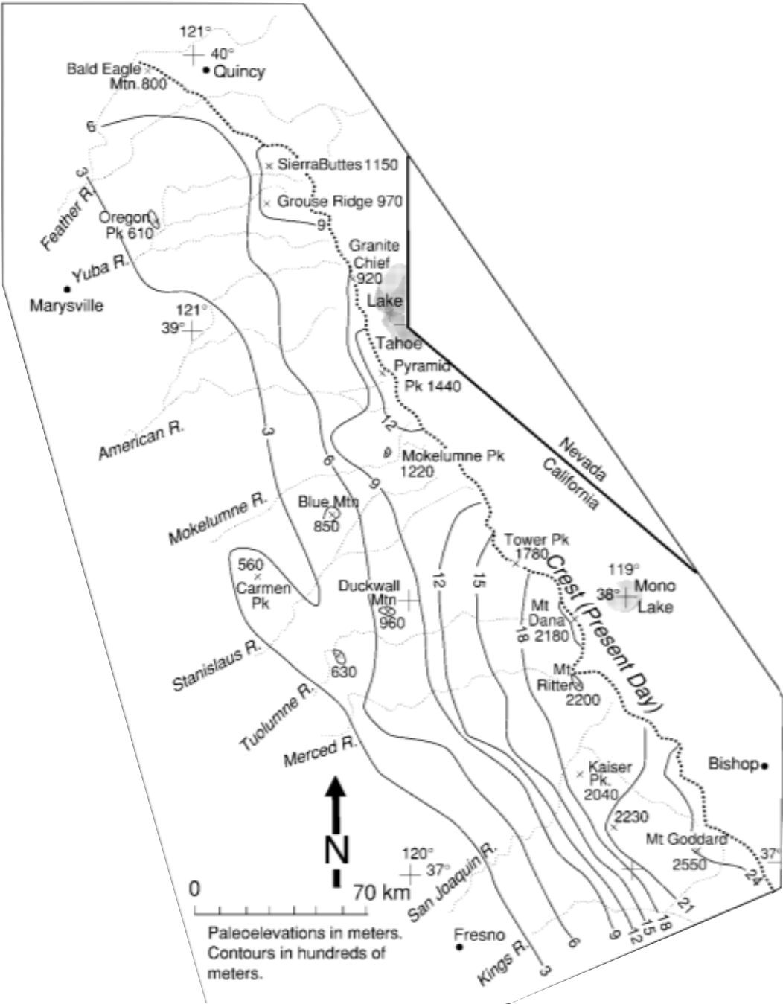
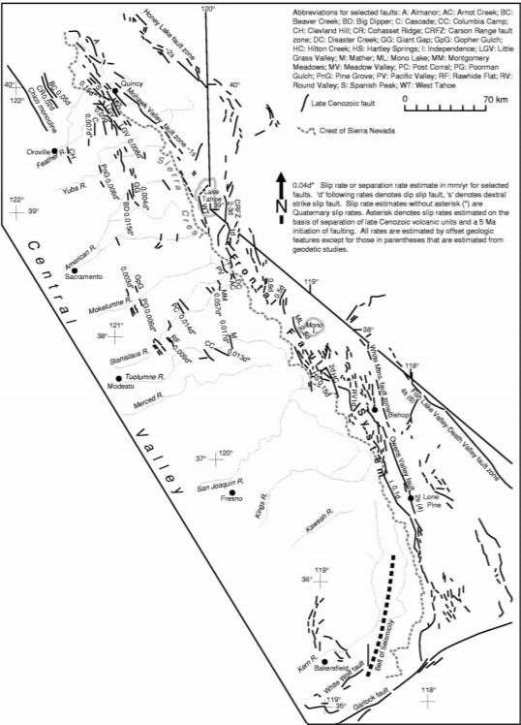

Slide 10
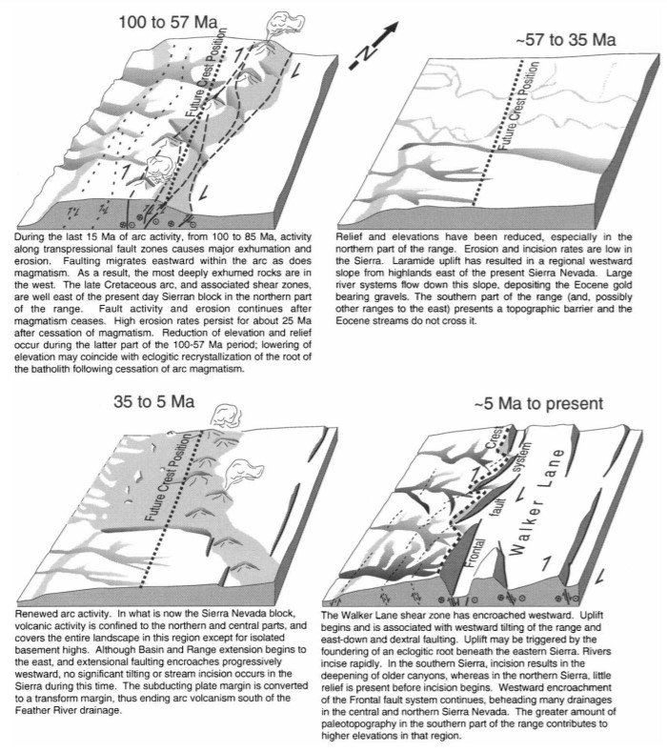
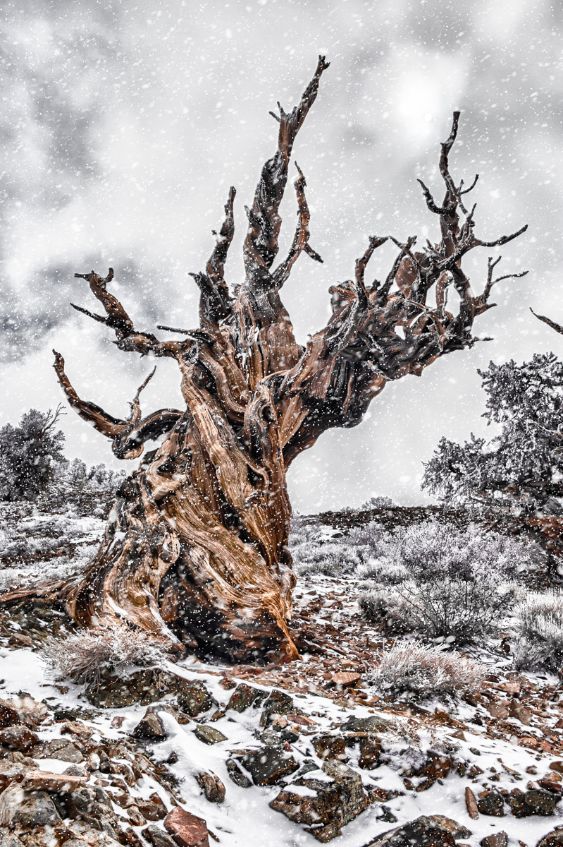
Conclusive diagram
Questions?

