Slide 1
Dating topography of the Sierra Nevada, California, using apatite (U-Th)/He ages
House, M.A., Wernicke, B.P., Farley, K.A., 1998. Dating topography of the Sierra Nevada, California, using apatite (U-Th)/He ages. Nature 396, 66-69.
Presentation by: Kurt Kraal

Slide 2
Goal:
Use apatite U-Th/He ages to date topography of the Sierra Nevada:
U-Th/He is a thermochronometer, which gives an age for when the apatite goes below 75 ºC
Thermal histories derived from this technique can be used to estimate timing of incision, as well as total relief of the mountain range
They do this by looking at samples from ridges and valleys, which should have different cooling histories, which can be described using the following equation based on thermodynamic principles:

Slide 3
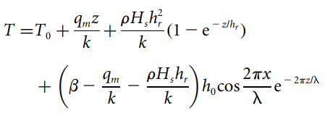
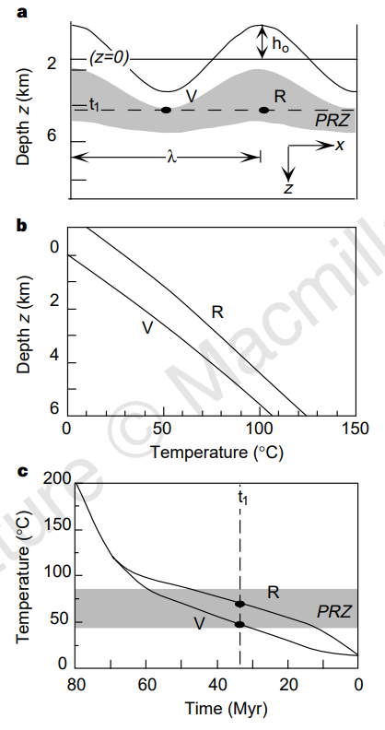
T = Temperature in shallow crust below a topography
x and z are horizontal and vertical distance
h_{o} is amplitude, λ is wavelength of topography
pHs=radioactive heat production, qm = reduced heat flow
Ht = characteristic depth of heat production
To is 15ºC, z = o km, beta = lapse rate of mean surface temperatures

Slide 4
Age variations between ridges and valleys (R and V) should be detectable with U-Th/He dating
Age variation is strongly dependent on h₀
Less dependent on wavelength (lambda)
Horizontal age profiles should be able to constrain paleotopography, where the oldest ages will date minimum age for river incision, and delta t would be used to estimate h_{0,} if cooling history and geotherm are estimated

Slide 5
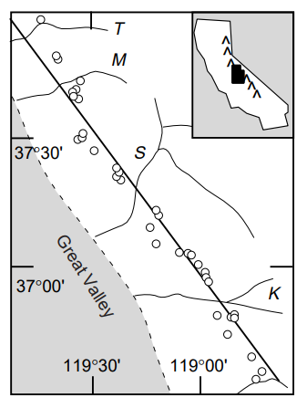
Sample Locations
36 samples along a 200 km range parallel transect crossing points of maximum valley incision at 2km in elevation
Total erosion and erosion was estimated from previous studies
Geothermal gradients were estimated based on previous papers
K is Kings Canyon, S is San Joaquin

Slide 6
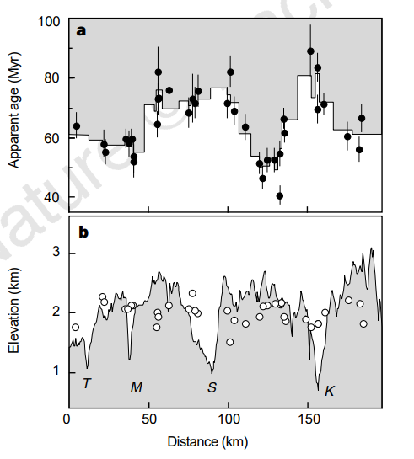
Results
A: Helium ages along the range profile.
B: current elevation and sample locations
Oldest ages occur in San Joaquin and Kings drainages suggesting that these were likely the oldest drainages
Minimum age of incision estimated as 70-80 ma based on oldest ages in Kings and San Joaquin

Slide 7
Results
Based on the equation discussed earlier, multiple assumptions, and the drainage amplitude (long wavelength of 4 km, delta t of 25 myr, derived from Ho), as well as how the range crest is likely higher than the drainages, the Cretaceous elevation of the Sierran crest was estimated to be ~ 4.5 km, similar to modern central Andes

Slide 8
Summary of overall conclusions
Sierra had Andean-scale topography sometime before 70-80 ma (based on minimum age of incision).
By 70-80 ma the San Joaquin and Kings drainages had deeply incised the western flank of the range, after which the mean crestal elevation decreased from 4.5 km to 2.8 km, and long wavelength relief decreased from 3 km to 1 km.

