Slide 1
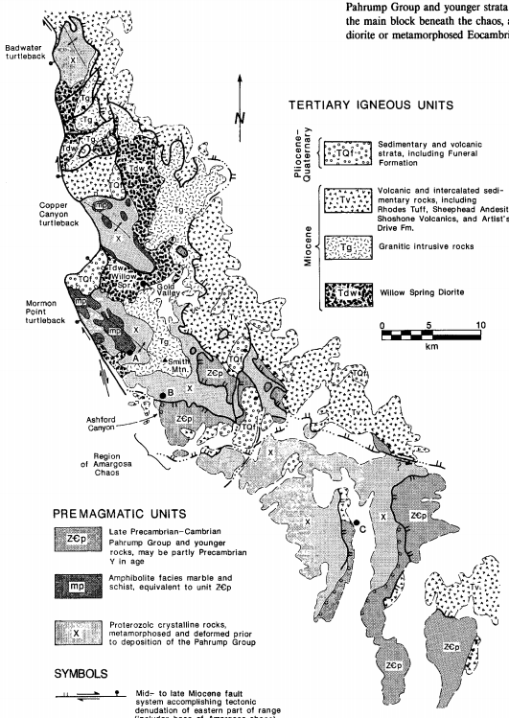
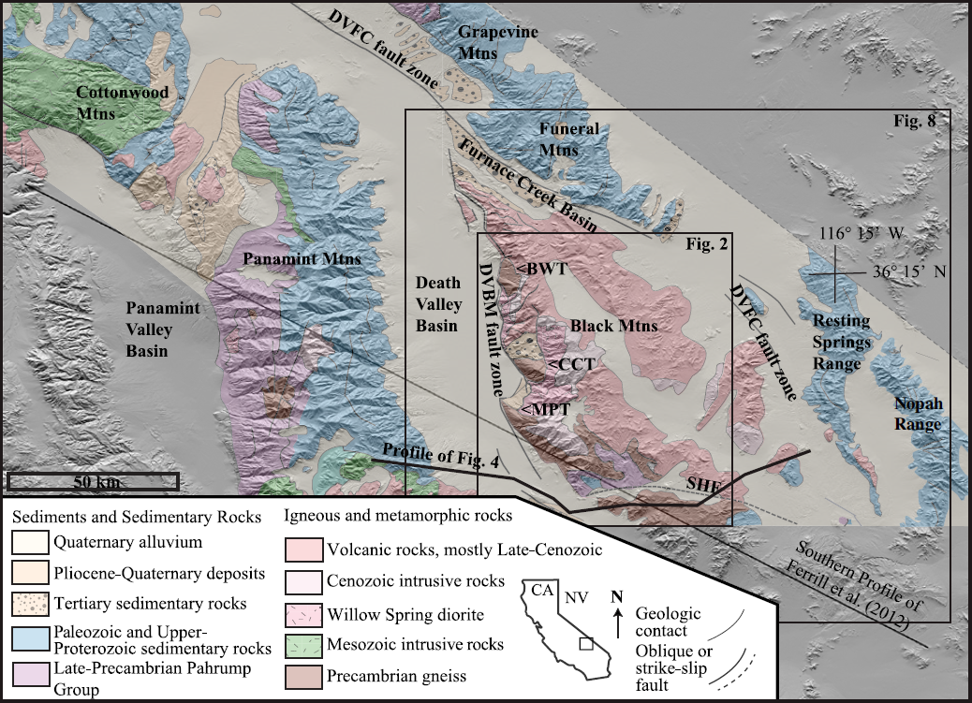
Interpretation and tectonic implications of cooling histories: An example from the Black Mountains, Death Valley extended terrane, California
Daniel Holm and Roy Dokka, 1993
By: Michael Say
Sizemore et al., 2019
Holm and Wernicke, 1990

Slide 2
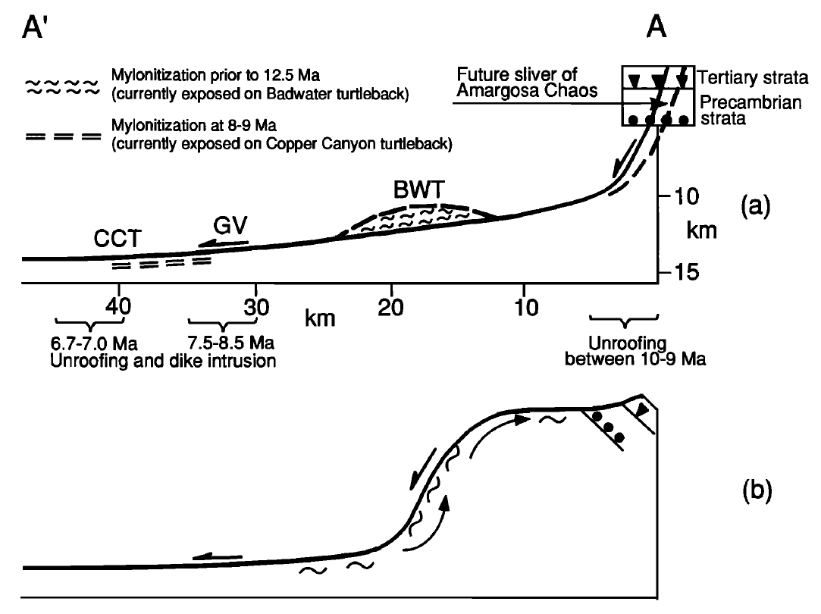
The Two Scenarios
High Angle Normal Faulting and Erosion
Low Angle Detachment and Footwall Flexure
Holm et al., 1992
Wright et al., 1974

Slide 3
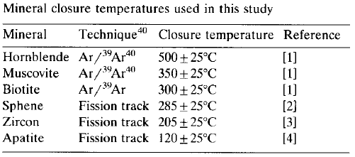
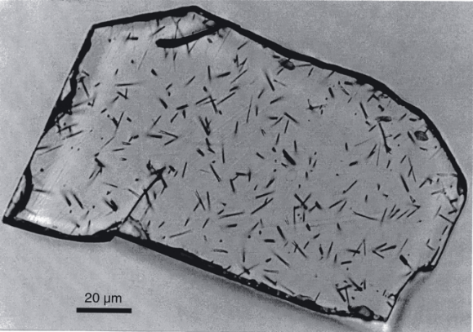
Methods
Purpose
To determine the timing, amount, and unroofing mechanics/process of the Black Mountains from thermal histories of Miocene intrusions and Precambrian crystalline basement
Rapid cooling history represents rapid tectonically driven exhumation
Slow cooling history represents erosion driven exhumation
Determine the thermal history of the Miocene Intrusions by:
Thermochronology: fission-track age determinations
⁴⁰Ar/³⁹Ar radiometric dating (Holm, Snow, and Lux, 1992)
Geobarametric methods to determine depth of intrusion emplacement
https://www.researchgate.net/figure/Etched-fission-tracks-in-an-apatite-grain-from-the-Grassy-Granodiorite-of-King-Island_fig3_238448391

Slide 4
DATA!
Northern Black Mountains
Central Black Mountains Core
Southeastern Black Mountains

Slide 5
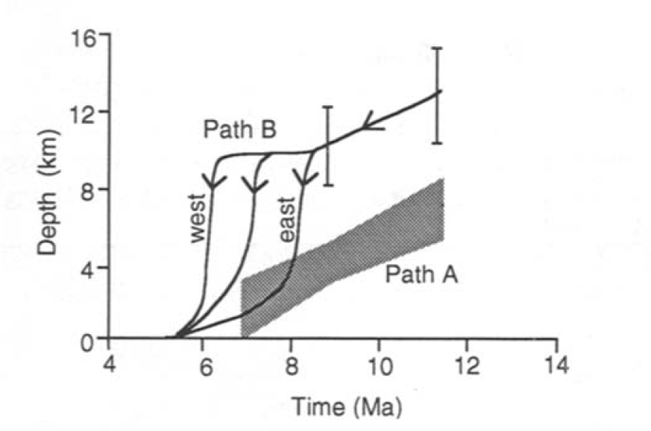
Thermal Modeling
Path A = Erosion dominant exhumation accompanied by high angle normal faulting
Path B = Westerly directed detachment faulting

Slide 6
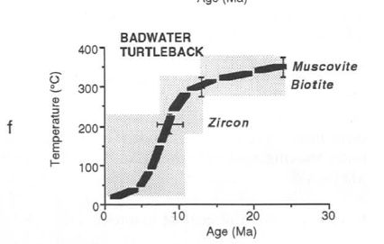
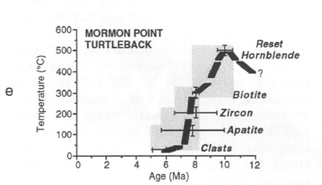
Thermal Models
11-12 Ma
9-6 Ma
13-9 Ma

Slide 7
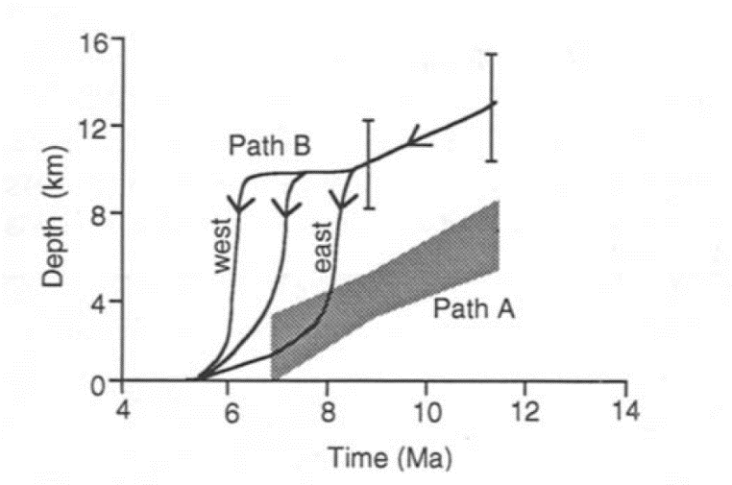
Timing of Cooling/Unroofing
Southeastern Black Mountains
Major unroofing and tilting occurred @ 13-9 Ma
Central Black Mountains Core
Rapid unroofing occurred @ 9-6 Ma
Northern Black Mountains
Suggest little cooling prior to the onset of intrusion and unroofing beginning at 11-12 Ma
6.3 Ma dikes intrude Badwater turtleback indicative of brittle faulting

Slide 8
Depth of Unroofing Results
Using many assumptions and the thermal cooling histories, one can estimate the depth of the Willow Springs Pluton (11.6 Ma) emplacement
Estimates show emplacement depth at 10-15 km
Smith Mountain Granite Complex emplaced at 8.7 Ma @ ~11 km
Geothermal Gradient (assumed here as 30°C/km) is critical to estimate emplacement depth

Slide 9
Conclusions
Thermal history of the Black Mountains show rapid northwest orientated unroofing (cooling) during ~13-6 Ma from 10-15 km depth, indicative of tectonic denudation and not erosion-dominated processes
~13-8.5 Ma in the southeastern range and 8.5-6.0 Ma northern range
11.6 Ma Willow Springs Pluton emplaced at 10-15 km depth
Footwall flexure of a low-angle, westerly-dipping detachment system rapidly exhumed crystalline basement (turtlebacks) just below the surface and there has been little cooling since 6-5 Ma
The Armagosa Chaos is remnant sliver of the
hanging wall
Possibly, the Badwater turtleback was transported
along a splay of the detachment system
Holm et al., 1992

