Slide 1
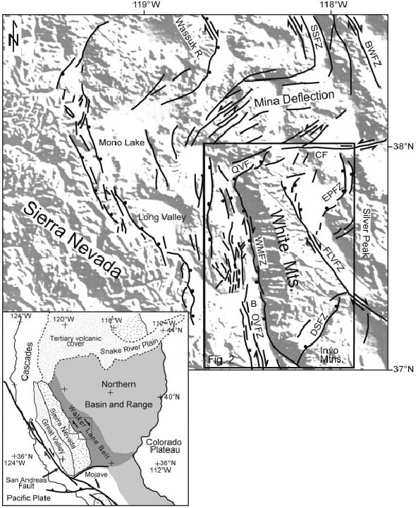
Cenozoic tectontic evolution of the white mtns, Ca & nV
Photo courtesy of UNAVCO
Stockli et al. 2003
Presentation by:
Nolan Dellerman
Notes:
Emphasis on the Fish Lake Valley FZ
White Mtn FZ
And Queen Valley F

Slide 2
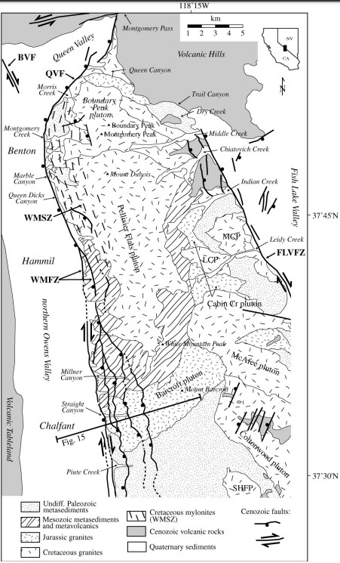
Geologic setting
Were a part of the Sierra NV pre Basin and Range extension
Share a common Paleozoic and Mesozoic tectonic and magmatic history
Geometry of Cenozoic fault zone (WMFZ) influenced by the Mesozoic shear zone (WMSZ)
Mylonites control location of range bounding White Mtn fault
WMFZ is ~80km long and accommodates up to 3km of topographic relief
The adjacent Owens valley has a half graben geometry shown by geophysical studies with up to 2km of sediment fill
Add this to the 3km of topo relief to get an idea of how much displacement along the WMFZ

Slide 3
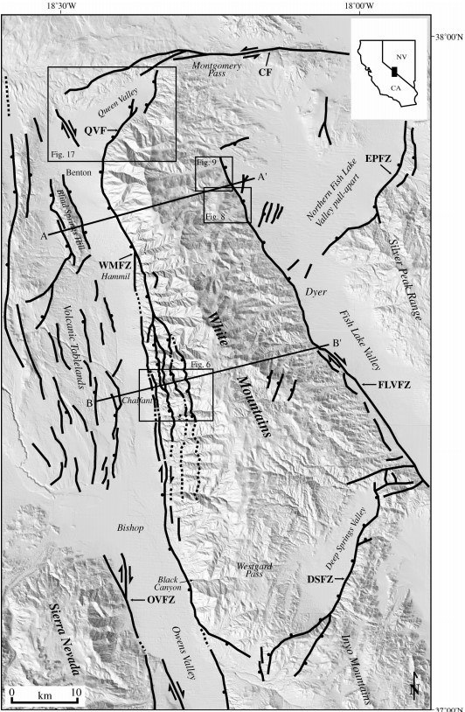
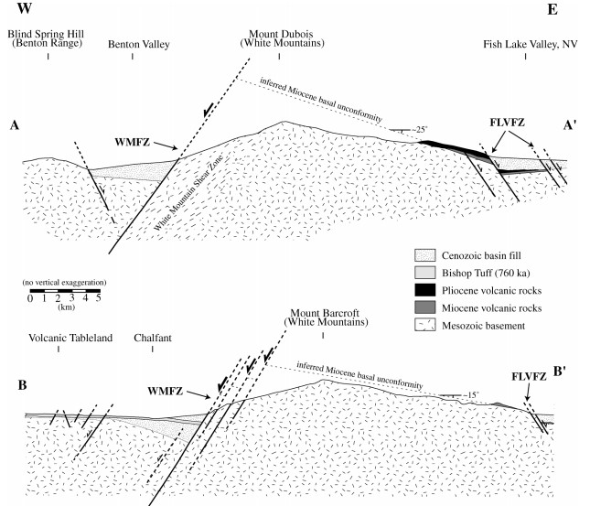
Notes:
Late Cenozoic fault map
Note location of WM fault and mylonite anisotropy
Zone of weakness already present?
Miocene basal unconformity

Slide 4
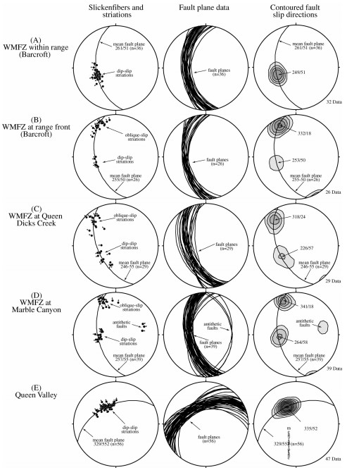
Faults within the range exhibit dip slip motion
Faults at the range front exhibit mostly right lateral strike slip motion
& D) moving northward exhibit two sets of indicators, the younger are right lateral oblique motion
E) Around the bend we see pure dip slip motion, but down to the NW
WHO CARES?!
Well this matters as it clearly shows there is an evolution in tectonics here through the Cenozoic. From an extensional regime (Basin and Range) which was then reactivated as a right lateral strike slip regime (Walker Lane)

Slide 5
Notes:
This earthquake swarm appears to have occurred along the subsurface continuation of the WMFZ

Slide 6
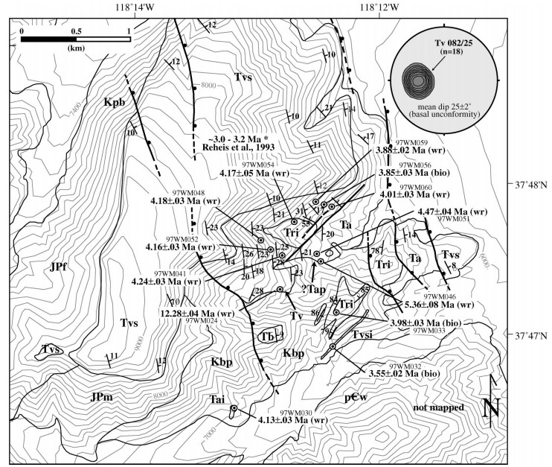
Notes:
Detailed mapping of volcanic stratigraphy reveal that these units record the entire late Cenozoic tilting history.
Rocks that overlie Mesozoic basement dip uniformly to the east at an average of ~25 degrees
These rocks are overlain by a basalt dated at 12.28 Ma
This unconformity is assumed to be a paleohorizontal reference and thus this present attitude represent the total tilt of the White Mtns since the deposition of the basalt at 12 Ma

Slide 7
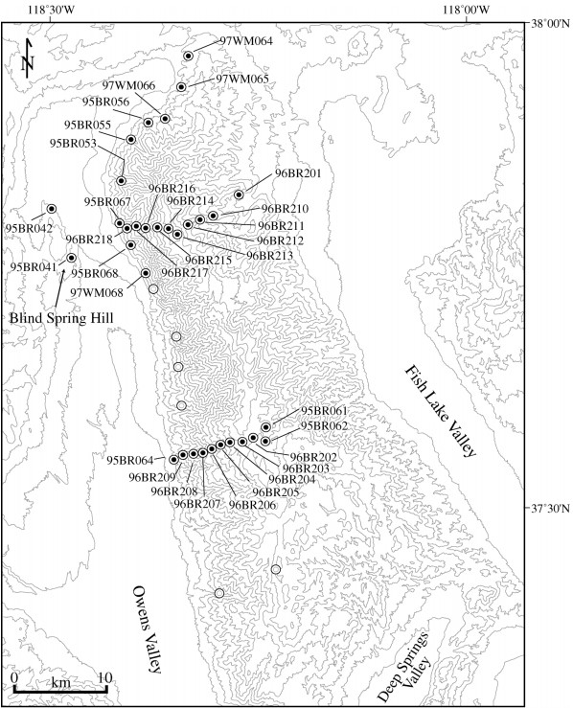
Fission track thermochronology data (FT) and (U-TH)/He thermochron data along cross section where samples were collected
Notes:
PRZ (Partial retention zone)
PAZ (Partial annealing zone)
These put constraints on exhumation timing as in these zones the fission track clock is not totally reset.
Below them where the clock is totally reset are good proxies for when exhumation occurred/commenced.

Slide 8
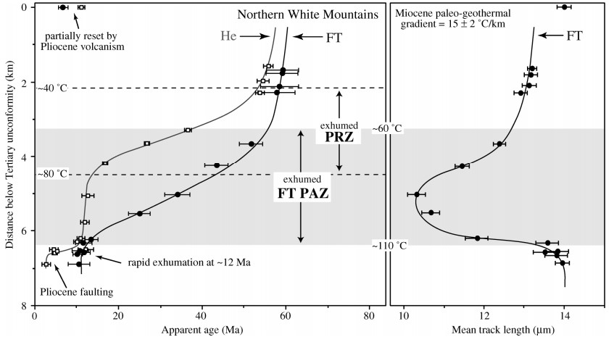

Slide 9
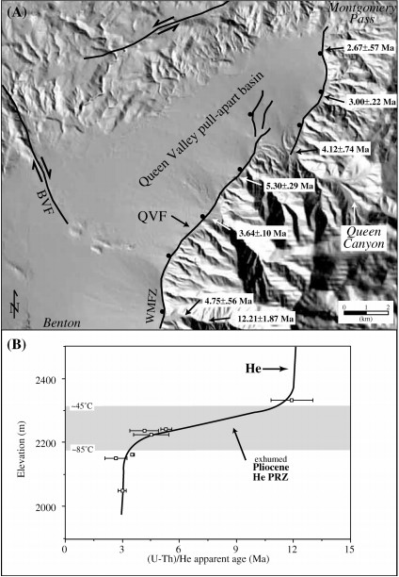
These data show that exhumation related to opening of the Queen valley basin occurred at 3 ma.
This is used as a proxy to define the onset of right lateral faulting in the Owens valley fault zone (and therefore the WMFZ) occurred at 3ma.

Slide 10
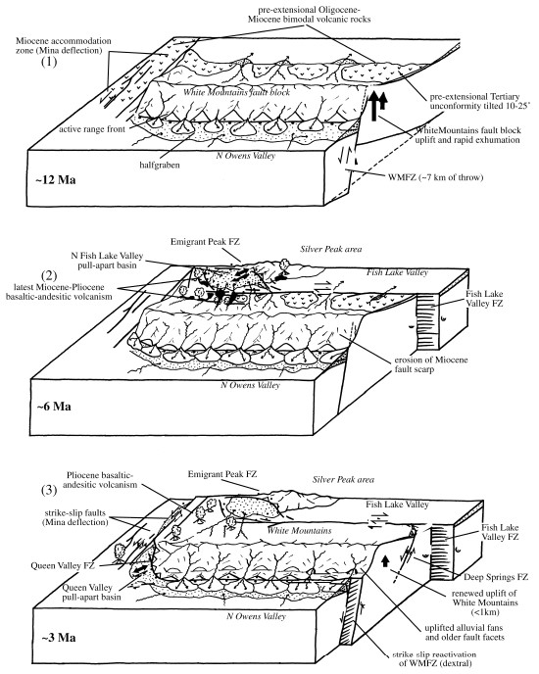
Cenozoic tectonic sequence of events:
East – West extension exhumes volcanic rocks, uplifts white mtns, and tilts block 10-25 degress
Onset of right lateral faulting on Fish Lake Valley FZ, constrained by late Miocene volcanism
Onset of right lateral faulting along WMFZ, as well as onset of Queen Valley pull apart basin

Slide 11
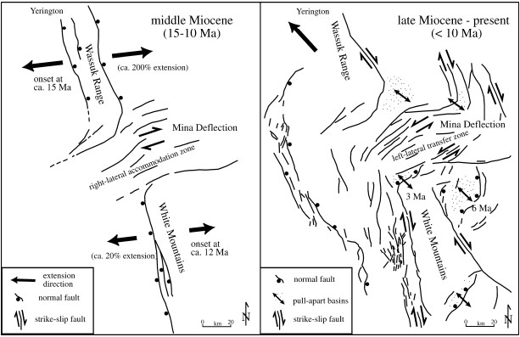
Questions?

