Slide 1
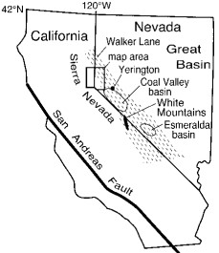
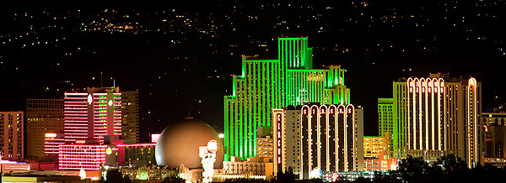
Sierra Nevada-basin and range transition near reno, Nevada: two stage development at 12 and 3 ma
Photo courtesy of UNAVCO
Henry, C. D. and M. E. Perkins, 2001

Slide 2
Motivation
Discern the timing of Cenozoic Sierra Nevada uplift
Figure out when the transition between SN and B&R (which geodetic data demonstrate accounts for ~20% relative motion between plates) initially formed

Slide 3
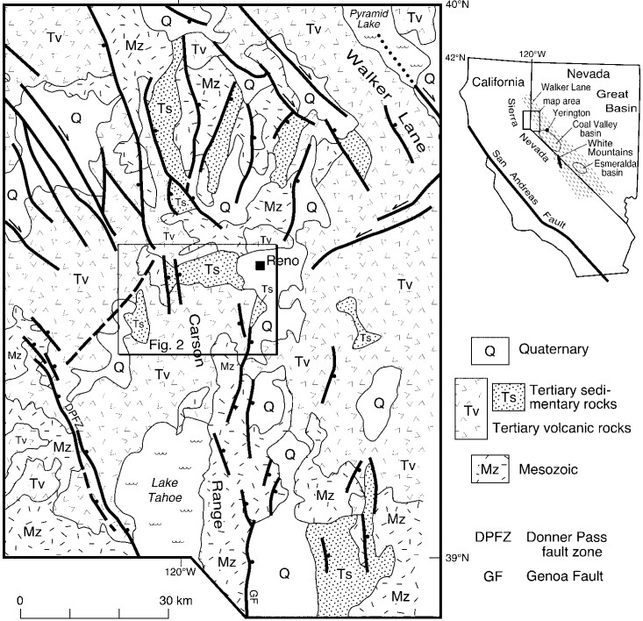
“Verdi – Boca Basin”
At least 700km² sedimentary basin
⁴⁰Ar/³⁹Ar and tephrochronologic ages constrain deposition from 12 to 3 Ma
Extensional origin at 12Ma
Attributed to the Donner Pass fault zone which underwent an episode of faulting from 13 to 8 Ma
Notes:
Sed sequence is similar in both parts
Generally fining upward
conglomerate – through sandstone – to lacustrine diatomite

Slide 4
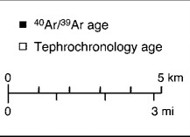
Red boxes outline areas of important age dates that constrain onset of deposition
Red lines are cross sections

Slide 5
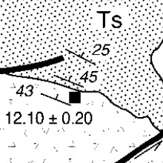
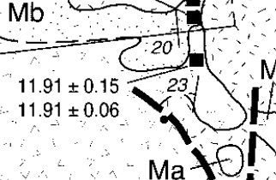
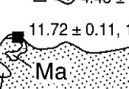
Evidence for 12Ma depositional onset
Oldest sed deposits conformably lie on top of andesite dated at 12.10 Ma.
Lava capping Verdi range give ages of 11.91 Ma
Andesite breccia dated at 11.72 Ma is interbedded with conglomerate SW of Reno.

Slide 6
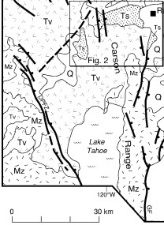
Evidence for 12Ma extensional episode
Donner Pass fault zone
Down to the east faulting
~800m displacement
Probably formed basins western boundary
West dipping basin rocks are covered by younger volcanics west of Boca reservoir, so their western extent is unknown
13Ma andesite lavas show greatest displacement
8Ma lavas are displaced less
DPFZ underwent episode of faulting from 13-8Ma
Combine this with 12Ma deposition of basin seds, and you can assume the basin was formed by extension starting at 12Ma.

Slide 7
3Ma deformation
Simplest structure is the Verdi range in the western portion of the preserved basin
Tilted westward ~20°
Two E dipping normal faults down drop Verdi-Boca strata at least 2km against Mesozoic basement
Structures in the eastern portion of the preserved basin indicate that deformation was complex
Resulted in a double plunging syncline with Mesozoic basement exposed in the middle

Slide 8
Evidence for 3Ma deformation timing
Youngest dated ash beds in Verdi-Boca basin sequence
3.1MA
Shallow dipping lava (~4°), overlies 15-20° west dipping Verdi-Boca sed rocks.
2.6Ma
Uplift of Carson range also likely occurred at 3Ma as the youngest sediments in that part of the basin are dated at 3.1Ma as well

Slide 9
Discussion/Implications
Moderate extension formed the Coal Valley, and Esmeralda basin beginning 12-13Ma
White mountains where uplifted and tilted beginning at 12 Ma
This study constrained early extension of Verdi-Boca basin at 12Ma
This 12Ma episode of extension is recognized along 300km of the eastern boundary of the Sierra NV
Much greater deformation occurred in the Verdi-Boca basin area at 3Ma
Created most of the present day topography in the area
Consistent with 3Ma uplift of Carson range found by Surpless et al., 2000
Leads to interpretation of SN – B&R boundary in Reno area being a left stepping transition zone b/w Genoa fault and Donner Pass fault zone

Slide 10
** This study claims that since the 3Ma deformation seen in Verdi-Boca sediments was all extensional; NW motion of the Sierra NV relative to B&R must have began post 3Ma.
Questions?

