Slide 1
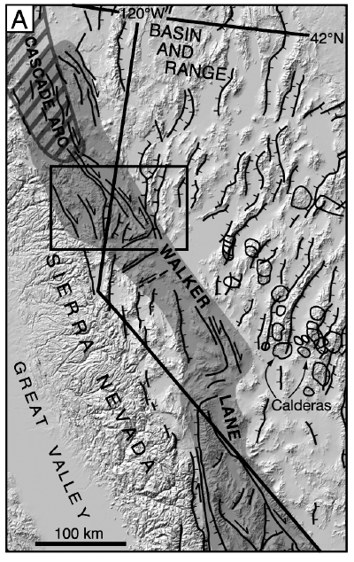
Faulds , James E., Christopher D. Henry, and Nicholas H. Hinz,
Kinematics of the northern Walker Lane: An incipient transform fault along the Pacific–North American plate boundary,
Geology, October 2007; v. 35; no. 10; p. 943–947; doi: 10.1130/G23868A
Presentation by Kurt Kraal

Slide 2
Methods: Geologic mapping, structural analysis, and geochronology
Goals:
define the geometry and kinematics of the northern Walker Lane
provide constraints on the timing and magnitude of dextral displacement across this region.
Also to develop a kinematic model based on clay models that has implications for strike-slip faults in intercontinental settings
Interesting because Northern Walker Lane is a “young” strike slip system with low slip, may provide snapshot of how larger strike-slip systems develop

Slide 3
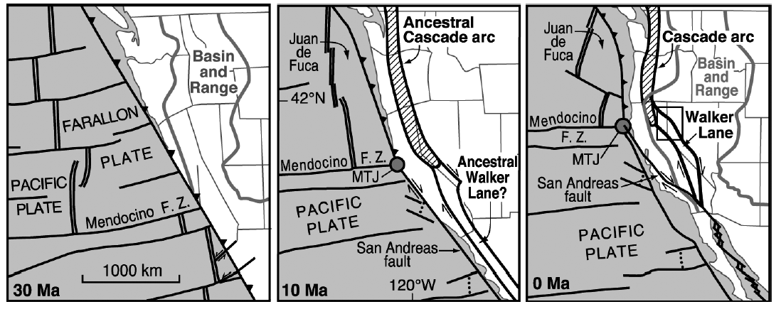
Geologic Setting
Between 30 Ma and now, the Pac/NA plate boundary evolved from a convergent to a transform plate margin.
From 30-20 Ma a southward migrating “ignimbrite flareup” occurred which deposited tuffs in paleovalleys

Slide 4
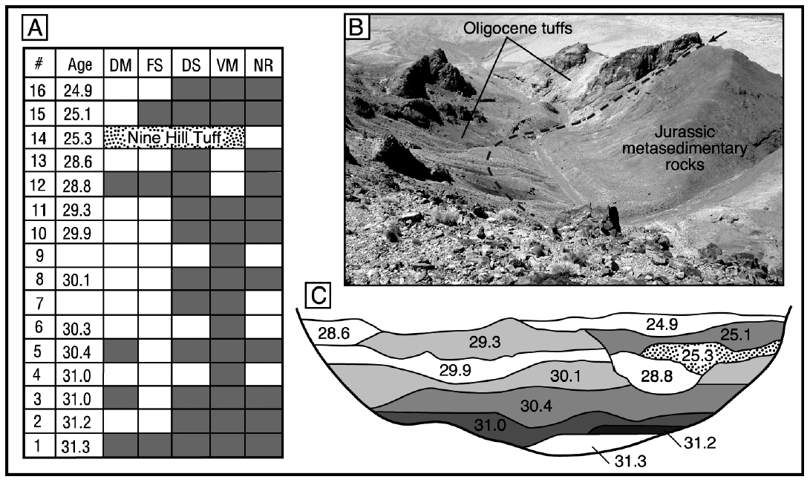
Ignimbrite Flare up
Deposited many sequences of Oligocene Tuff in east/west paleovalleys which have since been dissected by right-lateral walker lane faulting

Slide 5
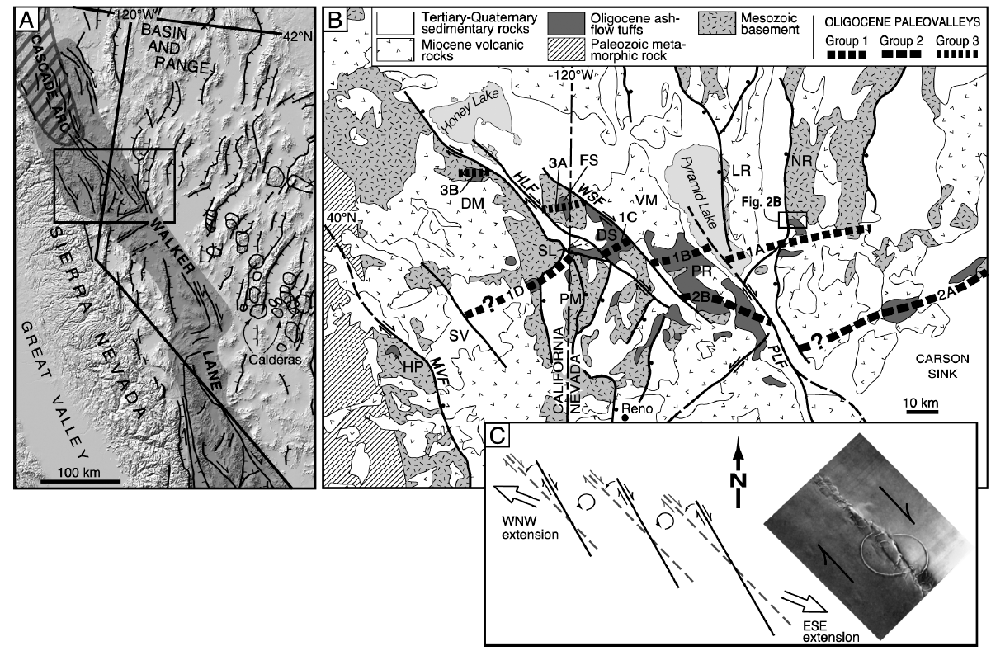
Results:
Map
Kinematically linked, NW striking left-stepping dextral strike-slip faults

Slide 6
Magnitude:
5-10 km of offset on Pyramid Lake Fault (PLF)
~10-15 km of offset on warm springs valley fault
At least 3-6, but perhaps 10-15 in Honey Lake Fault (Basin sediments obscure much of the paleovalley tuffs)
~1 km of dextral offset on Mohawk Valley Fault (interpreted from cretaceous and metamorphic piercing points)

Slide 7
Timing:
Relatively recent onset of strike-slip faulting in northern Walker Lane
Oligocene Tuffs and Miocene volcanic rocks are equally tilted, suggesting during the ignimbrite flare-up and arc magmatism
Extension initiating ~13 Ma but little evidence of strike slip faulting (Trexler et al., 2000).
Strike-slip therefore thought to have initiated between 9 and 3 Ma in this region

Slide 8
Conclusions:
Inferred offsets of Oligocene paleovalleys suggest ~20-30 km of cumulative dextral displacement
Inferred Magnitude and Timing suggest 2-10 mm/yr of displacement, compatible with current gps estimates

