Slide 1
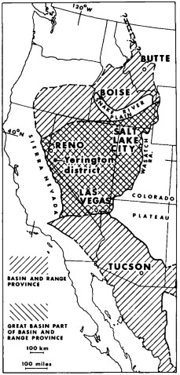
Cenozoic geology of the Yerington district, Nevada, and implications for the nature and origin of Basin and range faulting
Photo courtesy of UNAVCO
John M. Proffett Jr., 1977

Slide 2
Motivation
Describe the geology of the Yerington district in detail
Discern the timing of Basin and Range extension in this area
Touch on the mechanism of extension in the Basin and Range based on geometries seen in Yerington area

Slide 3
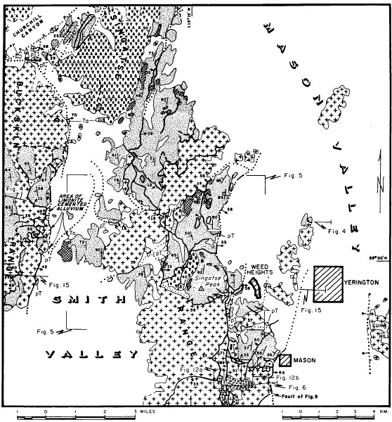
Yerington district
200 km² area
Mapped at 1:12,000 scale
30,000 m of core and cuttings logged
i.e. a very large amount of geologic data to describe in 10 min

Slide 4
Generalized Stratigraphy
Age | Lithologies | Thickness, etc.
Quaternary to present | Alluvial fans, and basin sediments
8 – 11 Ma | Conglomerate and sandstone, Capped by basalt flows | ±200 m
Miocene | Hornblend andesite Flows, breccias, and intusions (porphyrys) | 400 m +
Probably late tertiary | Olivine pyroxene basalt flows And breccias | ~200 m
Oligocene | Sequence of ignimbrite sheets Divided into 10 distinct units Overlain by dacite breccia | Up to 1,400 m
Early Tertiary | Conglomerate, sedimentary breccia, And minor basalt | ~400 m
Mesozoic Basement | Metamorphic and granitic rocks Triassic to Cretaceous age | Unknown

Slide 5
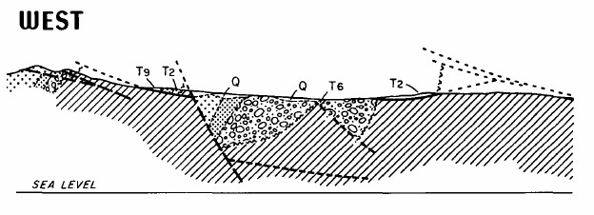
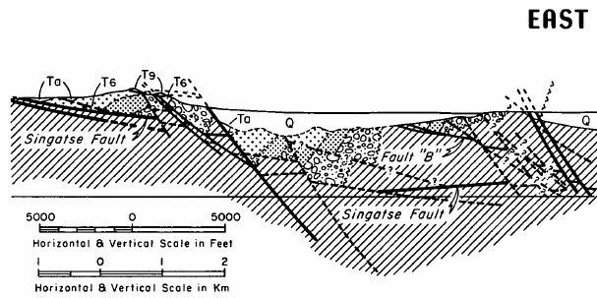
Cenozoic structure
East dipping normal faults
Steep west dipping strata
Rocks overlying Miocene angular unconformity are more shallow west dipping
Present day distance along this section is 7.3km, prefaulting distance measured along Cenozoic surfaces is ~17.3 km, so 10km of extension has taken place here

Slide 6
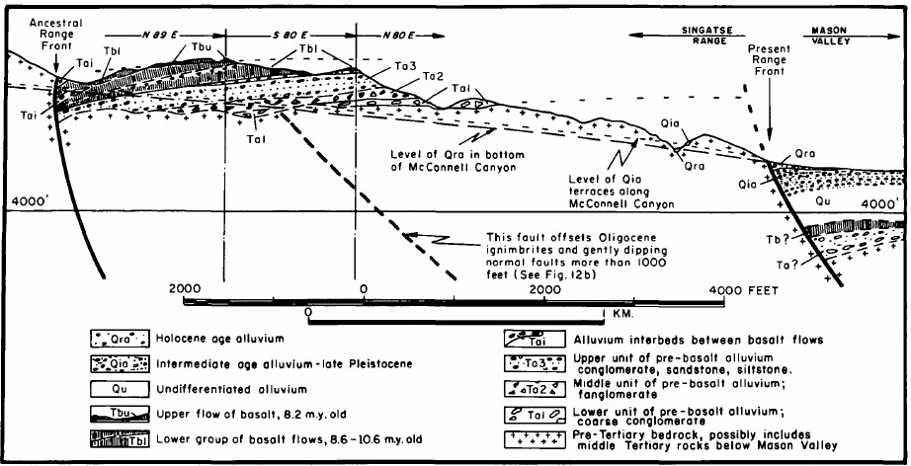

Slide 7
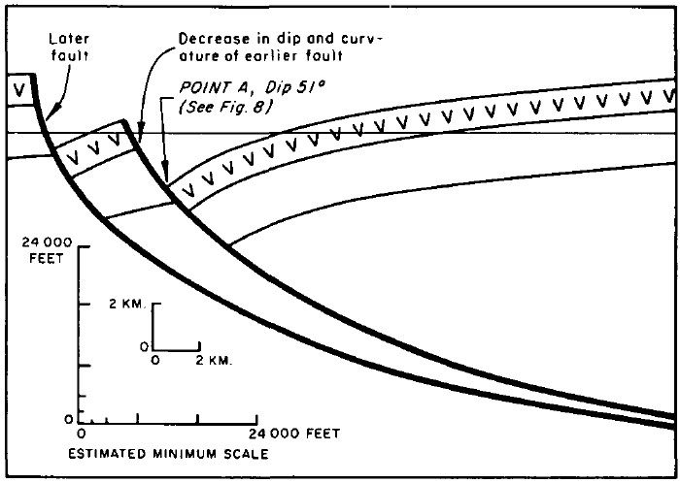
Fault style
East dipping
Primarily dip- slip
More gently dipping faults displace units up to 4,000m (gently dipping faults are older)
Steeply dipping faults displace units up to 1,200m (interpreted as younger
Curvature of fault planes allow for westward tilting of strata

Slide 8
Fault style
East dipping
Primarily dip- slip
More gently dipping faults displace units up to 4,000m (gently dipping faults are older)
Steeply dipping faults displace units up to 1,200m (interpreted as younger
Curvature of fault planes allow for westward tilting of strata

Slide 9
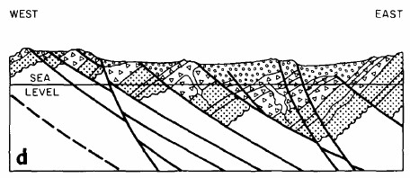
Geologic history
17-11 Ma
17Ma
18-17Ma
19-18Ma
Basin and Range faulting begins 18-17Ma, This comes from the fact that units older than this are all offset the same amount I the area
By 11 Ma early faults are rotated so much that they are too flat for continued faulting
In present time, steeply dipping range front faults are still active
11-8 Ma
Present

Slide 10
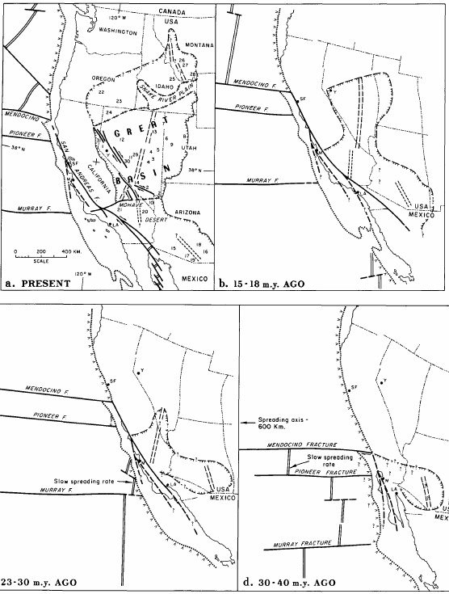
Discussion/Implications
Timing of Basin and Range extension constrained by structures in Yerington district to 18-17Ma
Prior theories of Basin and Range mechanism dispelled, and basis of current idea is hashed out
Ultimately, Basin and Range northern extent during formation roughly coincides with latitude of Mendocino triple junction, as well as the projection of the spreading centers b/w Mendocino and Murray fractures

