Slide 1
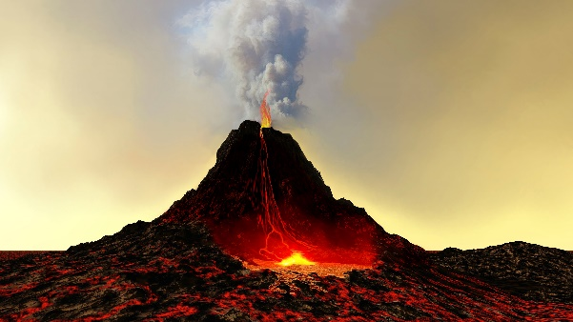
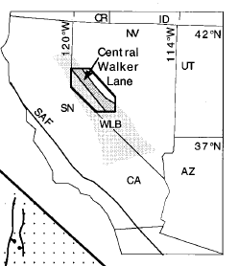
The chronology of Cenozoic volcanism and deformation in the Yerington area, western Basin and Range and Walker Lane
John Dilles and Phil Gans, 1995
By: Michael Say
Buckskin Range
Yerington
Pine Nut Mountains
Wassuk Range
Singatse Range
https://www.thoughtco.com/composite-volcano-facts-4174718

Slide 4
Methods
Purpose
To determine the temporal relationship and interaction between normal faulting of the Basin and Range and strike-slip faulting of the Walker Lane
⁴⁰Ar/³⁹Ar radiometric dating on Cenozoic volcanic rocks and intrusives 15 new ages
Minerals measured:
Biotite
Sanidine
Plagioclase
Groundmass
Stratigraphic and Structural Analysis
Previously published Geologic Mapping (Proffett, 1977; and many many others…)

Slide 5
Stratigraphy
1) Oligocene Ash-Flow Tuffs
2) Miocene Andesites
3) Miocene Clastic Sediments
(“Wassuk Group” Coal Canyon Frm. Gilbert and Reynolds, 1973)
4) Basaltic Andesites
5) Pliocene and Holocene Deposits

Slide 6
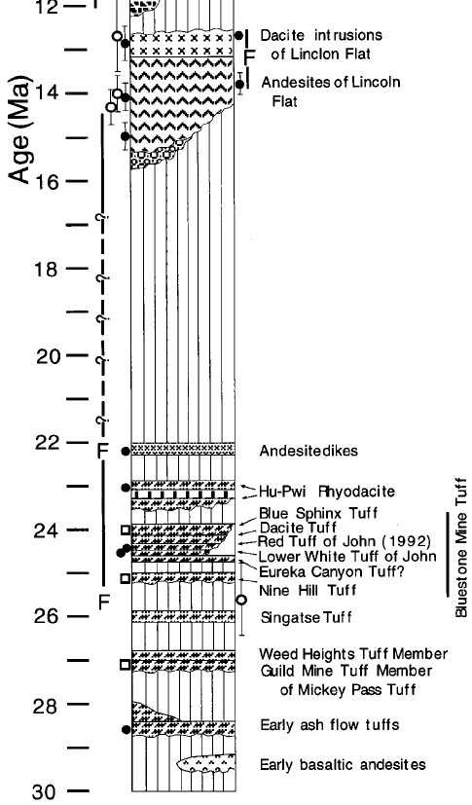
30-12 Ma
Normal faulting and possibly ancestral Walker Lane strike-slip faulting from ~26 to 23 (well documented) to ~15 Ma
Voluminous Magmatism associated with extension @ 14-12.5 Ma
150% extension at Yerington is bracketed between 13.8-12.6 Ma (0.7-1.7 my period!)
Equates to ~5-10 mm/yr of extension

Slide 7
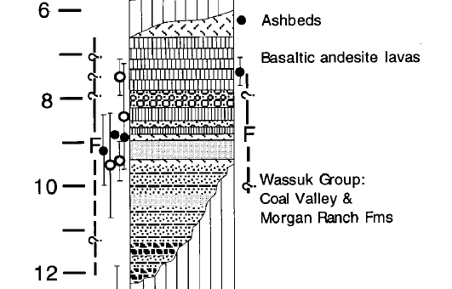
11-8 Ma
Clastic Sediments correlated to the Coal Canyon Formation of Gilbert and Reynolds, 1973
Widespread moderate extension localized clastic sediments (Wassuk Group aka Coal Canyon Formation)
Tilted sediments ~35°

Slide 8
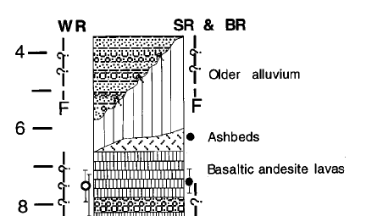
7 – 0 Ma
Faulting occurred during this period after deposition of the Basaltic Andesites (~7.5 Ma)
Basaltic andesites are intercalated or slight angular unconformity with the Clastic Sediments
Normal faults during this period are responsible for the present day morphology of the ranges

Slide 9
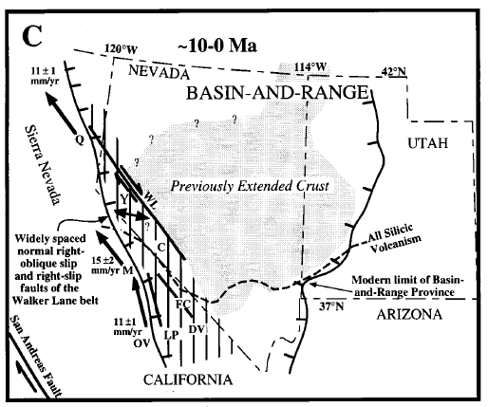

Slide 10
Conclusions
Basin and Range Normal faulting propagated southwest through NV arriving in the study area ~24 Ma
Ancestral Walker Lane strike-slip faulting initiated in the Central Walker Lane ~24 Ma bounding the western margin of B&R extension until 15 Ma
During 14-12.5 Ma, large magnitude extension (>150%) occurred near Yerington and surrounding ranges
11-8 Ma period resulted in lower strains less amount of extension and strike-slip faulting
Since 7 Ma, normal right-oblique faulting has been diffuse over a >100 km wide area
Holm et al., 1992

Slide 11
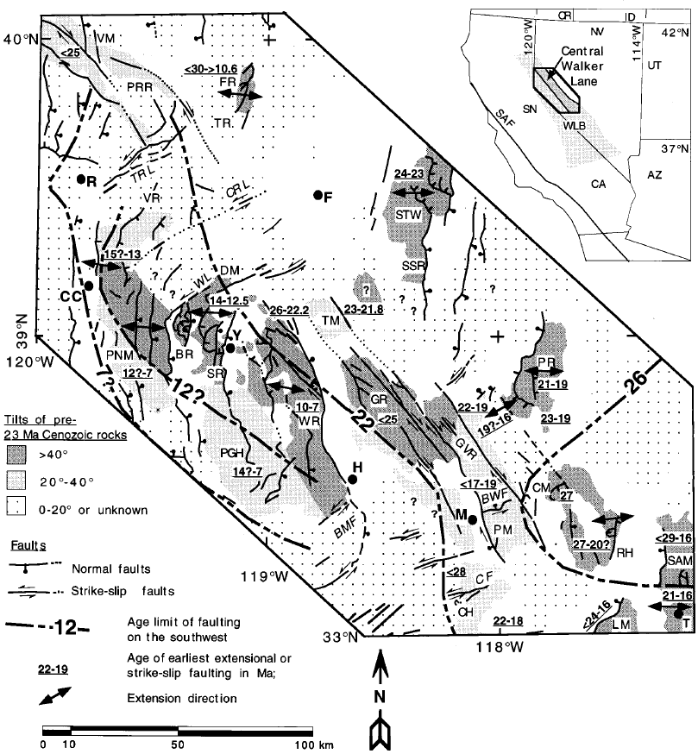
The Important Stuff
26-22 Ma Ancestral Walker Lane? coeval with arrival of SW propagating B&R extension at Lat. 39°N
B&R extension propagates westward into WL resulting in rapid, extreme extension 14-12.5 Ma
Lesser extension and strike slip faulting 11 Ma to Present Day

