Slide 1
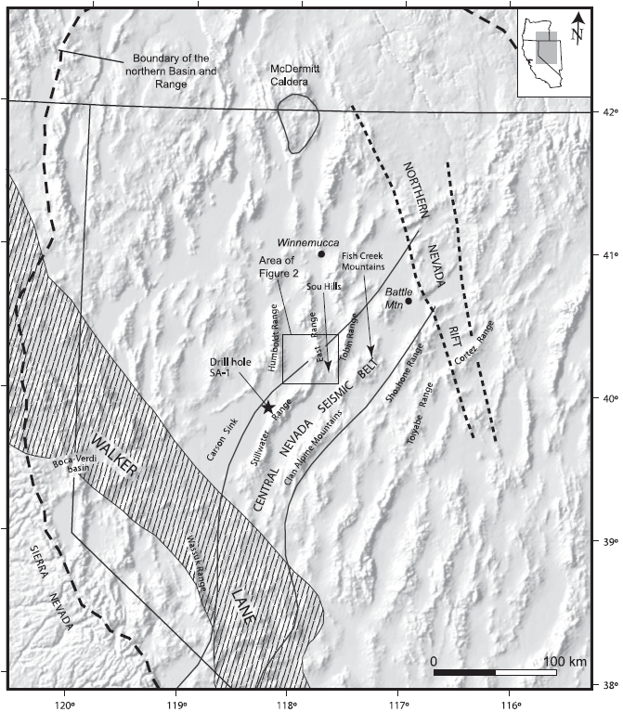
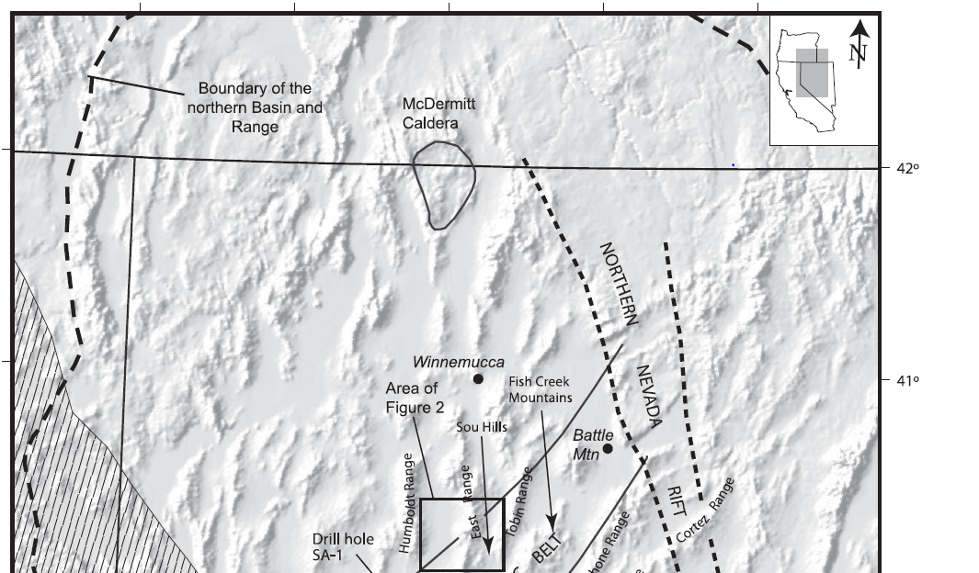
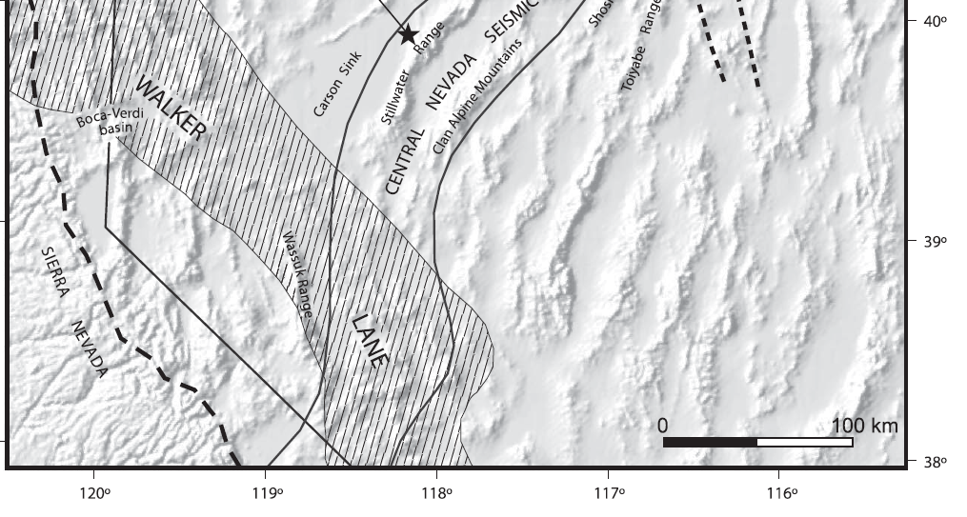
Miocene extension in the East Range, Nevada: A two-stage history of normal faulting in the northern Basin and Range
Fosdick, J.C., and Colgan, J.P.
2008, GSA Bulliten v.120 no. 9/10, p. 1198-1213
Presentation by Kurt Kraal
Purpose: constrain timing of extension in the East Range, central Nevada
Methods: Geologic Mapping, Thermochron

Slide 2
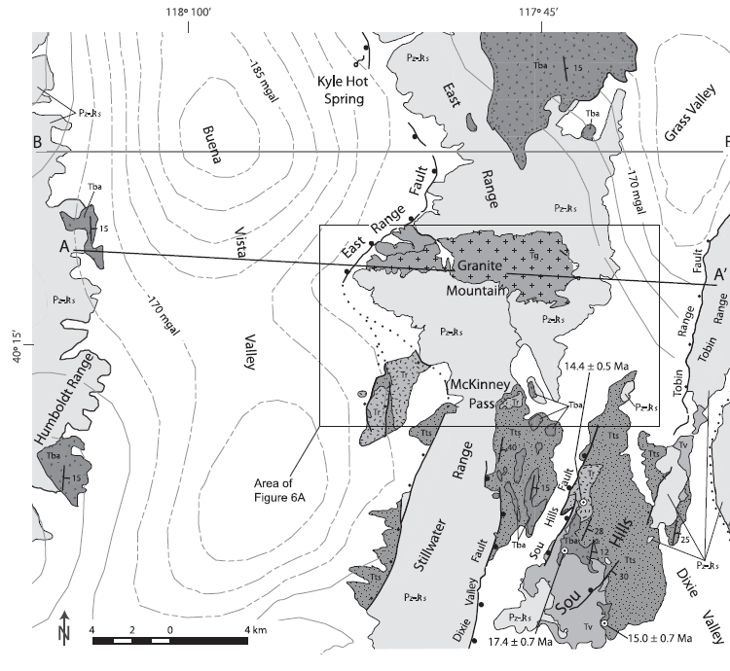
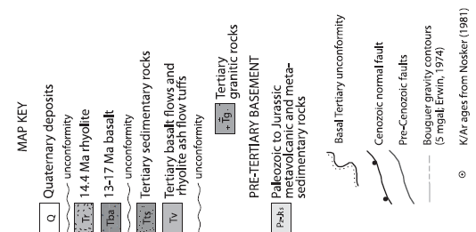
Part One:
Mapping, ages of units, and dip analysis to estimate timing and magnitudes of extension
Field Area

Slide 3
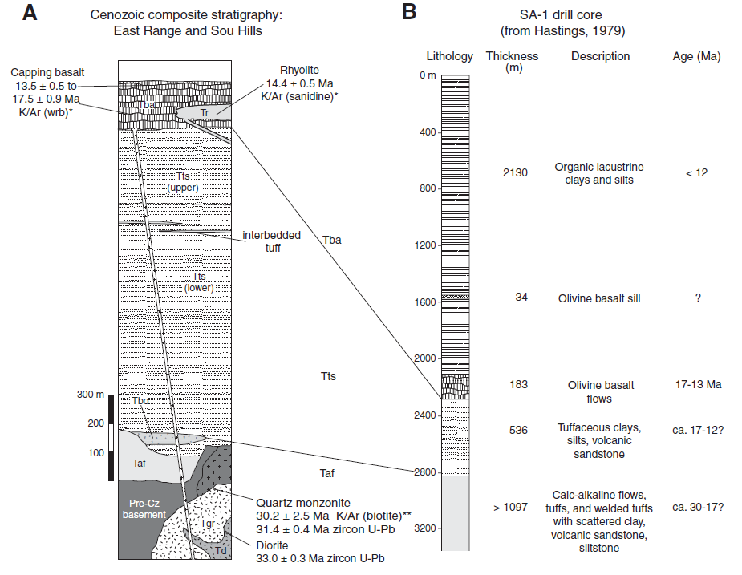
Strat Columns

Slide 4
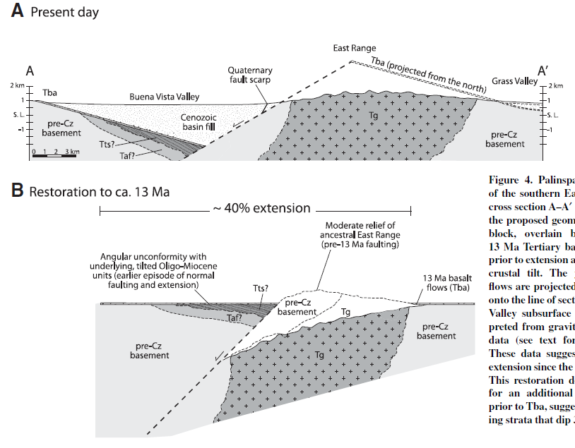
Geologic Data:
There’s a 13 Ma basalt on top of a sequence of 30-12 Ma tuffs and sediments separated by an uncomformity, both are tilted, and faulted

Slide 5
Cenozoic Structures of the East Range:
There’s a 13 Ma basalt on top of a sequence of 30-12 Ma tuffs and sediments separated by an uncomformity, both are tilted, and faulted
~15 degrees of dip in the basalt, and ~30 degrees of dip in seds/tuff (therefore half of tilting occurred prior to 13-17 Ma)
Shallow dipping basin bounding fault (from gravity and drillcore data)
Magnitude of Extension
Restoration (by aligning the basalts units) suggests 40% extension since 13 Ma
The fact that seds/tuff and basalt are dipping at different amounts suggests some geologic activity between those two geologic events

Slide 6
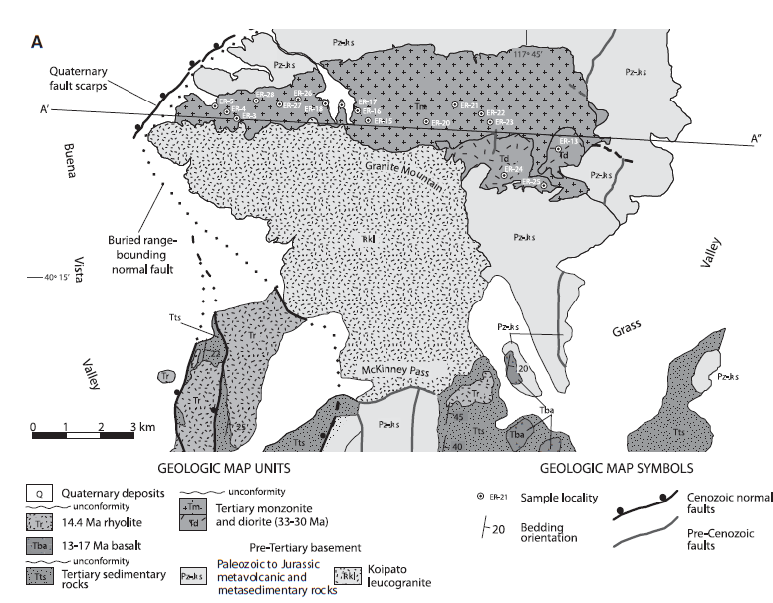
Part 2: Thermochron
In part one, they found a nice intrusive rock that has been exhumed and tilted, making it ideal for a thermochron study to understand timing of exhumation via extension

Slide 7
Apatite Fission Tracks
Rely on “tracks” formed from the spontaneous fission of ²³⁸U
If the crystal is >120 ºC, the crystal is able to heal itself, but below 60 ºC, the crystal retains all fission tracks
(U-Th)/He
He is produced, can escape at temperatures greater than 85 ºC, but are trapped at temperatures lower than 40 ºC
Both methods can provide a record of temperature of the sample through time (when combined with computer modelling), and if the geothermal gradient is estimated, can be correlated with depth through time, and therefore timing of exhumation

Slide 8
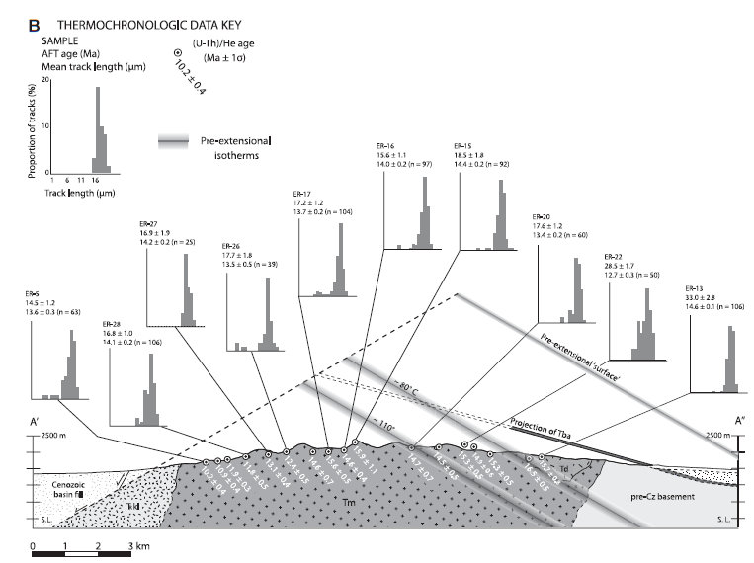
RESULTS
West deepest, youngest exhumation ages,
East, shallowest, oldest exhumation ages
Makes sense

Slide 9
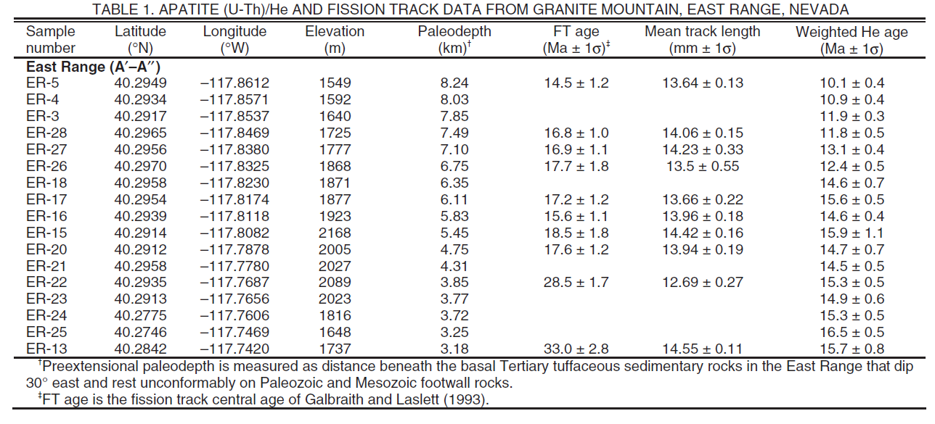

Slide 10
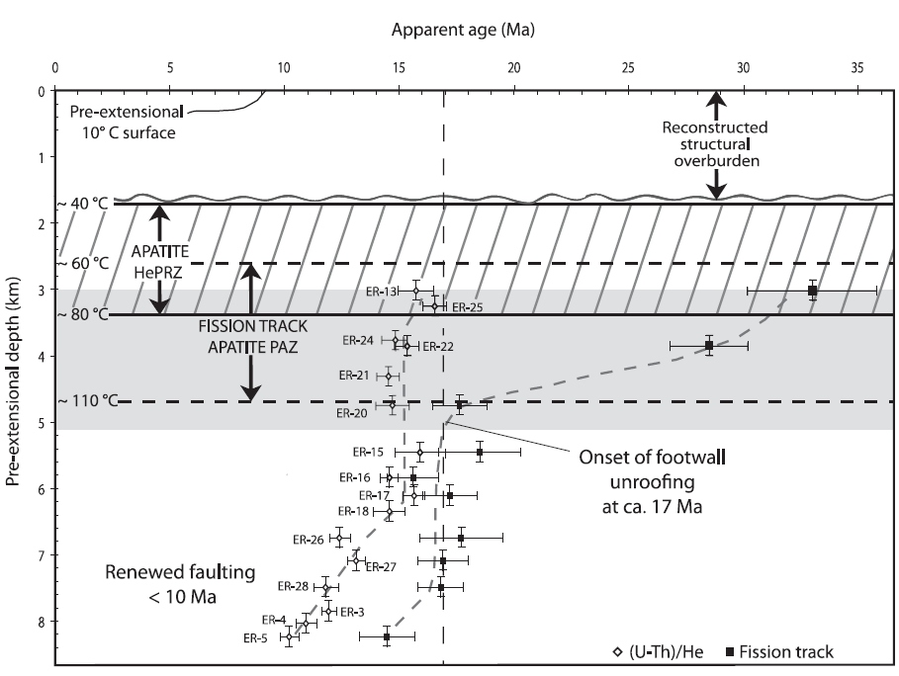
Paleodepths of each sample (estimated based on geologic constraints, such as estimated tilt/rotation, and estimated geotherm), plotted with (U-Th)/He and Fission Track ages.
Suggest onset of footwall unroofing at about 17 Ma

Slide 11
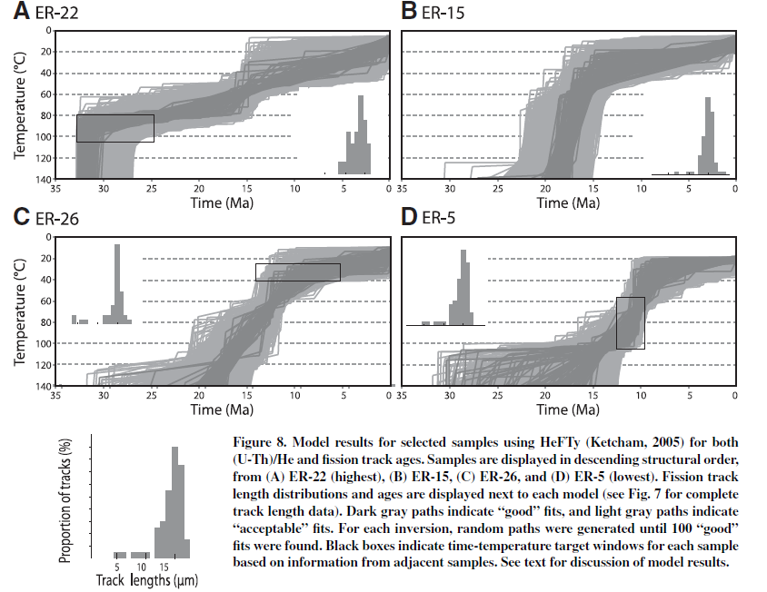
Model Results of thermochon data from shallowest to deepest:
ER-22, shows cooling of actual pluton
ER-15 shows rapid exhumation at about 17 Ma, then slow cooling
ER-25 shows 2 exhumation events, the first at 17-15 Ma and a second cooling event after 10 Ma (possibly?)
ER-5 shows a 10 Ma cooling event

Slide 12
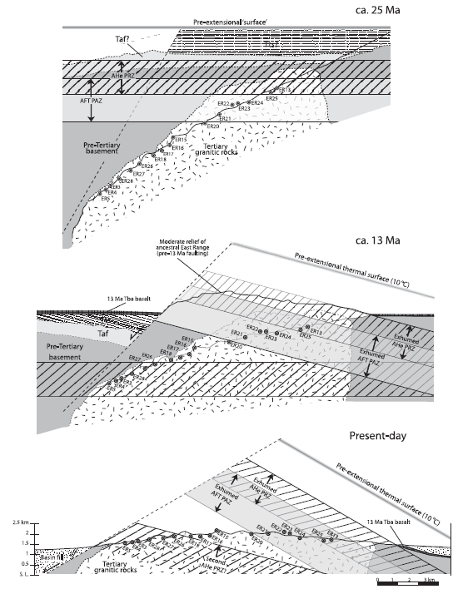
Conclusions
At least 7 km of exhumation since ~17 Ma
2 exhumation/cooling events, the first at 17-15 Ma, and then a second at ~10 Ma
Independent geologic estimates suggest as much as 60% extension during this period
The two faulting events are separated by a period of basalt eruption

