Slide 1
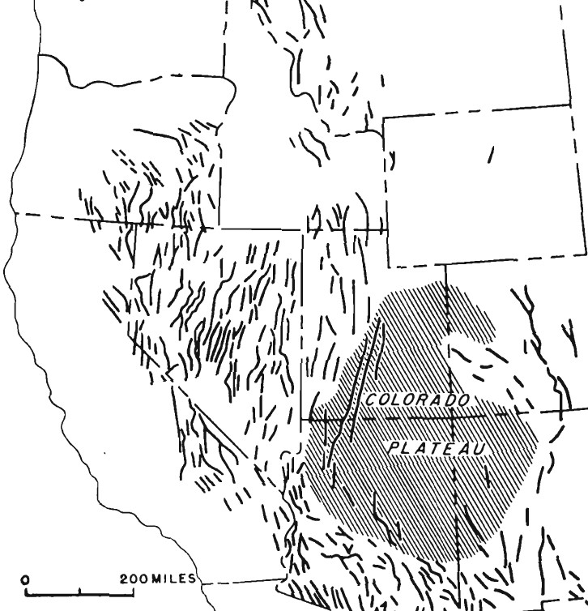
Photo courtesy of UNAVCO
Gravity measurements b/w Hazen and Austin, Nevada: A Study of Basin-Range Structure
Rate and Direction of Spreading in Dixie Valley, Basin and Range Province, Nevada
Thompson 1959 and 1973

Slide 2
Motivation
The motivation for both papers stems from historic earthquake ruptures in the central Basin and Range
The gravity paper aims to understand the structural history of the Basin and Range using the fault movements of 1954 as a “dynamic demonstration” of such structures
The Dixie Valley paper aims to measure extension amounts from single earthquakes (1903, 1915, 1954), measure extension in the last 12,000 years from offset Lahontan shoreline deposits, and measure extension for late Cenozoic time from geophysical studies
Ultimately these papers aim to outline a basic understanding of how much extension has taken place across the Basin and Range since the late Cenozoic, and in what direction

Slide 3
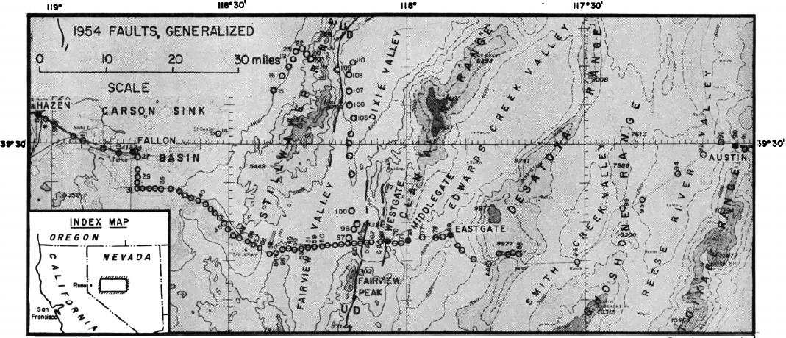
Gravity transect

Slide 4
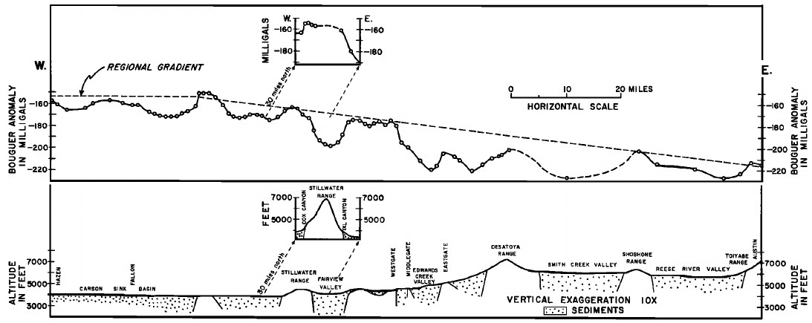
Bouguer anomaly decreases to the west
Large negative anomalies are associated with all of the basins indicating very thick fill
Fairview and Dixie Valleys contain more than 5000ft of fill, Edwards Valley more than 6000ft
These data indicate that the Basin and Range is basically isostatically balanced, and therefore assumptions can be made about the entirety of the Basin and Range deforming in the same manner

Slide 5
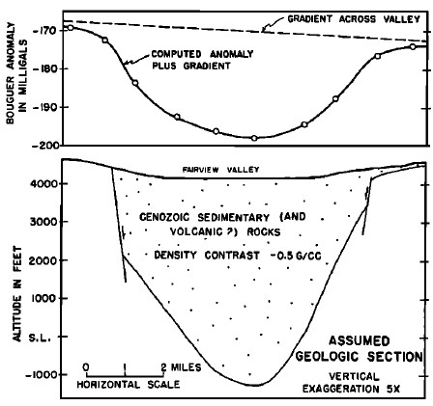
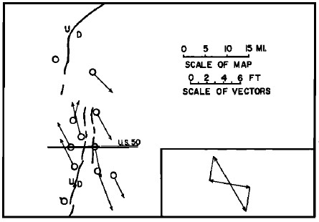
Structural relief, backed up by gravity data, at Dixie Valley and Fairview Valley is ~ 2 miles
If the faults dip 60° (which is well within possibility based on simple geometry of Vertical disp. Vs. horizontal, seismic first motion observations, and direct measurement on bedrock surfaces) then the total extension amounts to about 2 miles
Horizontal movements of the latest episode of deformation (1954), are well constrained from seismic and geodetic measurements to about 5 ft of extension normal to the fault trace
Do some math, and from this you can say that this valley has extended ~1.5 mi in the last 15Ma

Slide 6
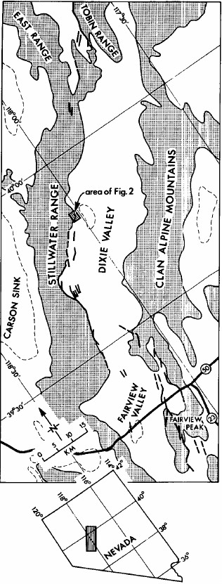
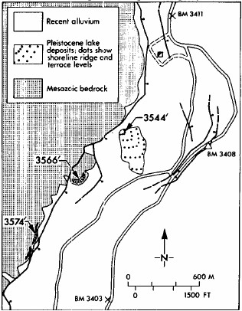
Geologic observations from Dixie Valley
The shorelines outlined in this figure are recognized as being the highstand shorelines of Lake Lahontan, and they have been dated with reasonable certainty to about 12,000 years old
They are offset vertically by faults by about 9m (~30ft)
Scarps in alluvium on the other side of the basin exhibit the same amounts of offset
From this, 9m of vertical offset and 10m of horizontal extension in the last 12,000 years can be assumed
This gives an average extension rate of ~1mm/yr in that length of time

Slide 7
Geophysical observations from DV
Bedrock geometry of the valley was constrained using seismic refraction, gravity, and magnetic depth estimates, as well as dip of faults in subsurface
Restoring the cross section drawn from these data (above) yields 5km vertical displacement, and 6km horizontal displacement
Using 15Ma as the inception of faulting (from how Miocene sediments were deposited) the spreading rate is at least 0.4 mm/yr in the last 15 m.y.

Slide 8
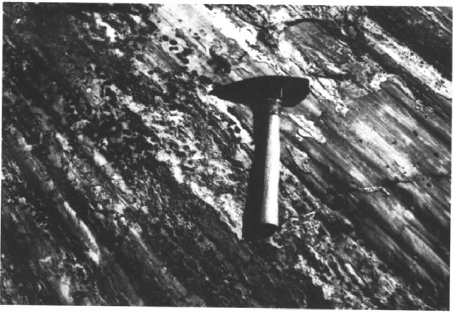
Spreading direction from slickensides
Geodetic work covering S part of 1954 faults showed a NW-SE extension direction
However, looking at older fault surfaces exposed in bedrock can give a measure of this relative motion over longer time periods
Slickensides on fault surfaces indicate the lateral component of slip, e.g. faults striking N-S show a component of right lateral slip, faults striking NE-SW show a component of left lateral slip

Slide 9
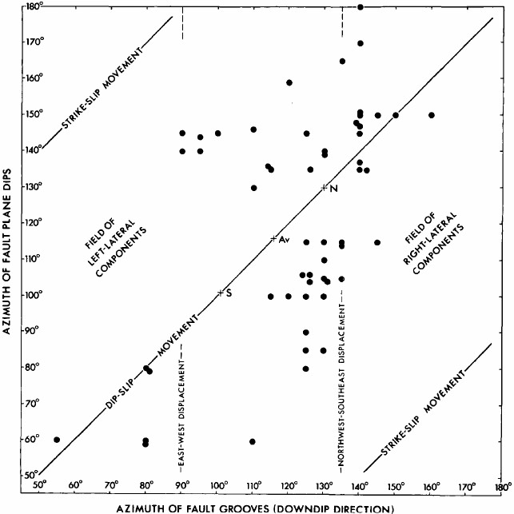
Analysis of slickensides yields this plot
The point “Av” is used to represent the spreading direction for the whole basin
The mean groove direction lies between 125° and 130° to the right of “Av”
From this average direction, they interpret the extension direction to be ~125°, or N 55 W - S 55 E
This agrees with the recent geodetic derived extension direction

Slide 10
Main points
Initial estimates of 30mi (~50km) of extension across Basin and Range from earlier gravity study is an underestimate, further geologic observations indicate ~100km (10% increase in crustal area) in the last 15 m.y.
Spreading rate for the last 15 m.y. is ~0.4mm/yr, and data from shorelines indicates that rate is ~1mm/yr during the last 12,000years
Extension direction seems to be consistent over a wide region of the B&R and is ~ N55W – S55E

