Slide 1
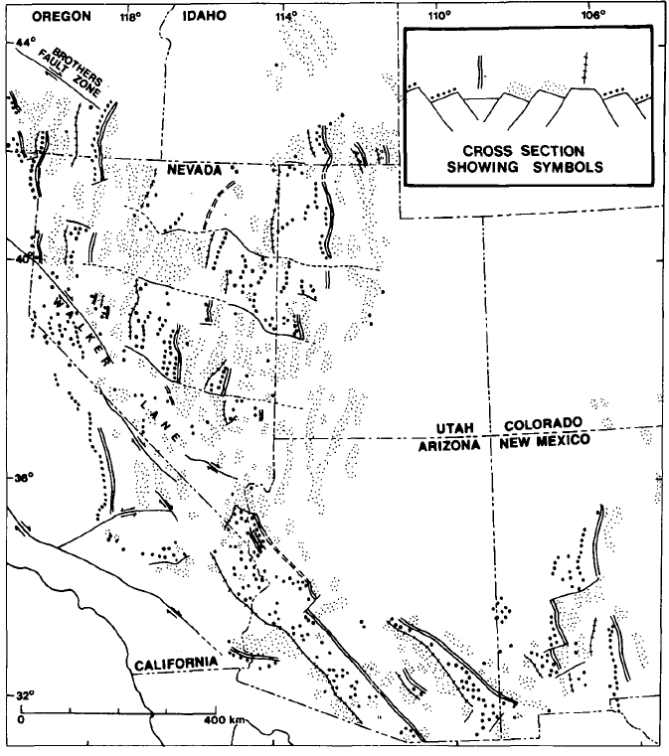
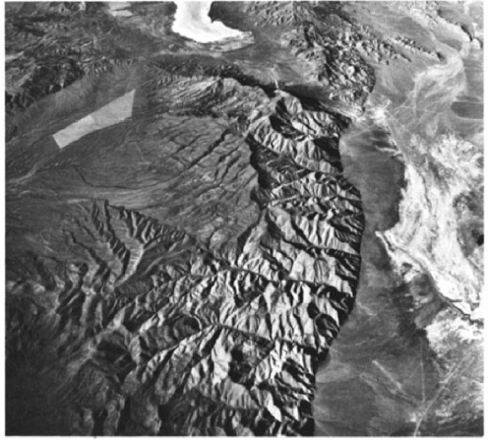
Regional tilt patterns of late Cenozoic basin-range fault blocks, western United States
John H. Stewart, 1980, GSA bulliten
Presentation by Kurt Kraal

Slide 2
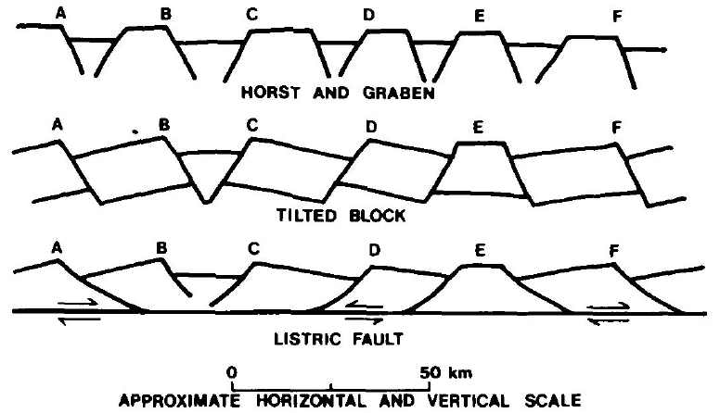

Slide 3
Regional Tilt Patterns
E or W tilt directions that can be broken up into various “domains”
These zones are separated by west-northwest trending transverse zones or bounderies.
these domains have an absence of major tilted blocks by changes in the density and pattern of young faults, and changes in topographic grain
Often correspond to defined lineaments
Extension Directions:
In the GB, extension direction is perpendicular to basin bounding structures (and parallel with transverse structures)
Different direction than Southern B&R (possibly due to different timing?)

Slide 4
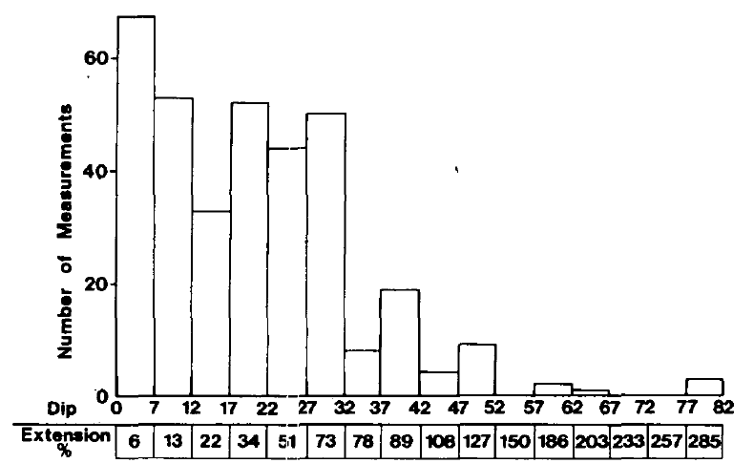
Bed Tilting: Extension
Based on tilted block model (although similar relationships of higher tilting = higher extension for the listric fault model would be expected) from Morton and Black 1975
Most measurements suggest 0-32 degrees of tilting, therefore 5-73% extension in most ranges

Slide 5
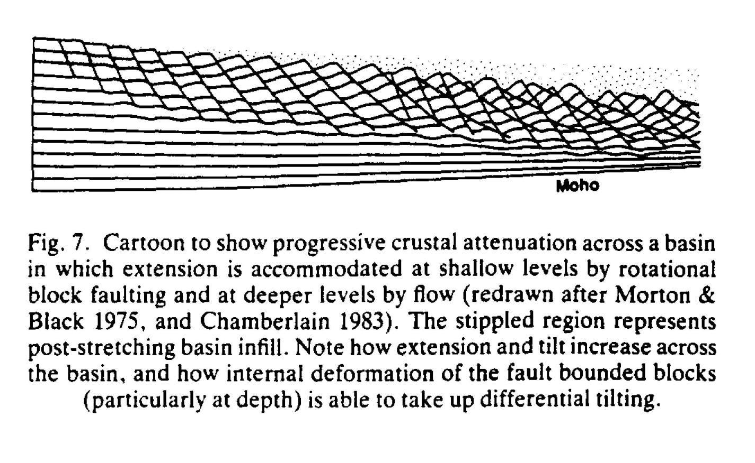
The method of Morton and Black 1975 appears complicated as presented – but the principle is not – see following..
(Drawn by Morton & Black, 1975, to describe faulting in Afar, Ethiopia)
Jackson & White, J. Struct. Geol., 1989

Slide 6
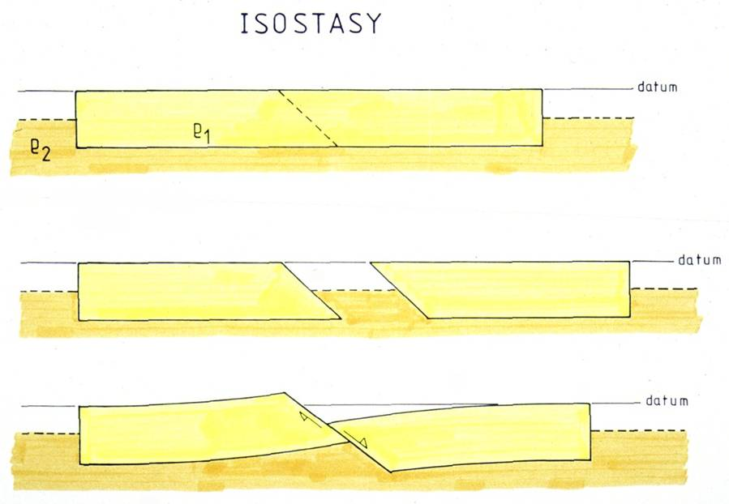
Simple explanation of why tilting accompanies extensional faulting uses isostaccy as a principle..
James Jackson-trieste

Slide 7
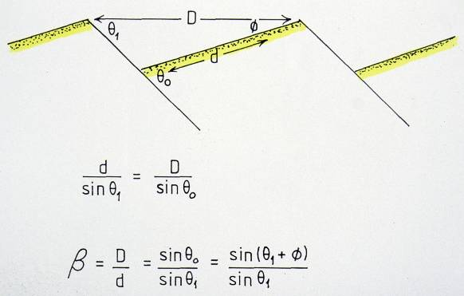
Deriving extension from range tilts -
stretched width of the basin
β is the amount of extension = original width of the basin
Rotating from fault dip 60º to 30º gives β = 1.7
James Jackson - Trieste

Slide 8
amount of extension (β)
is related to tilting
… but topography is
related to block width
James Jackson - Trieste

Slide 9
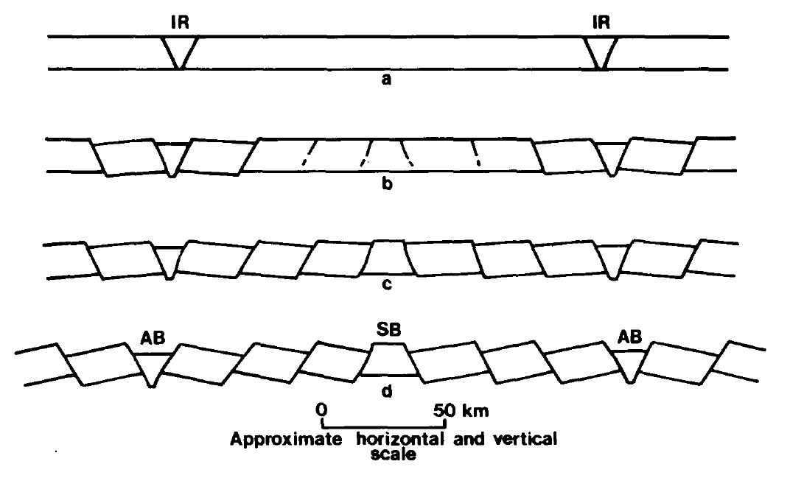
Initial rupture proposed to occur antiformal boundaries that propagate until hitting already ruptured and tilted blocks

Slide 10
Conclusions
Tilting of 15 to 20 º observed regionally in the GB correlates with 20-30% extension over the entire great basin (using the model proposed by Morton and Black 1975)
Block rotation or listric fault proposed as possible models

