Slide 1
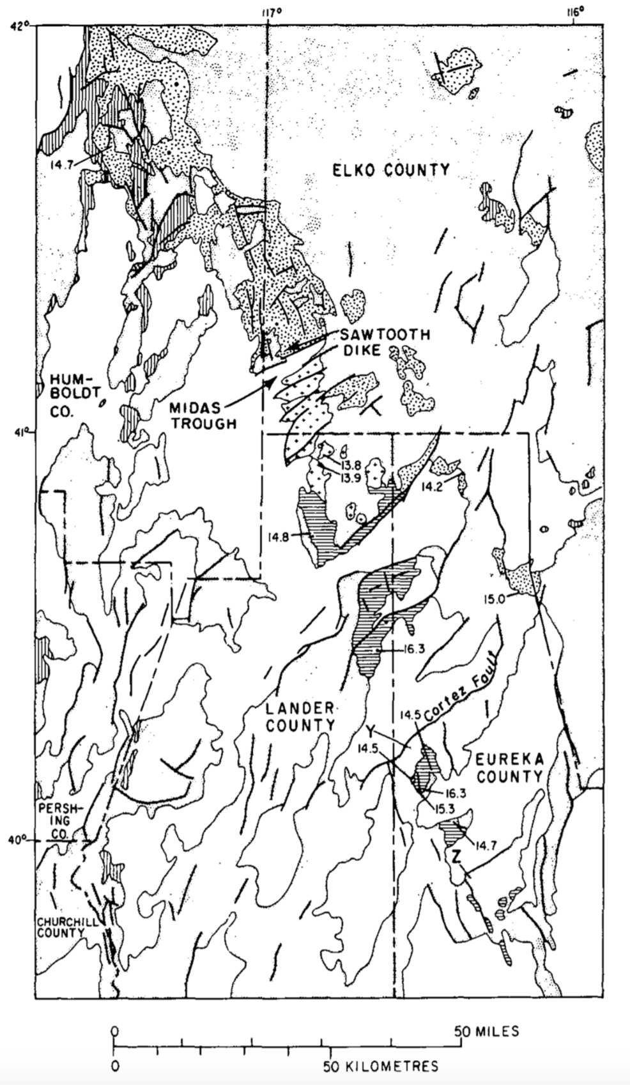
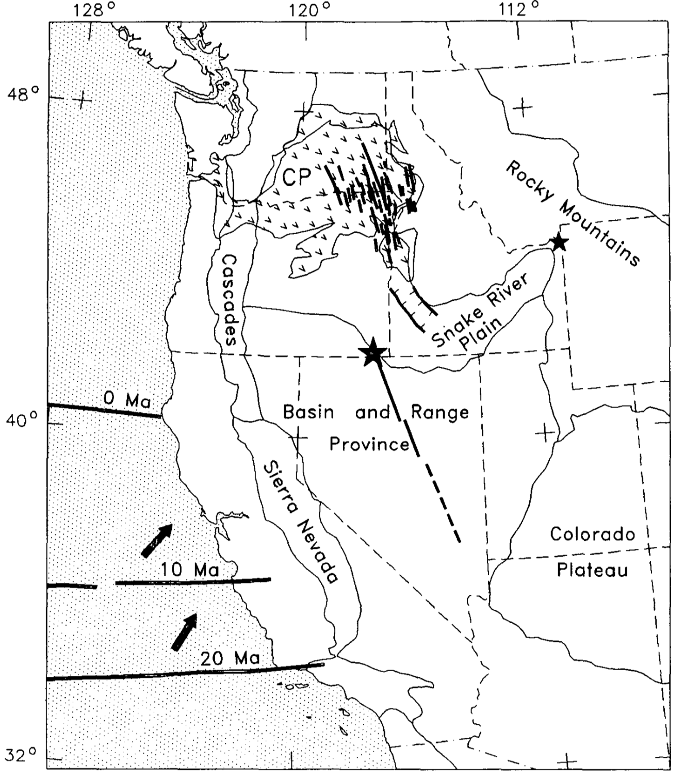
Basin and Range rifting in northern Nevada: Clues from a mid-Miocene rift and its subsequent offsets
The northern Nevada rift: Regional tectono-magmatic relations and middle Miocene stress direction
Zoback and Thompson, 1978
Presented by Luke J. Schranz
Zoback et al., 1994

Slide 2
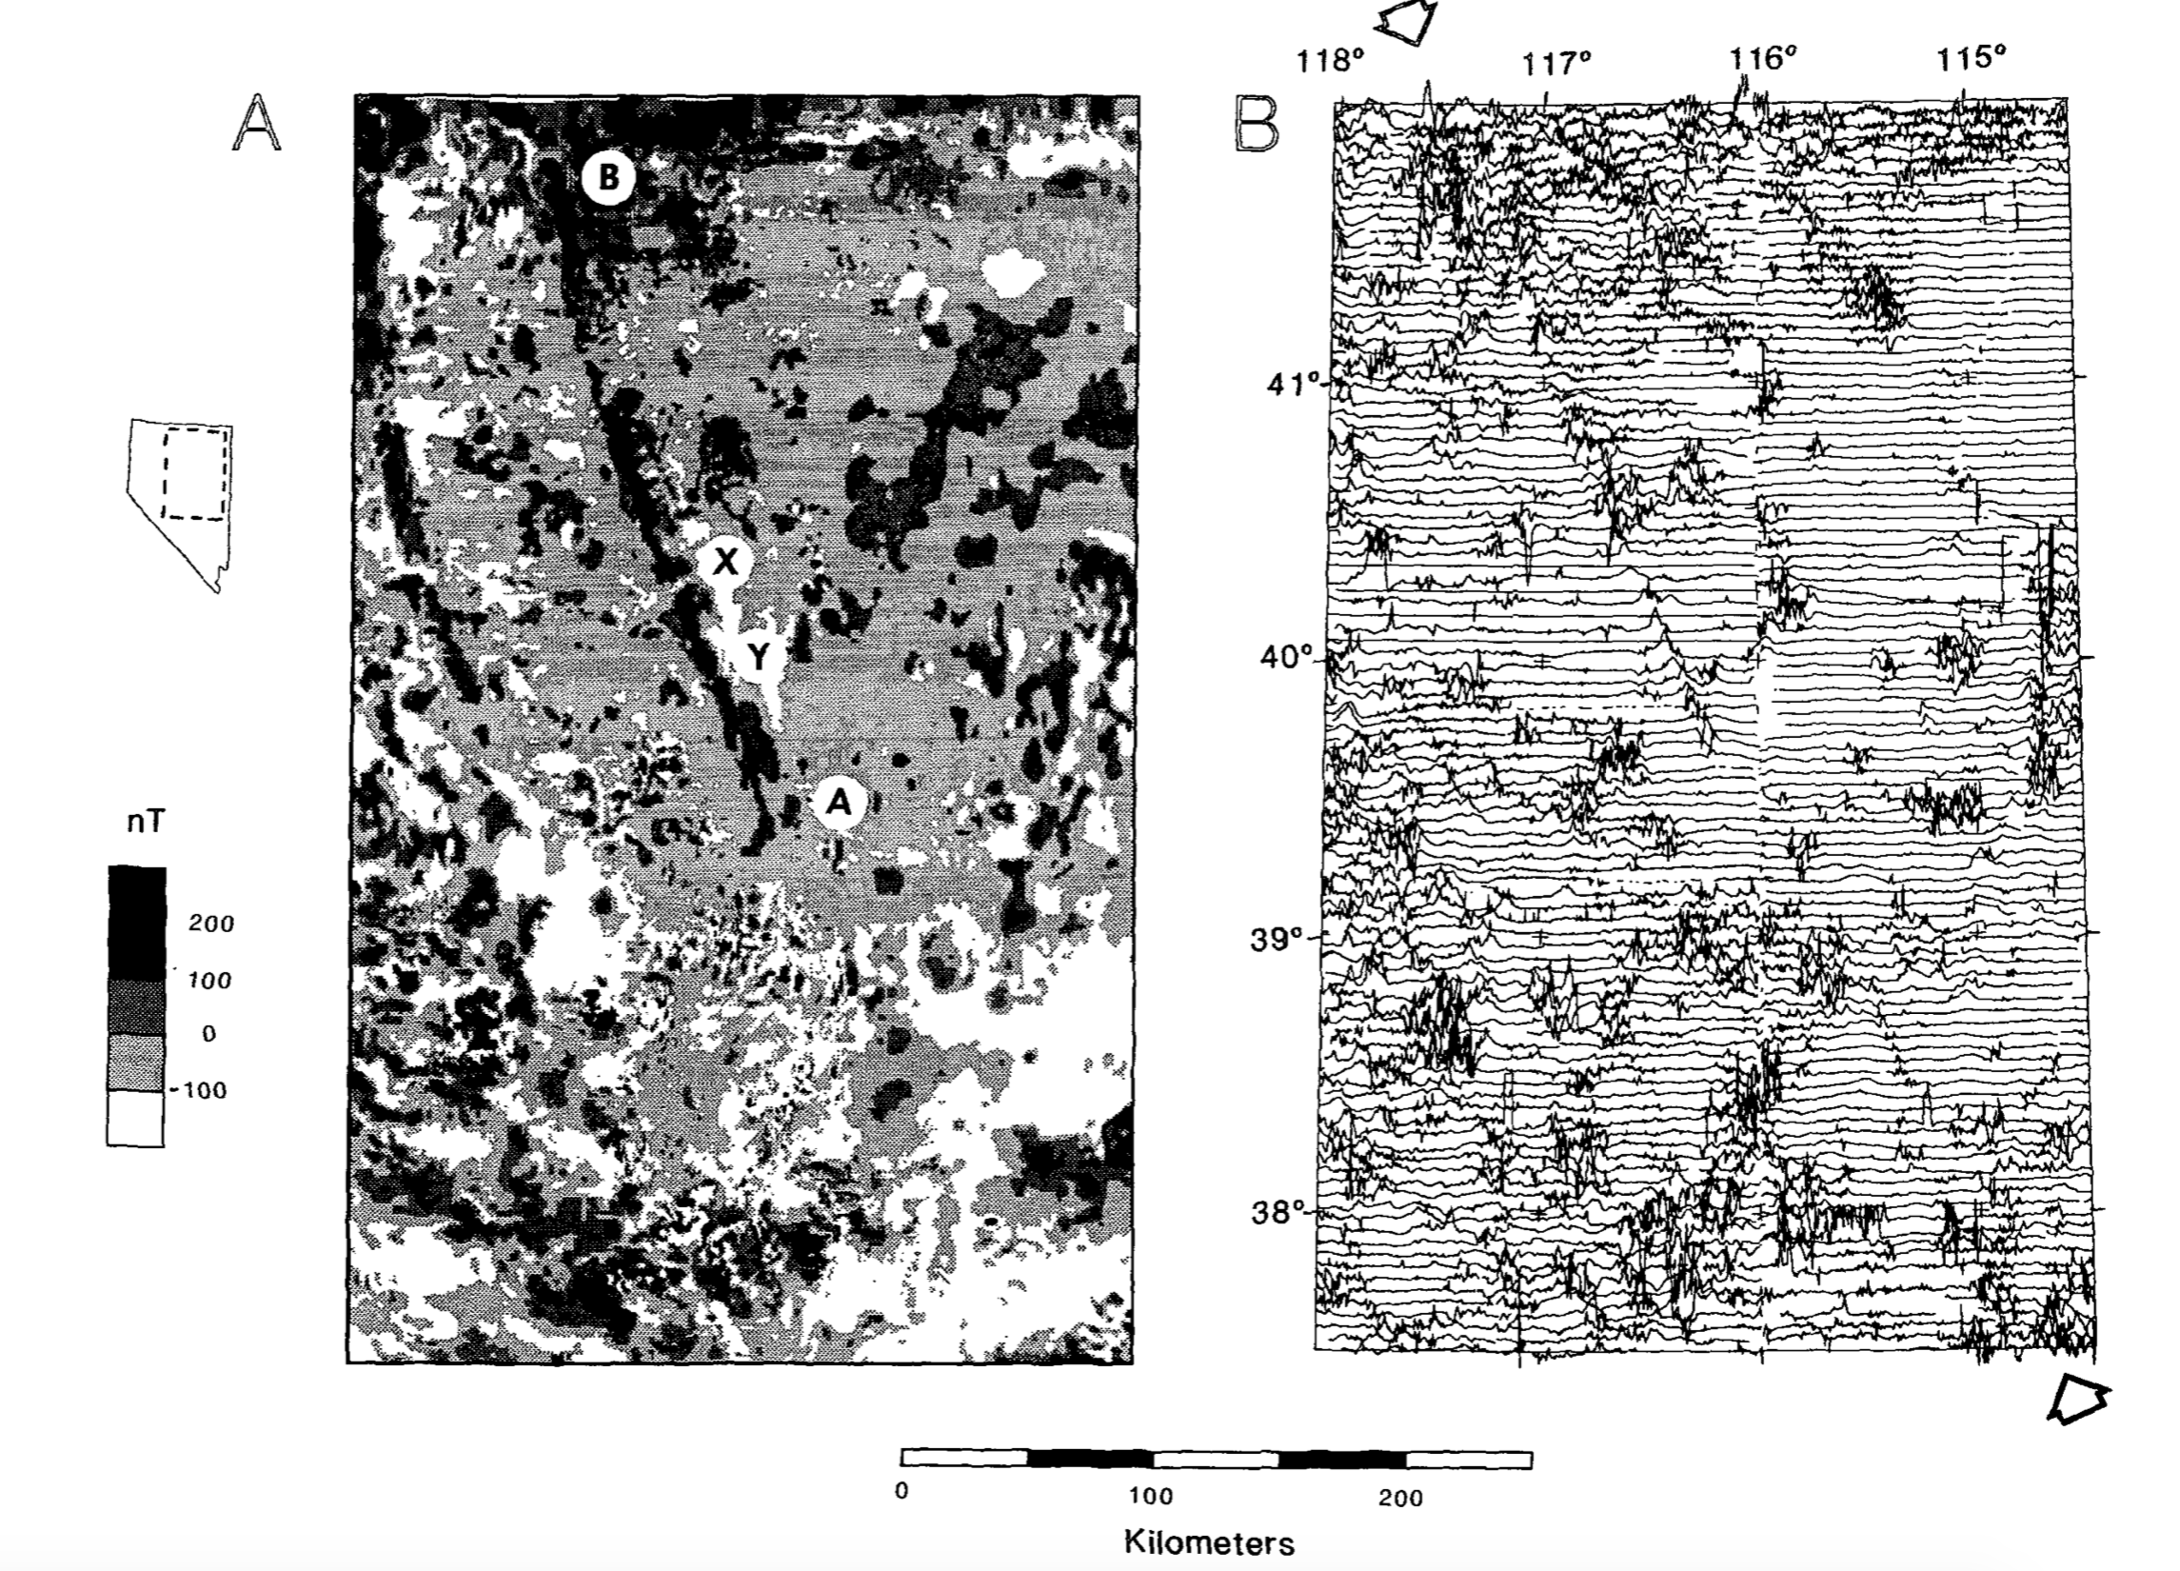

Slide 3
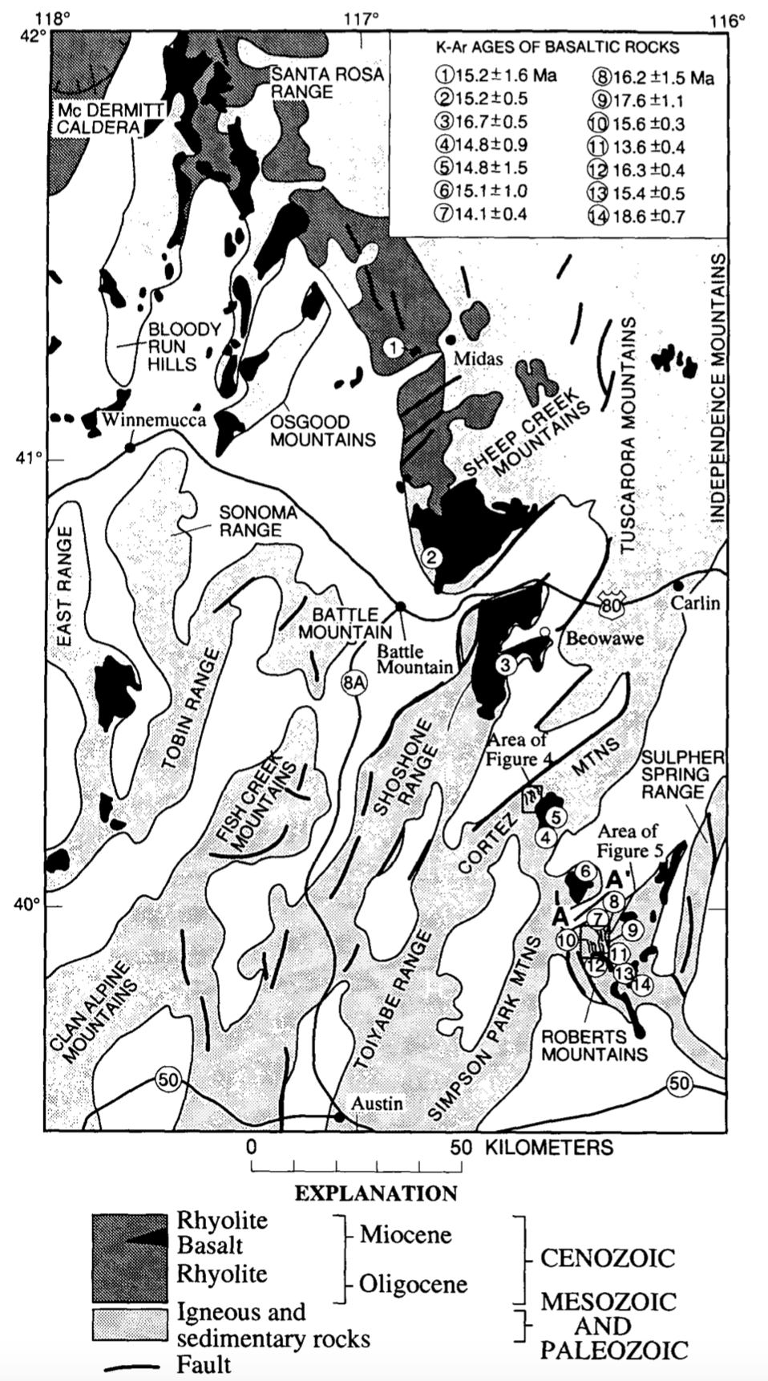
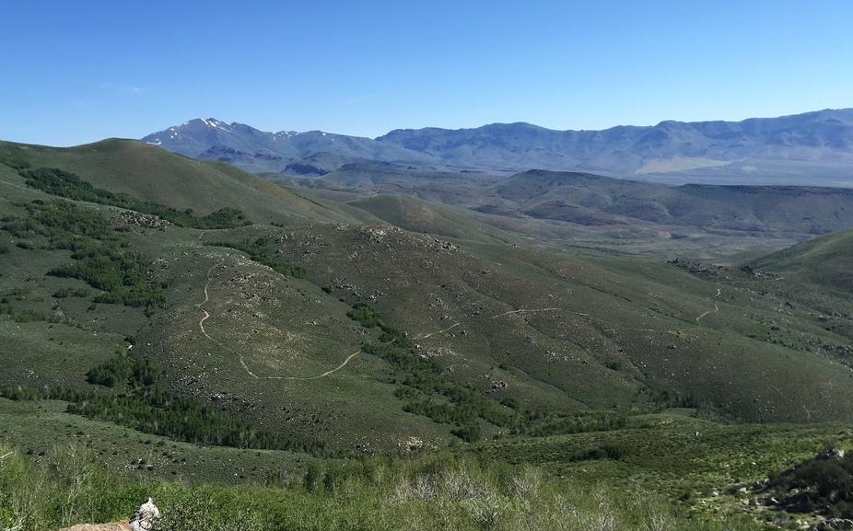

Slide 4
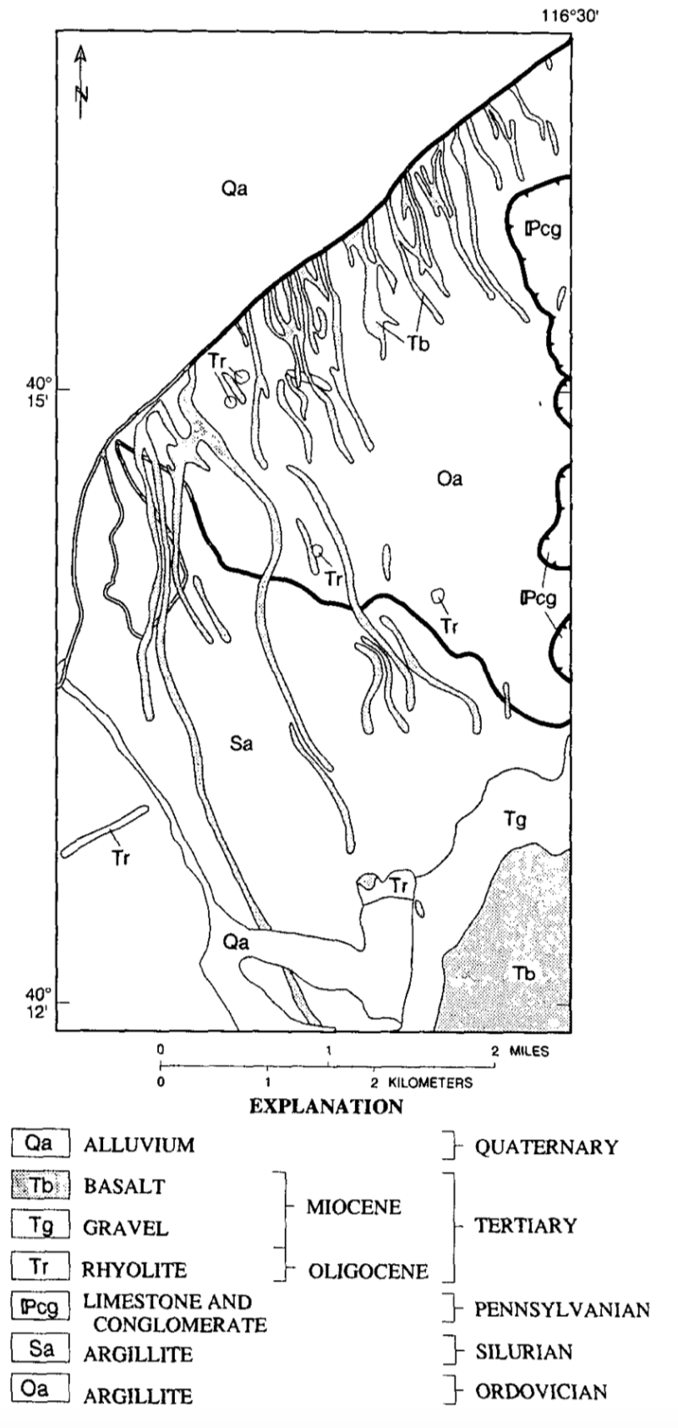
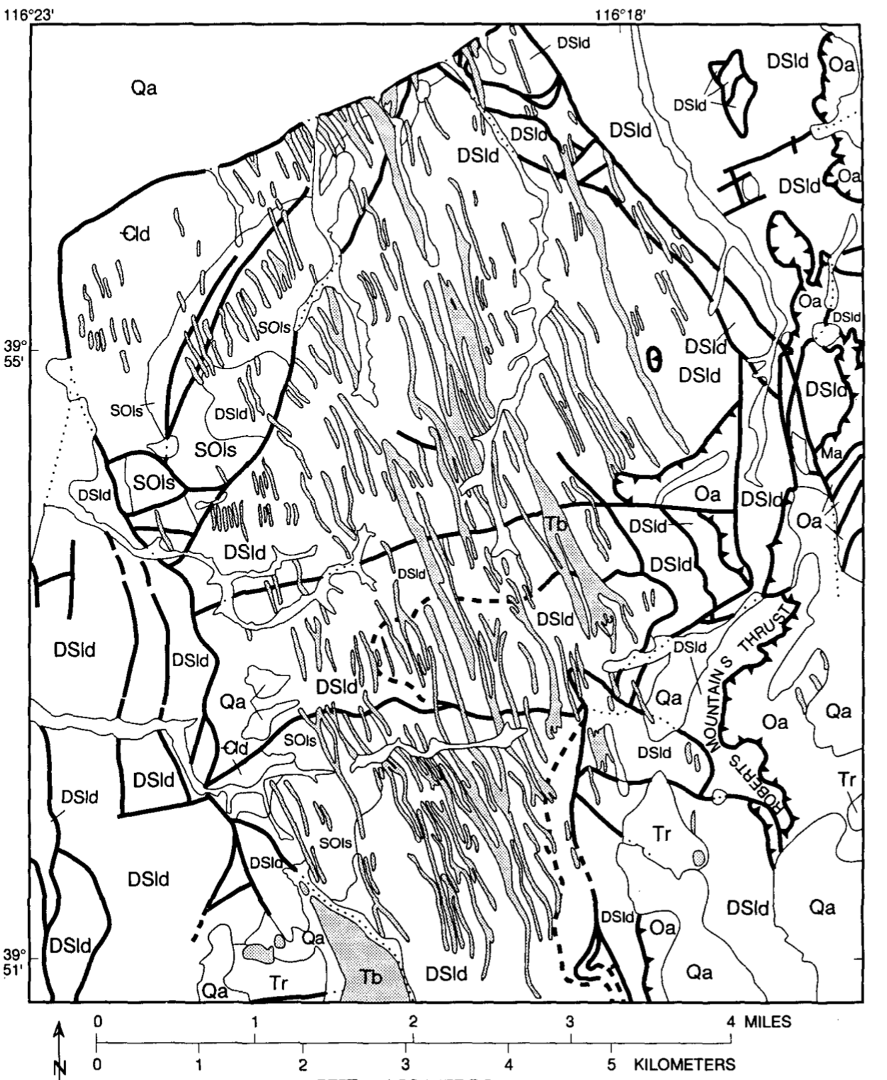

Slide 5
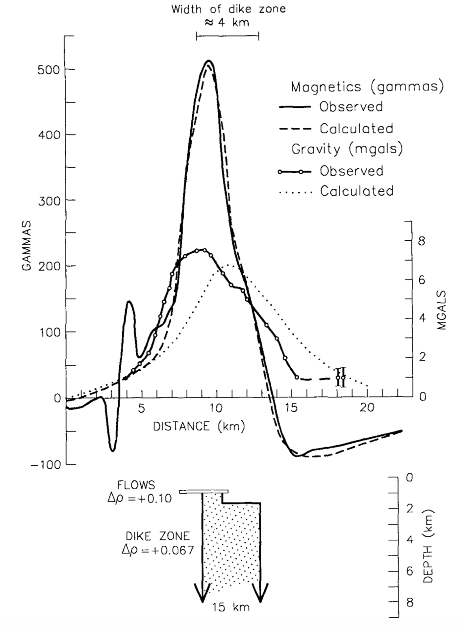
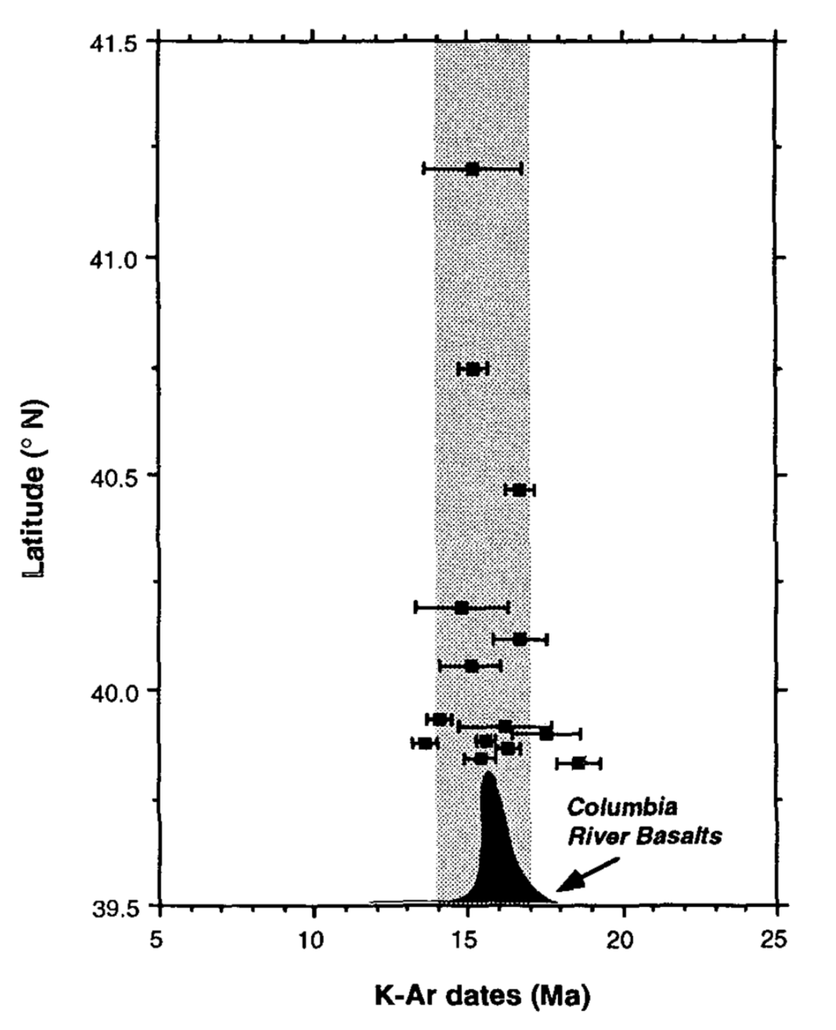

Slide 6
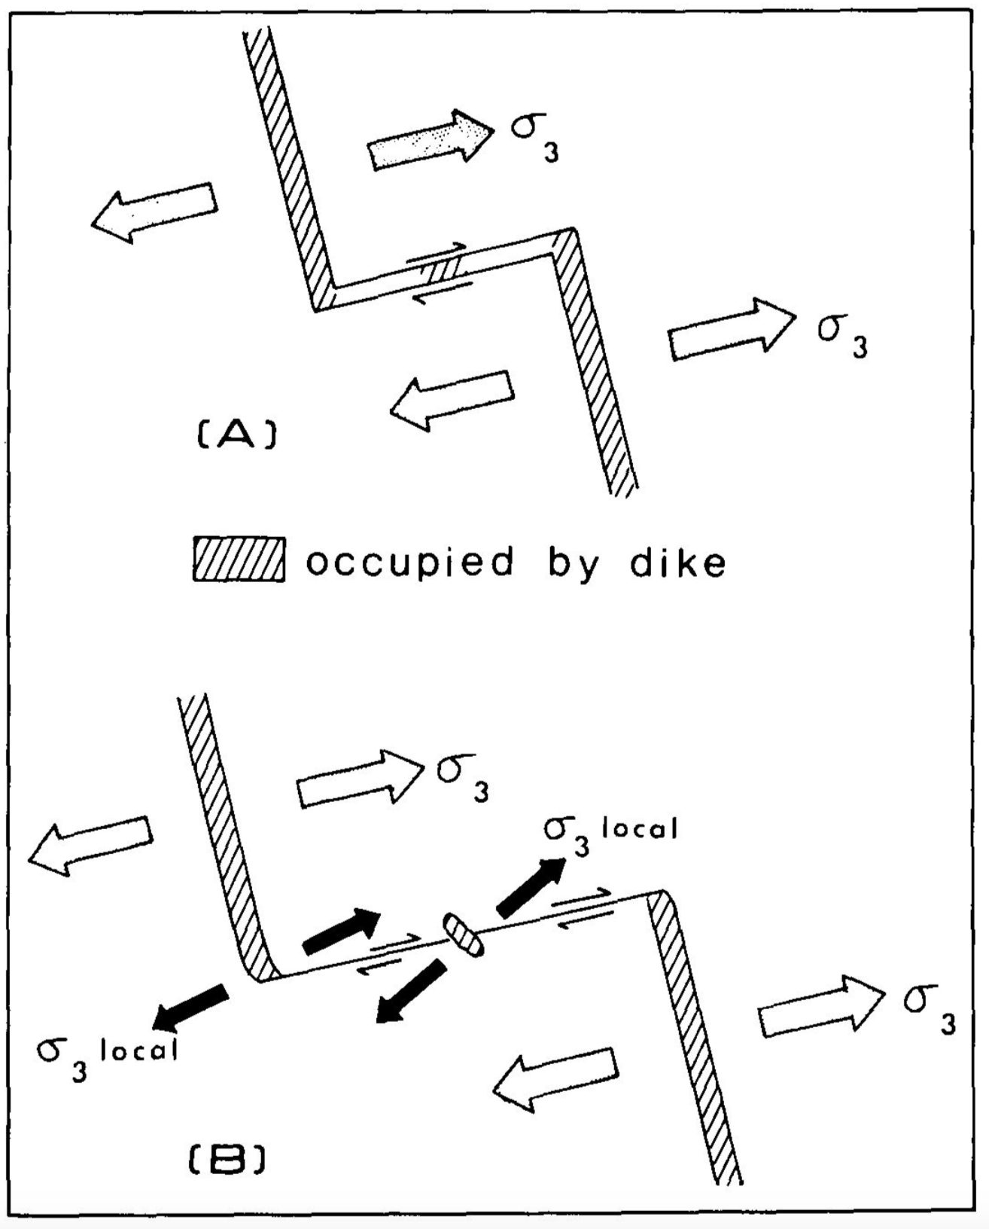
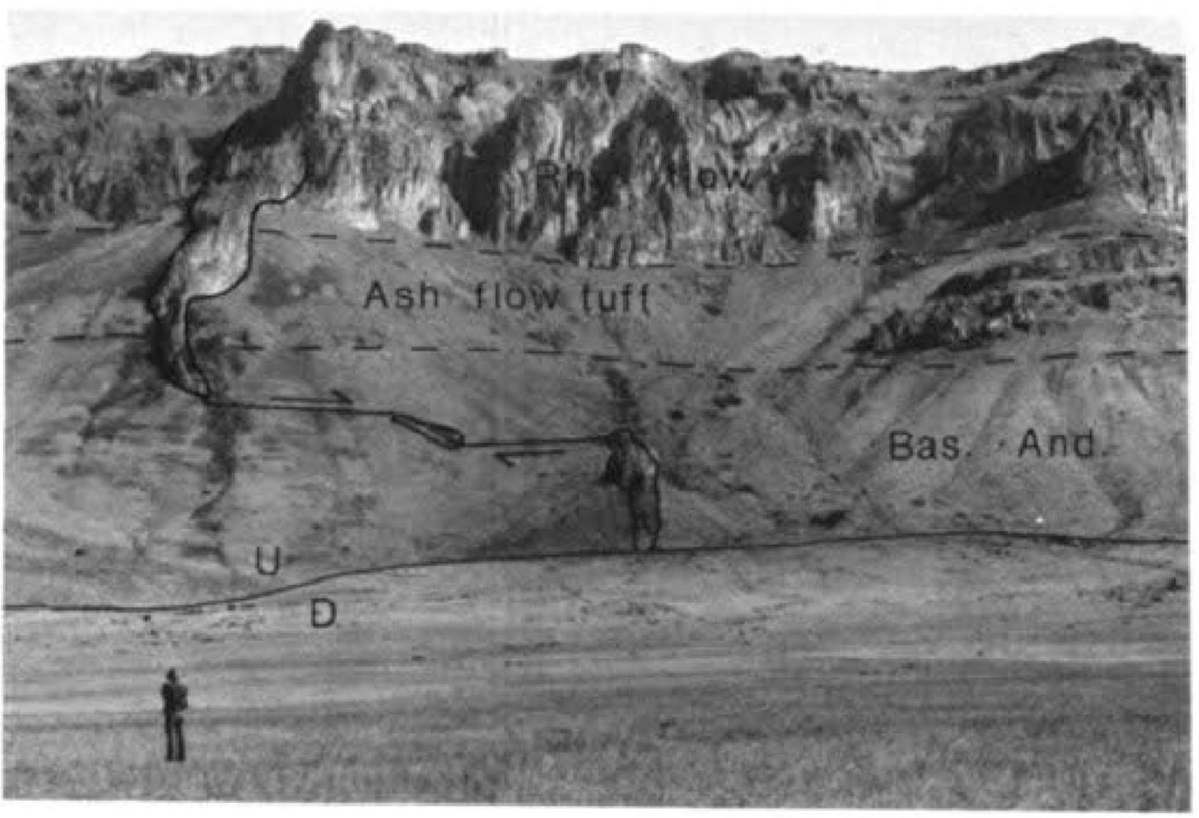
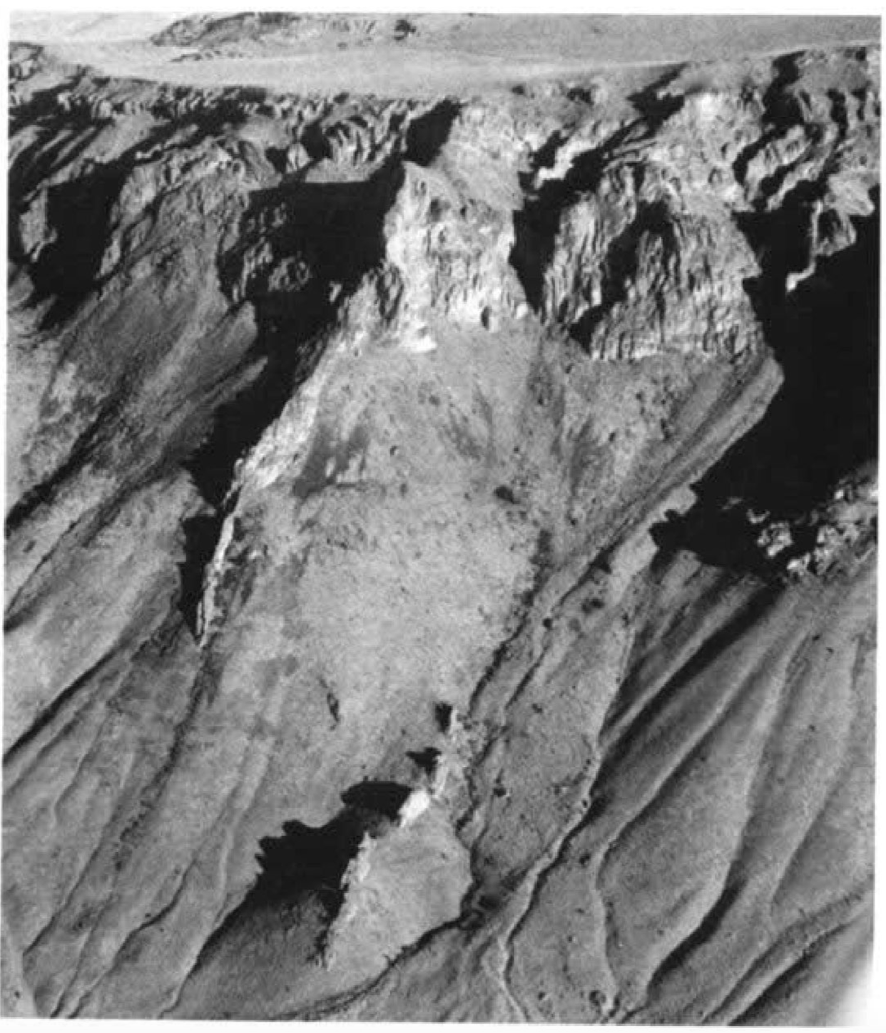

Slide 8
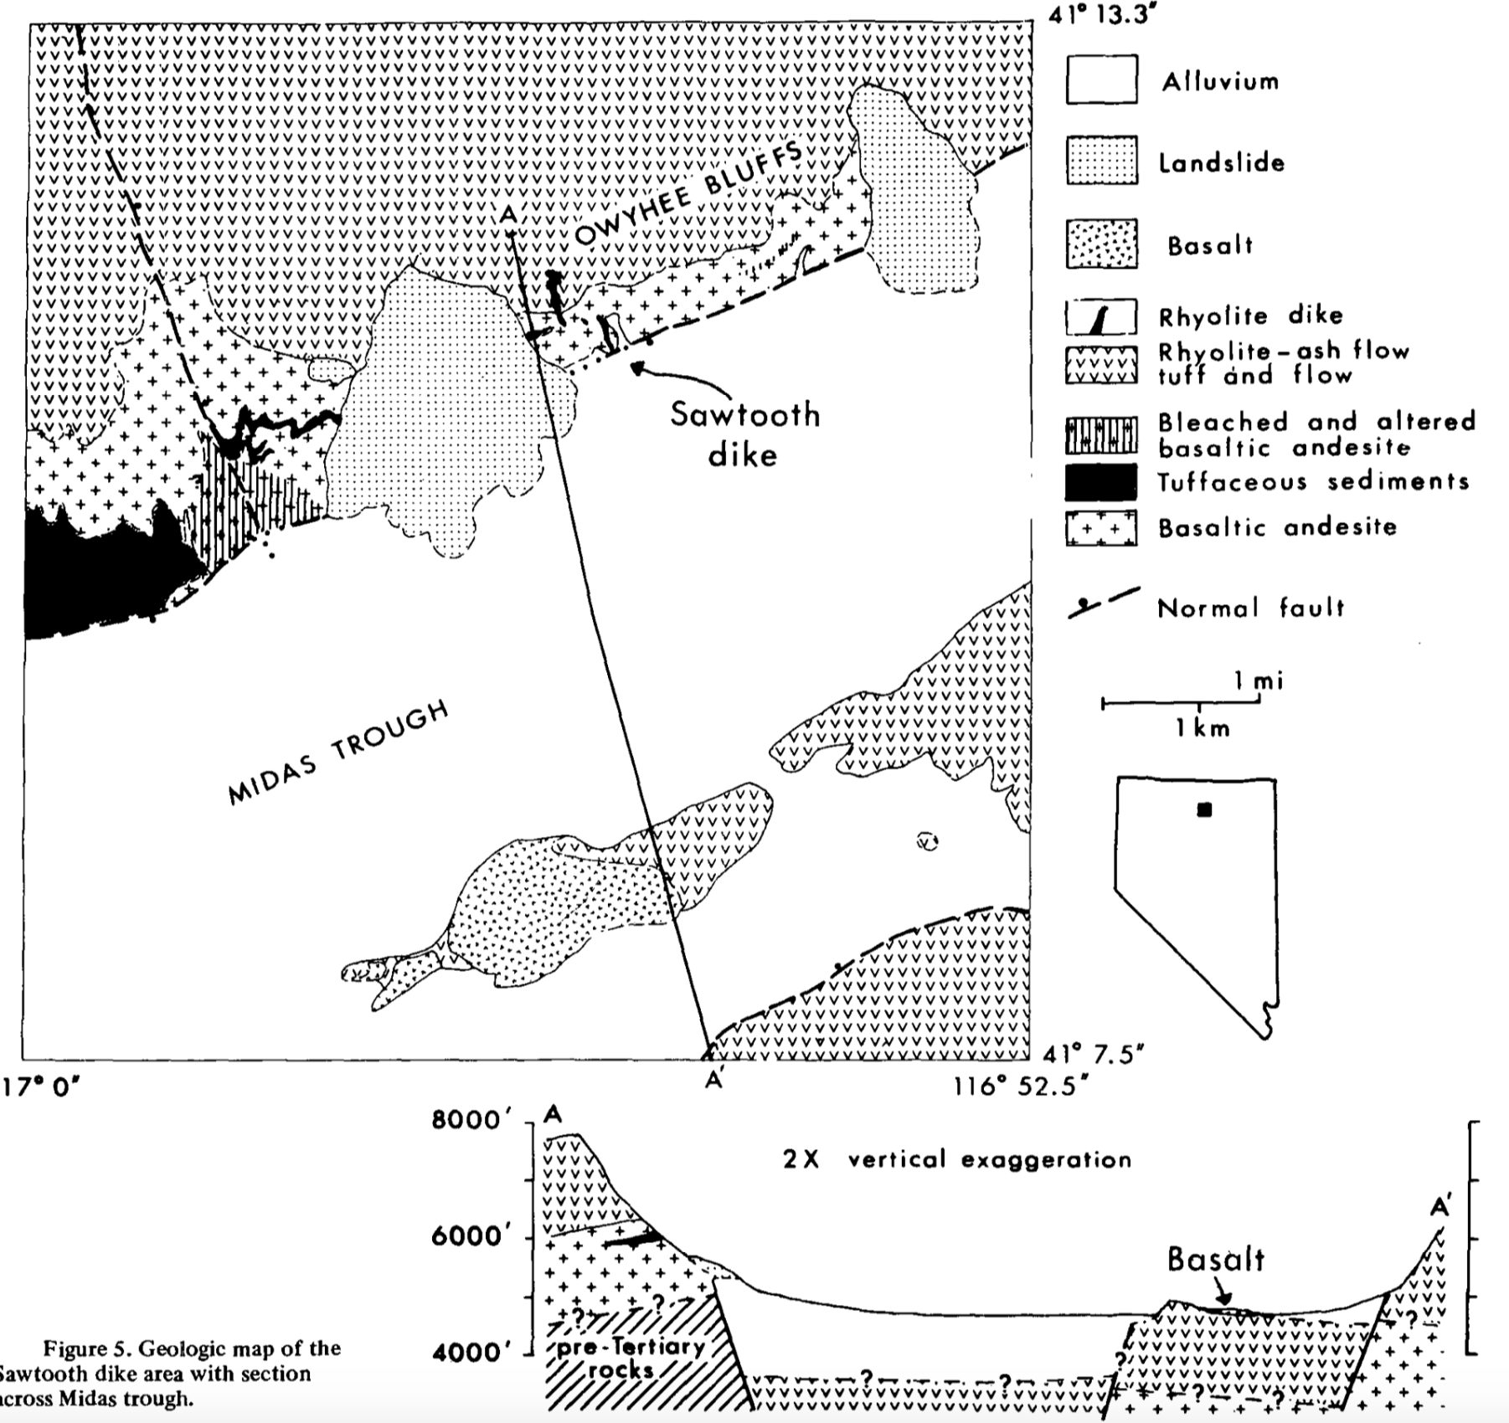

Slide 9
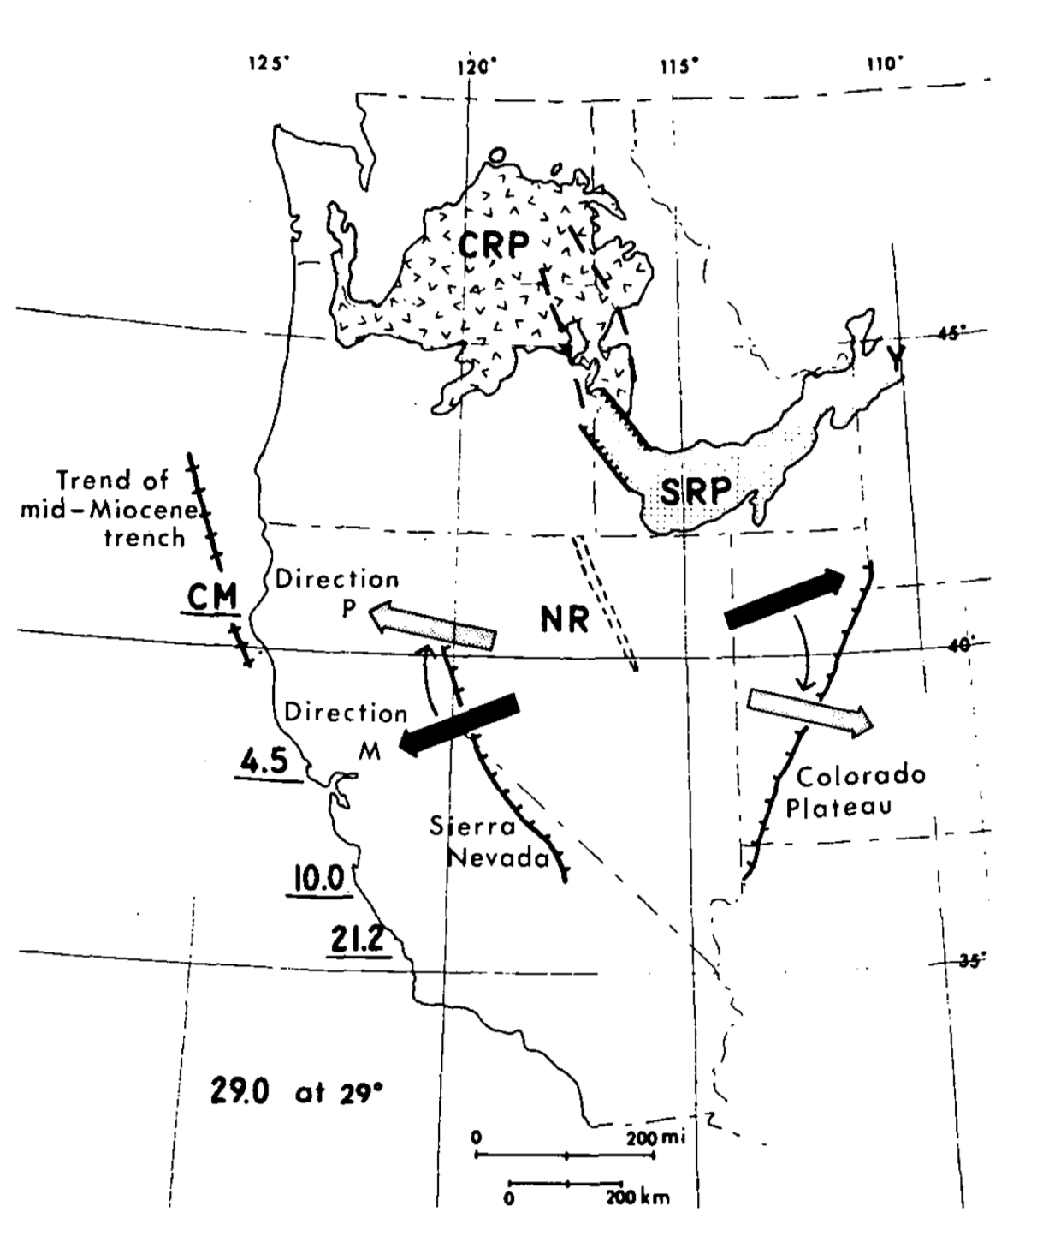

Slide 10
Conclusions
Middle Miocene (17-14 Ma) stress direction was perpendicular to NNR
Modern stress direction is rotated 45° clockwise of Mid-Miocene direction (NE to NNW)
Likely related to Columbia River basalts and initial Yellowstone Hotspot volcanism

