Slide 1
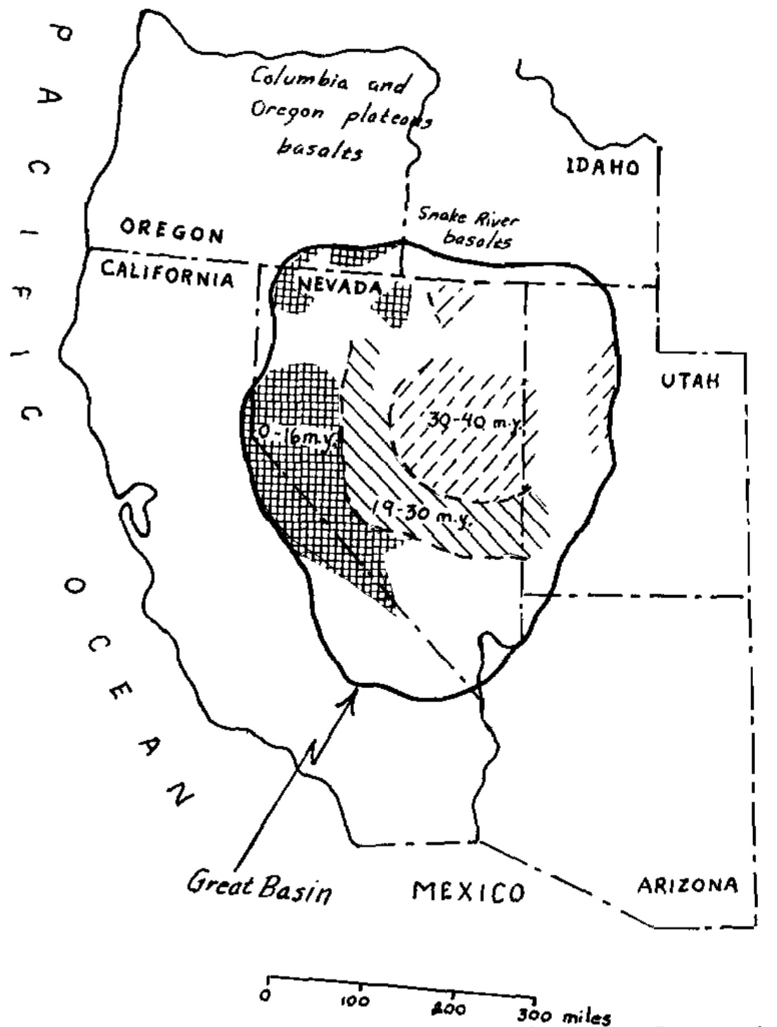
Tertiary Igneous Chronology of the Great Basin of Western United States-Implications for Tectonic Models
McKee, 1971
By: Michael Say

Slide 2
Methods
Purpose
To test newly theorized plate tectonic models of the western USA against Tertiary igneous rocks of the Great Basin.
These new models must take into account the ”Rock Record” (Tertiary magmatic suite) in terms of composition and timing of eruption/emplacement
Expansive and robust radiometric age dates from previously published studies
Geochemistry from previously published studies
Tectonic models of the western USA from previously published studies
Spreading centers ages
Oceanic data
Etc.

Slide 3
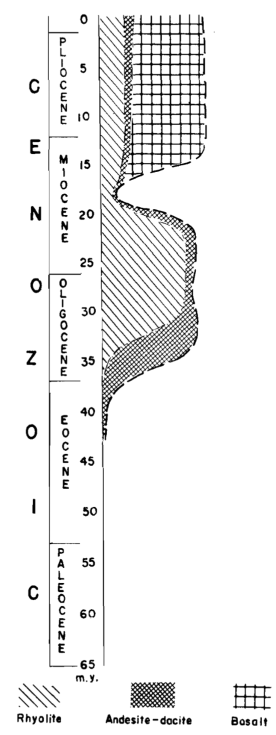
The Data
Basaltic Volcanism
(Bimodal)
Radiometric ages and geochemistry show two significant time intervals:
~40-35 Ma to ~19-17 Ma
Deposited on tectonically stable erosional surface of moderate to low relief
HIATUS!!!!
2. 16 Ma to Present
Resumption of volcanism was accompanied with high-angle normal faulting
High-K Andesites and Rhyolites

Slide 5
Conclusions
Plate tectonic models must consider the rock record in order to be credible
Two phases of Tertiary volcanism observed in the Great Basin:
~40-35 Ma to ~19-17 Ma high-K andesites and rhyolite related to subduction of the Farallon Plate.
Deposited on tectonically stable erosional surface of moderate to low relief
HIATUS!! ~18-16 Ma
16 Ma to Present basaltic (bimodal) volcanism related to Basin and Range normal faulting and crustal expansion
Syn-depositional with high-angle normal faulting

Slide 6
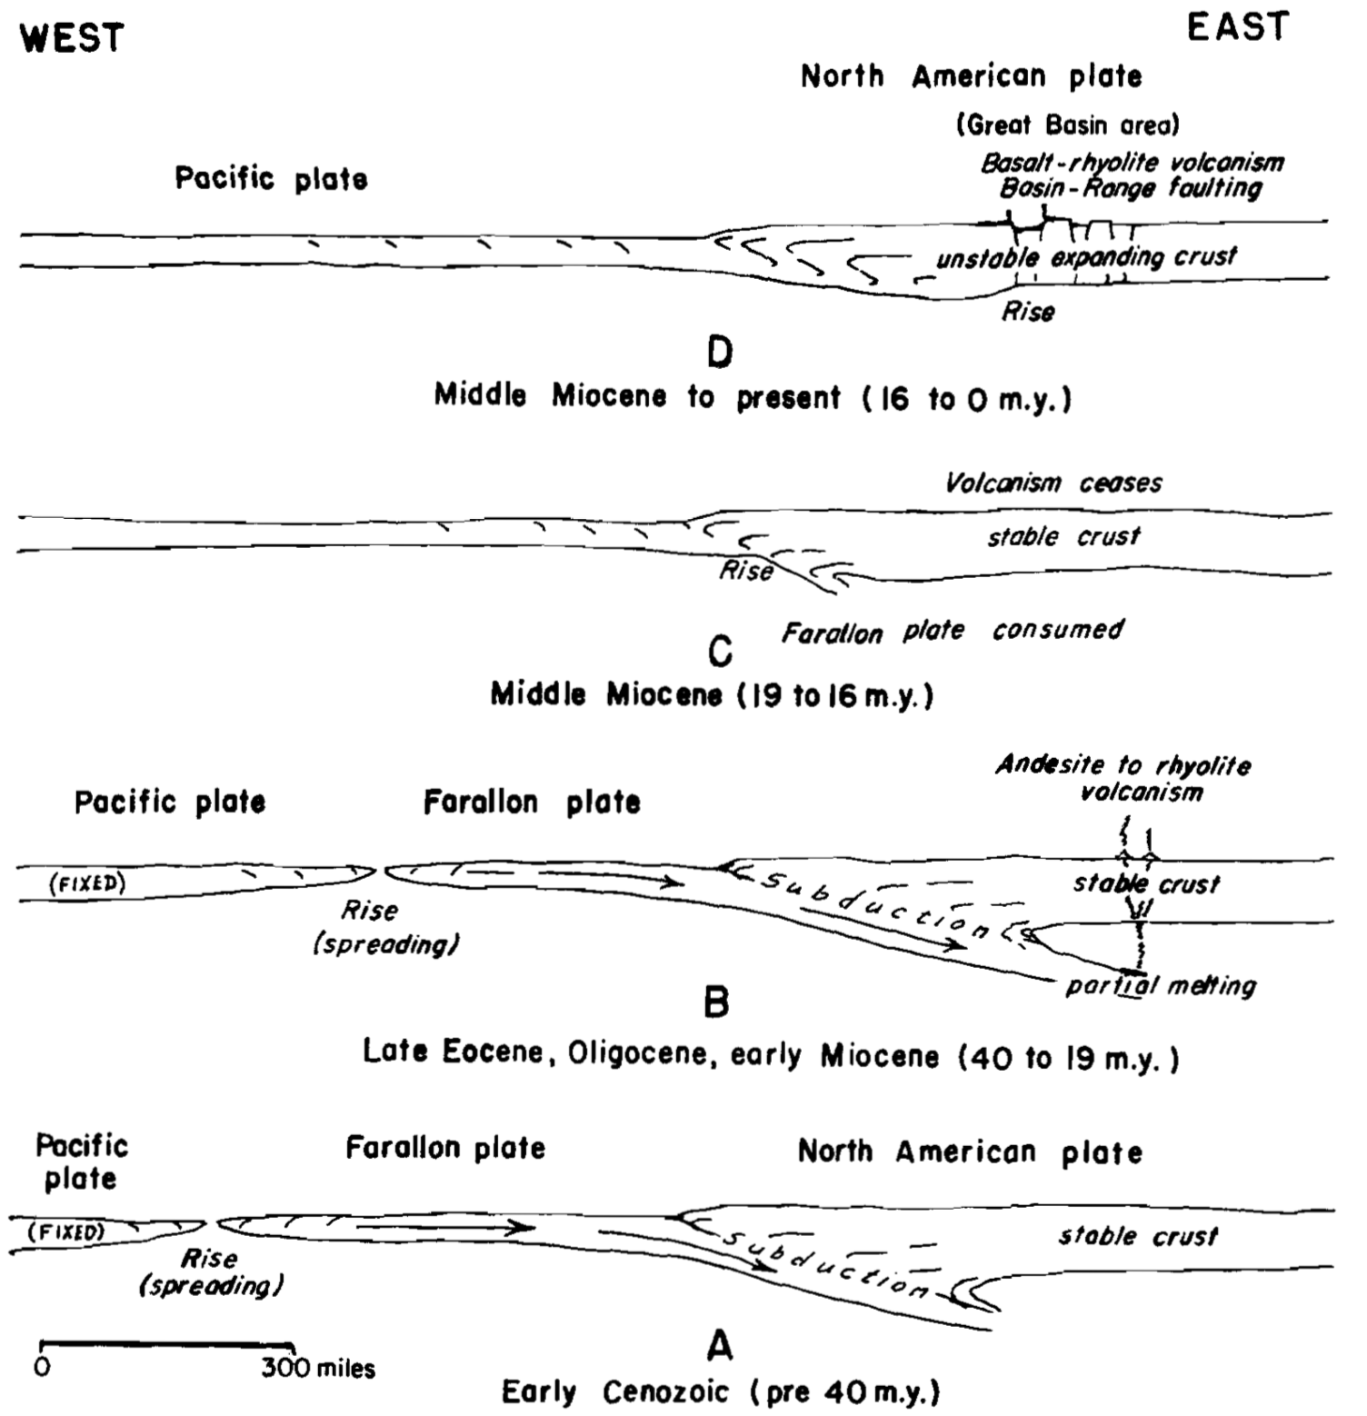
Questions???

