Slide 1
Tectonic and Magmatic Development of the Great Basin and Western United States During the Late Cenozoic Time
Paper by: Edwin H. Mckee & Donald C. Noble
1985
Presentation: Emily Maher

Slide 2
Focus
Mckee + Noble say the tectonic development of the North Western occurred in 2 phases during the later Cenezoic.
  40-18Ma subduction of Farallon Plate created silicic to intermediate calc-alkalic igneous rocks
  18 Ma and younger the rocks are basaltic or bimodal rhyolite-basaltic igneous rocks in the Great Basin and the Columbia Intermontane Region.
  This paper focuses on 18 Ma and younger

Slide 4
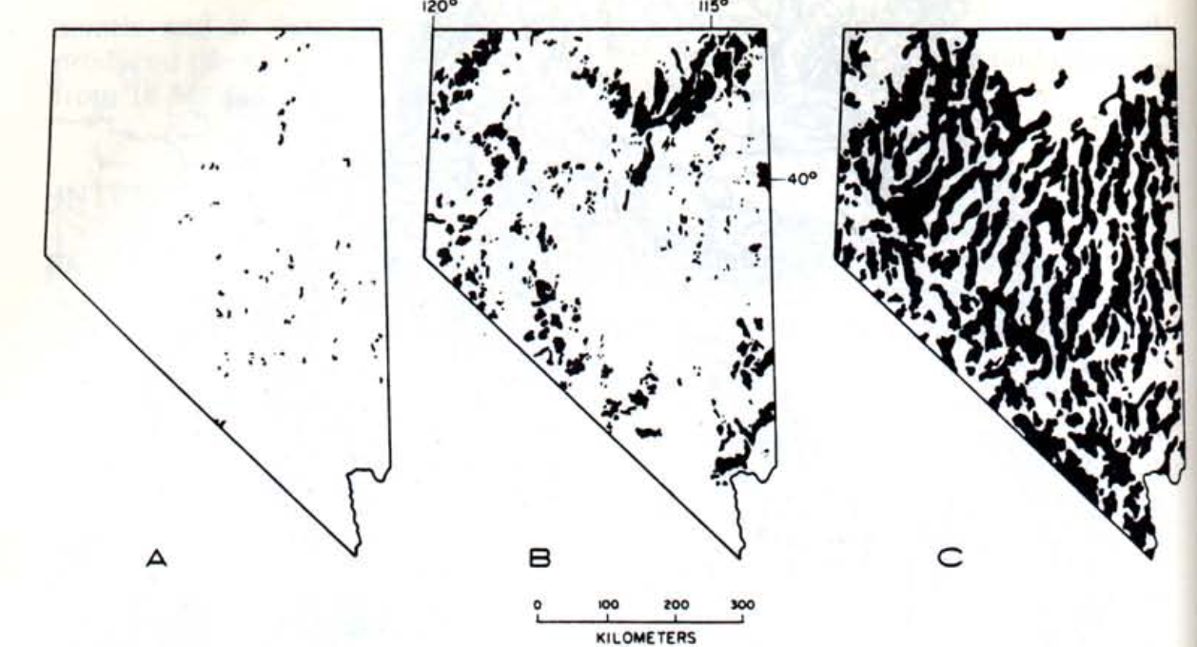
Sedimentary Evolution
Sedimentary Rocks
  Mostly found on edges of basins and occasionally high in fault-block mountains
  Actively eroding with abrupt facies changes.
  Age is mostly late Miocene or younger points out that basins came to existence in early Miocene.
  Oldest Sediment basin fill is 17-18 Ma ( Mckee&Noble, 1974)
Notes:
Actively eroding with abrupt facies changes = Course Conglomerates to siltstones asap
Figure: A = Outcrops 45-18Ma B = 17 – 1 MA C = Alluvium in valleys. Point out difference between A and B

Slide 5
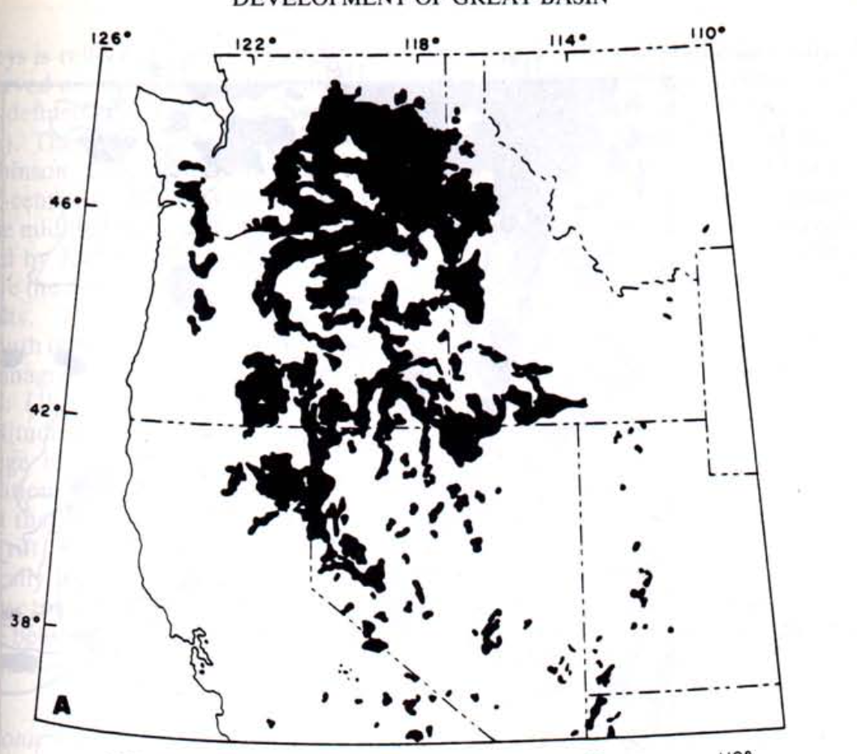
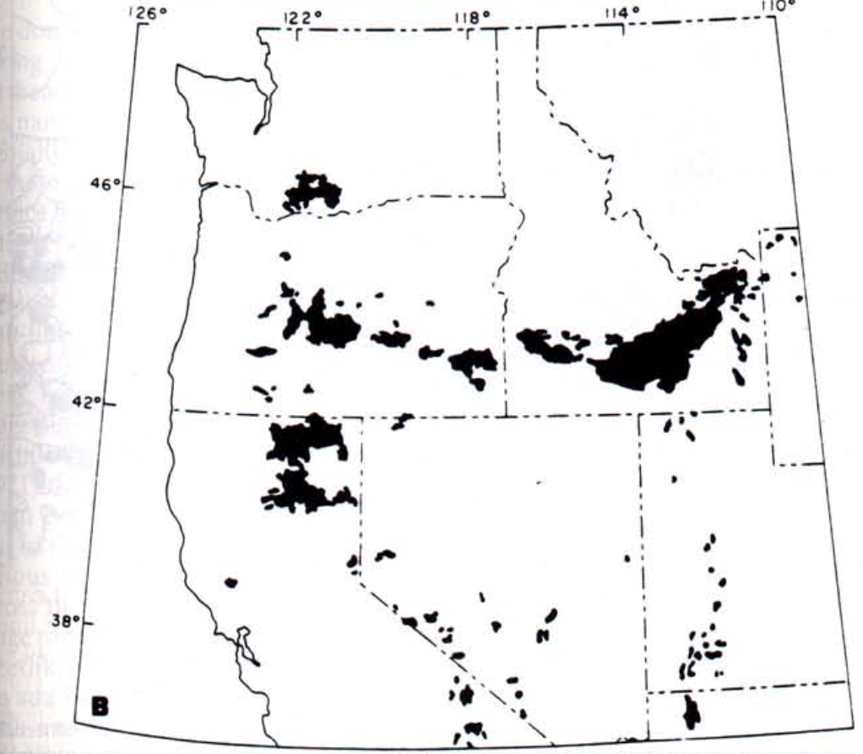
Basalts
A. Mid Miocene (~18Ma)
Present along margins of Great Basin
  Mostly in northern part (FigA)
Oldest Cenozoic Basalts are 18Ma
  Go from Eureka to Snake River Plain
In Central/Southern Nv poorly defined lineaments and dikes that are north-northwest trending.
B. Quaternary

Slide 6
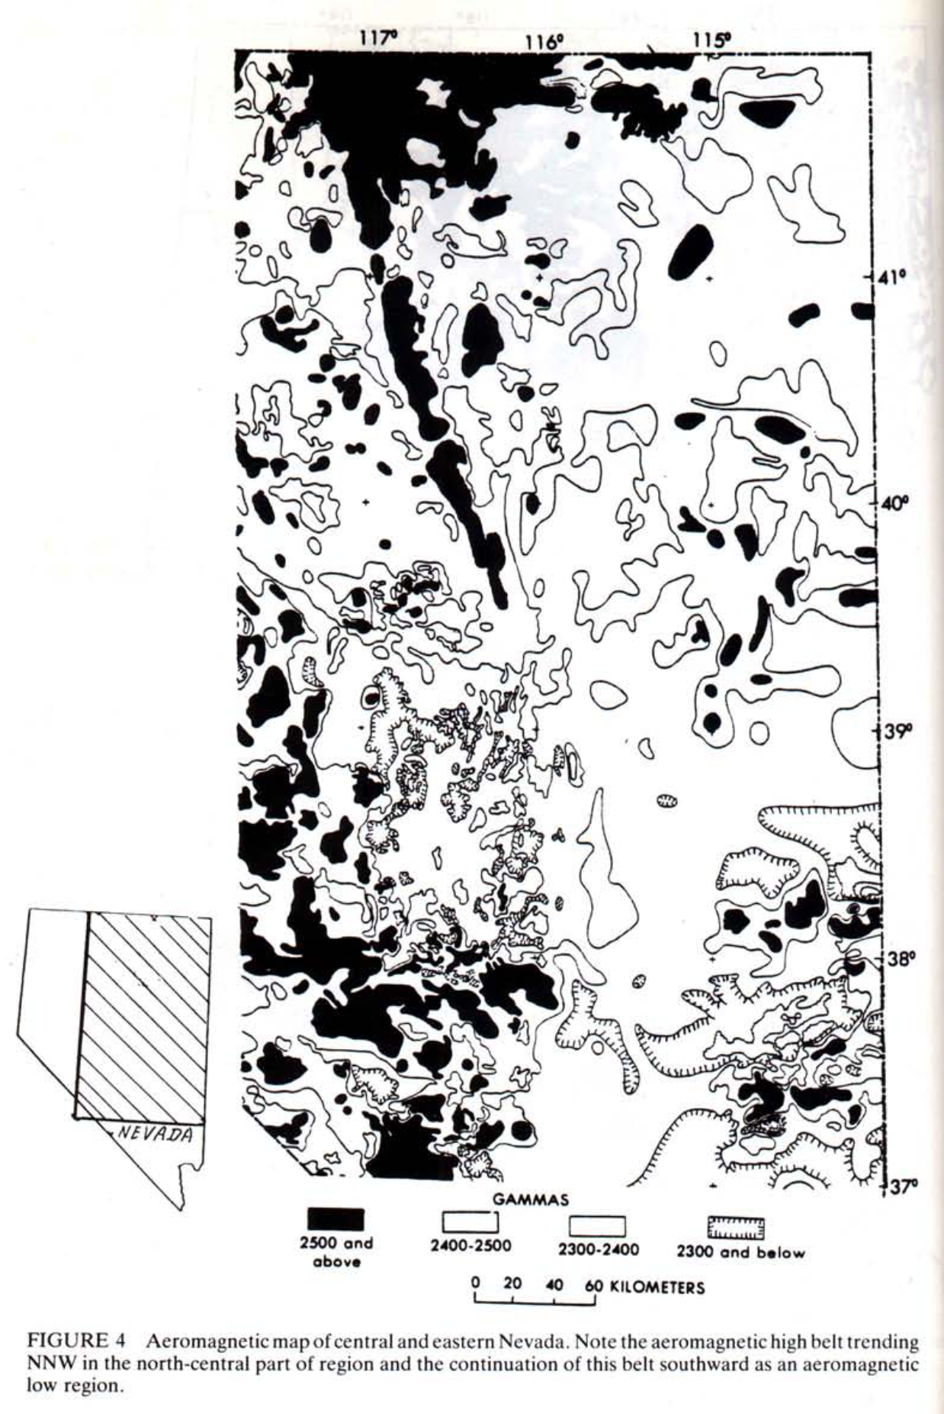
Aeromagnetic
High aeromagnetic anomaly starting in central NV and trending northwest towards OR
  Southern half of Oregon-Nevada Lineament
There are surface outcrops of basalt that show this as well
Aeromagnetic shows basalt through deep alluvium in valleys
  K-Ar dated to 15-17Ma (Mckee, unpub. data 1984)
Aeromagnetic low could be a rift and mark the beginning of Basin and Range extension.
Notes:
Note that where the high zone widens the dates were at 10Ma
Belt Highlighted in next slide
Also points out the Aeromagnetic low

Slide 7
Notes:
First fig show outcropping of basalt Goog earth compliments

Slide 8
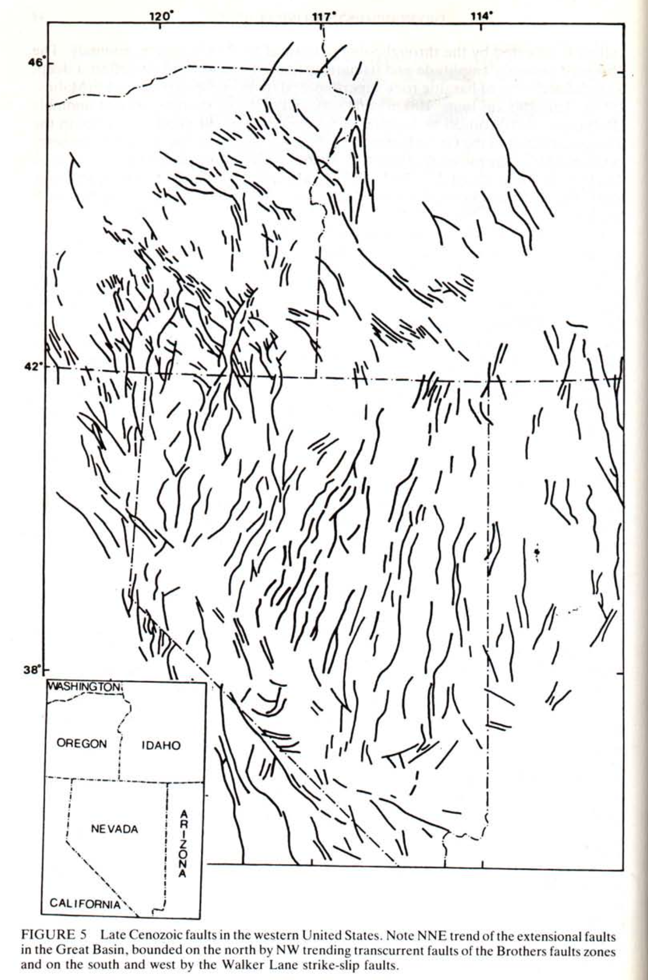
Tectonics
Total spreading ~100km
Active faulting across entire Basin + Range, but east/west edges most active.
  Maybe cause of extension currently
Evidence that Basin + Range topography did not exist prior to 18Ma
  Early Miocene (20-25Ma) sheet-like tuffs prove little relief when deposited
  Little sediments dated before 18Ma
Based on basalt ages (16-18Ma) suggestion that this is when Basin + Range faulting began.

Slide 9
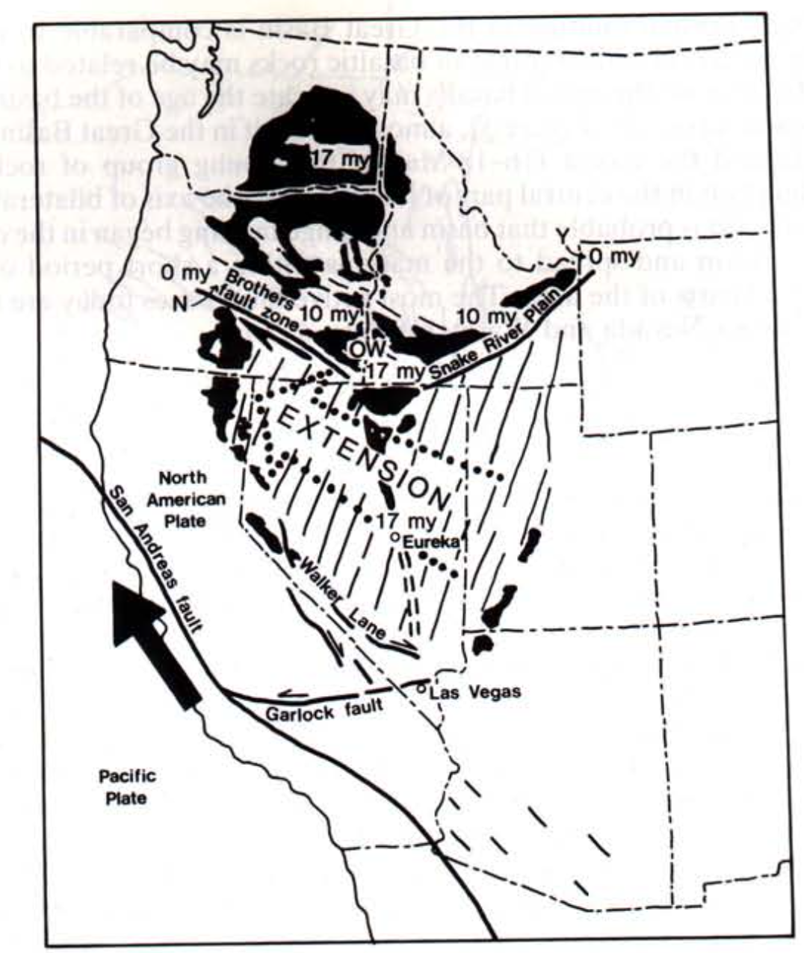
Tectonic + Magmatic Model
20-40Ma abundance of calc-alkalic volcanics possible proof of Farallon subduction.
  No basalts around dated to this time
Post 18Ma basalts have a high presence in area
  Tectonic setting also possibly changed
San Andreas movement also proof
  Pacific plate subduction should stop around 18Ma
  Drag of this could cause the extension
Notes:
Late cenezoic basalt = black
Tectonic trends lines
Dots = extension

Slide 10
Conclusion
Basin + Range extension started roughly 18Ma
Basalts were also deposited in this time period
Proof from dating rocks as well as no more presence of calc-alkalic deposits
San Andreas also a contributing factor to rifting.

Slide 11
Reference
McKee, E.H. and Noble, D.C., 1986. Tectonic and magmatic development of the Great Basin of Western United States during late Cenozoic. Modern Geology, 1: 39-49.
All images from this paper expect for Google Earth images.

