Slide 1
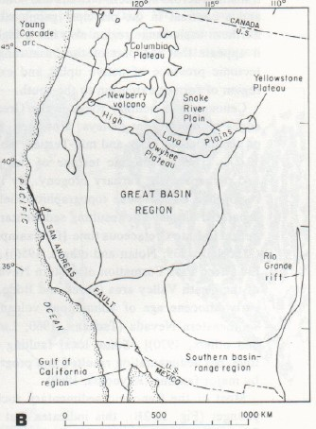
Late Cenozoic volcanic and tectonic evolution of the great basin and Columbia intermontane regions
Christiansen 78

Slide 2
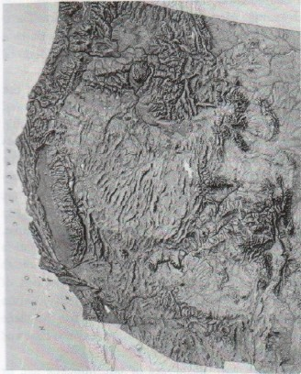
Motivation
Characterize the volcanic and tectonic evolution of the Great Basin in the late Cenozoic (since about 17 Ma)
Compare that to what is happening north of the extent of the Great Basin (high lava plains)
How? By looking at basalts across both regions

Slide 3
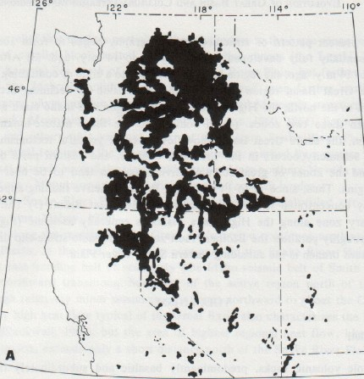
Colombia plateau
Thick, widespread basalt field indicates that topography was subdued during time of deposition
Most of the Colombia River group has been dated at ~16 – 14Ma
Sourced from several vent systems that trend linearly N-NW for tens of km’s in the center of the Colombia Plateau
<17Ma

Slide 4
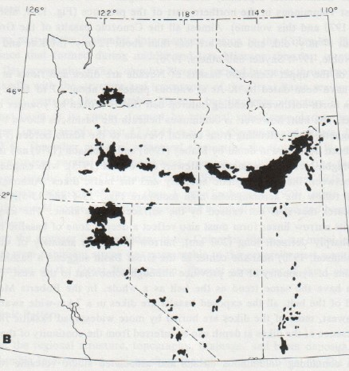
High lava plains
East of Owyhee Plateau, volcanism began ~14Ma and has migrated northeast to the Yellowstone plateau which overlies and active magma chamber.
West of the Owyhee Plateau the oldest basalts are ~17-16Ma. Rhyolitic rocks record a progressively younger volcanic periods from 17-14Ma near the SE end to less than 1Ma at Newberry
These two belts basically mirror each other in age and propagation rate
Quaternary

Slide 5
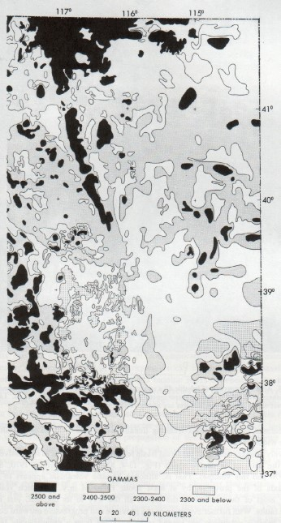
Great Basin
Oldest Cenozoic volcanics (17-14Ma) are the basalts found along the N-NW trending aeromagnetic high (N NV rift)
Basalts of the Great Basin tend to occur in greater volumes along the margins and to the north.
Younger basalts are more and more concentrated towards the margins as time progresses.

Slide 6
Quaternary
<17Ma

Slide 7
So who cares?
Basalts begin erupting across not only Great Basin but further north in the Colombia Intermontane region around 17Ma
Eruption of the most voclanics roughly correlates to the times of highest extension in GB, and the onset of GB extension is ~17Ma
The propagation of the High Plains volcanism is similar in rate to the outward propagation of volcanism in the GB

Slide 8
Model
The mostly basaltic volcanism during this time period, which correlates with the timing of onset of extension, is used as evidence that the magma generation is a result of extension
Plate boundary interactions (Mendocino triple junction) are attributed to being the mechanism for the opening of the initial “rift” at 17Ma, ultimately evolving into the oblique extension that dominates the Great Basin around 14Ma
The northern boundary is guided by an older structural boundary allowing for the propagation of volcanism to the NW and NE from a central point
Continued extension has concentrated normal faulting closer to the margins, accounting for the progressive movement of volcanism towards the margins

Slide 9
