Slide 1
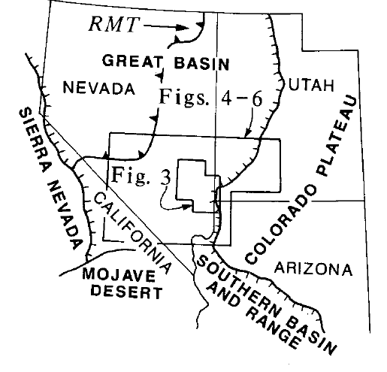
Space-time patterns and tectonic controls of Tertiary extension and magmatism in the Great Basin of the western United States
Gary Axen, Wanda Taylor, John Bartley
1993: GSA Bulliten
Presentation: Kurt Kraal

Slide 2
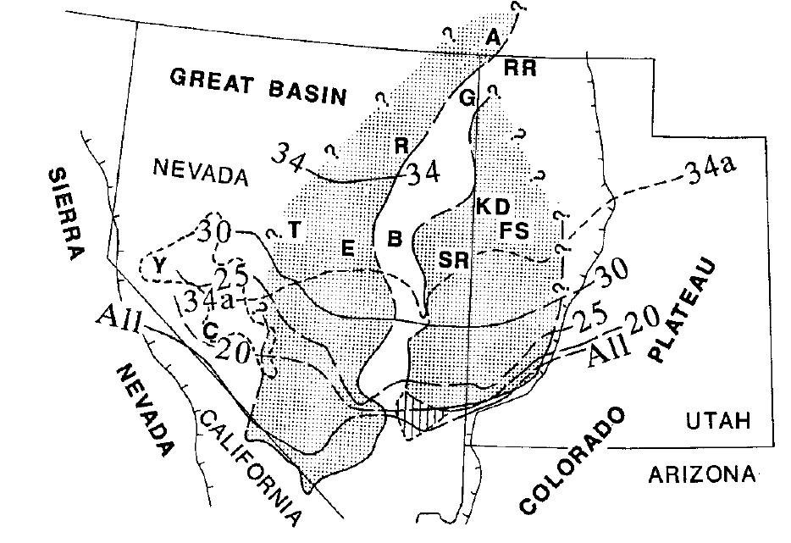
Background:
Space-Time of Volcanism
Distribution of volcanic rocks and their sources are well constrained(Stewart and Carlson 1976):
Volcanism began in Eocene time, with mostly effusive volcanism and swept southward
Ended with voluminous Oligocene-Miocene ignimbrite eruptions from calderas
Voluminous caldera forming eruptions from 34-14 Ma in Southern Great Basin
Space-Time of Extension:
less well known, especially for pre-Miocene extension that did not form Metamorphic Core Complexes
Often overprinted by younger faults, scarcity of Mesozoic and early tertiary deposits, concealment of rocks beneath volcanic cover, and poor access to military reservations may contribute to this lack of knowledge
Lines represent southern limit of calderas at each time
shaded areas represent areas interpreted late Paleogene-early Miocene extensional belts defined in this paper

Slide 3
This Paper:
Conclusions
Review available geologic data that bear on the onset of extension in the Great Basin
Infer the existence of 2 Paleogene (63-23 Ma) extensional belts
Then they focus on relations between initiation of extension and major crustal magmatism
They found that calderas preferentially formed in previously extended crust, and effusive volcanism is favored in unextended or actively extending areas
Then they compare the inferred crustal evolution with a thermal model that suggests extension and volcanisms were triggered by changes in the thermal state of the subducted plate.
This allows for various disparate timing and relations between extension and volcanism to evolve in different areas of the Great Basin
Lines represent southern limit of calderas at each time
shaded areas represent areas interpreted late Paleogene-early Miocene extensional belts defined in this paper

Slide 4
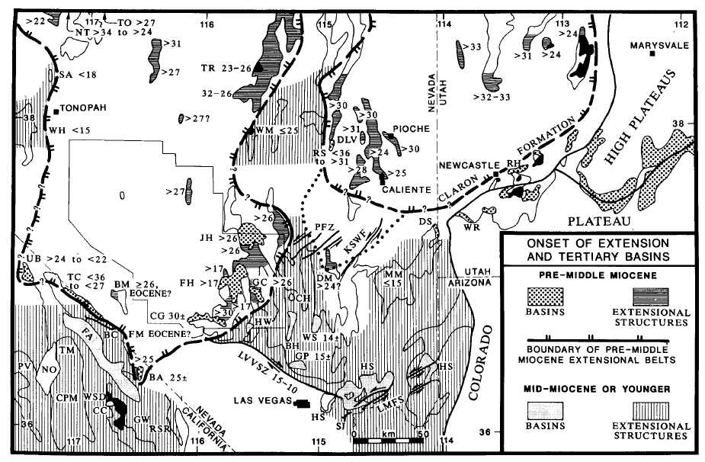
Main figure in paper:
Map compiling large volume of literature containing observations of the timing of earliest extension

Slide 5
Eastern Extensional Belt:

Slide 6
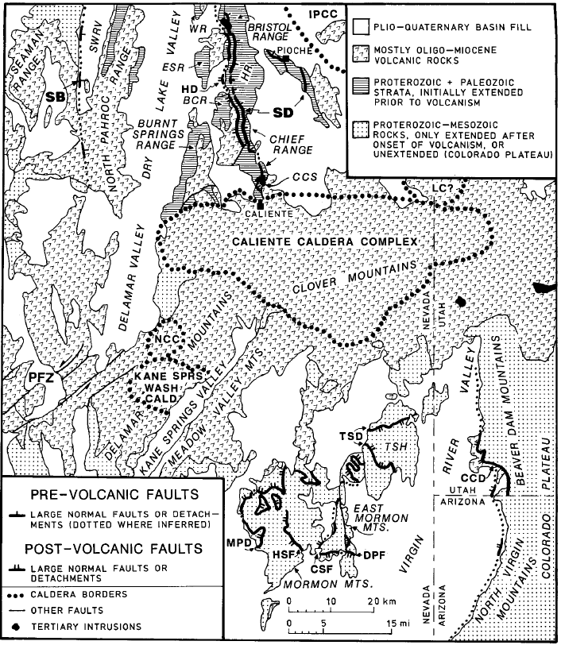
Eastern Extensional Belt:
Map of Dry Lake Valley-Mormon Mountains region
These rocks were extended in the late Paleogene in the upper plate of the Stampede detachment (SD) and associated with the Seaman breakaway (SB)
Extension began before volcanism at about 32-30 Ma (Bartley and others)
Western Boundary of this zone: Seaman breakaway fault (SB)
Southern Boundary: Caliente Caldera Complex

Slide 7
Eastern Boundary:
Can be traced through structural evidence within 50 km of eastern edge of basin and range in southern Utah
Commonly there are normal faults that crosscut older strata capped and overlapped by volcanics

Slide 8
Stratigraphic Evidence:
Not much sedimentary accumulation which suggests that the pre-middle Miocene extension is not likely Mesozoic in age
Analysis of sediment shows sediment accumulation in basins stratigraphically below volcanics and tuffs, meaning that there must have been a basin there before the volcanics were erupted
Sometimes they can use interbedding with volcanics, or fossils to constrain ages of sediments, which all suggest Paleogene deposition

Slide 9
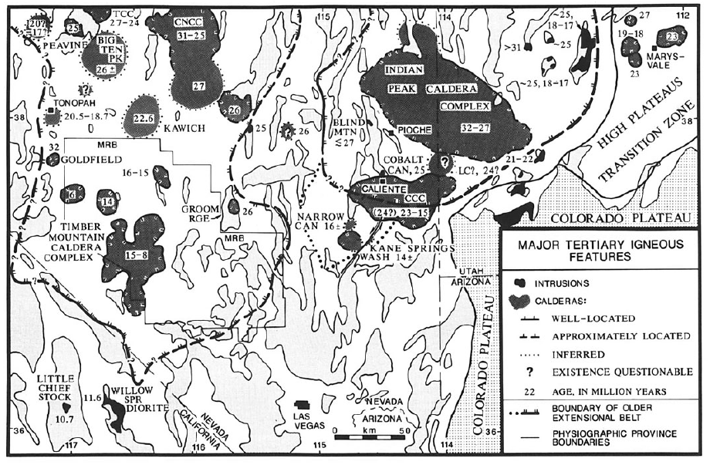
Evidence for existing extensional terranes from ignimbrite accumulations:

Slide 10
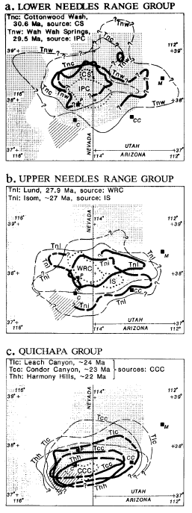
The figure shows calderas (dotted lines), and isopachs of ignimbrite accumulation (thick lines representing 100 m isopachs, thin lines are 0 m isopachs.
They argue that these ignimbrite accumulations are confined to paleotopography, and therefore do not spread that far.
Also show a general southern migration through time suggesting that the caldera formation may have waited for extension to occur before happening (and a southward migration of extension).

Slide 11
It seems like calderas are confined to areas of pre-middle Miocene extension

Slide 12
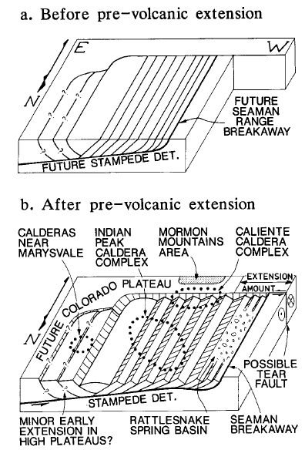
Possible model of extension and caldera formation in the southern eastern extensional belt

Slide 13
Western Extensional Belt:

Slide 14
Early extension is less constrained than the eastern belt due to lower exposures
Mostly relied on stratigraphic evidence of pre-volcanic basins existing in this area

Slide 15
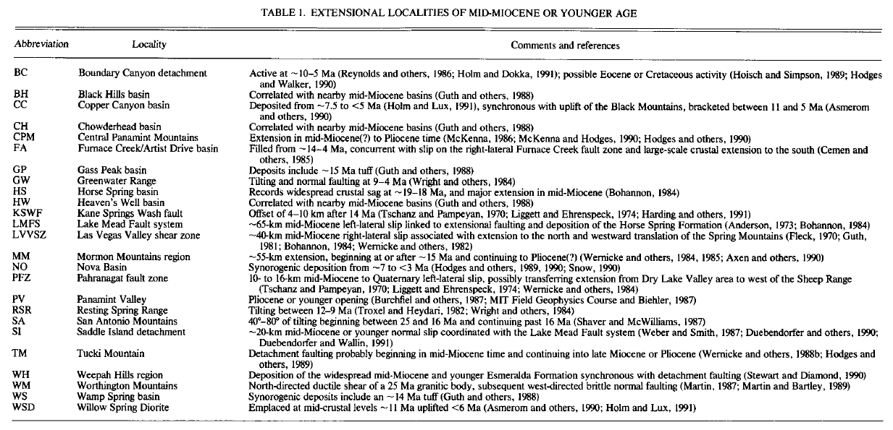

Slide 16
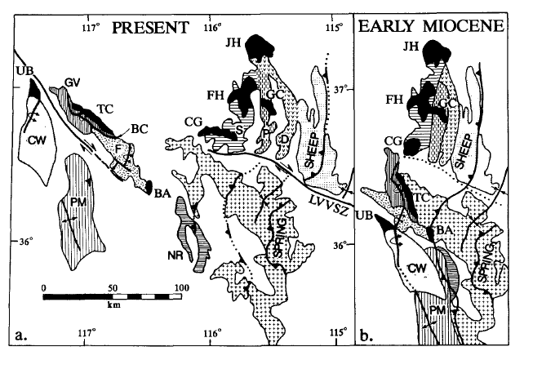
A reconstruction of extension between the early Miocene and the present near Las Vegas

Slide 17
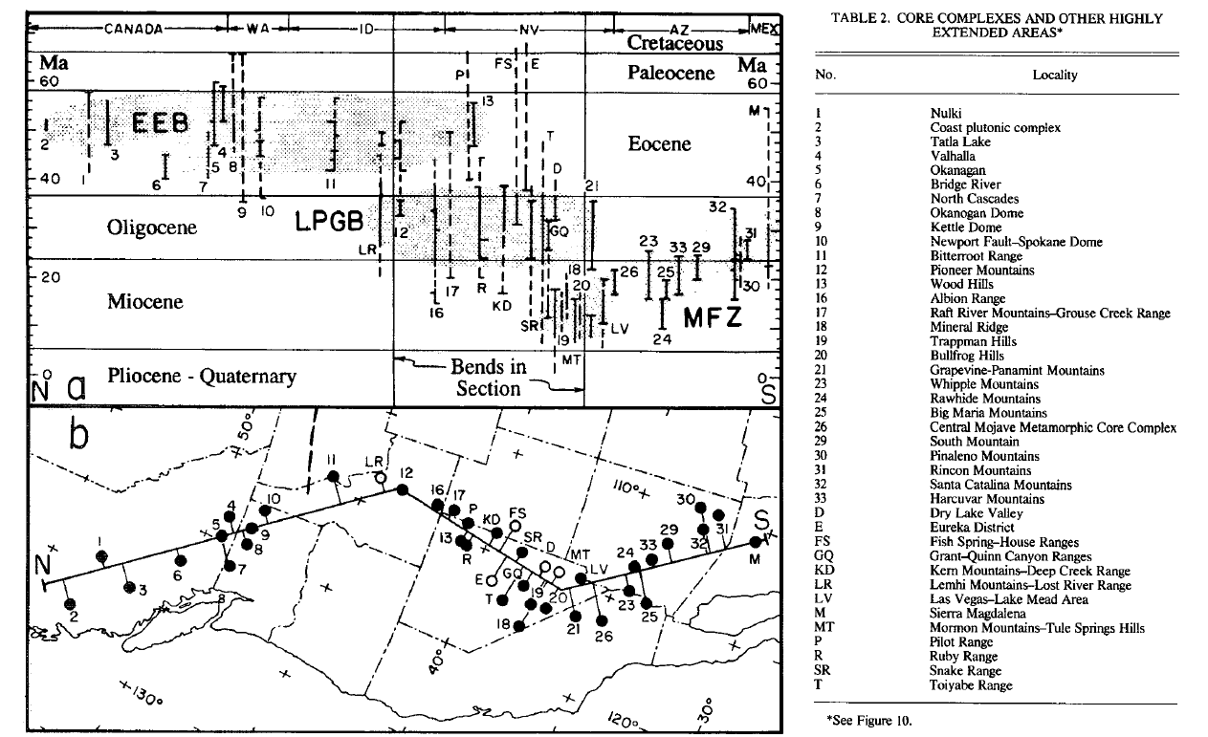

Slide 18
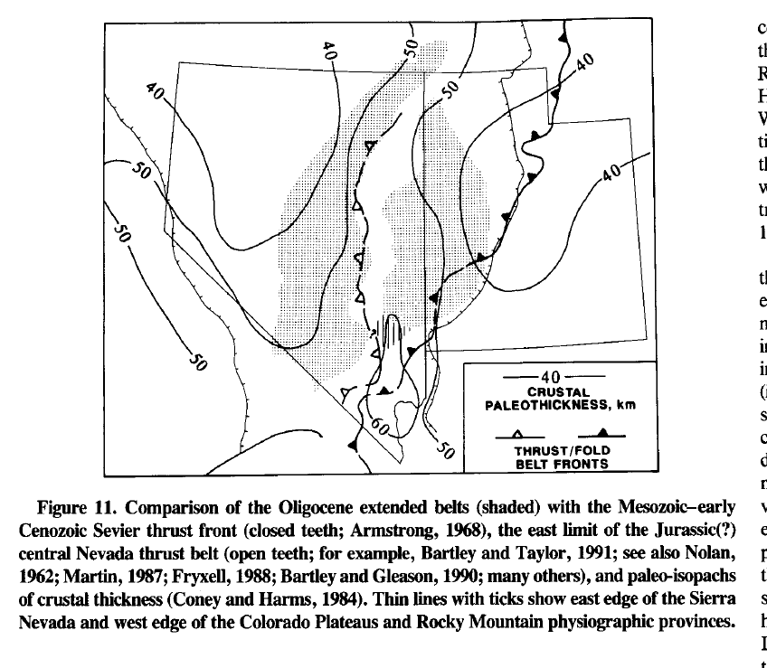

Slide 19
Summary of Discussion
The authors suggested that “the space-time patterns of Paleogene extension in the Great Basin are consistent with extension being triggered by thermal weakening of the subducted oceanic lithosphere rather than effects transmitted from the plate margin, but being driven by gravitational collapse of a thick crust”
The space time patterns seem to fit thermal weakening or destruction of a subducting slab
Active and passive rifting does not seem like a good fit because they would mean spatial and temporal association of extension and magmatism, which was not generally observed

Slide 20
Conclusions:
Late-Paleogene extension was common in the GB
Formed 2 north trending belts
Crustal magmatism spread southward, and only locally coexisted in time and space with extension
The structural state of the upper crust (i.e. extended or unextended) controlled the eruptive style of volcanism
Within late Paleogene extended belts, preextensional or synextensional volcanism was primarily effusive
Post-extensional or late synextensional volcanism in the southern part of the belts was dominated by voluminous ignimbrite eruptions
Southward migration of volcanisms seems to have stalled at the end of these extensional belts

Slide 21
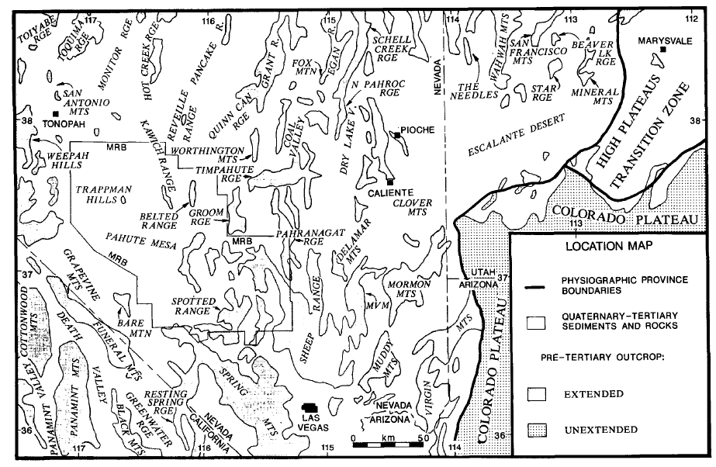
text

