Slide 1
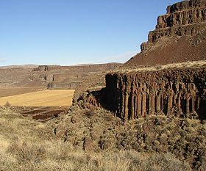
Age of the steens and Colombia river flood basalts and their relationship to extension related calc-alkalic volcanism in eastern Oregon & discussion and reply from Baksi, 2004
Hooper et al. 2002

Slide 2
Motivation
Better constrain ages of all the flood basalts of the Colombia River Basalt group and Steens basalt
Differentiate those associated with lithospheric extension (Calc-alkalic) and those associated with the Yellowstone hotspot (tholeiitic)
Get a better handle on the relationship between the eruption of Colombia River flood basalts and extension

Slide 3
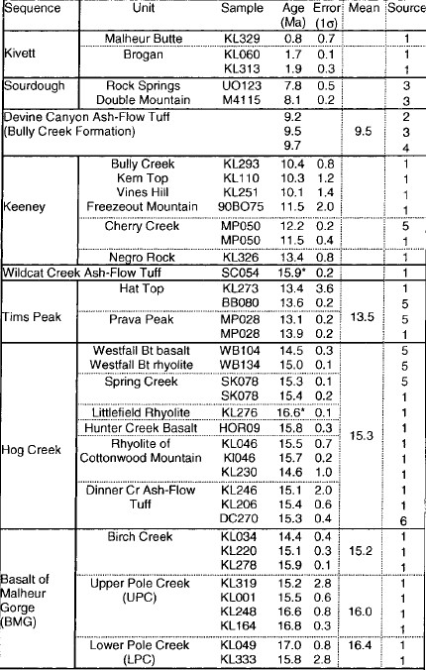
Stratigraphy
<17Ma
Stratigraphy of volcanic units in E-Central Oregon
Grouped into sequences of similar age to simplify

Slide 4
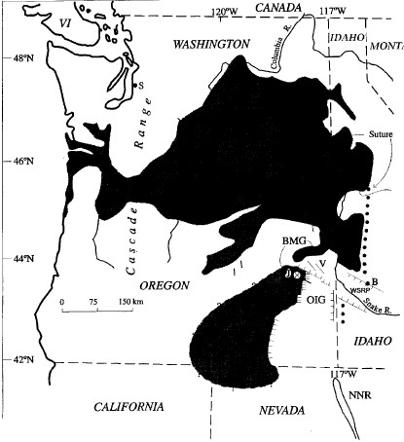
Malheur gorge
Oldest Tertiary volcanics in the study area
South end of the major Colombia River group
Dated between 16.1 – 15.0 Ma
Quaternary

Slide 5
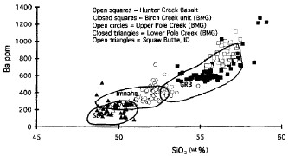
Hog Creek sequence
Conformably overlies the basalt of Malheur gorge
Field evidence shows that eruption of Malheur creek and Hog creek volcanics are essentially cotemporaneous
Both of these coincide with the opening of the Oregon Idaho graben

Slide 6
Tims Creek Basalt
Quaternary
Unconformably overlies the Hog Creek
Distinct chemical difference (Calc-alkalic)
Younger age (dated at 13.5 Ma)
<17Ma

Slide 7
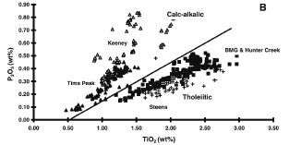
The lowest unit correlates with the Steens basalt (Tholeiitic)
Middle younger units correlate with the Imnaha and Grande Ronde formations (Colombia River Basalt Group) and are Calc Alkalic

Slide 8
Discussions
So all of this began with the eruption of the Steens basalt at 16.6 Ma, correlated with the Yellowstone hotspot at the time, at this point.
The focus of the eruption then moved north to around this point, where 90% of the Colombia River Basalt Group was erupted between 16.1 and 15.0 Ma
Based on chemical similarities with both the Steens Basalt and the lower CRBG, the flood basalt eruptions of Malheur Gorge were super imposed on both in a short intermittent period between 16.6 and 15.3 Ma here

Slide 9
So who cares?
You should, because the intermittent eruption sequence of basalts at Malheur gorge correlates to east west extension here (opening of the Oregon Idaho graben, etc.)
Based on this idea, the author states that this extension essentially controlled the entire eruption sequence and allowed for the northward migration of flood basalt magmas to the CRBG where it erupted for another 7my

Slide 10
Also this Baksi guy, cares
He published a reply that the dates used by Hooper are ~10% too young, due to their alteration state.
Therefore, the 16.6Ma start of eruption of all this stuff, is more likely ~ 18.3Ma
Does that mean the correlation of this stuff with extension is not a thing?
Questions, comments, concerns?

