Slide 1
Paper Outline:
Describe simple model of plate geometries during transition from subduction to transform plate boundary, and the creation of a slab free zone beneath the continental crust
Make some changes to simple model to fit with observations of the North American/Pacific plate boundary
Test implications of model with geologic data and see if plate boundary conditions can predict interplate conditions
Presentation by Kurt Kraal

Slide 2
Simplified Model
Assumptions:
Spreading is symmetric and occurs perpendicular to rise crests
Relative plate motions are parallel to trends of transforms
Migratory triple junctions at either end are stable
Plates of lithosphere being consumed remain as intact slabs
Strict continuity of motion
Subduction slabs inherit plate motion of original slab
Oceanic lithosphere of any age can be subducted

Slide 3
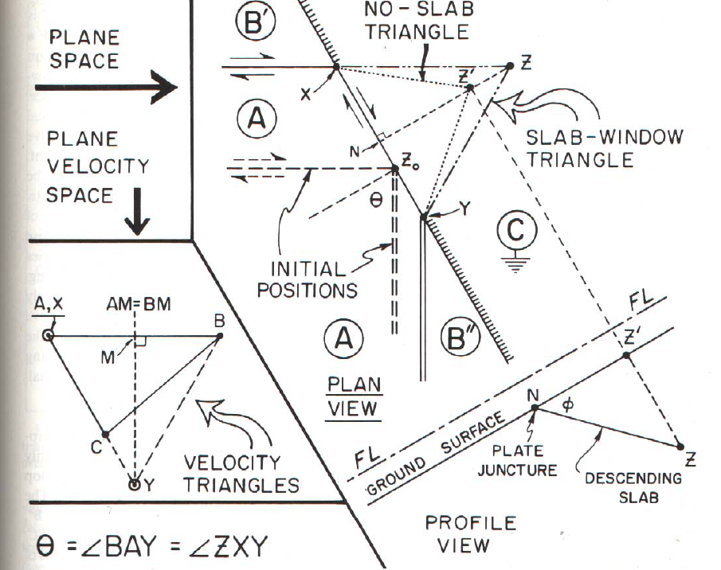
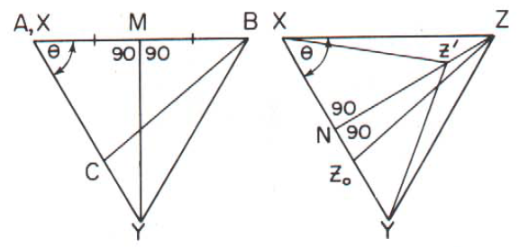
Simplified Model
Slab Window:
Dimensions will be proportional to the dimensions of the velocity triangle
Z’ edge of slab when incorporating descending slab dip
NZ’=2XYsinөcosөcosф

Slide 4
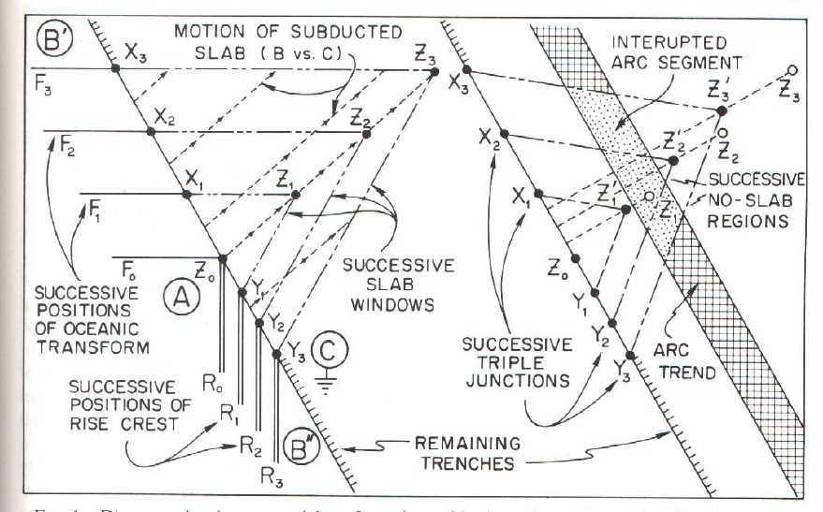
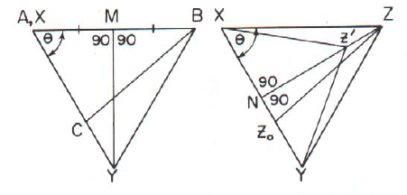
Evolution of “slab window” using the simplified model
As the slab window expands, arc magmatism should be shut off.

Slide 5
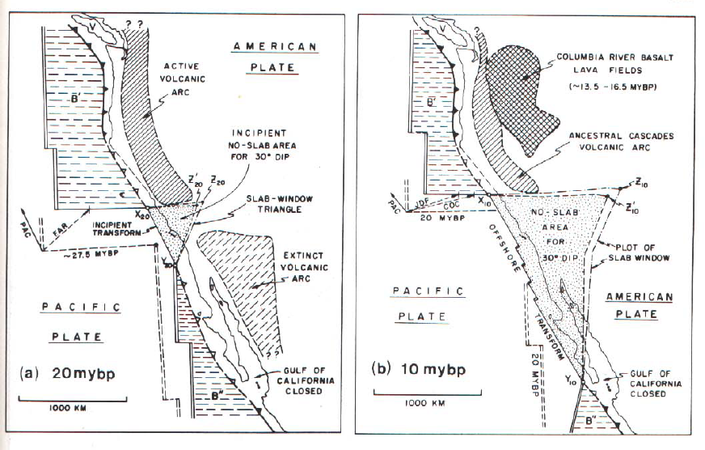
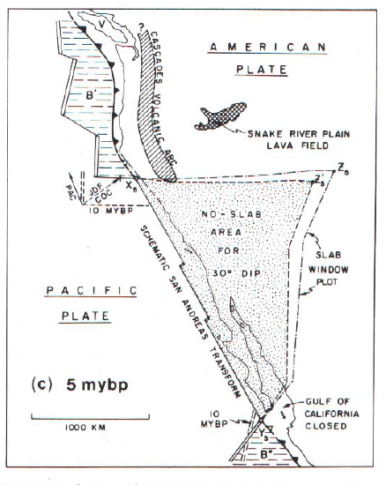
More complicated model for Western USA:
Relative plate motions changed through time during evolution of SA, therefore shape of slab window is not as nice of a triangle as in the simplified model
Relative plate motions based on magnetic anomalies on the sea floor (Atwater and Molnar 1973).
Also incorporated effects of different ages of subducted oceanic lithosphere (which would have different properties)

Slide 6
Between 25-20 mybp, there was an arc that extended from Canada to Mesoamerica
Starting 20 mybp, the slab free region began to terminate this arc activity, in a manor predicted by their modified geometric model
Lack of volcanism in the south may have to do with young age of subducted oceanic lithosphere

Slide 7
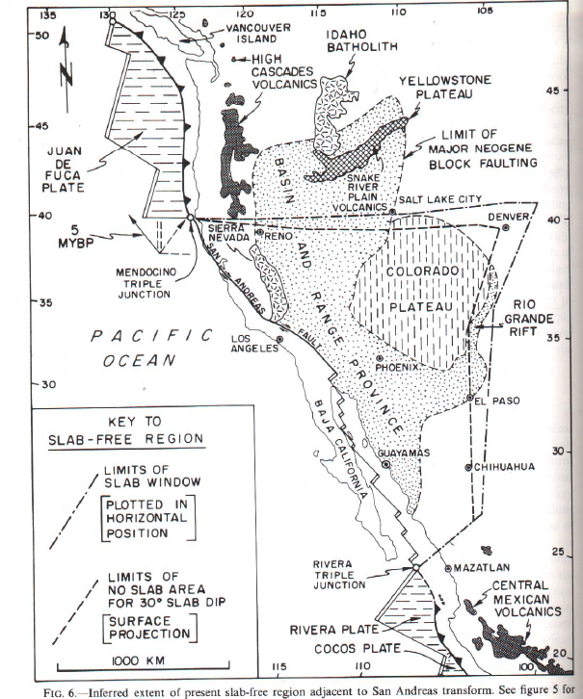
Current Extent
No slab beneath most of Great Basin, Colorado plateau, California, Northern Mexico

Slide 8
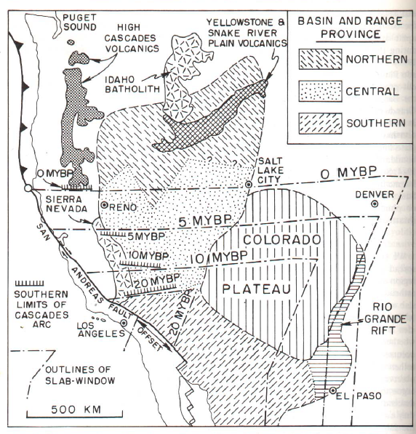
Tectonic implications: Southern limit of cascade arc seems to correspond with the edge of the slab free zone.

Slide 9
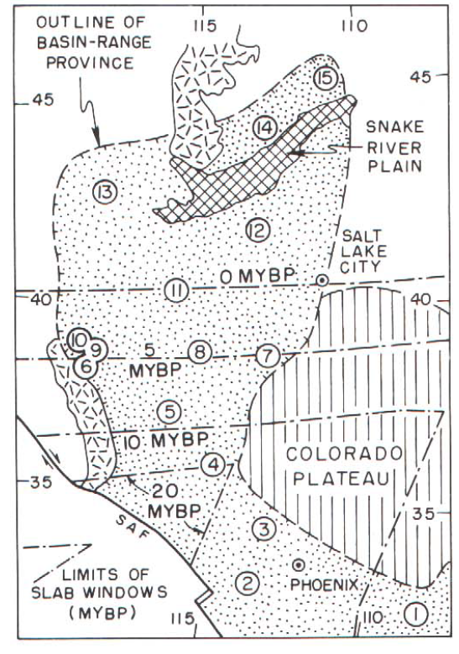
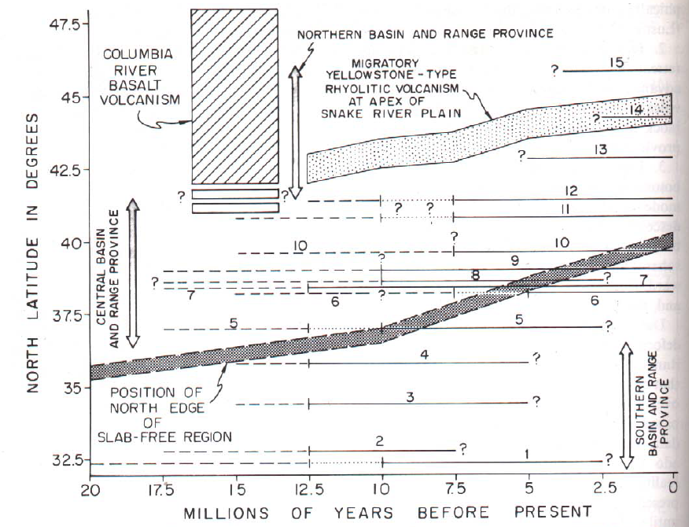
Timespace diagram of Basin and Range deformation.
Solid lines are faulting on main range fronts
Also seem to progressively get younger to the North, just as the slab window grew from the South to the North.

Slide 10
The authors suggest that the uplift of the Colorado Plateau and Sierra Nevada may be related to upward flow of asthenosphere at the opening of the slab window based on the possible overlap in timing of uplift and slab window opening

Slide 11
Conclusions
Neogene magmatic and tectonics within the continent seem to display systematic relationships in time and space related to evolution of San Andreas transform
Lengthening of coastal transform was accompanied by gradual enlargement of a “no slab” zone or slab window
Geometry can reconstruct the growing extent of the slab-free region
This model can be argued to explain the shutoff of arc magmatism in the Cordillera
Basin and Range extension and Colorado Plateau uplift also seem to be related to the extent of the slab-free region possibly caused by the upwelling of asthenosphere through the slab window

