Slide 1
Birth of the Sierra Nevada magmatic arc: Early Mesozoic plutonism and volcanism in the east-central Sierra Nevada of California
Paper: A.P. Barth1, J.D. Walker2, J.L. Wooden3, N.R. Riggs4, and R.A. Schweickert5
2011
Presentation: Emily Maher

Slide 2
Purpose
Paper’s
“describing the petrogenesis of felsic volcanic rocks associated with batholithic magmatism in the earliest stages of evolution of the arc in the east-central Sierra Nevada and adjacent parts of eastern California”. (Barth et al)
Studying the Mesozoic transformation of the Sierra Nevada Suite
Mesozoic plutonism (~70-250Ma)
Our’s:
Look at the ages of the rocks as well as where they are located.

Slide 3
Quick Trip Through Time:
https://www.dropbox.com/s/ovxxmq4vgb8uy1m/1-PacHist_Big%20(Converted).mov?dl=0
Notes:
Pay attention to the plate movement and the Continental margins. Possibly pass to steve to explain red lines

Slide 4
Paper also working to constrain:
Thrusting in the Sierra Nevada-Death Valley thrust system dated at many different times by different people :
Stevens and Stone (2005) – active in the Late Permian Morrison orogeny
Dunne and Walker (2004) - Triassic or Jurassic in age
System not understood, but shows final truncation of North American continental margin. This sets up for Mesozoic subduction.

Slide 5
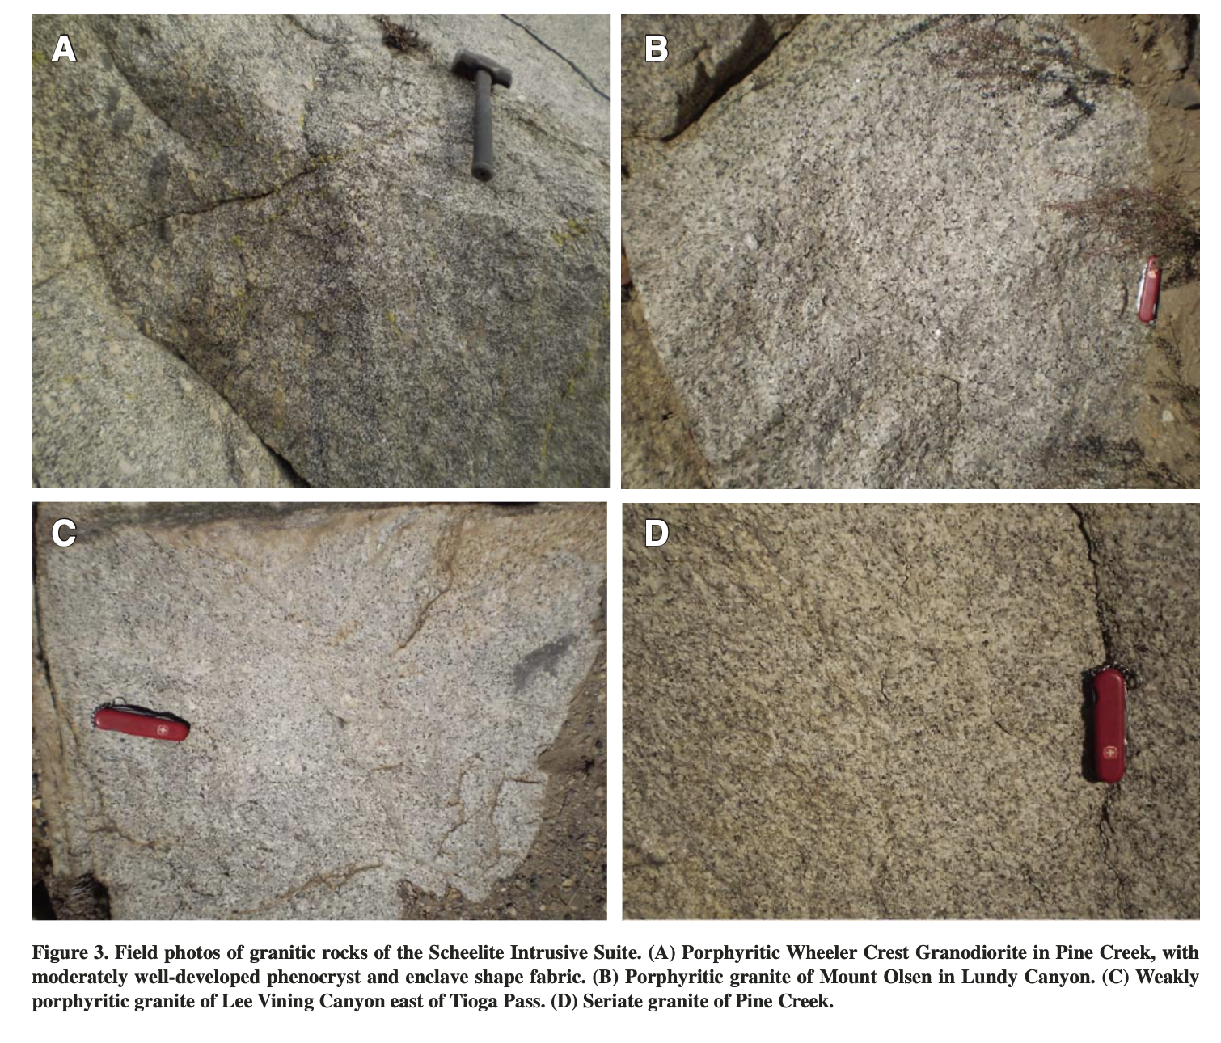
Geology
Oldest granitic rocks – East-central CA called the Scheelite intrusive.
Bateman (1992) named this group with the following characteristics:
Intrusive suite
Granite rocks with true age differences of no more than a few million years
textual and compositional changes of well-exposed., clearly nested/zoned intrusions.
Notes:
Geologic map showing plutons of the Scheelite Intrusive Suite in the east-central Sierra Nevada and Mono Basin–northern Owens Valley region, adapted from Rinehart and Ross (1957), Bateman (1965, 1992), Huber and Rinehart (1965), Kistler (1966a), Crowder et al. (1972), Krauskopf and Bateman (1977), Bailey (1989), and Schweickert and Lahren (1999). Filled black circles show geochemistry sample localities, with ages (in Ma) labeled on geochronology sample localities. Open black circles are additional whole-rock samples from Bateman et al. (1984). CDP—Casa Diablo Pendant, MMP—Mount Morrison pendant, PCP—Pine Creek pendant, RRP—Ritter Range pendant, SLP—Saddlebag Lake pendant. Inset: Black rectangle shows location of map in California.

Slide 6
Geology
Northern Ritter Range + Saddlebag Lake pendants are above parautochthonous units of the SN-DV thrust system.
Allochthons said to be placed by east- to southeast-vergent thrust faulting during the Mississippian Antler and Permian–Triassic Sonoma orogenies (Schweickert and Lahren, 1987, 2006; Greene et al., 1997a).
The order of plutonism + volcanism in this area could constrain the miogeoclinal and eugeoclinal units in eastern Ca
Imbricated Paleozoic rock possibly offset by strike-slip faulting
Notes:
Geologic map showing plutons of the Scheelite Intrusive Suite in the east-central Sierra Nevada and Mono Basin–northern Owens Valley region, adapted from Rinehart and Ross (1957), Bateman (1965, 1992), Huber and Rinehart (1965), Kistler (1966a), Crowder et al. (1972), Krauskopf and Bateman (1977), Bailey (1989), and Schweickert and Lahren (1999). Filled black circles show geochemistry sample localities, with ages (in Ma) labeled on geochronology sample localities. Open black circles are additional whole-rock samples from Bateman et al. (1984). CDP—Casa Diablo Pendant, MMP—Mount Morrison pendant, PCP—Pine Creek pendant, RRP—Ritter Range pendant, SLP—Saddlebag Lake pendant. Inset: Black rectangle shows location of map in California.

Slide 7
Geology
Mesozoic Granodiorite is found along the SN range front.
3 intrusive units: Wheeler Crest Granodiorite, the granite of Lee Vining Canyon, and Tungsten Hills Granite. (Triassic/Jurassic K-Ar and U-Pb ages)

Slide 8
Geology
Koip Sequence Volcanic rocks (Named by Kistler in 1966)
Saddlebag Lake Pendant - Basal metavolcanic section that overlies Paleozoic to Early Triassic metasedimentary rocks
Metamorphosed volcanic rocks unconformably overlying Paleozoic metasediments in the eastern Sierra Nevada.
Notes:
Geologic map showing plutons of the Scheelite Intrusive Suite in the east-central Sierra Nevada and Mono Basin–northern Owens Valley region, adapted from Rinehart and Ross (1957), Bateman (1965, 1992), Huber and Rinehart (1965), Kistler (1966a), Crowder et al. (1972), Krauskopf and Bateman (1977), Bailey (1989), and Schweickert and Lahren (1999). Filled black circles show geochemistry sample localities, with ages (in Ma) labeled on geochronology sample localities. Open black circles are additional whole-rock samples from Bateman et al. (1984). CDP—Casa Diablo Pendant, MMP—Mount Morrison pendant, PCP—Pine Creek pendant, RRP—Ritter Range pendant, SLP—Saddlebag Lake pendant. Inset: Black rectangle shows location of map in California.

Slide 9
Methods
Did 45 new whole-rock analysis + 14 whole-rock major element analysis
X-ray fluorescence (XRF)
Micromass inductively coupled plasma–mass spectrometer (ICP_MS)
“Sr and Nd whole-rock isotope ratios were measured on the VG Sector mass spectrom- eter”
“Separation of Sr and rare earth element (REE) group ele- ments was done using standard cation exchange technique “
Zircons - examination using a cathodoluminescence detector on a scan- ning electron microscope.
Etc.

Slide 10
Discussion
Koip sequence dates allow for assumption of subduction in roughly the late Triassic (~200-215 Ma).
Volcanism starting by 232 Ma. - From single tuff on Black Mountain
Early Mesozoic Magmatism starting roughly at 242-250 Ma.
From detrital zircons in Great Valley forearc + Western NV Great Arc
SIS, Wheeler Crest Granodiorite, the granite of Lee Vining Canyon, and Pine Creek Granite
Oldest + largest intrusive suite in SN – 226-218Ma from Pb/U zircon ages
Imply early regional shortening – early interval of East Sierra Thrust system

Slide 11
Discussion
Late Triassic plutonic + volcanic rocks are located in the early Mesozoic Cordilleran arc.
Saddle Bag Lake Pendant could be: shallow- marine Triassic arc.

Slide 12
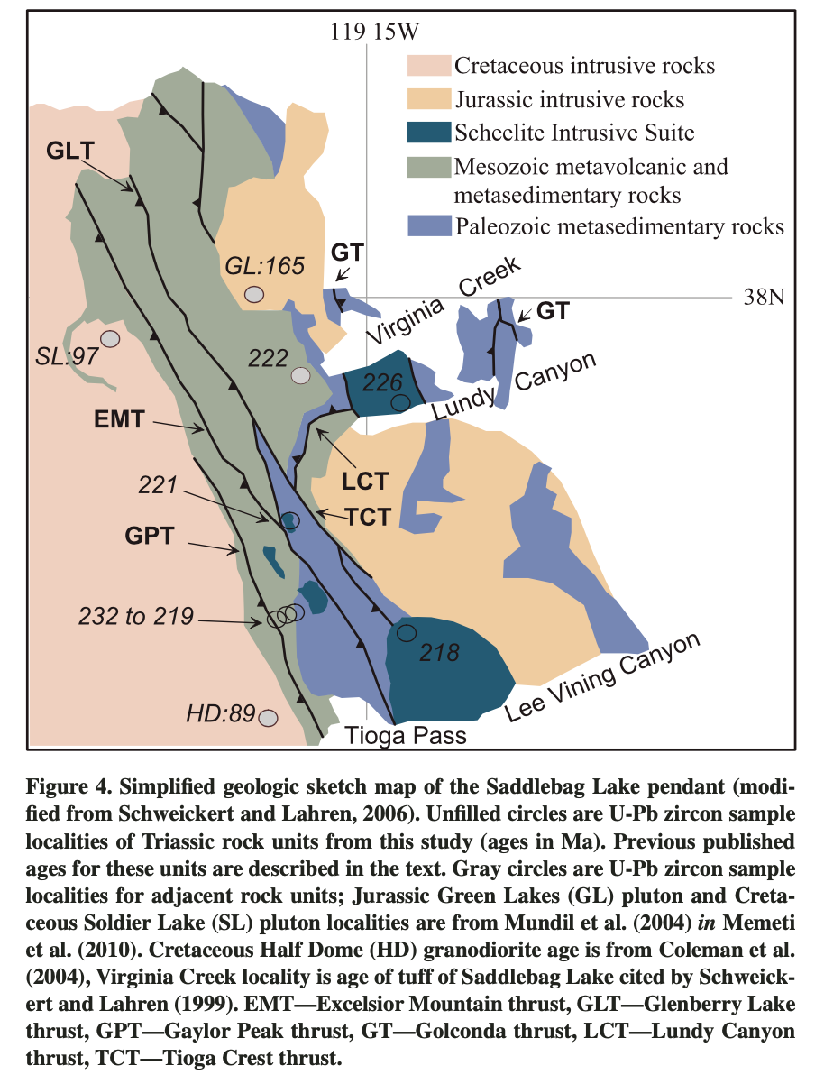
Questions?
Notes:
“Zircon data indicate that SIS plutonism (and its associated volcanism) persisted for at least 6 m.y. (and perhaps 12 m.y.)” (Barth)

