Slide 1
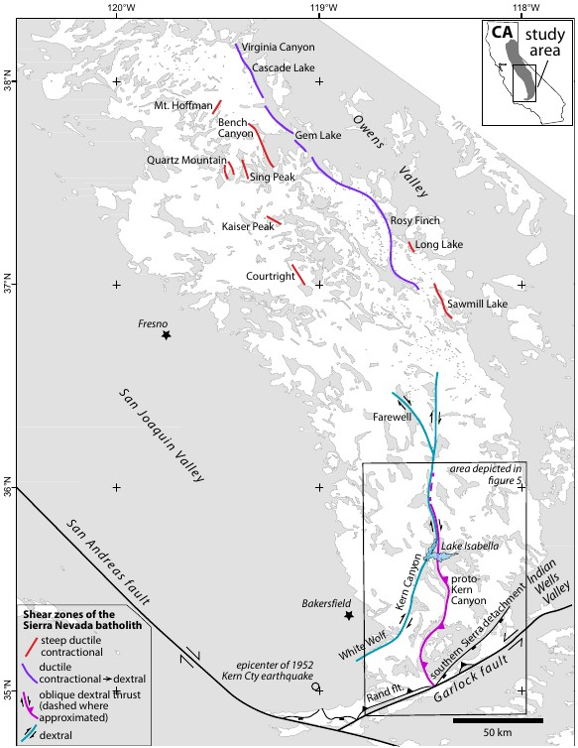
Thermal evolution of the sierra Nevada batholith, California, and implications for strain localization
Nadin et al., 2016

Slide 2
Motivation
Summarize all published U-Pb zircon, ⁴⁰Ar/³⁹Ar hornblende and biotite ages to create age distribution maps which track batholithic cooling from crystallization through the transition to brittle conditions
Examine regional thermal state of the SNB during formation of the major shear zones outline on the figure on the title slide.
Present new data to constrain deformation ages of the proto-Kern Canyon and Kern Canyon faults (southern SN)
Notes:
Point 2
Examine cooling from crystallization (<900C) through brittle- ductile transition (~300C)
Point 3
New Ar/Ar thermochronometric data

Slide 3
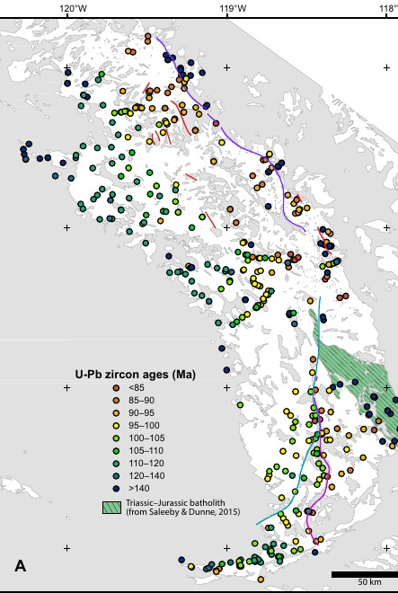
Pluton crystallization ages
Contains plutonic material as old as ca. 250 Ma, but primarily high flux magmatism of Cretaceous age
U-Pb zircon geochronology (900°C) used to constrain the timing of crystallization on this map
General younging to the east
Superimposed on here are the shear zones that drive this study
They are all Cretaceous structures, and coincide with emplacement of the largest vol. of igneous material (115 – 83 Ma)

Slide 4
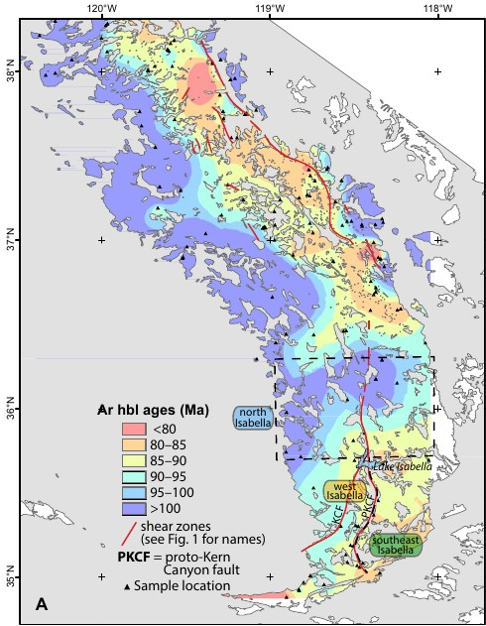
Age data mapping Ar hornblende
Closure temp of 525°C
Indicates transition of batholith from ductile to brittle
Note how shear zones seem to play a part in spatial age distribution

Slide 5
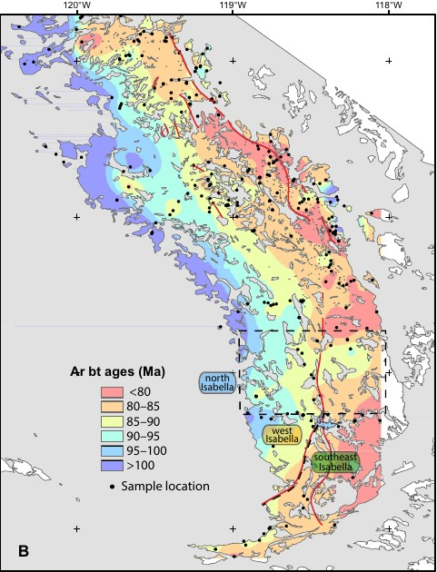
Age data mapping Ar biotite
Closure temp of 300°C
Batholith acting completely as brittle crust at this point

Slide 6
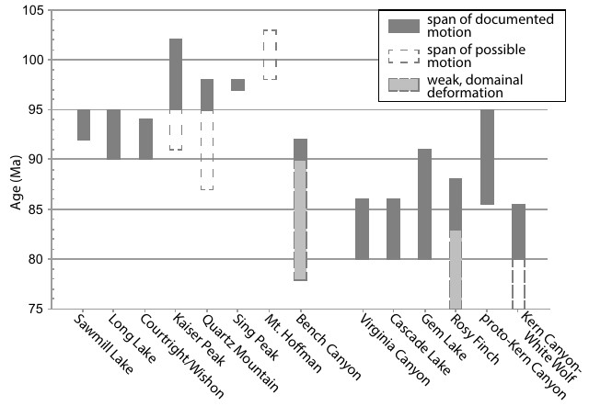
Shear zone age distribution
Contractional structures
Contractional to dextral

Slide 7
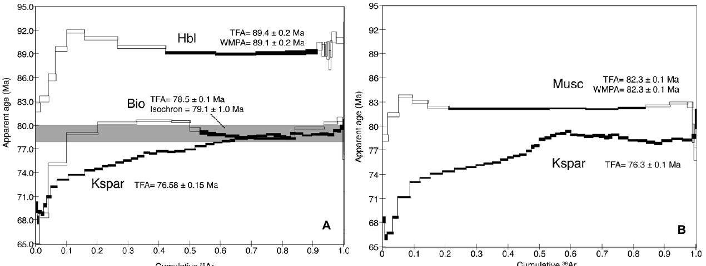
Location map of new ⁴⁰Ar/³⁹Ar data
These data suggest moderate cooling (350C – 165C) from 82-70 Ma
Followed by very slow cooling to <150C after 70 Ma
The 70 Ma cooling of these samples correlates to a different (younger) cooling history in this southern portion than in the rest of the SNB
<17Ma

Slide 8
Farallon plate convergence
This is the driver for cooling and deformation of the SNB
SNB is in continuous compression from 120 – 85 Ma
At 85 Ma the plate motion transitions from compressional to transpressional
This coincides with the major change in the deformational regime, recorded in the shear zones

Slide 9
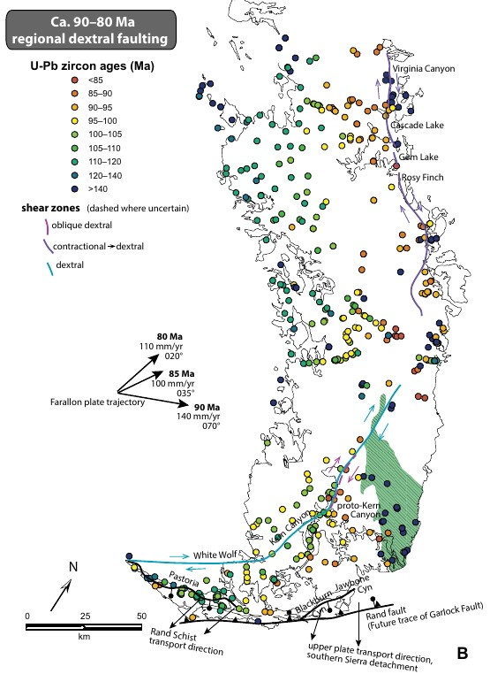
Discussions
Contractional deformation (100-90 Ma) is recorded in short shear zones along the axial zone of the central SNB.
The transition to transpressional deformation (90-80 Ma) is recorded in shear zones along the crest that exist at the boundary between some of the oldest and youngest intrusives
These boundaries may have served to localize the shear during this transition as the plate kinematics changed
Furthermore, the observations on the proto-Kern Canyon fault and the Kern Canyon fault serve to solidify this interpretation, as the Kern Canyon fault is a dextral fault that overprints the older proto fault

Slide 10
Questions, comments, concerns?

