Slide 1
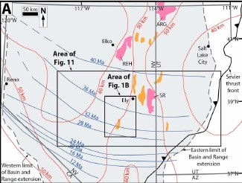
Rapid Oligocene to Early Miocene Extension Along the Grant Range Detachment System, Nevada, USA: Insights From Multipart Cooling Histories of Footwall Rocks
Long et al., 2018

Slide 2
Motivation
Try to understand the processes that lead to extensional collapse of thickened orogenic crust using the collapse of the cordilleran orogen in Nevada and Utah, specifically the detachment system of the Grant Range, as a case study. Ultimately giving insight into the full evolution of the orogenic cycle.

Slide 3
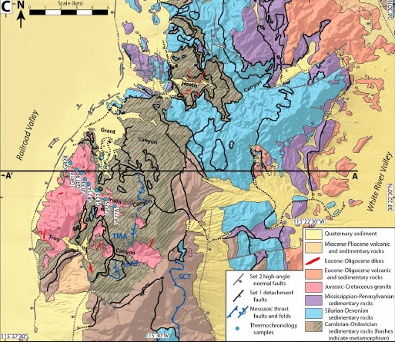
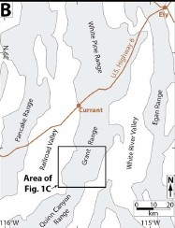
Notes:
NOTE difference between set 1 and set 2 normal faults!!!!!

Slide 4
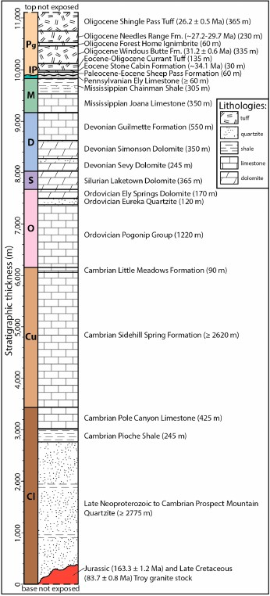
Stratigraphy
10km thick section of Cambrian- Pennsylvanian rocks, mostly carbonates. In the study area these rocks have been folded into a recumbent anticline that’s been overturned to the east
Intruded by a Jurassic – Cretaceous granite. During the late stages of the intrusive event, Cambrian sediments were metamorphosed to green schist facies
Paleozoic seds are unconformably overlain by a Paleocene – Eocene sedimentary formation, and late Eocene to Oligocene ash flow tuffs (ignimbrite flare up rocks)

Slide 5
Tectonic history
During Neoproterozoic and Palezoic, Nevada was a site of shallow marine sedimentation.
Cordilleran orogenic construction took place during the Jurassic to Paleogene (150 – 50 Ma), Nevada was part of the hinterland of the Sevier fold-thrust belt
During orogenesis, shortening was accommodated by thrust faults and folding in the upper crust and thickening in the middle – lower crust
By the end of the thickening in the late Cretaceous-Paleocene, the high elevation Nevadaplano existed with up to 60km of crustal thickness
Contemporaneous with late stages of shortening (80-60 Ma) spatially isolated extension was occurring
Following this, two stages of extension have occurred:
Eocene-Oligocene extension that is associated spatially and temporally to the ignimbrite flare up
Initiation of wide-spread extension related to the San Andreas / NA-PA plate boundary motion, forming modern day Basin and Range

Slide 6
Paleogene unconformity restored to horizontal
Prior to onset of extension on “set 1” faults
Present day section
Section restored to before offset of “set 2” faults

Slide 7
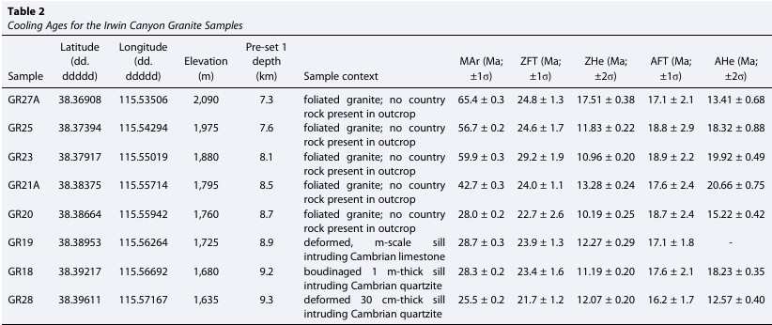
Table of cooling ages
Notes:
Focusing on the M ar dates
Indicates structural depth because:
Passage through the bulk closure temperature for muscovite (350-400C) occurred later for more deeply buried rocks (bottom 4 samples)

Slide 8
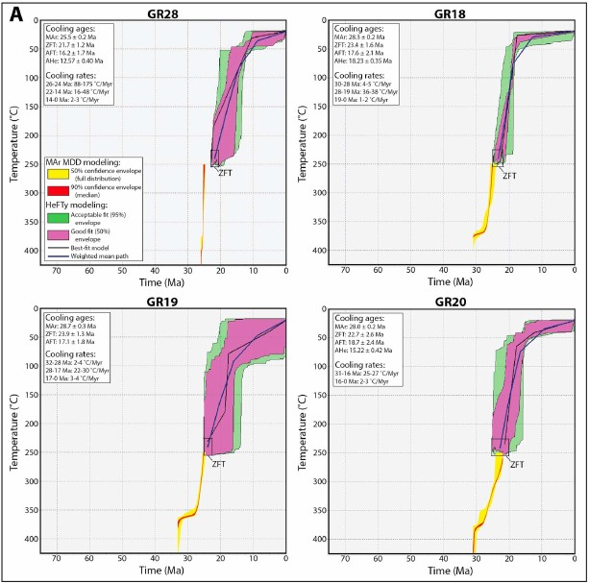
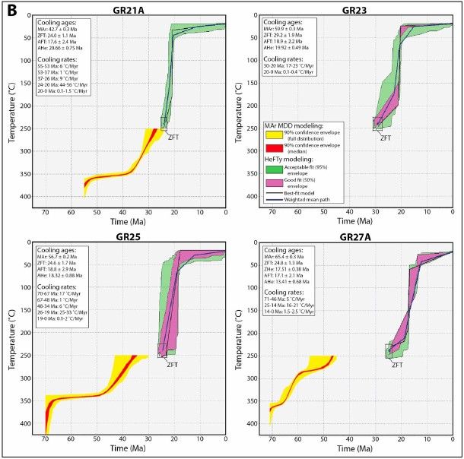
Granite cooling age modelling
<17Ma
Notes:
Multi diffusion domain modelling, uses diffusion of Ar gas to constrain thermal history
Inflection point on all of these indicated rapid cooling (exhumation basically)
A is deepest 4 samples
B is shallowest 4 samples

Slide 9
Animation showing evolution of deformation throughout set 1 extension (i.e. detachment faults)
Thermochronological samples and their structural depth through time is represented

Slide 10
Discussion
A set of detachment faults in the Grant Range accommodated ~24km of extension
Rapid cooling of granite between 28-31 Ma is used to define the duration of motion on the detachment system
Long term extension rate from this is 1.5-2.6km/Myr (Damn that’s fast!)
The Grant Range represents one fault system that can be contextualized in the Eocene-Oligocene extension of the thickened Cordilleran crust.
Basically the onset of extension during post-Laramide slab rollback
This study provides evidence that decrease in intraplate coupling that accompanied slab rollback was the primary driver of early distributed extension within the Cordilleran plateau.
This illustrates that the collapse of the cordillera happened before Basin and Range extension started due to the plate boundary motions

Slide 11
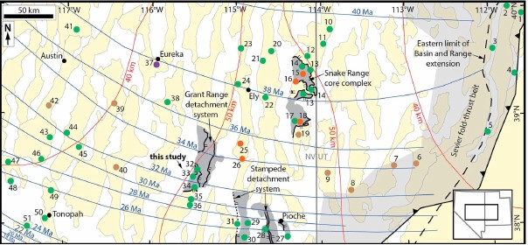
Questions?
Notes:
Green dots are extension that is syn volcanic / overlaps with Eocene-oligocence sweep of volcanism
Orange dots are extension that happened prior to and during Eocene-oligocence
Brown? Dots are pre volcanic extension
Purple dot is weird outlier of late cretaceous extension
Overall this figure represents all the known localities that represent much or all of the extensional motion associated with orogenic collapse

