Slide 1
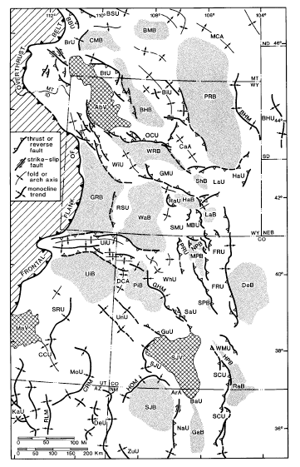
Paleogeographic and paleotectonic setting of Laramide sedimentary Basins in the central Rocky Mountains Region
William R. Dickinson et al., 1988 GSA Bulliten
Presentation by Kurt Kraal

Slide 2
Background and Goals
In the Late-Cretaceous what is now the Rocky Mountain region was a broad foreland basin in which laterally continuous marine facies had accumulated
The Laramide Orogeny (Late-Cretaceous-Early Tertiary) observed in the area created sedimentologically isolated nonmarine basins formed by Laramade basement deformation
In this study, stratigraphic and sedimentologic analysis is used to constrain the onset, duration, and termination of Laramide deformation
They hope to use this data to constrain hypotheses about the causes of the Laramide deformation

Slide 3
Characteristics of Laramide Deformation
Consist of basement-cored uplifts and intervening sediment-filled basins developed over a wide area
Laramide deformation is east of the Sevier overthrust belt. The “thin-skinned” Sevier deformation for the most part predated Laramide deformation (although in some locations there is overlap)
Laramide deformation consisted of the breakup of the foreland province into discrete sedimentalogically isolated basins and basement-cored uplifts
Structural features record northeast-southeast shortening, but crustal strain was complex

Slide 4
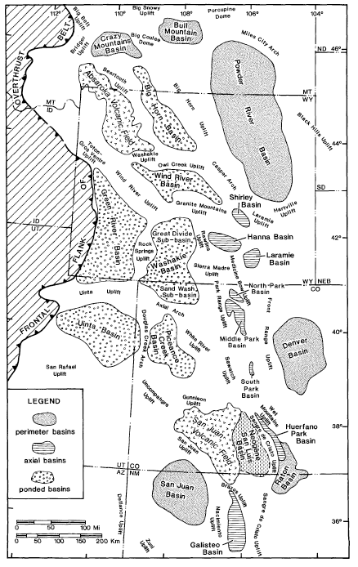
Laramide Basins
3 Types:
Perimeter Basins
Found along the eastern periphery, drained by fluvial systems into the great planes
Axial Basins
Aligned along a N-S trend, now occupied by younger Rio Grande rift system, small in size compared to other two basin groups
Ponded Basins
Closer to the overthrust belt, occupied at times by lakes, and were regional sediment traps
~5-10 km of relief between basins and crests of adjacent uplifts
Basins contain nonmarine successions of late-Cretaceous-Eocene strata

Slide 5
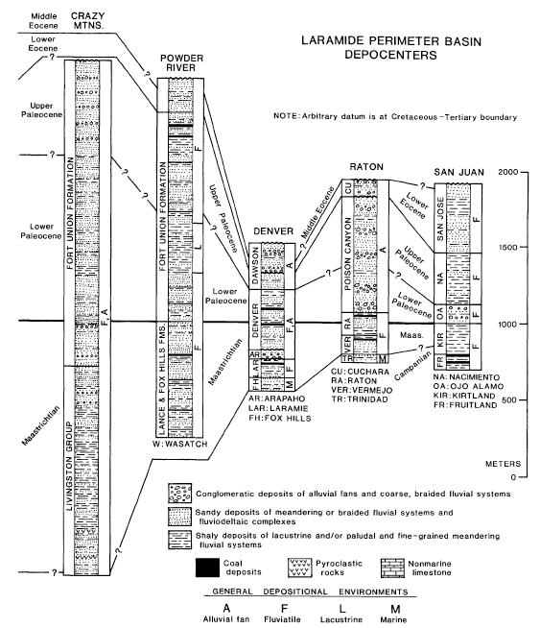
Lithostratigraphic columns of Laramide Basins:
Contain rock types, ages, contacts, and unconformities
They made one of these for each basin, and grouped them by type of basin
The one here is for Perimeter Basins

Slide 6
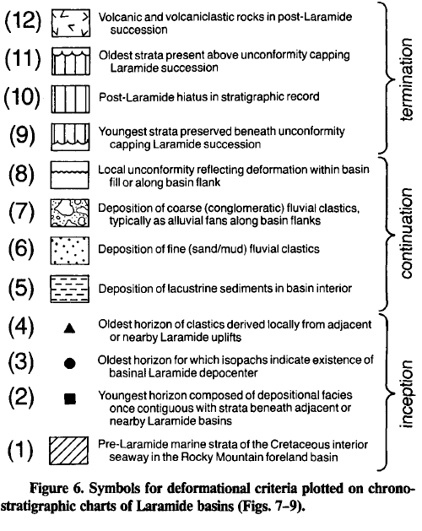
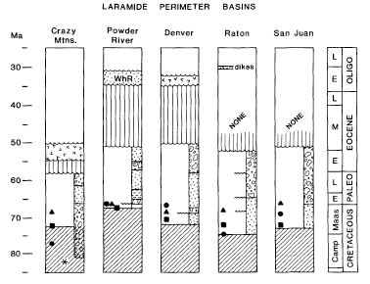
They then interpreted the basin litho-stratigraphic columns based on 12 Criteria in order to interpret the inception, continuation, and termination of the deformation

Slide 7
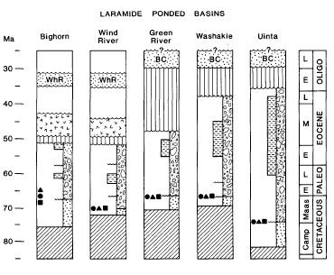
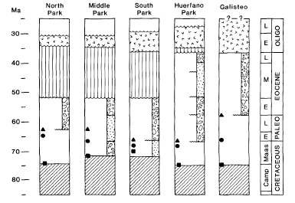
Ponded Basins
Axial Basins

Slide 8
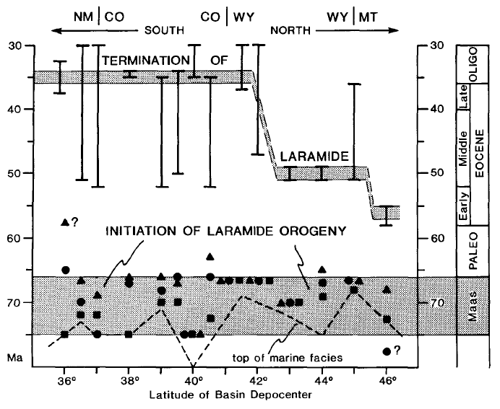
Putting it all together:
Laramide deformation began 65-75 Ma over the entire Rocky Mountain region (no systematic diachroneity for inception of deformation)
Deposition of nonmarine clastic strata was most common from 50-70 Ma, and persisted through 35-40 Ma locally
Topographic relief large enough to create lacustrine basins was most common 50-55 Ma (Eocene time)
Laramide Deformation ended earlier in the North than in the South
(50-55 Ma in the north, and 35-40 Ma in the south)
There were igneous activity in the area during, and post Laramide deformation
Post-Laramide volcanics occur earlier in the North than in the South

Slide 9
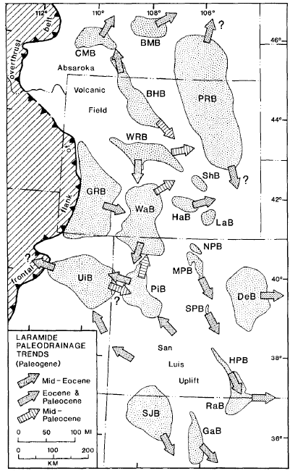
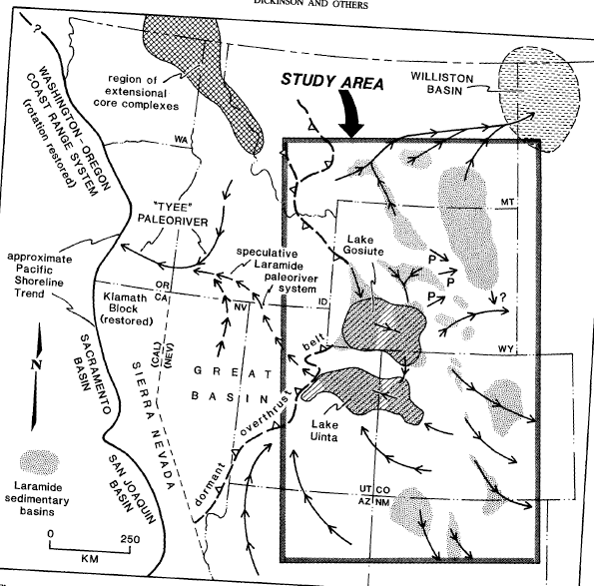
Laramide Paleo-Drainage
The paper also

Slide 10
Conclusions
Onset of Laramide deformation was synchronous during Maastrichtian time
Termination of laramide deformation was diachronous from North-South (in early-late Eocene time)
In Eocene time lake basins were common in this province, and they may have drained into the Pacific NW

Slide 11
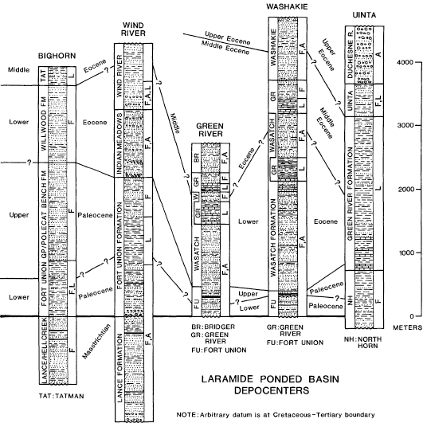

Slide 12
