Slide 1
Development of late Mesozoic to early Cenozoic structures in the eastern Great Basin
Paper: Hose, R. K. and Danes, Z.F.
1973
Presentation: Emily Maher

Slide 2
Point of Paper
Synthesized previous observations from:
Misch, 1960
Blackwelder, 1910
Billingsley & Locke, 1933
Harris, 1959
Armstrong, 1968
Etc.
Focusing on the Eastern Great Basin
Creating models based on how low angle faulting began in this area.
Authors believe they were created by differential uplift and gravity sliding.
Work to strengthen the hypothesis that ”eastern Nevada structural province was coextensive with the allochthonous rocks of a part of the Sevier orogenic belt. (Hose & Danes)”

Slide 3
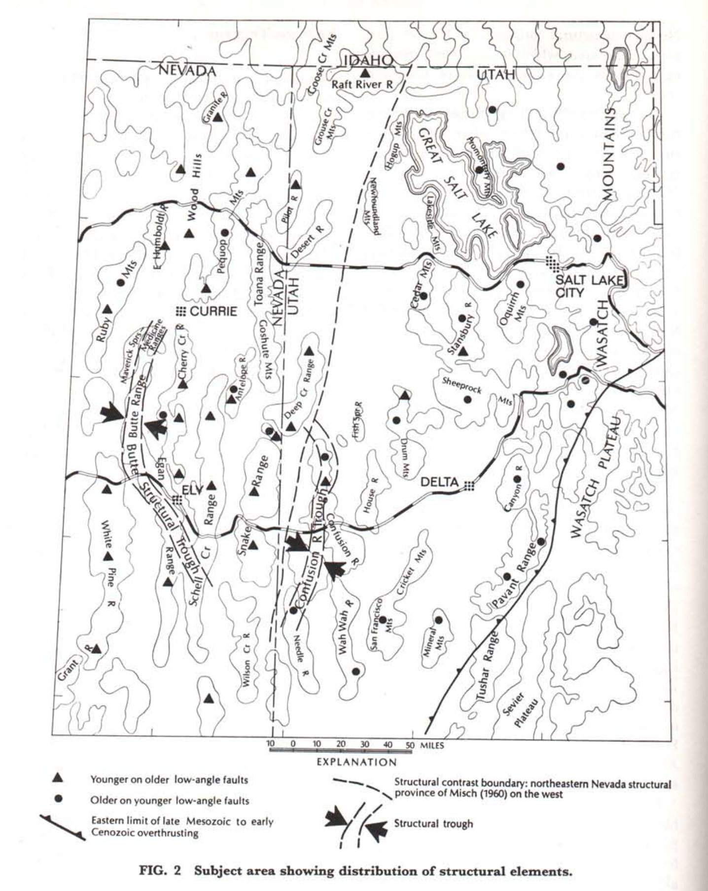
Geology
General
Low angle faults with lots of displacement.
Misch (1960) believed that there was décollement-type Fault complex here
Eastern Terrane
Low angle faults with varying displacements (12-75 miles)
Allochthonous rocks are folded and have steep dips near frontal thrusts.
In Wasatch Paleocene rocks overlay a large thrust.
Western Terrane
Low angle faults with younger rock over older rock
Exceptions: Antelope Range + Snake Range
General homoclinal structure of the mountain ranges (not a ton of folds)
Most allochthons seem to be metamorphosed

Slide 4
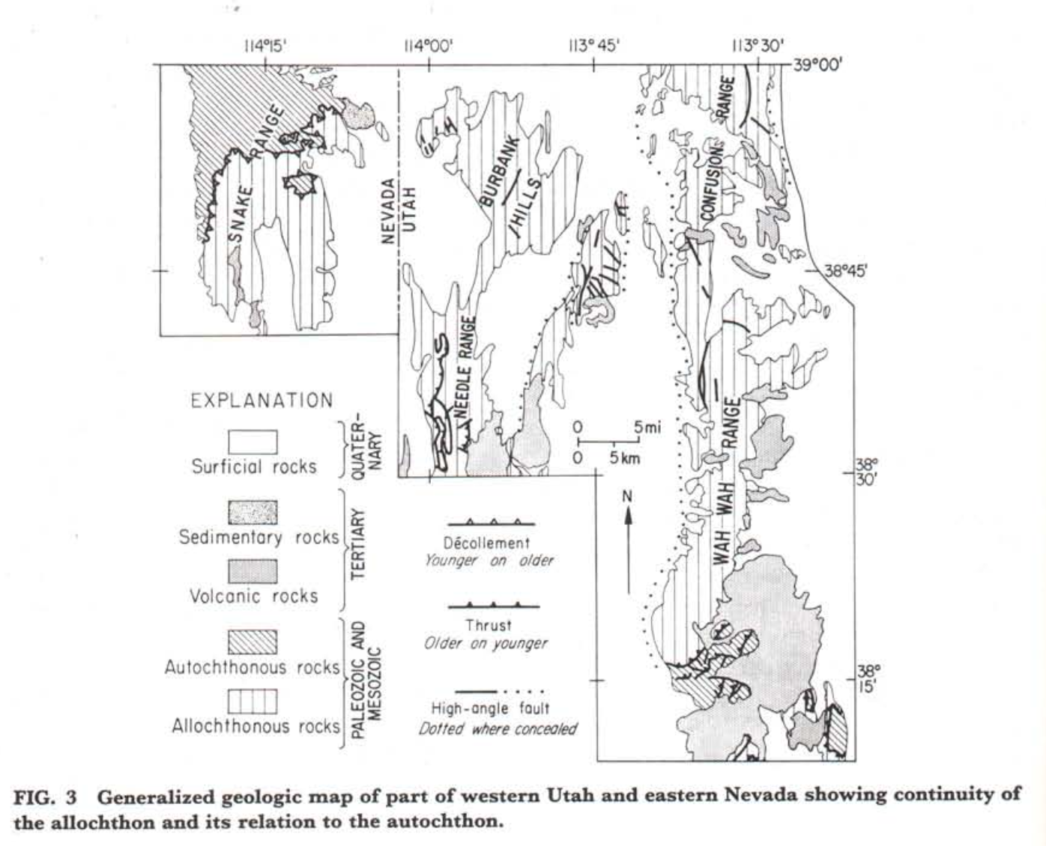
Geology
Extent and Correlation of Faults
Not including intrusive rocks, autochthonous rocks are early-mid Precambrian
Also metamorphosed + internally deformed
Allochthon rocks of the same age are unmetamorphosed, but broken by high + low angle faults.
Looked at the stratigraphic differences between the allochthon and autochthon in the Snake Range.
Authors figured it would extend beyond this range under the Burbank Hills or appear in the intervening area
Is the décollement of the Snake Range coextensive with thrust faults of the Sevier orogenic belt?
According to them yes – proved by assuming that the décollement extends beneath Burbank hills.
This plus two other thrusts mapped in the San Francisco Mountains

Slide 5
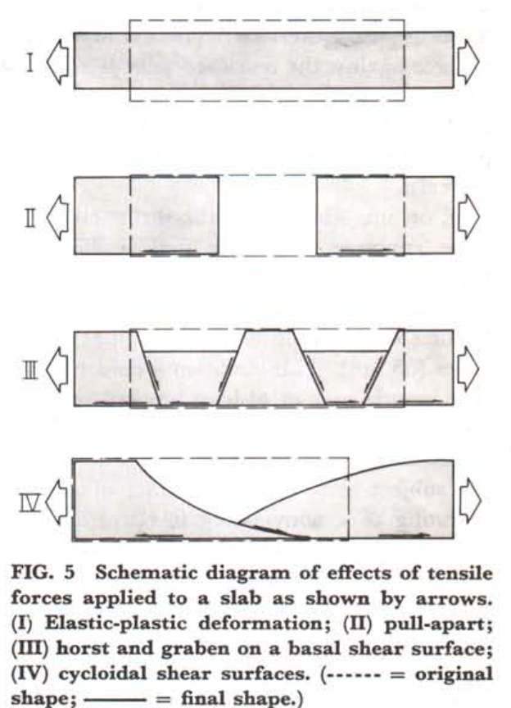
Interpretations
Figure 4 – Ideal horizontal compression for the east.
Figure 5 – Extension in the west
To get both of these you need either uparched in the west or downwarped to the east.
Hubbard and Rubey suggest, “ a fluid zone of greater than hydrostatic pressure is present near the base of a thick tabular mass (developing allochthon) so it could glide eastward.”
This would allow for eastward glide. With compression at the toe. Attenuation to the west and compression to the east.
The combo of the two parts (allochthon) is about 200 miles wide.
Assume 40 miles of movement this would mean original width of 160 miles
Thickness assumed to be 18000-40000ft

Slide 6
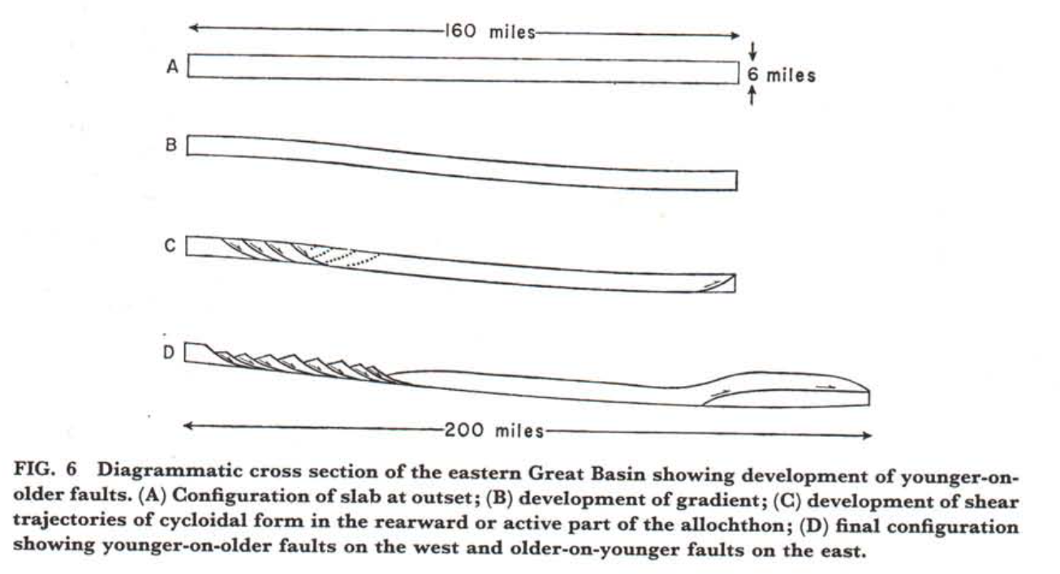
Interpretations
Gravity
Thickness of the allochthon in the west is a critical factor in the evolution of low angle young on older faults
As the gradient developed the higher compressed area would need to adjust to the stress, hence cycloidal shear trajectories.

Slide 7
Conclusions
Allochthon moves downslope and creates less mass in the hinterland and more mass on the leading edge.
This would uplift the autochthon and increase the gradient.
The increased mass on the leading edge would reduce the angle of the slope.

Slide 8
Reference:
Hose, R. K. and Danes, Z.F., 1973. Development of late Mesozoic to early Cenozoic structures in the eastern Great Basin. In: K.A. De Jong and R. Scholten (Editors), Gravity and tectonics. John Wiley and Sons, New York, pp. 429-442.

