Slide 1
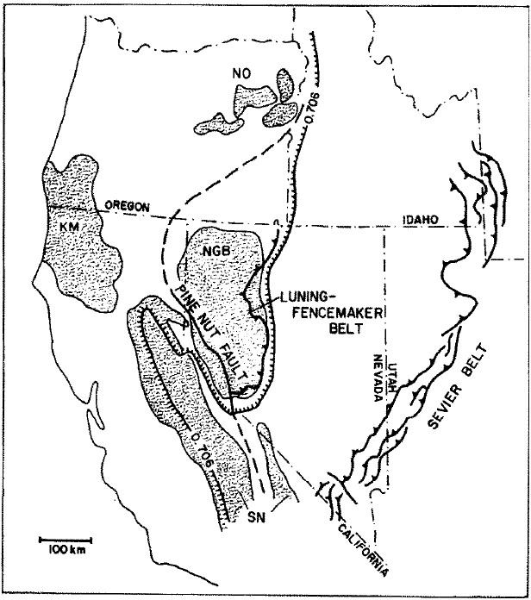
Evolution of late Mesozoic back-arc fold and thrust belt, northwestern great basin, Usa
John S. Oldow, 1984

Slide 2
Motivation
Understand how the Paleozoic basement controlled the deposition and deformation of Mesozoic crust in the NW Great Basin
Use “lithotectonic assemblages” to aid in the interpretation of major thrust faults, as most of the Mesozoic crust does not have an exposed lower contact
Describe the tectonic controls and timing on the Luning Fencemaker thrust system
Notes:
Lithotectonic assemblage in this context:
Used to segregate coeval rock packages that accumulated in separate but similar settings, or have different structural history

Slide 3
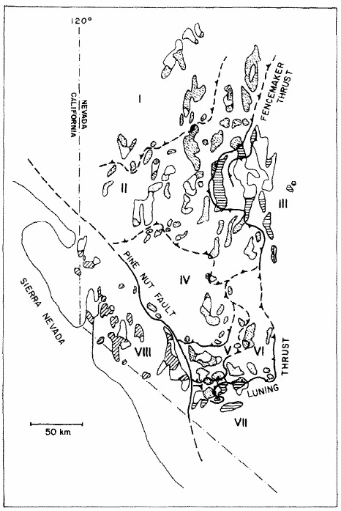
Lithotectonic assemblages
8 assemblages delineated
Generally separated by thrust faults
Some are inferred
Pine nut fault is an inferred left lateral strike slip fault
Most laterally continuous is the Luning Fencemaker thrust which parallels the eastern boundary of the Mesozoic marine region

Slide 4
Mesozoic Marine Province
Eastern and southern margins generally coincide with the Luning Fencemaker thrust system
As mentioned before, most of the lower depositional contacts are not exposed, but where they are it is generally an angular unconformity with the underlying Paleozoic rocks
In the southern extent, Mesozoic rocks are more volcanic, as conditions for marine deposition likely did not exist (area is underlain by continental crust)

Slide 5
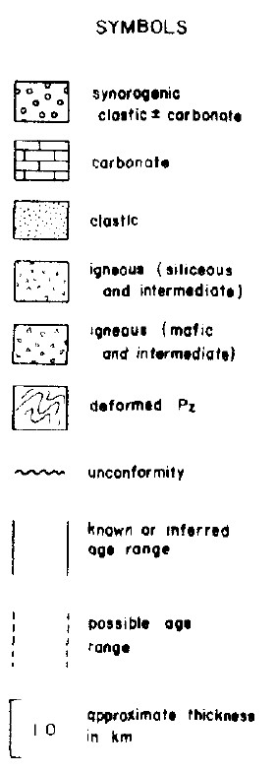
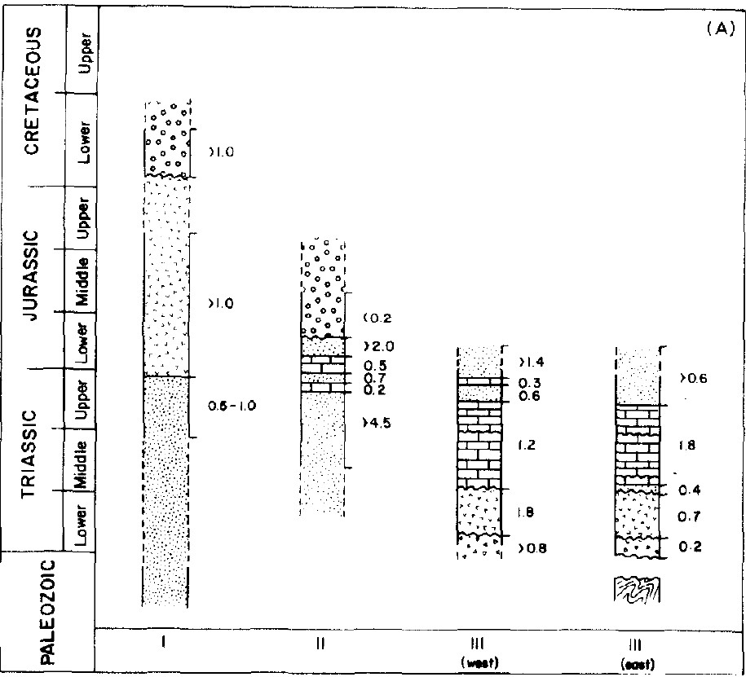
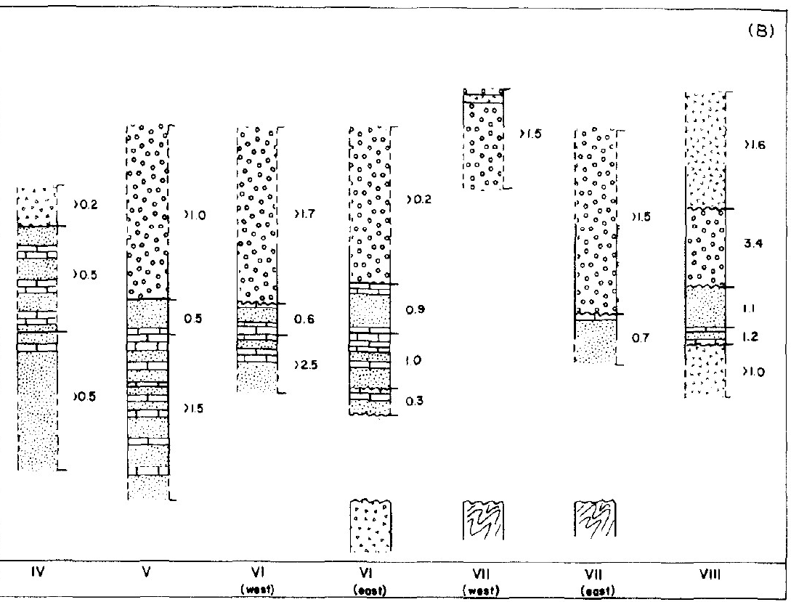
Stratigraphic correlation
Note similar stratigraphic make up of each assemblage, as well as lack of Paleozoic contact exposure

Slide 6
Structural history
Structural history of the rocks east of the pine nut assemblage is very similar in terms of orientation, sequential development, and timing.
The author breaks it up into 4 events:
D1 – more localized NW trending folding (Late Triassic to middle Jurassic)
D2 – Major widespread NW-SE shortening, resulting in NE trending structures (middle/late Jurassic – early Cretaceous)
D3 – NW trending folds and thrusts that extend outside of the boundaries of the Mesozoic marine rocks (timing not well constrained)
D4 – Locally occurring minor deformation marking the final stage of deformation in this area
The structural history of the region west of the pine nut assemblage is much different, and more closely aligned with the deformation of the Sierran arc
Lack of lateral continuity of Mesozoic stratigraphy among mountain ranges
Lack of NE trending D2 structures

Slide 7
Previous Tectonic Model
“tear fault” model accounts for decoupling of Sierran block from the dismembered assemblages
Amount of shortening in the back arc region is much greater than deformation in the Sierran block region
The regional strike slip fault proposed here accounts for that decoupling and agrees with the long standing idea at this time of right oblique subduction
However, how can the major NW-SE shortening (D2) of the back arc be explained by this model?

Slide 8
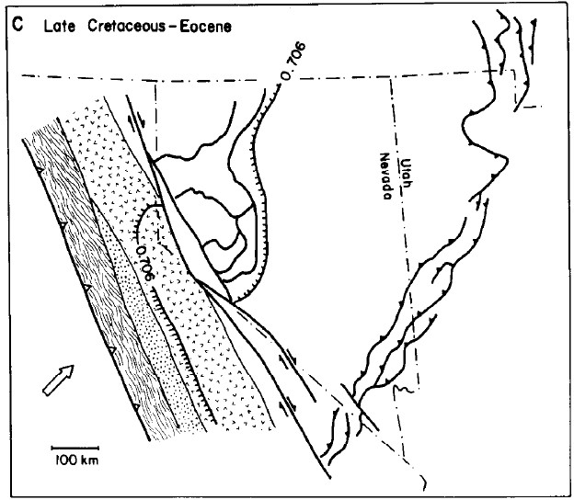
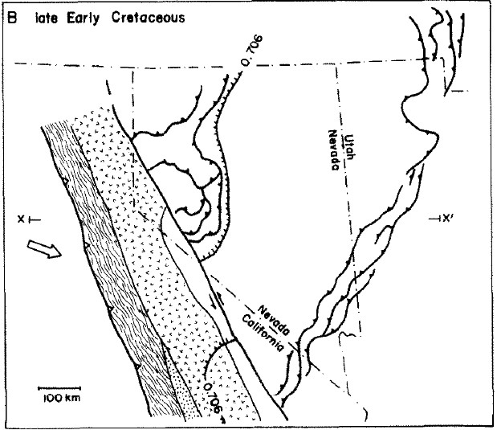
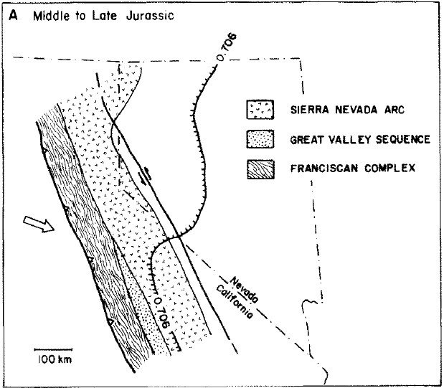
Proposed tectonic model
Authors propose a long period of left lateral movement on “Pine Nut” fault
This fault accommodated offset due to a change in subduction direction from NE to SE during that time
This allows for the shortening direction observed in both the Luning-Fencemaker and Sevier thrust belts
Ultimately right lateral movement that we know and love today was reinstated and overprints left lateral movement on the “Pine Nut” fault (basically now the Walker Lane)
<17Ma

Slide 9
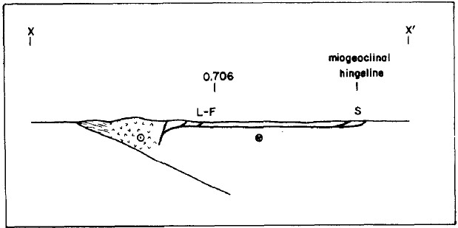
How is the Sevier tied in?
Trend of the Sevier belt corresponds with the depositional hingeline inferred for the Paleozoic miogeocline
The Sevier was active at the same time as the L-F for much of their histories
Therefore, the authors consider them as paired back arc thrust belts
They infer that the must be linked by some decollment at depth to account for quiet zone between them
Notes:
Miogeocline is the passive margin of a continent where sedimentation occurs

Slide 10
Discussion
A regional back arc fold and thrust belt developed in the Mesozoic marginal basin rocks which resulted in major NW-SE shortening from middle/late Jurassic to the early Creatceous
Older Paleozoic crust controlled the deposition of Mesozoic rocks and the orientation and location of the L-F and Sevier thrust belts
During this time the Sierran arc and the back arc region were decoupled by a regional left lateral strike slip fault
The shortening axis of the L-F thrust belt is incompatible with the right oblique convergence direction, and thus an interval of left oblique subduction must have taken place to explain the development of it

Slide 11
Questions?

