Slide 1
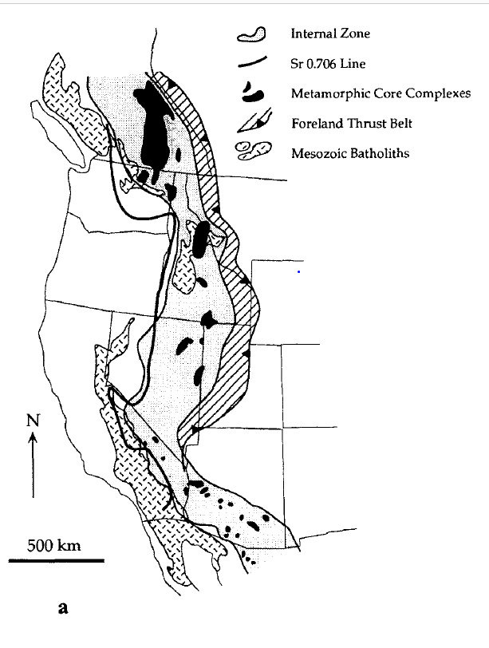
Extension in the Cretaceous Sevier Orogen, North American Cordillera
Hodges and Walker 1992, GSA Bulletin

Slide 2
Tectonic Setting of the Sevier Orogen
Notable Features:
Foreland thrust belt to the east
“internal zone” which contains evidence of Mesozoic Extension such as metamorphic core complexes
Hinterland to the east, as well as Mesozoic batholiths
End of the “internal zone” seems to be associated with the Sr 0.706 line, interpreted as being at the edge of Pre-Cambrian NA basement rocks

Slide 3
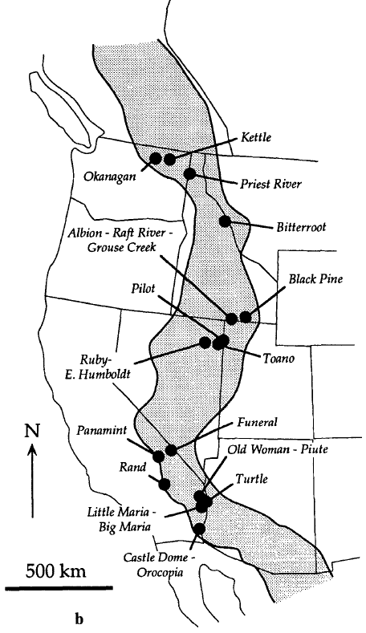
Summary of Mesozoic extension
Big table in the paper describing extension (neal), with dozens of citations about each individual location (e.g. priest river, Ruby E.Humboldt, lots of MCCs etc.)
The table compiles Structural, Geochronologic, and petrologic evidence of Mesozoic extension
Main observation of extension is observations of younger over older lithologic contacts, (or low-grade on high grade), and missing stratigraphy suggesting normal faulting
Also metamorphic P-T paths that suggest isothermal decompression and T-time paths that suggest rapid cooling
Metamorphic Core Complexes

Slide 4
Why is there extension and compression at the same time?
A number of models have been proposed
Stretching associated with pluton emplacement
Not a good model because extension has occurred in areas without volcanism
Gravitational Collapse:
Gravitational Instabilities from crustal thickening leads to extension in upper crustal levels and contraction in lower-crustal levels
Real world analogues of this (for example: Himilayas)

Slide 5
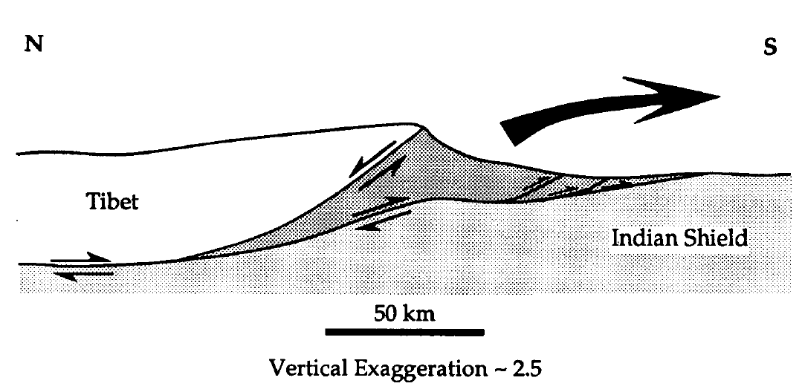
Himalayan Model of Gravitational Collapse
In the Himalayas Gravitational Collapse is manifested as metamorphic rocks extruding (as seen in the figure to the left)
Many contrasting observations with the Sevier:
E.g. in the Himalayas this is accommodated by surface breaking normal faults (but there is no evidence of this in the Great Basin)
Therefore we need a more complex model to explain

Slide 6
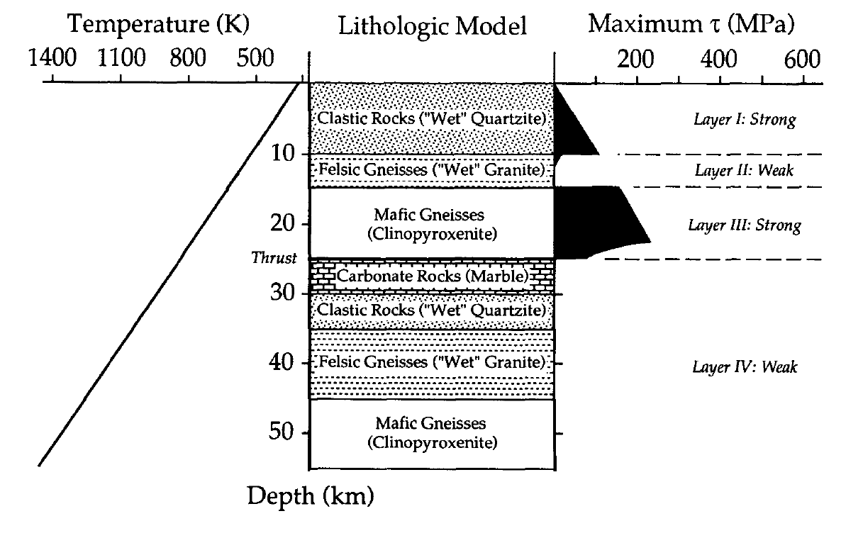
The more complex model is based on rheologies
Essentially the bottom of the hanging wall contains a strong layer of mafic gneisses, which is separated by relatively weak layers

Slide 7
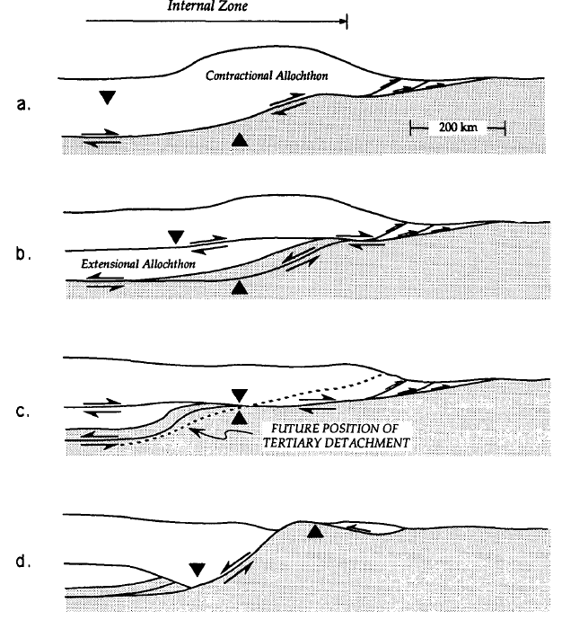
Cross sections based on rheological model
Initial “contractional Allochthon”
When buoyancy forces develop great enough to cause gravitational collapse, a decollement develops, and the extensional-allocthon is removed using normal faulting in the subsurface
How does this fit with P-T data? If the extensional allocthon is ~20 km thick, it would explain the P-T pathways observed in the lower triangle
When contraction switches to extension, tertiary detachment leads to exhumation of deep crustal rocks.

Slide 8
Questions?
How far west did the Extensional Allocthon move and where did it go?????? It would hit the arc eventually. Maybe it was subducted.
Implications?
May need to reassess tertiary extension amounts (some of it may have occurred earlier, and the normal faulting may have occurred during a time of overall contraction)

Slide 9
End

