Slide 1
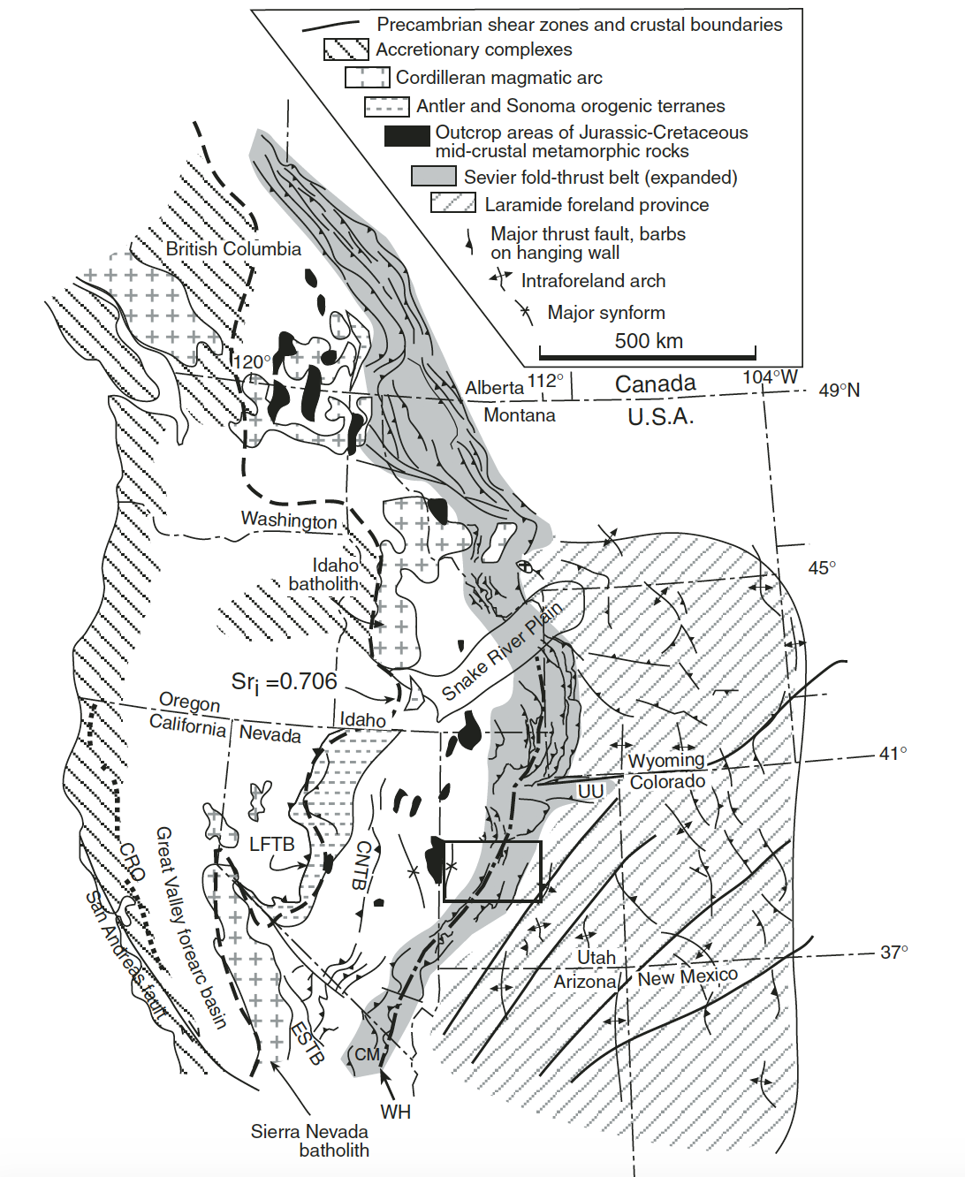
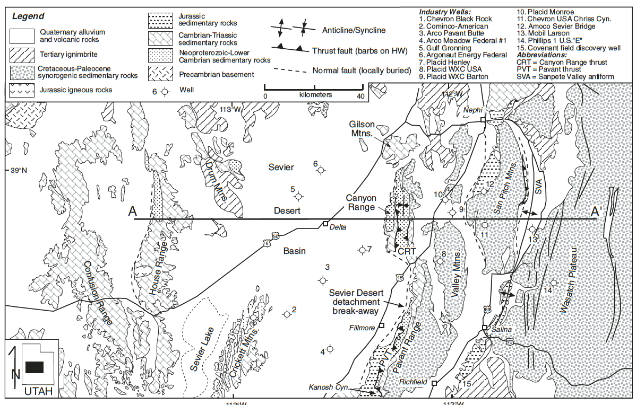
Regional Structure and Kinematic History of the Sevier fold and thrust belt, central Utah
Peter G. DeCelles and James Coogan, GSA Bulletin, 2006
Presented by Angie

Slide 2
Tectonic Setting
Sevier fold and thrust belt is a segment of the greater cordilleran retro arc thrust belt
Formed along the western margin of north America in response to the subduction of oceanic plates, subduction rates increased after oceanic basin closure
Major features across the greater cordillera include the Sierra Nevada, the Luning- Fencemaker thrust belt, Golconda and Roberts Mountains allochthons, Sevier fold and thrust belt, Sevier desert basin

Slide 3
Motivation
To provide a revised synthesis of data for the Sevier belt in the central Utah area.
Results have implications for:
The history of the Cordilleran foreland basin
Crustal thickening and elevation gain estimates in the central part of the orogenic belt
The cordilleran magmatic arc history

Slide 4
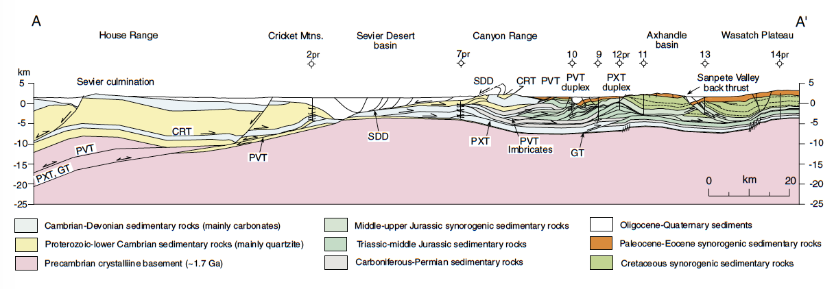
Stratigraphy

Slide 5
Stratigraphy
West- Thick Offshore
East - Thin Platformal
Transition zone: Canyon range Wasatch plateau
Above Jurassic Section: Wedge top and foredeep fill of the Cordilleran foreland basin system derived directly from growing cordilleran orogenic belt
Major detachments: exposed in shaly units like the Pocatello Neoproterozoic formation, Cambrian shale, Triassic shale, middle Jurassic shale
Competent units: quartzites, carbonates, sandstones
Incompetent: arpen shale unit strongly influences the structural style

Slide 6
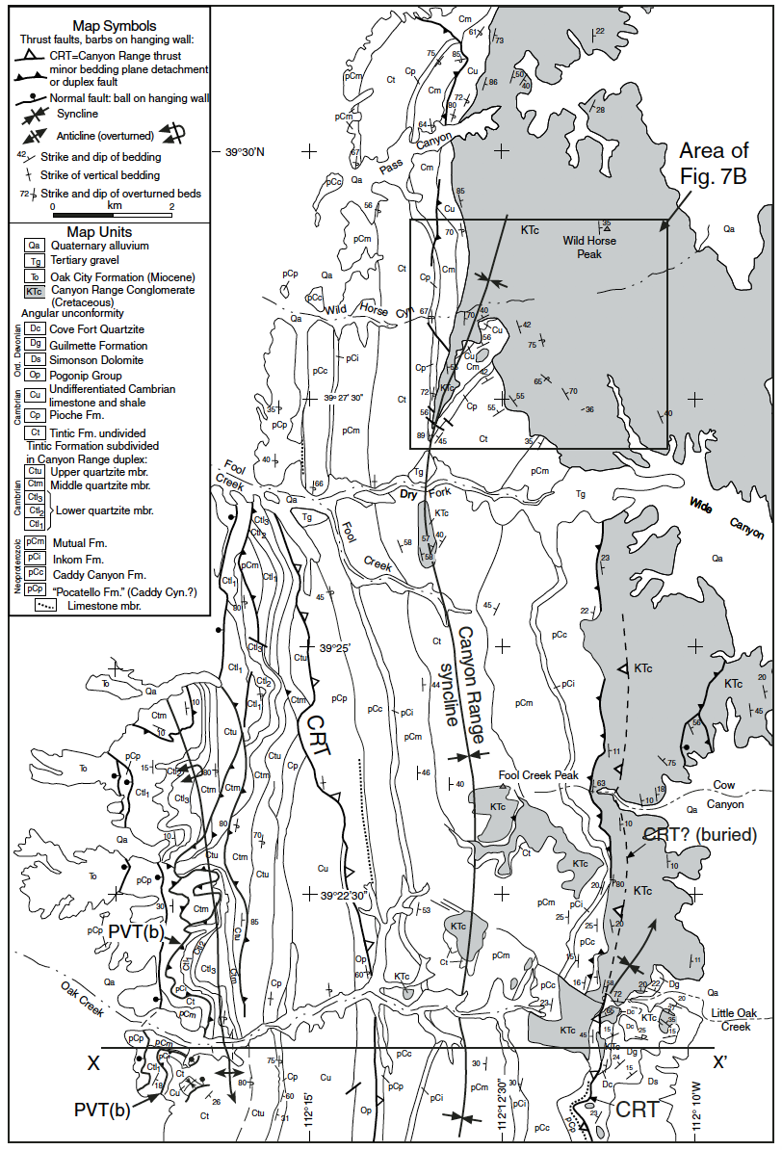
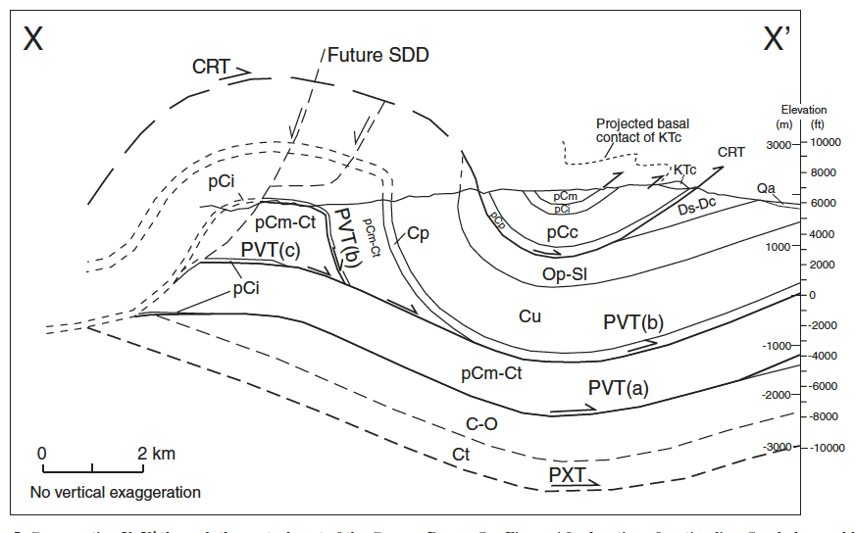

Slide 7
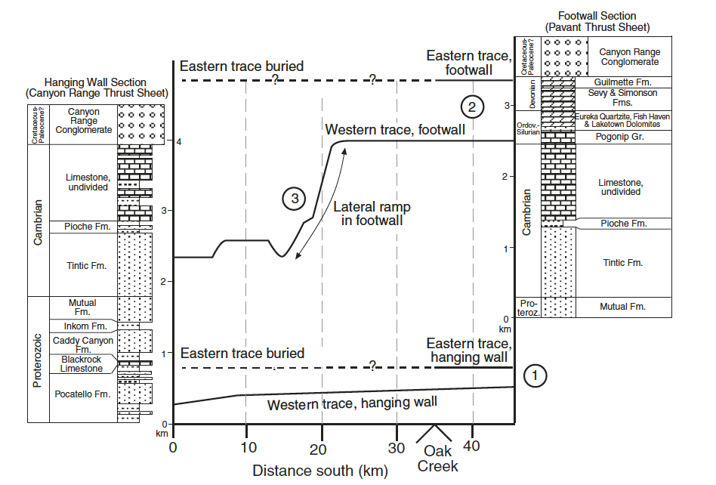
Key Structures
N
S

Slide 8
Key Structures
Canyon Range Thrust- folded into a north trending synform
Pavant thrust – east dipping thrust fault
PVTi- pavant footwall imbricates mapped, based off of seismic profiles and wells drilled in the area total shortening for this area = 26km
PXT- doesn’t outcrop to surface, so not described in detail. However it is known bc of seismic and well data
GT- doesn’t outcrop but is documented in industry boreholes and seismic profiles
Sevier culmination-antiformal structure defined by deformation patterns and broadly arched seismic reflectors. Pavant, Paxton, Gunnison are thought to root beneath culmination. Canyon ridge folded above culmination

Slide 9
Stratigraphic Seperation
Stratigrpahic separation diagram- evidence for a low hanging wall ramp on a frontal foot wall ramp
North- Western section: thurst climbs from west to east 250K= low angle hanging wall ramp
South- Eastern section: thrust climbs from west to east 1km = high angle footwall ramp
North south- Central section: thrust climbs 1.5km = major north dipping ramp

Slide 10
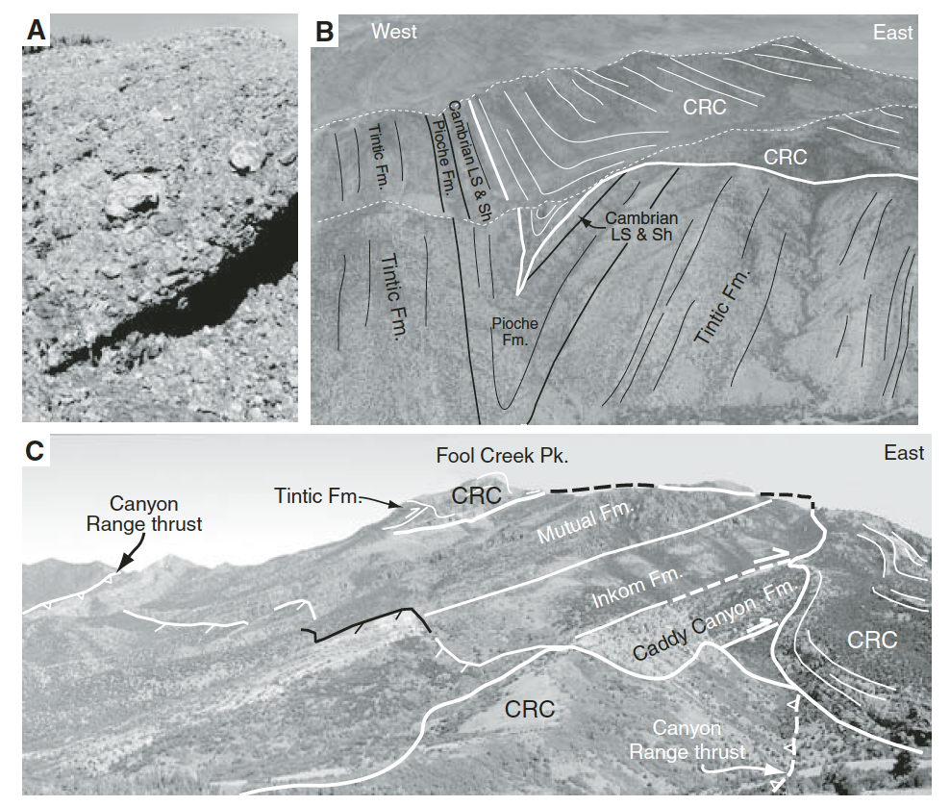
Canyon Range Conglomerate

Slide 11
Canyon range conglomerate
Contains quartzites that have been dated to mid cretaceous age
Contains growth structures that indicate it was deformed as it accumulated by slip on minor bedding plane detatchements in the hanging wall of the thrust
Important new observation: it isn’t cut by the canyon range thrust in the east, rather conglomerate overlaps the thrust in a buttress unconformity

Slide 12
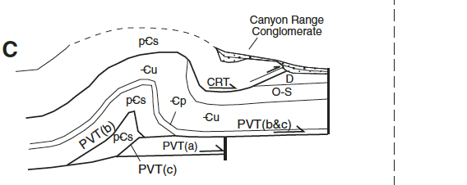
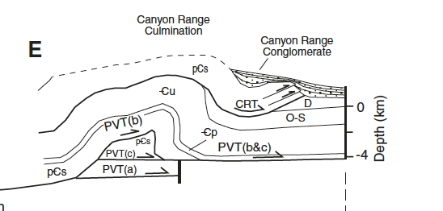
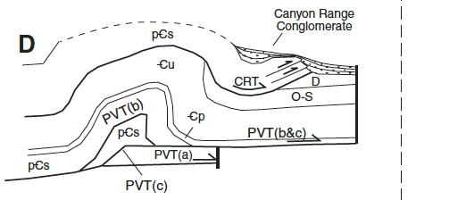
Thrusting Event | Emplacement Constraint | Thrusting Event Duration
Canyon Range Thrusting | AFT ~140Ma Syn-kinematic white mica Ar/Ar and FT ~140-143Ma | 145-110 Ma
Pavant Range Thrusting | Palynologically dated late Albian- Cenomanian San Pitch Formation conglomerated Growth structures in canyon range conglomerate | 110-86Ma
Paxton Thrusting | Angular unconformity seen in subsurface data | 86-75Ma
Gunnison Thrusting | Coeval development of Axhandle wedgetop basin at surface | 75-65Ma

Slide 13
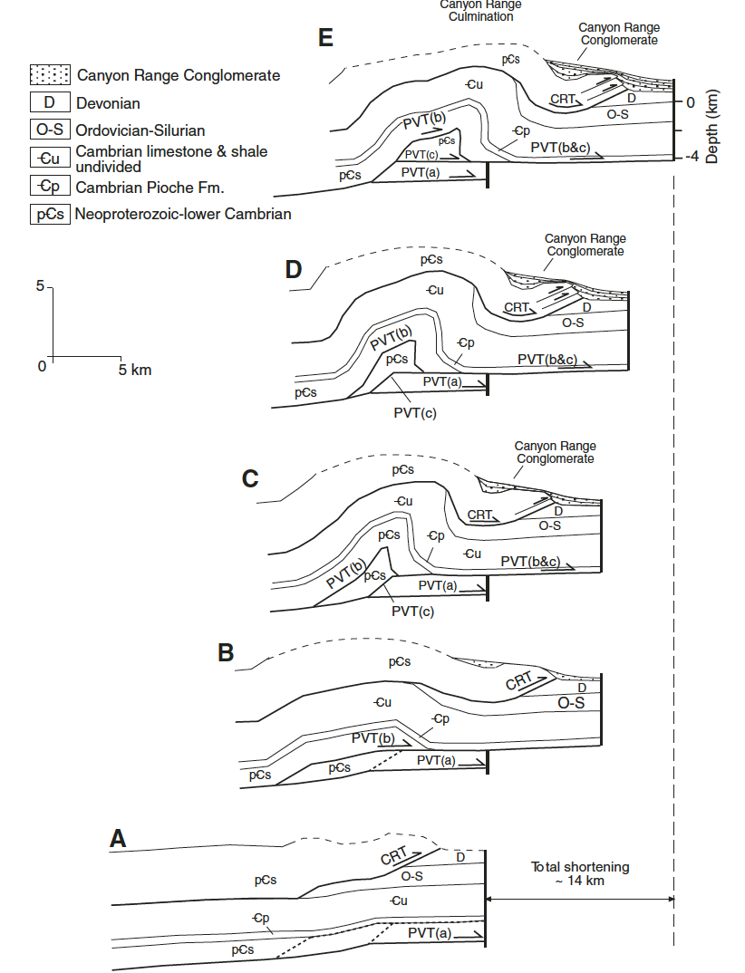
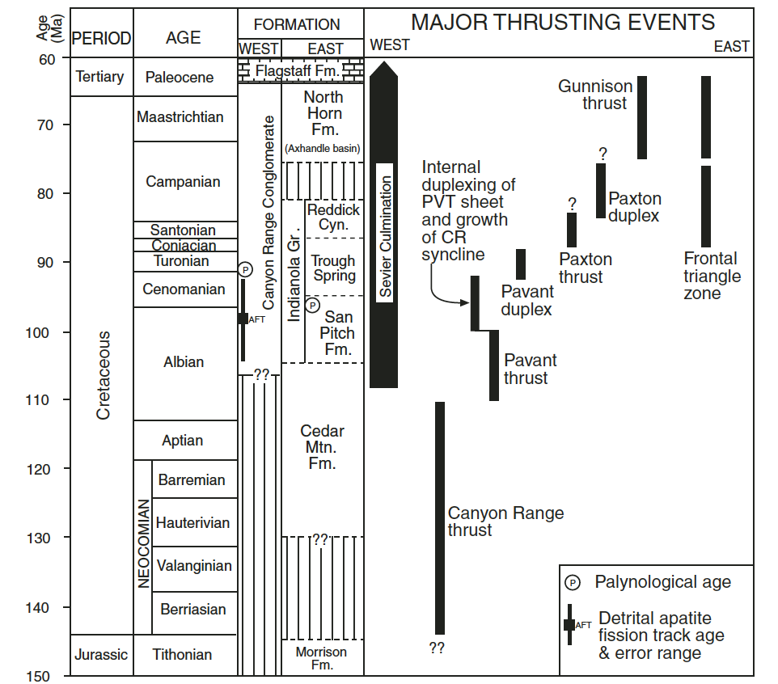
Kinematic History

Slide 14
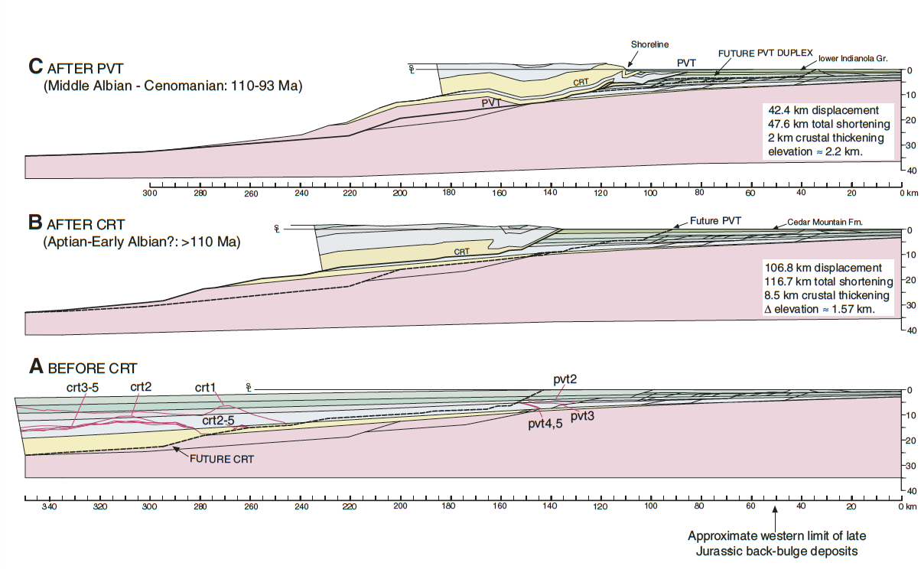
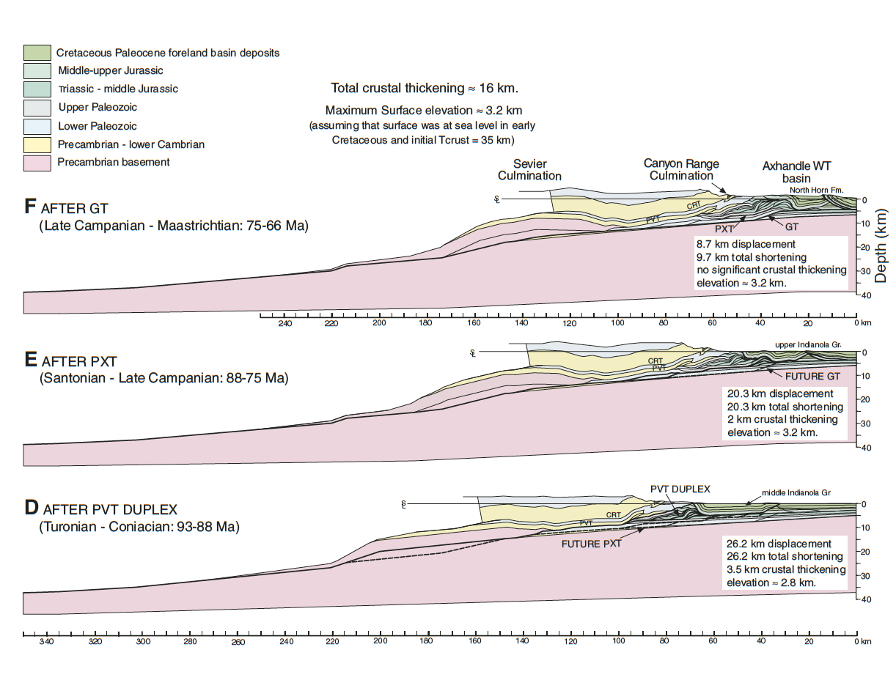
Kinematic History
CRT-PVT-PVTimbricates-PXT-GT

Slide 15
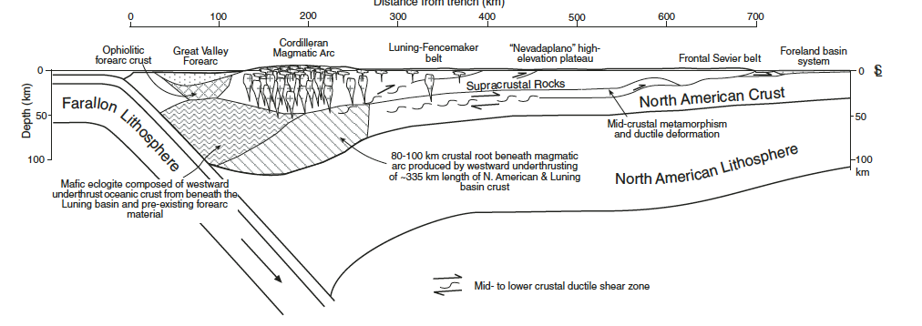
Implications
The history of the Cordilleran foreland basin
From kinematic reconstruction data, data suggests a 250 km wide Nevadaplano sandwiched between Luning Fencemaker and Sevier fold and thrust belts
Crustal thickening and elevation gain estimates in the central part of the orogenic belt
Total shortening from reconstructions = 220km, 164Km at 90Ma
Forward Propagation at 90 Ma = 300km
Flexural Wave Migration at 90Ma (164km+300km)= 464 km
Cordilleran Magmatic History
Equal amounts of displacement in upper crust and lower crust due to thrusting
Underthrust crust went westward where it melted and produced granitic magmas

Slide 16
Conclusions
Type section of the Sevier fold
and thrust belt
Shortening = 220km total
Early Cretaceous – Maastrichtian
Four major faults
Western Faults- thicker units, longer distances. Eastern Faults- thinner units, shorter and more compact
Crustal thickening suggests Nevadaplano in the hinterland
Assuming equal amounts of displacement in upper and lower crust, lower crust underthrust to the west could correspond to the cordilleran magmatic arc root.

