Slide 1
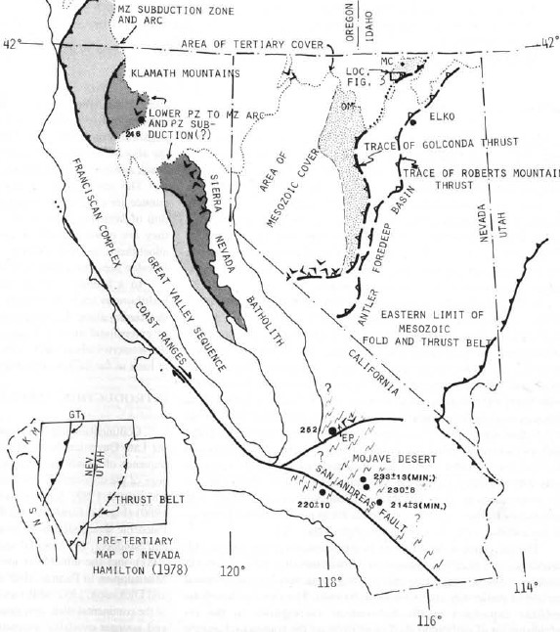
Stratigraphy and structure of the schoonover sequence, northeastern Nevada: implications for paleozoic plate-margin tectonics
Miller et al., 1984

Slide 2
Motivation
Describe the stratigraphy within the Roberts Mountain and Golconda allochthons (Antler and Sonoma orogenies resp.)
Understand what these regions were like pre thrusting
In doing so, understand the plate margin tectonics that controlled them

Slide 3
Independence Mtns and Shoonover sequence

Slide 4
Gen geology of Independence mtns
Rocks of the Roberts Mtns (RM) allochthon are thrust over lower Paleozoic rocks of the Cordilleran miogeocline (cont. shelf rocks)
The RM allochthon is unconformably overlain by Mississippian sediments, both packages were then cut by high angle faults, and following further erosion, are unconformably overlain by Permian shallow marine sediments
The upper Paleozoic Schoonover sequence is thrust over all of these units, and unconformably overlain by Eocene-Oligocene volcanic rocks
Most importantly, the Schoonover thrust is considered part of the Golconda thrust, and therefore the Schoonover sequence is perfect for describing the stratigraphy of the Golconda allochthon
Notes:
Schoonover sequence divided into ten stratigraphic members by Fagan 1962 who first mapped them

Slide 5
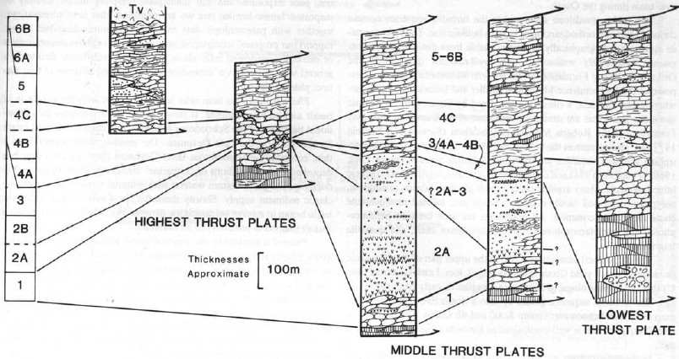
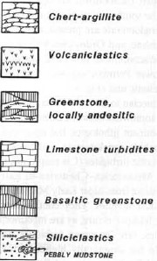
Restored stratigraphy of Schoonover sequence
Radiolarian assemblages
Notes:
Thicknesses are crude approximations due to faulting and folding of section
Sections are correlated with radiolarian assemblages of same age
Radiolarian assemblages assigned to one of the ten strat members of the Schoonover (1-6b)

Slide 6
Sequence of events prior to thrusting
Phase 1 : beginning late Devonian
Basin forms in rifting environment with basalt and andesite extrusion
Phase 2: Turbidite deposition into basin
Bathymetric complexities develop in basin
Phase 3: Middle Mississippian time
First appearance of detrital carbonate
Phase 4: Pennsylvanian – Permian
Increased supply of carbonate
Greater enclosure of marine basin with “lagoonal’ style circulation
Notes:
The gist of this is that this indicates a basin near the flanks of an island arc in late Devonian time that has an extensional/rift related origin.

Slide 7
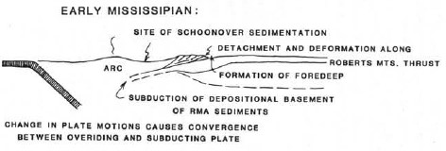
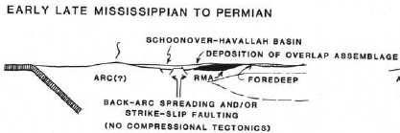
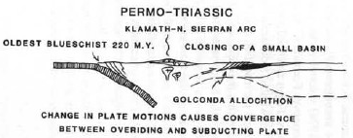
Closest previous model
<17Ma

Slide 8
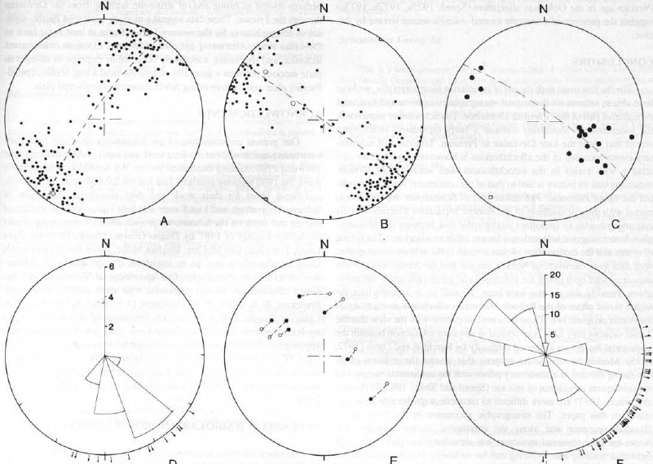
Structural data
A: fold axes
B: poles to axial planes
C: Poles to thrust fault planes
D: Rose diagram of calculated slip directions
E: Calculated slip directions compared to measured ones
F: Striations and slickensides
Biggest takeaway from structural data is the NW-SE shortening direction, and ultimately the SE directed movement of the allochthon

Slide 9
Discussion
The earliest part of Schoonover deposition was coeval with the RM allochthon (Antler orogeny), allowing for a link between the Antler orogenic belt and the adjacent offshore island arc
The timing of events in the Schoonover sequence and the composition of rocks suggest the Antler orogeny was related to eastward subduction of an arc beneath the continental margin
The Schoonover stratigraphic succession suggest that Antler compressional tectonism was short lived, and extensional tectonism began in the late Mississippian and affected the continental margin into Permian times. Following this extension was the Sonoma orogeny, which resulted in the Golconda thrust.
This paper introduces the idea that the Golconda allochthon records short episodes of arc volcanism and shortening along the cont. margin, separated by longer periods of extension.
These alternating episodes most likely occurred in response to changing plate motions between the subducting Pacific plate and the continental North American plate.

Slide 10
Questions?

