Slide 1
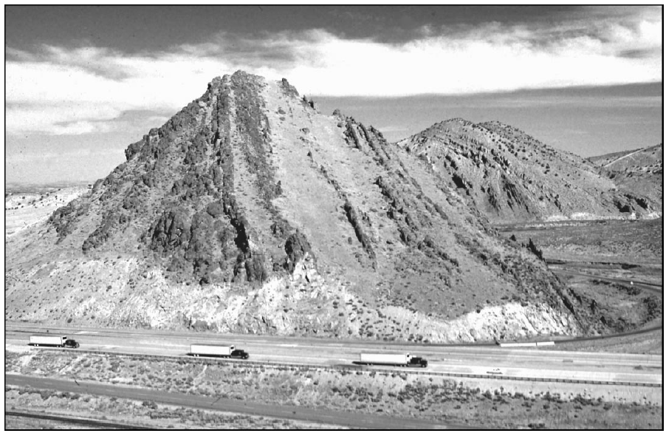
Late Paleozoic tectonism in Nevada: Timing, kinematics, and tectonic significance
Trexler
et al., 2004

Slide 2
Background
Orogenies in the Paleozoic in western North America have traditionally been grouped into two:
Late-Devonian through Early Mississippian Antler Orogeny
Late Permian-Early Triassic Sonoma Orogeny
However: Additional events are recorded in the rocks between the Mississippian and the Permian:
Are these continuations of the Antler or their own thing (due to plate reorganizations?)
In this paper, the author’s present new data that constrains timing and type of thrust faulting and contractional deformation in the Pennsylvanian-Early Permian

Slide 3
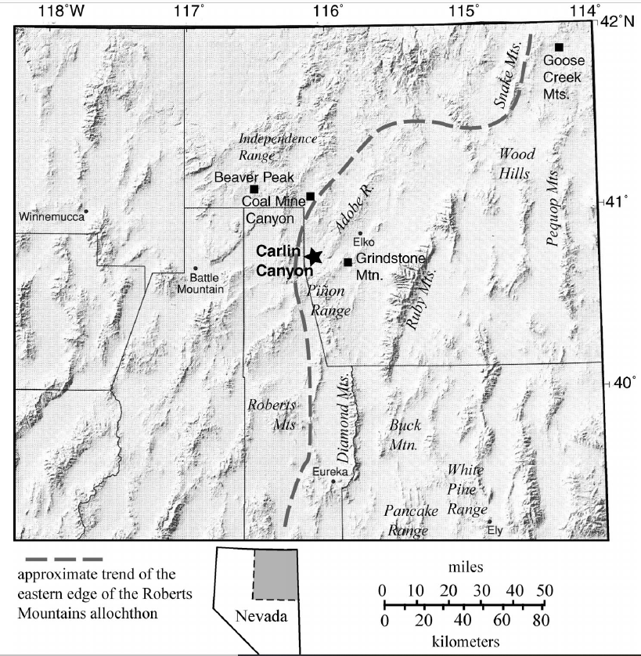
Purpose/Goals
Constrain timing, kinematics, and geometry of late Paleozoic tectonism in Nevada (at least during this interval).
Deformation, syntectonic basin formation, and unconformities are evidence of uplift and erosion, and contractional tectonism
Field Area: Carlin Canyon
Good exposer of 3 late-Paleozoic unconformities, that are well constrained in age from biostratigraphy and

Slide 4
C2, C6. and P1 well exposed at Carlin Canyon
Other events exposed in other parts of the Great Basin

Slide 5
C2 Unconformity at Carlin Canyon
C6 somewhere over
here

Slide 6
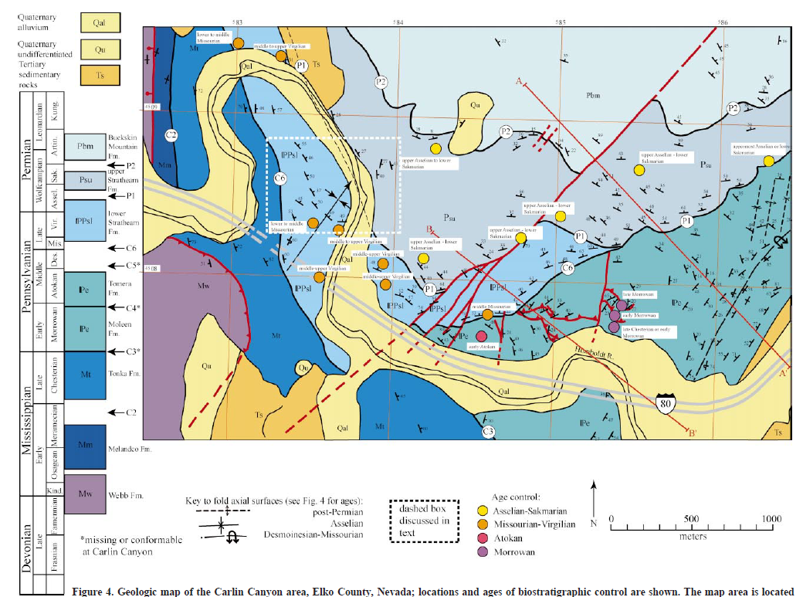

Slide 7
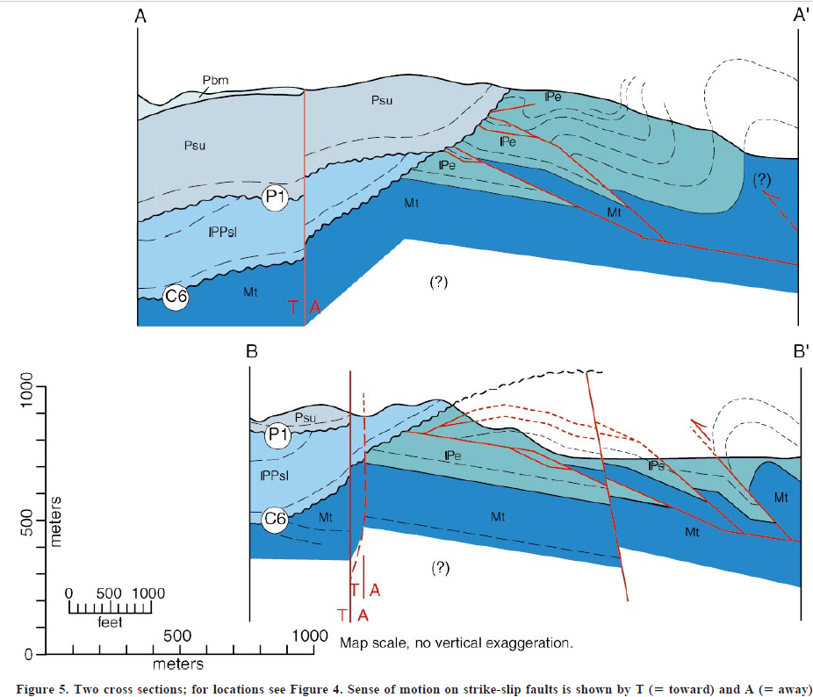

Slide 8
Duplex and thrusting

Slide 9
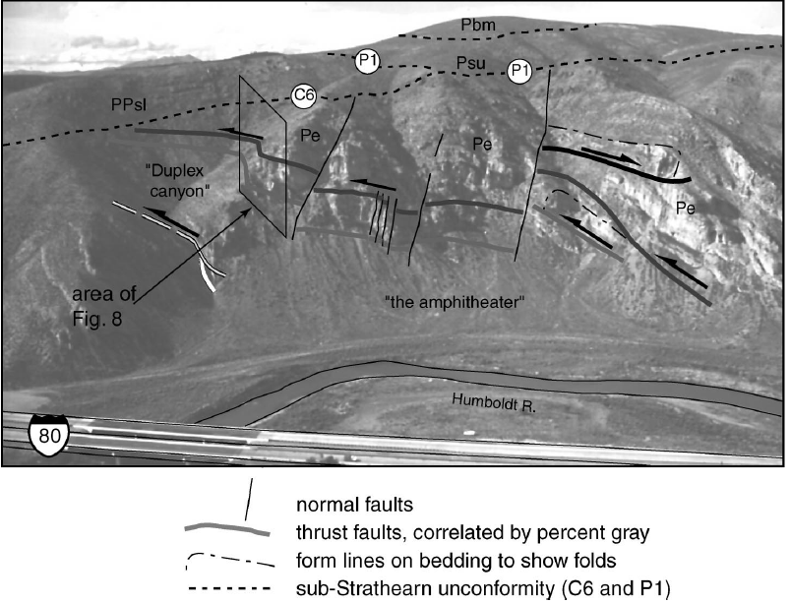

Slide 10
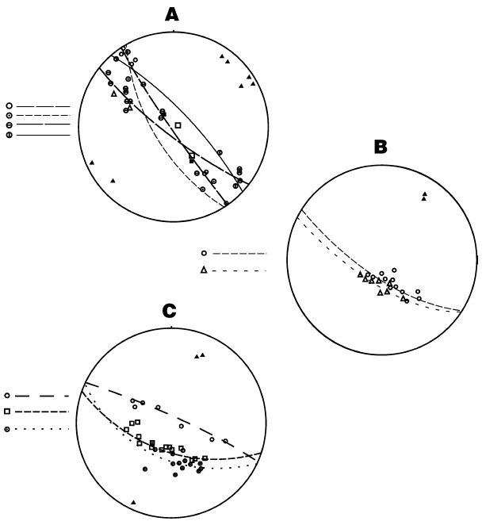
Kinematics:
A C6 Deformattion
asymmetric to overturned folding and northwest-directed thrust faulting
Fold axes Trend E-W, dip 50-65 degrees
B. P1 Deformation
Open upright folds
Plunge of fold axes ~30^{O}
C. Post Permian deformation
Open upright folds
20-26 degrees of plunge

Slide 11
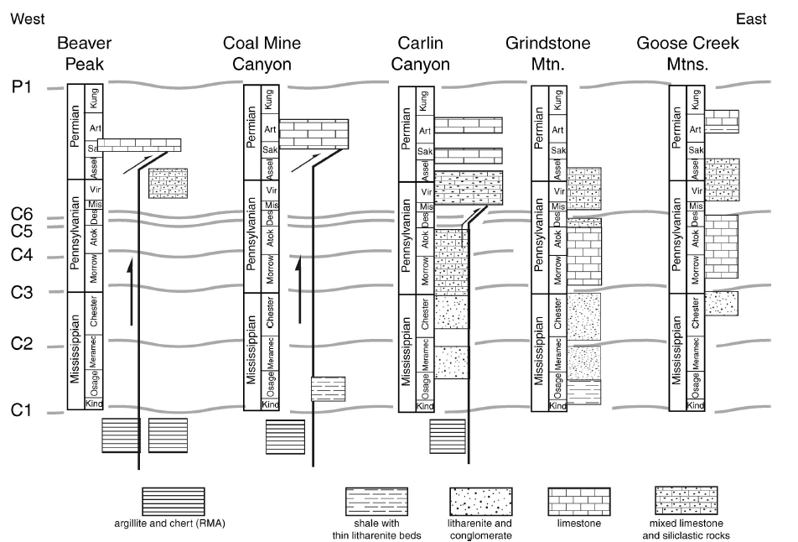

Slide 12
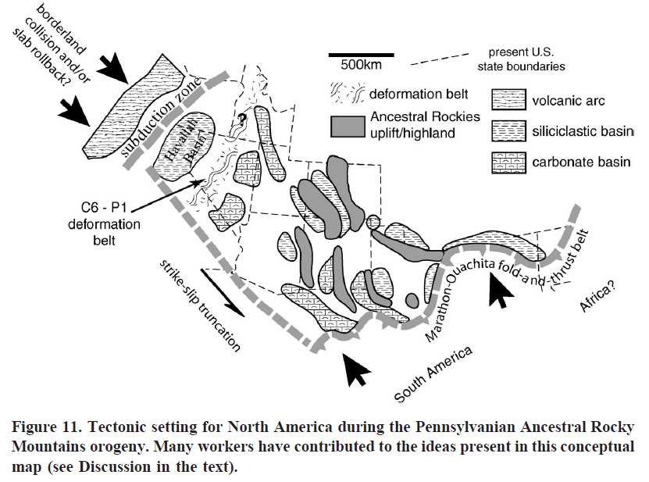
Discussion:
well-dated deformation events at Carlin Canyon appear to require an active orogenic belt to the west of North America at the latitude of the Great Basin in Carboniferous and Permian time
Synchronous deformation in the Marathon0Ouachita fold and thrust-belt, which had a role in the formation of the ancestral Rocky Mountains

Slide 13
Conclusions
Late Paleozoic Deformation was widespread in the Great Basin
Contractional deformation occurred between the Antler and Sonoma orogenies multiple times
Continent-continent collision along the Marathon-Ouachita orogenic belt, (which is thought to have formed the Ancestral Rocky Mountains orogeny), cannot alone explain concurrent deformation in the Great Basin
Plate convergence along the western margin of the continent must have played a significant role deformation and sedimentation in western North America during the late Paleozoic.

