Slide 1
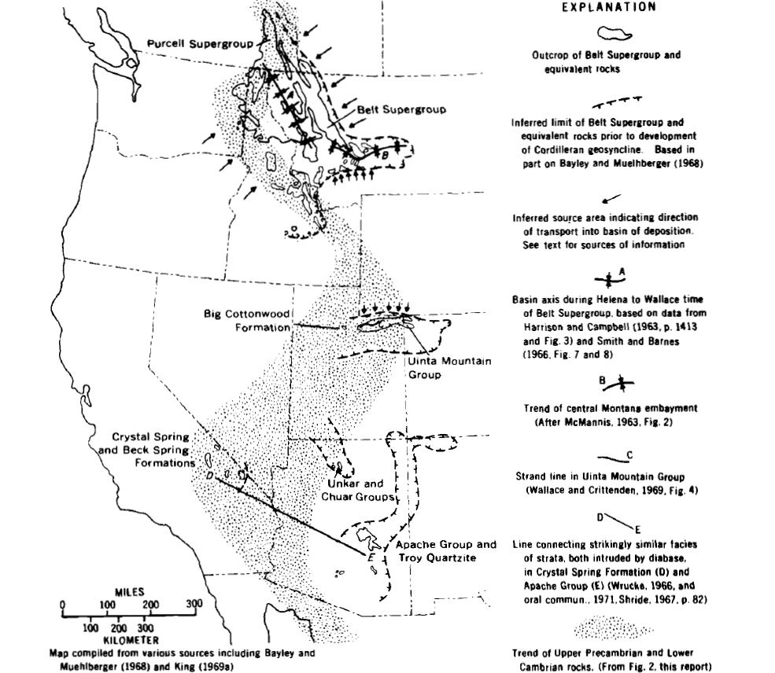
Initial Deposits in the Cordilleran Geosyncline: Evidence of a Late Precambrian (<850 m.y.) Continental Separation
Stewart, 1972
Presented by yours truly: Michael Say
How did the passive margin depositional sequences initiate?

Slide 2
Methods
Purpose
Stratigraphic comparison from published works
Describe the stratigraphy of the upper Precambrian (Windmere Group and equivalent rocks) along with the overlying lithologically similar Lower Cambrian strata and to compare this sequence of rocks with the underlying and overlying rocks
Some geochemistry and K-Ar geochron
Application of new plate tectonic theory
To determine the cause for the change in stratigraphy post deposition of the Belt Supergroup (and equivalent rocks: 850 to 1,250 Ma)
Likely a major Orogenic event: Continental Separation???

Slide 3
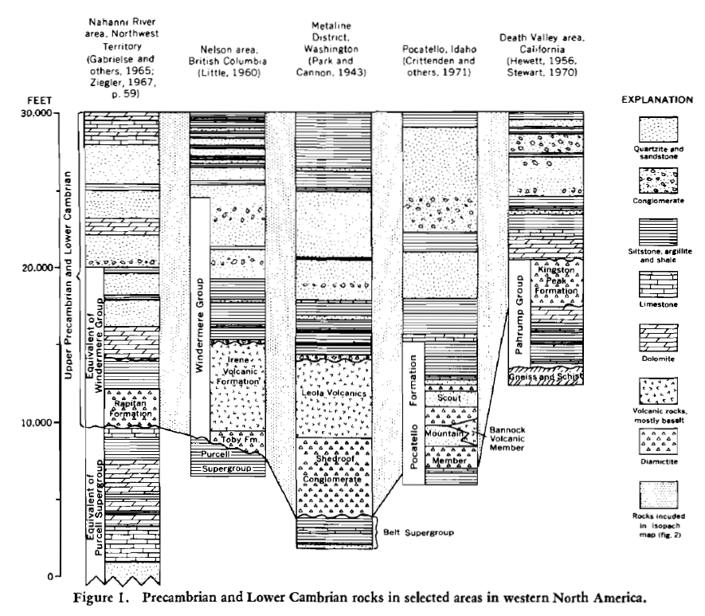
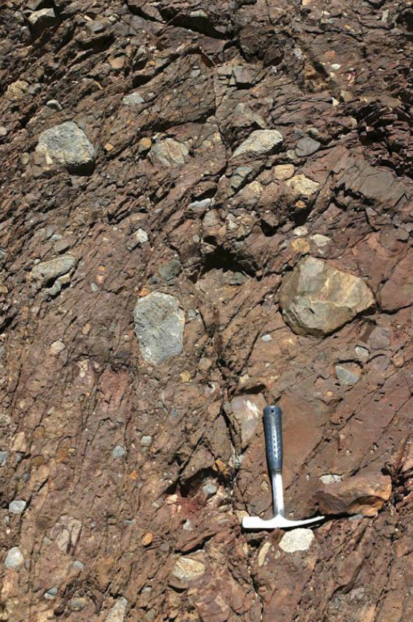
Two Stratigraphic packages
Two Sequences:
Belt Supergroup and equivalent rocks (850-1,250 Ma)
Deposited in east-west trending troughs
Windermere Group and equivalent rocks (<850 Ma)
Deposited north-south striking
Basal unit is a diamictite: (subangular pebbles to boulders (5-8 ft. across) in a muddy, silt matrix
Volcanics: Metamorphosed tholeiitic basalt, pillow basalt, some limestone and argillite are interstratified
Geochemically similar to ocean basalts

Slide 7
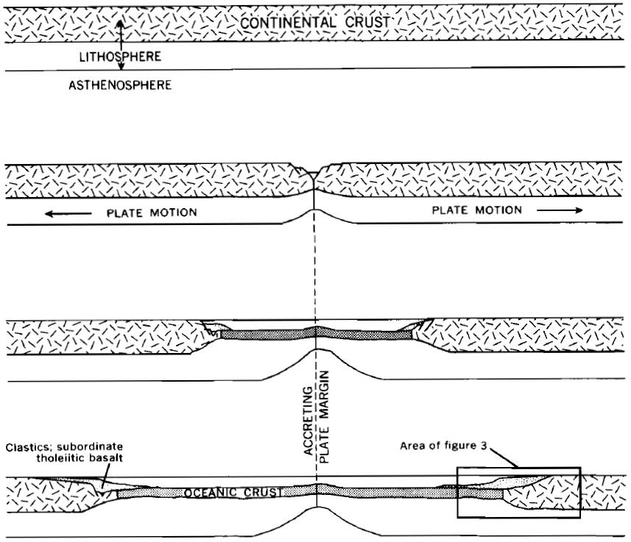
Timing of Continental Separation
Occurred post the deposition of the youngest Supergroup rocks (<850 Ma)
Might be younger than 750 Ma from K/Ar ages of intrusions intruding the Purcell Supergroup

Slide 8
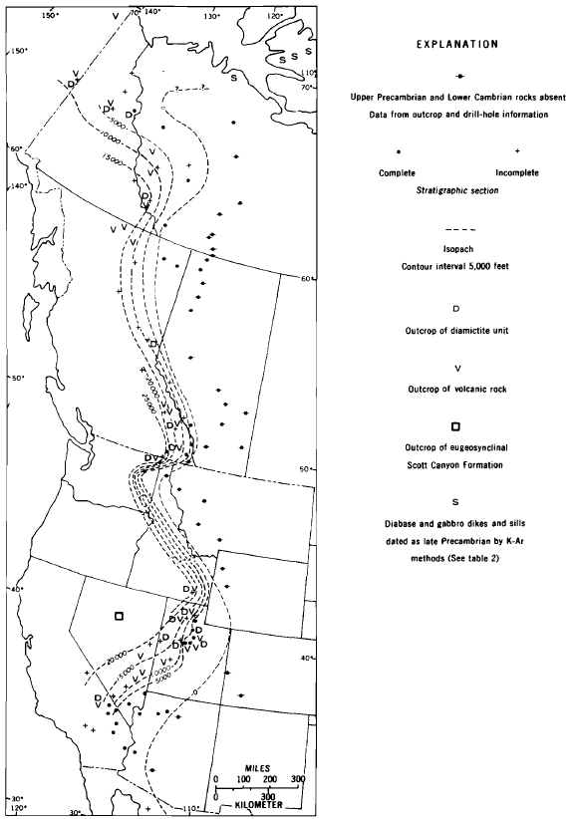
Conclusions
The north-south trend of the Windermere Group (<850 Ma) and younger rocks cuts across the existing grain of the east-west trending Supergroup rocks (850-1,250 Ma)
Indicative that the tectonic setting of western NA changed prior to deposition
Based on distribution and thickness pattern, the Windermere Group and younger rocks were the first to be deposited in the geosyncline (passive margin)
Deposition of passive margin sequences and sparse tholeiitic basalts are evidence for Continental Separation that occurred <850 to ~750 Ma

Slide 9
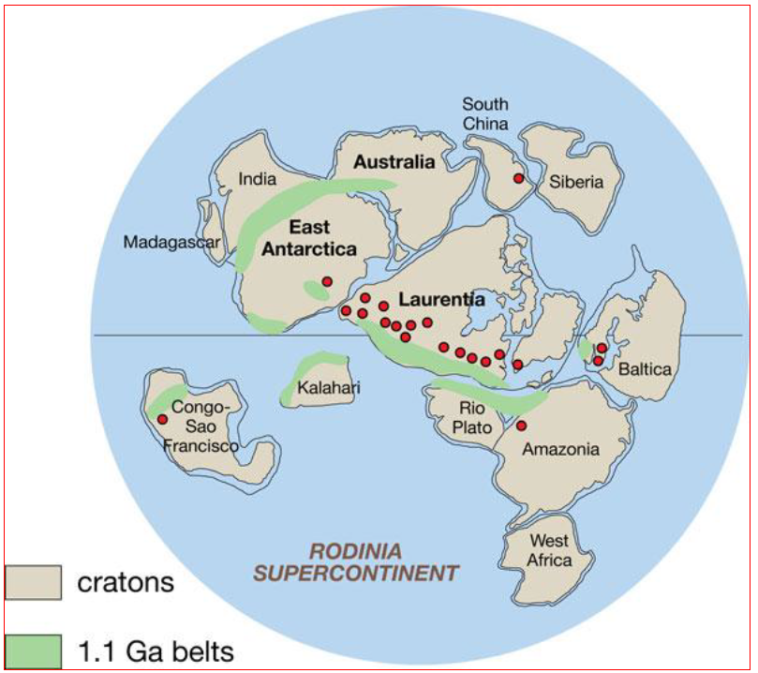
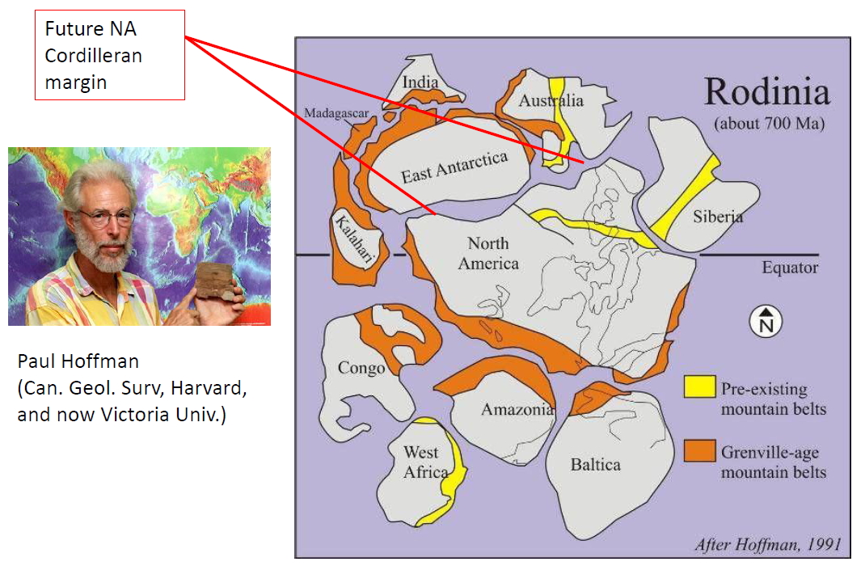
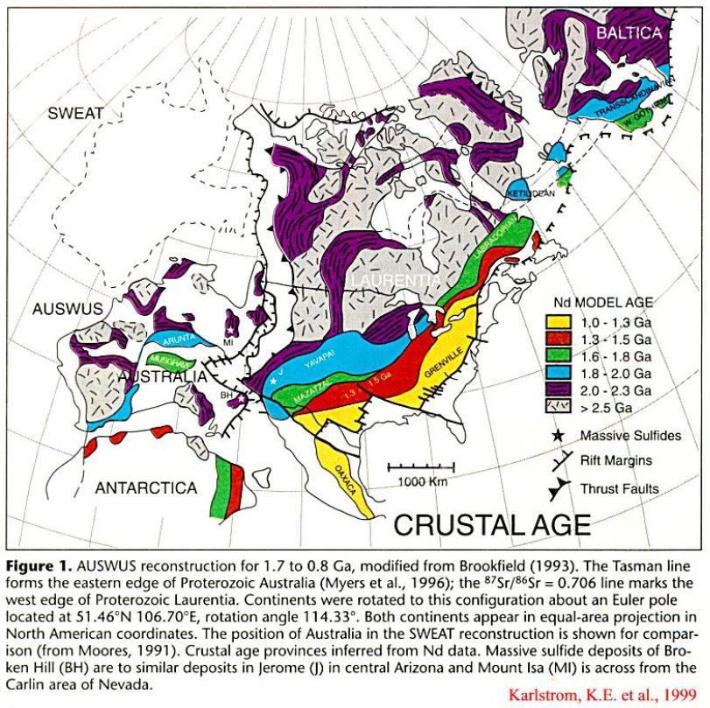
Modern Theories
SWEAT hypothesis
Moores, 1991
AUSWUS hypothesis
Karlstrom et al., 1999

