Slide 1
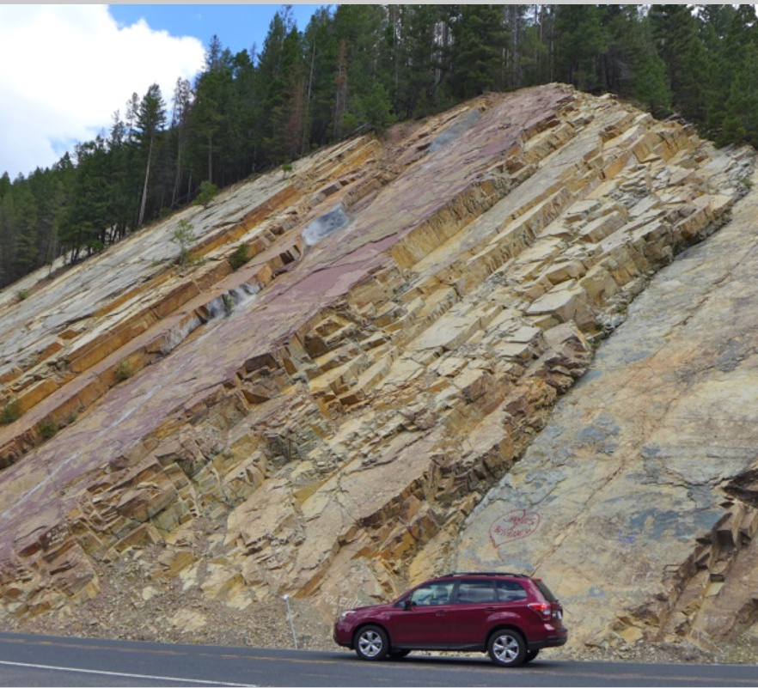
Late precambrian evolution of north America: plate tectonics implication
Stewart, 1976
Photo is of belt supergroup rocks along Montana highway from formontana.net

Slide 2
Motivation
Describe the change from “belt” supergroup rocks deposited in intra continental basins in the Precambrian, to miogeoclinal rocks deposited at the continent margins in the late Precambrian to Cambrian
Understand how plate tectonics can be attributed to this change

Slide 3
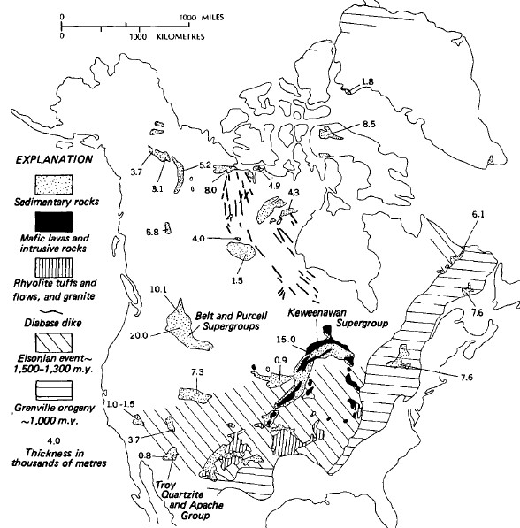
Precambrian rocks
1,700 to 850 Ma
The two supergroups were deposited in fault bounded “epicratonic” basins
Each contain more than 15,000m of sediments and volcanic rocks
Other Precambrian rocks were deposited in shallower troughs
Two orogenic events are also represented with the Elsonian event, and the Grenville orogeny

Slide 4
Significance
Deposition is localized within the craton
The highest amount of deposition occurred in the large supergroup basins
Notes:
Schoonover sequence divided into ten stratigraphic members by Fagan 1962 who first mapped them

Slide 5
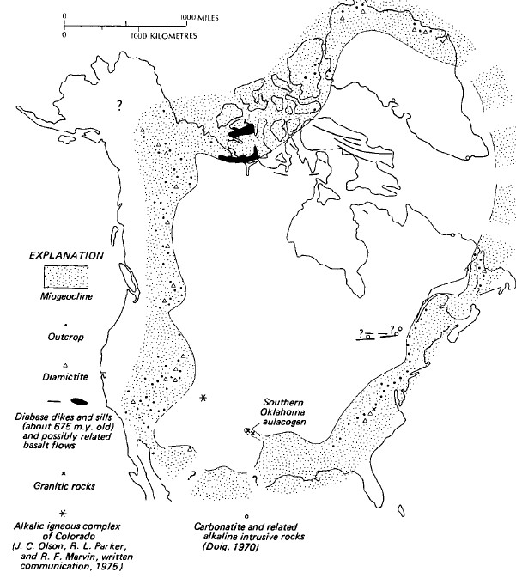
Late Precambrian and lower Cambrian rocks
850 – 540 Ma
Remarkably similar detrital sequence across north America
Thin sandstones on the craton edges grading into thick miogeoclinal sequences away from the continent
Voluminous mafic volcanic rocks (Aged ~645 Ma) are widespread in the Canadian arctic

Slide 6
Significance
Deposition occurred mostly along the continental edges
Interpreted to have followed a widespread rifting event in the late Precambrian (850 Ma)
This is less clear along the west coast, as there is arguments that an ocean margin already existed there
Notes:
NOTE
These late Precambrian and early Cambrian miogeoclinal rocks are deposited in much the same pattern as later Paleozoic rocks.
Indicating that these were probably the initial deposits in the Cordilleran and Appalachian geosynclines.

Slide 7
Discussion
Beginning as early as 2,000 Ma, the plate tectonic regime that the rocks studied in this paper record is that of cratonic instability
Basins and troughs developed within the craton from 1,700 – 850 Ma, as well as emplacement of extensive basaltic dyke swarms
There was a distinct change in the tectonic setting of NA at 850 Ma, that may indicate that the entire continent began rifting along its margins
Following this change at 850 Ma, the craton has acted more or less stable in that it has remained in the same configuration, as evidence by the spatial correlation of Precambrian miogeoclinal rocks and Paleozoic rocks
<17Ma

Slide 8
Questions?

