Slide 1
Stewart, J.H. and Suczek, C.A., 1977. Cambrian and latest Precambrian paleogeography and tectonics in the western United States.
Presentation by Kurt Kraal

Slide 2
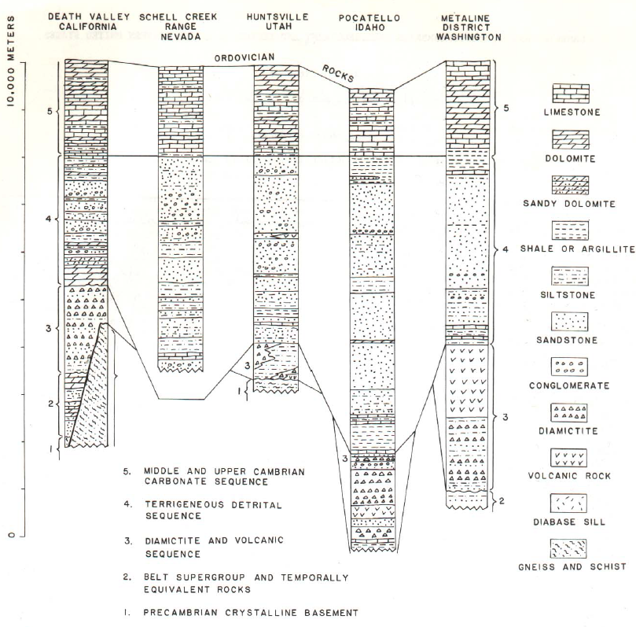
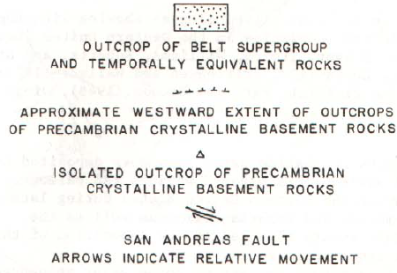
540-500 My
650-540
900-800 My
1450-900
2,400-1450

Slide 3
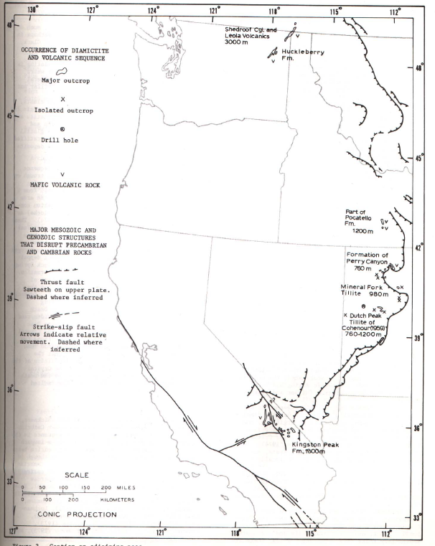
540-500 My
650-540
900-800 My
1450-900
2,400-1450
Notes:
Unit 3:
Primarily Diamictite: terrigenous sediment containing particles that range in size from clay to boulders, suspended in a matrix of mudstone or sandstone
Volcanics are primarily altered basalt
Common dropstones suggests glacial coastline
May be associated with pre-Cambrian normal faulting

Slide 4
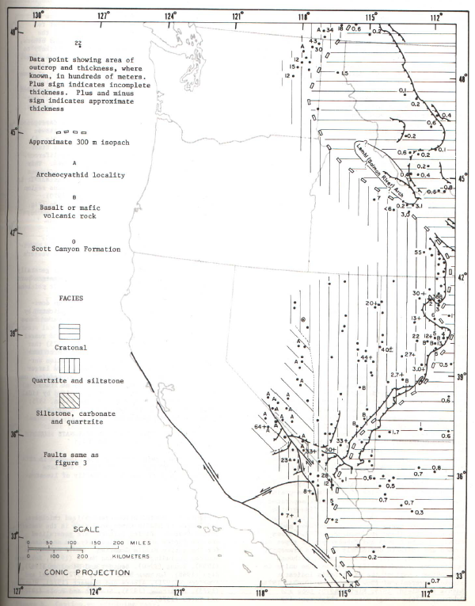
540-500 My
650-540
900-800 My
1450-900
2,400-1450
Notes:
Precambrian-early Cambrian detrital sequence: Mostly quartzite, fossils indicate that it was shallow. It thickens in the west (1000s of meters thick in some places) Death valley area has more carbonates

Slide 5
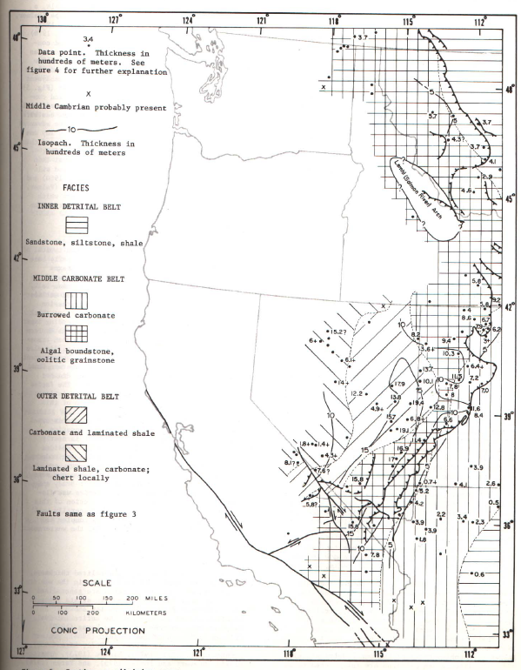
540-500 My
650-540
900-800 My
1450-900
2,400-1450
Notes:
Middle Cambrian rocks: dolomite and limestone (with some shale and quartzite)
Suggest transgression of the sea onto the craton that began in the late Precambrian
Thickness of both middle and upper Cambrian rocks is about 1/3 of that of the upper Precambrian and lower Cambrian rocks in the west (where seds are the thickest)

Slide 6
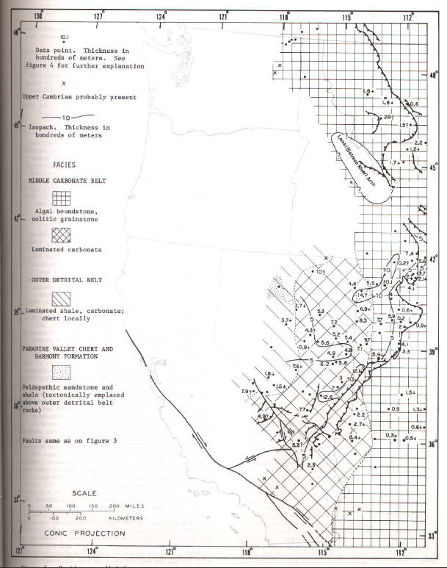
540-500 My
650-540
900-800 My
1450-900
2,400-1450
Notes:
Upper Cambrian similar to middle Cambrian, but there's a few brief regressions in sea level observed by the shale and sandstone layers

Slide 7
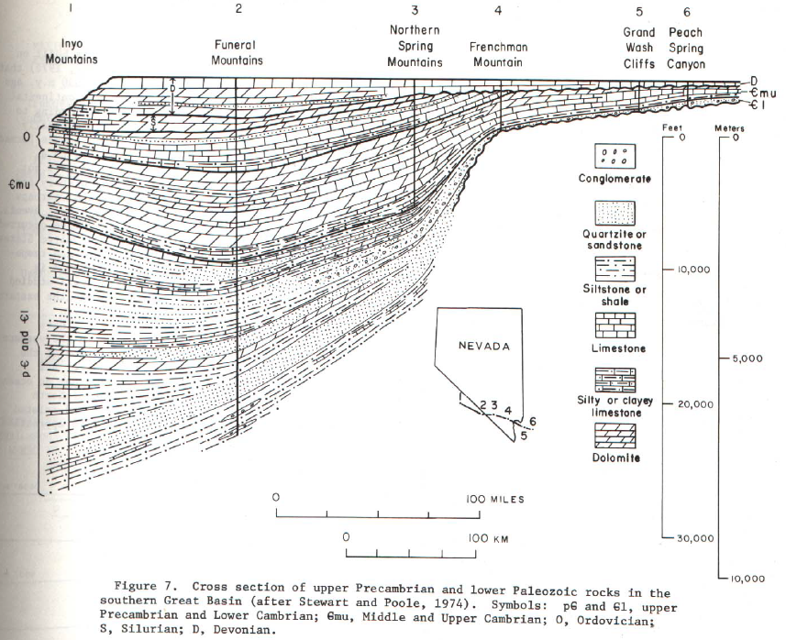

Slide 8
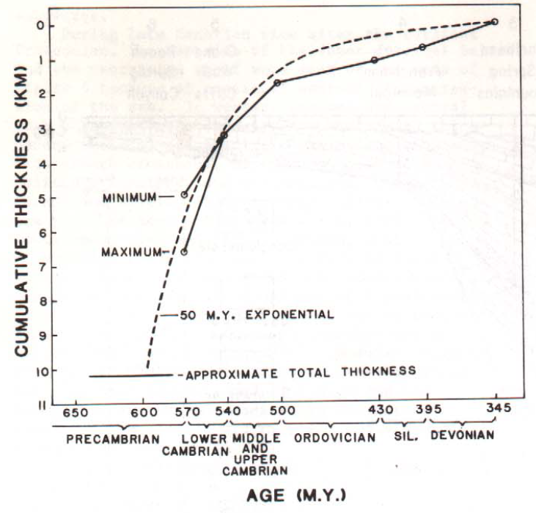

Slide 9
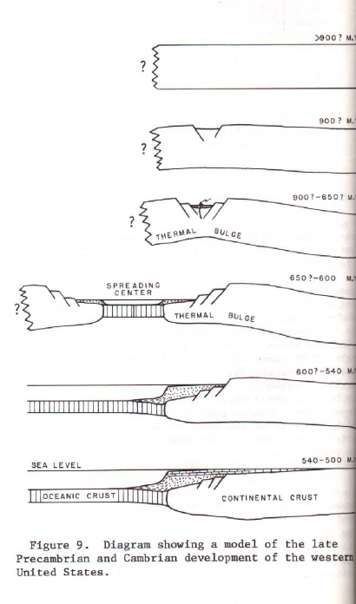
Summary
Diamictite and volcanics may have been deposited in rift valleys
The Terrigenous detrital sequence wad deposited when the shelf margin was well established. Shelf margin continued into the Devonian
The rifting that possibly created this shelf could have caused a highland due to thermal expansion, which could provide sediments up until the early Cambrian
By the end of early Cambrian time, the highland was largely destroyed (by erosion and thermal contraction)
This allowed the sea to transgress eastward.

Slide 10
