Slide 1
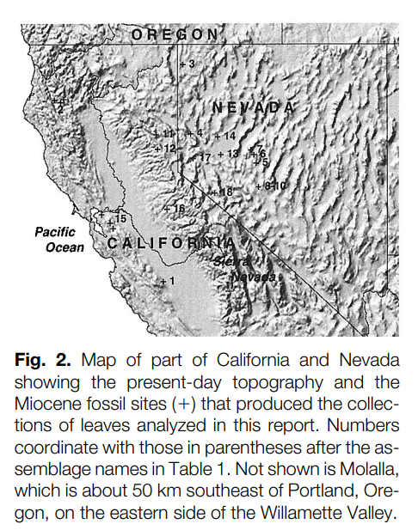
Paleobotanical Evidence for High Altitudes in Nevada During the Miocene
Jack A. Wolfe,* Howard E. Schorn, Chris E. Forest, Peter Molnar - 1997
Presentation by: Iza Ogilvie
Motivation/Purpose
Estimate paleo-altitudes of the Basin and Range Province.
Analyses using 12 mid-Miocene floras from western Nevada.
Compare the results of two paleobotanical methods.

Slide 2
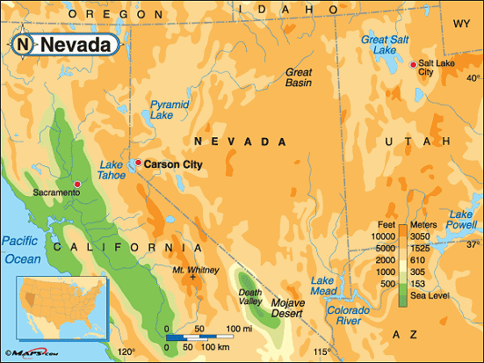
Previous Work
It was previously assumed that plants do not evolve by adapting to different environments.
Environmental tolerances of a fossil species were assumed to be the same as those of its closest living relative.
Paleobotanical data using this method indicated that the Basin and Range province was at low altitudes (<1 km) until ~5 million years ago when uplift was inferred to have started.
Present day altitudes of ~1 to 1.5 km.
It has been suggested that this recent uplift helped initiate late Cenozoic glaciation.
https://www.netstate.com/states/geography/mapcom/nv_mapscom.htm

Slide 3
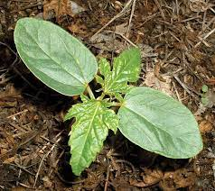
Methods
Results from the previous method were considered doubtful because plants do adapt to different environments.
A second method instead relates the physiognomy (the form of leaves) of plants to their environment.
Physical aspects of leaves (outlines, shapes, sizes) can be observed to change along with present-day environmental gradients.
Leaves of 20 species of woody dicots were collected to calibrate changes in environmental parameters.
CLAMP (Climate-Leaf Analysis Multivariate Program)

Slide 4
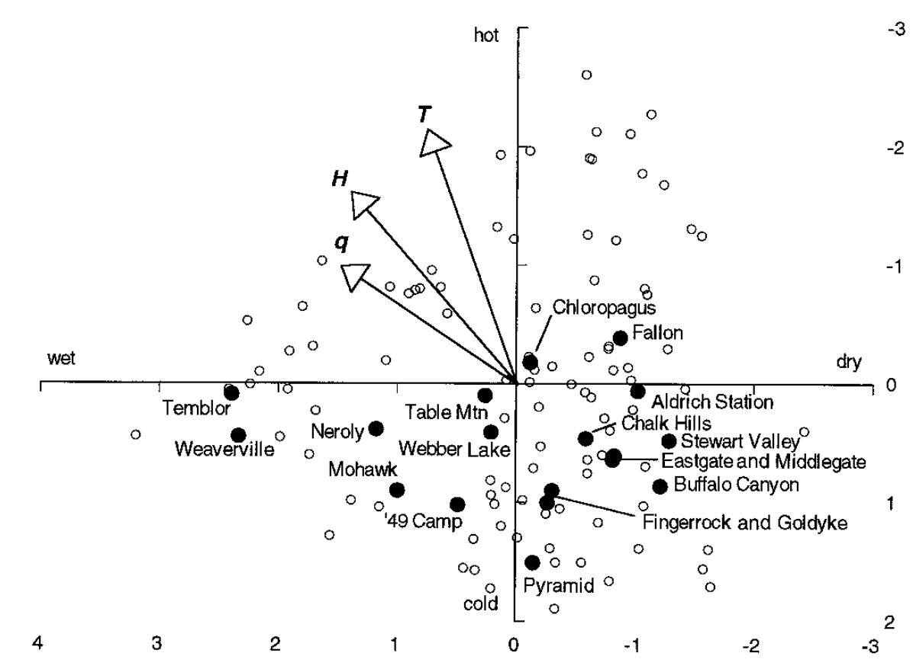
Methods
Concentrated on mean annual temperature (T), specific humidity (q), and enthalpy/total heat content of the system (H).
Environmental factors
Solid circles-Fossil leaf assemblages
Open circles-Modern samples
Water stress
Temperature factors
Length of the environmental vector approximates the significance of the factor in explaining variation
Enthalpy varies relative to altitude
almost as significant as temperature

Slide 5
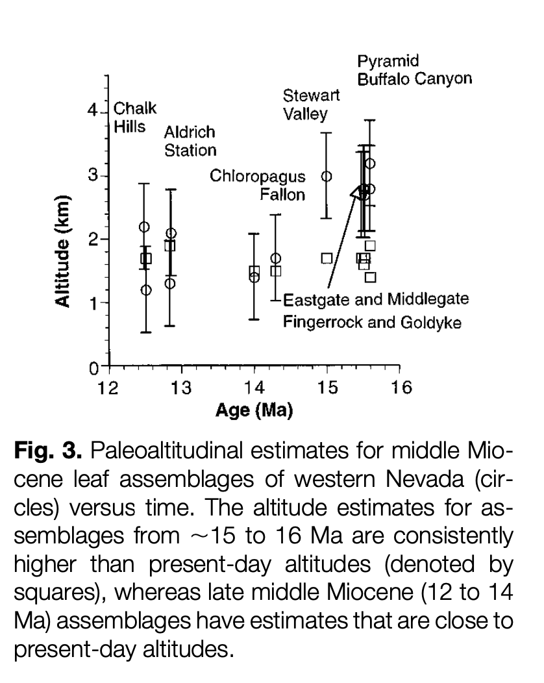
Results
late-middle Miocene (12 to 14 Ma) assemblages are close to present-day altitudes.
Squares – present day altitudes.
Circles – fossil leaf assemblages
Assemblages from ~15 to 16 Ma are consistently higher that present-day altitudes.
Collapse may have occurred between 14 and 15 Ma.
Assemblages from the Sierra Nevada and northern California all have paleoaltitudinal estimates within 700 m of present-day altitudes at the fossil localities.

Slide 6
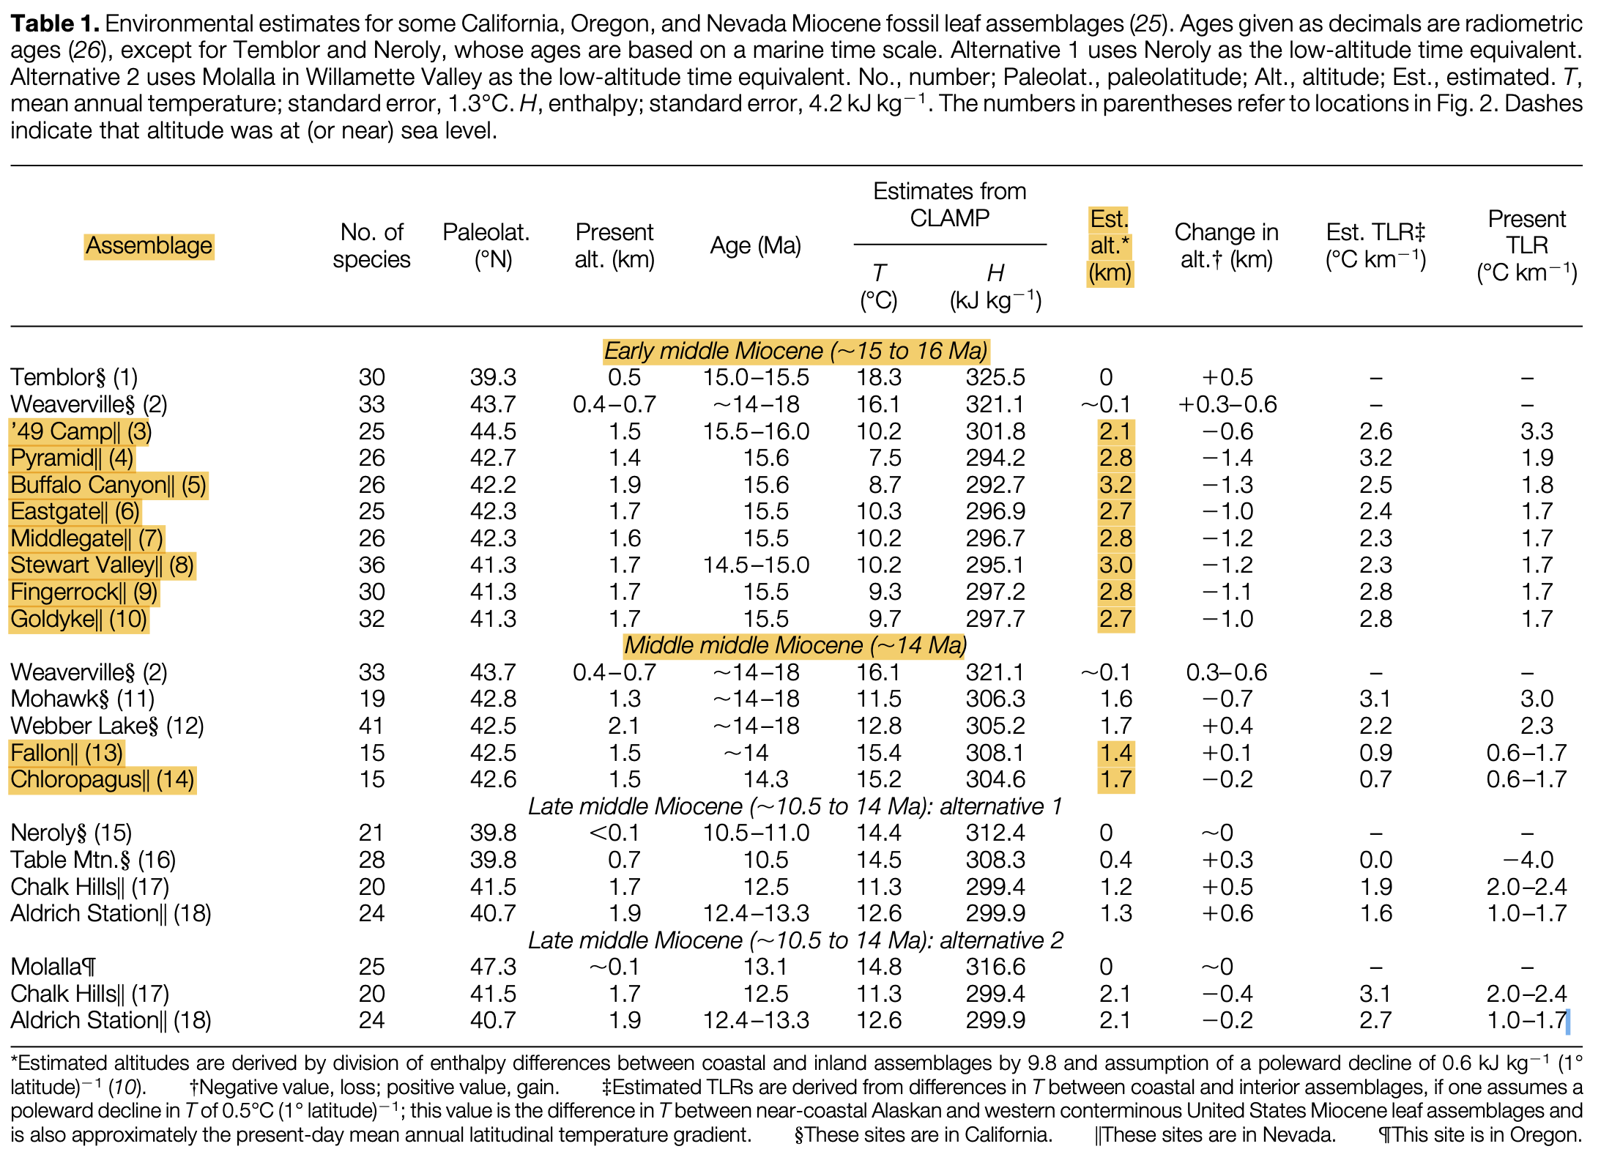
Estimates of enthalpy from CLAMP.
Assemblages in rocks deposited from ~15 to 16 Ma imply paleoaltitudes of 2.9 to 3.2 km.
Close to present altitudes.
Collapse might have occurred between 14 and 15 Ma.

Slide 7
Conclusion
Paleobotanical evidence supports the hypothesis that Mesozoic thrust faulting and crustal thickening built a high terrain in what is now the Basin and Range Province.
Altitudes in Nevada could have been higher than ~3 km before 16 Ma.
Results imply decreasing altitudes around the time that most Basin and Range style faulting began.
Late Cenozoic uplift of Nevada appears to not have occurred.
Many previous estimates may have been much too low.

