Slide 1
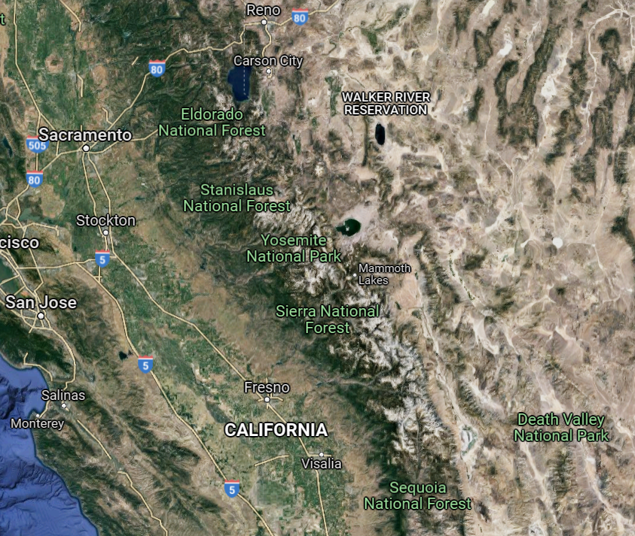
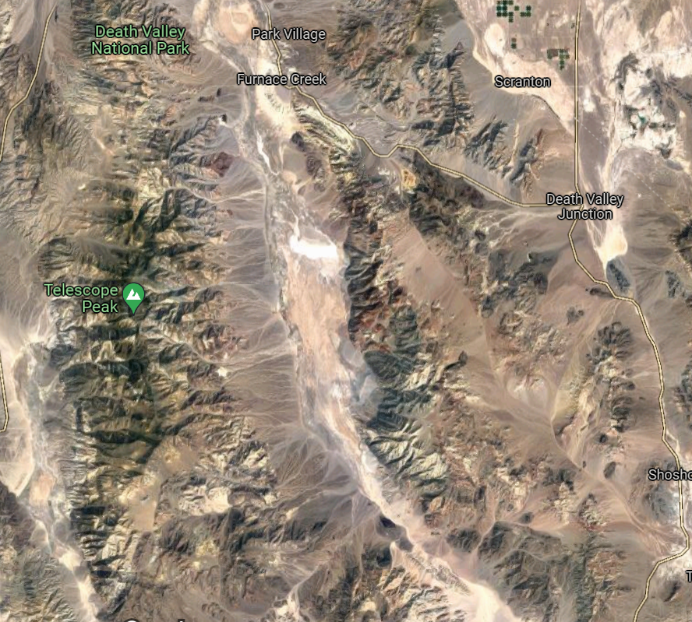
Death Valley
Atticus Proctor 9/14/21

Slide 2
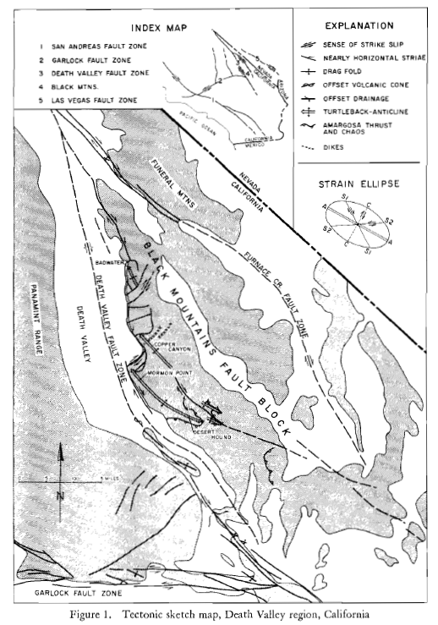
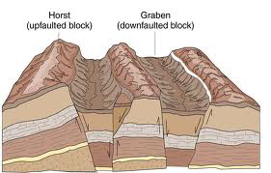
Premise for research is the geometry of Death Valley cannot be resolved using traditional Basin and Range faulting concepts
Authors propose that the complex tectonics in Death Valley are part of a single larger system of deformation, regionally related to right-lateral slip on the San Andreas fault
Timing: Tertiary to present
From University of Wisconsin Geoscience

Slide 3
Evidence for right lateral slip:
Striations plunging 30° NW on fault surfaces bounding the Black Mountains
Right-lateral offset on a volcanic cone in Death Valley
Right-lateral offset of drainages
En echelon pattern of turtlebacks
Turtleback anticlines formed when a fault contact developed between crystalline Precambrian rocks and incompetent Tertiary rocks

Slide 4
Conclusions:
The structures in Death Valley are manifestations of northeast-southwest shortening and northwest-southeast extension due to regional strike slip motion
The compatibility and apparent contemporaneous nature of the structures further reinforces a single system of deformation since the early Tertiary
Compressional forces are responsible for these tectonics, not tensional
Final arm waving: the authors propose that the strike-slip system of faults seen in Death Valley could be applied to other structurally complex areas of the Great Basin.

Slide 5
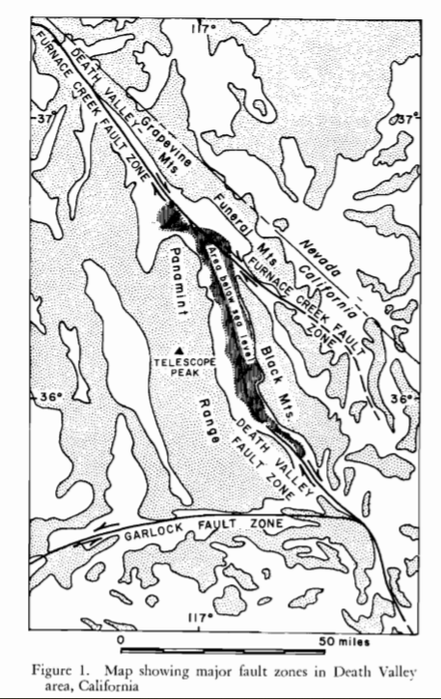
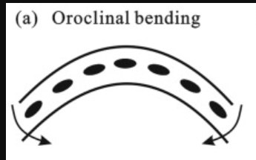
Claims the central part of Death Valley is a graben that formed due to a tensional zone between the Furnace Creek Fault and Death Valley right lateral strike slip zones
Aim is to show how tension led to the development of Death Valley
Up to 50 miles of right lateral offset
Displacement is also accommodated by large oroclinal folds
Deng et al., 2013

Slide 6
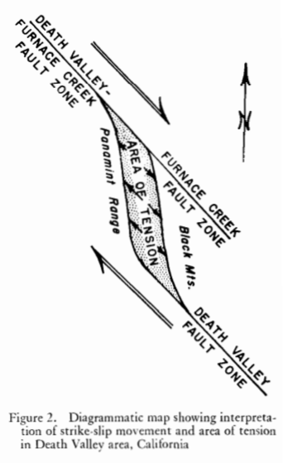
Claims the central part of Death Valley is a graben that formed due to a tensional zone between the Furnace Creek Fault and Death Valley right lateral strike slip zones
Up to 50 miles of right lateral offset
Displacement is also accommodated by large oroclinal folds

Slide 7
Works Cited
Burchfiel , B. C., and Stewart, J. H., 1966, "Pull-apart" origin of the central segment of Death Valley, California, Geological Society of America Bulletin, 77, 439-442.
Deng, B., Liu, S., Liu, S., Jansa, L., Li, Z., & Zhong, Y. (2013). Progressive Indosinian NS deformation of the Jiaochang structure in the Songpan-Ganzi fold-belt, Western China. PloS one, 8(10), e76732.
Hill, M. L. and Troxel, B. W. 1966. Tectonics of Death Valley Region, California, Geological Society of America Bulletin, 77, 4, 435-438
http://geoscience.wisc.edu/~chuck/Classes/Mtn_and_Plates/BsnRng_SAFZ.html

