Slide 1
Palinspastic restoration of the thrust belt places classically defined North American rocks west of the edge of North America as defined by 0.706 ⁸⁷Sr/⁸⁶Sr line
1
Havranek and Mize (unpublished manuscript)
Presented by Alex Holmwood

Slide 2
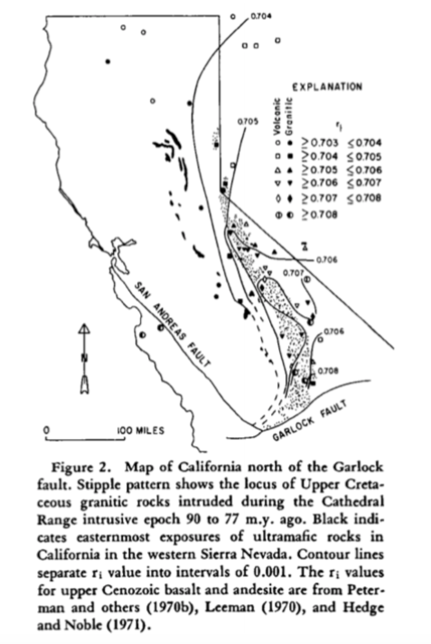
2
Initial ⁸⁷Sr/⁸⁶Sr ratio of igneous rocks in California and Great Basin varies systematically
0.706 contour near California: consistent with trend and near boundary between Paleozoic miogeosynclinal and eugeosynclinal rocks
0.706 line marks boundary between shelf deposition and eugeosynclinal deposition
Is 0.706 line a good indicator of the North American continental margin?

Slide 3
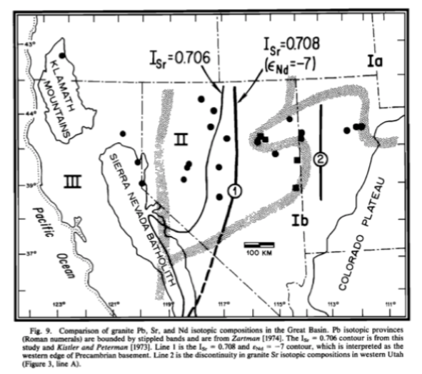
3
0.706 line ~100 W of Precambrian basement in Nevada
Runs northward to Idaho roughly along Idaho suture zone

Slide 4
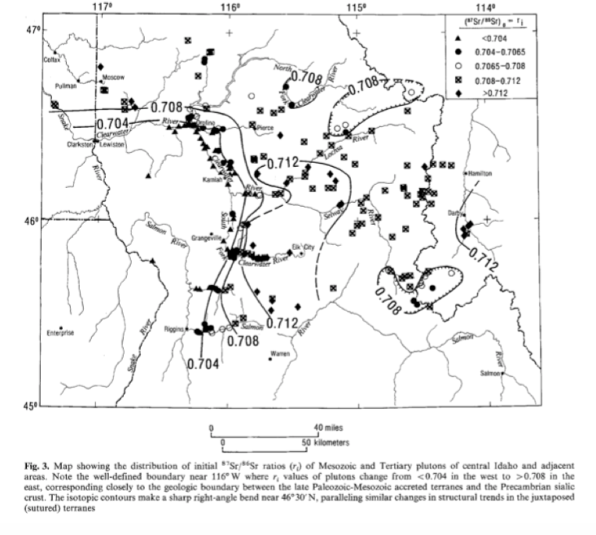
4
Idaho: klippes of material with ⁸⁷Sr/⁸⁶Sr ratio >0.706
  However, are lower than surrounding ratios

Slide 5
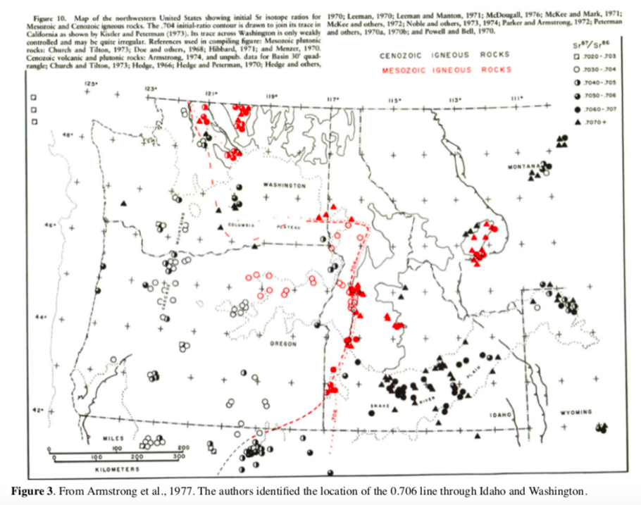
5
0.706 line not defined well in Washington or Canada
  High density of a different ⁸⁷Sr/⁸⁶Sr values
Canada: isotopic ratios occur as part of transition zone rather than a defined border

Slide 6
Conclusions
6
0.706 ⁸⁷Sr/⁸⁶Sr line not appropriate marker for edge of North America
Restoration places many North American rocks beyond shelf edge
Suture between North America and accreted terranes is >100 km west of ⁸⁷Sr/⁸⁶Sr contour (Evans and others, 2002)

