Slide 1
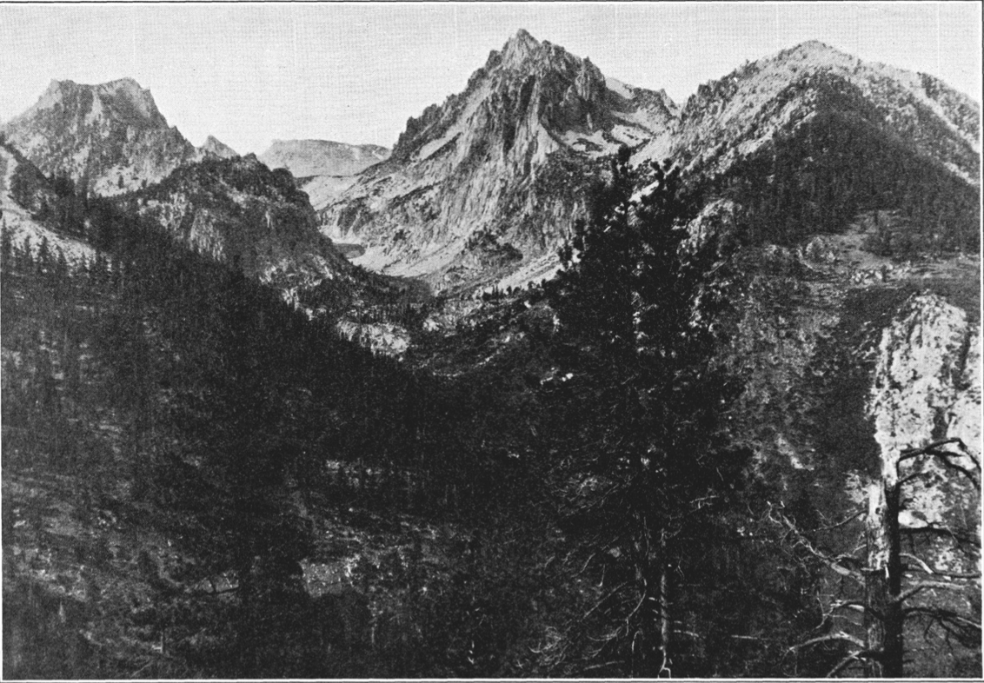
Pleistocene glaciation in the Sierra Nevada and Basin and Ranges
Blackwelder, E.B., 1931. Pleistocene glaciation in the Sierra Nevada and Basin Ranges. Geological Society of America Bulletin, 42: 865-922.

Slide 2
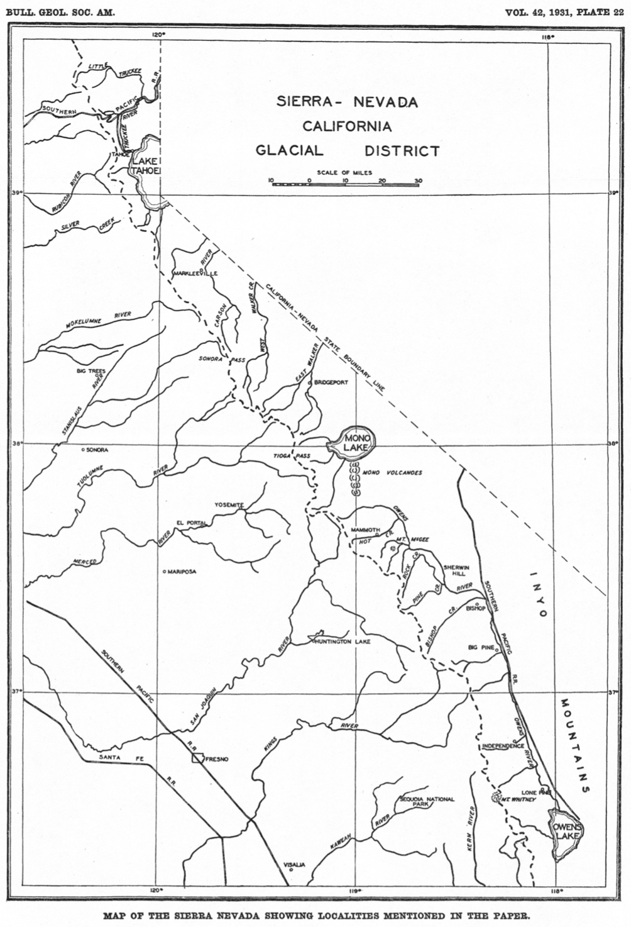
Introduction
Purpose: to explain evidence that allows the conclusion that the glacial period in the Sierra Nevada’s can be split into four-five ages
- presenting general facts and correlations with the Rocky Mountains
Glacial stages:
4. Tioga Stage
3. Tahoe Stage
2. Sherwin Stage
1. McGee Stage
Pleistocene period contained notable advances and retreats of ice
Eastern Sierra Nevada’s examined due to lack of forest

Slide 3
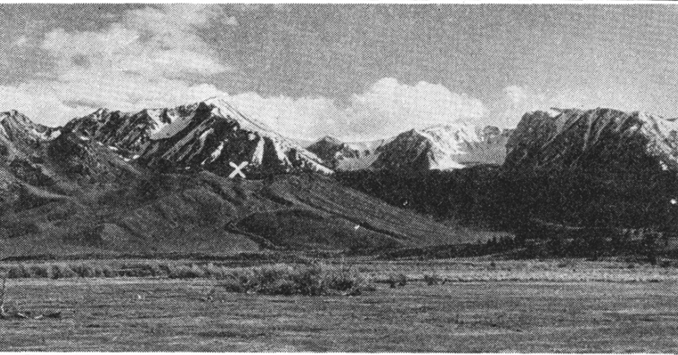
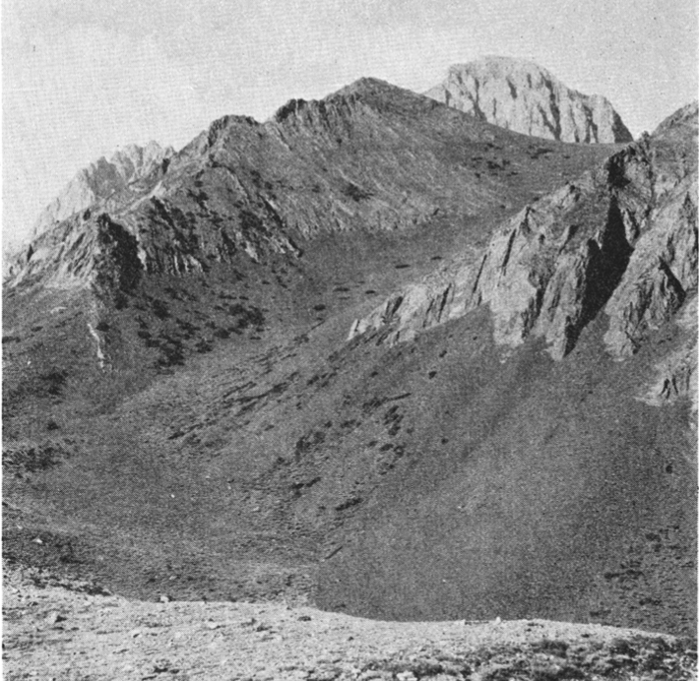
Criteria
Based off Eastern U.S.
20 criteria
Only a few applicable
No fossils
Bad soil profile
Cirques
Topographic relations
Decay, weathering, and frequency of glacial boulders
Erosional forms
Advances of talus cones in cirques
Appearance of cirques
Preservation of polished and striated rocks
Depths of valleys
Extent of destruction of terminal moraines
Extent of valley growth in moraines
Presences of stream terraces
Talus Cone

Slide 4
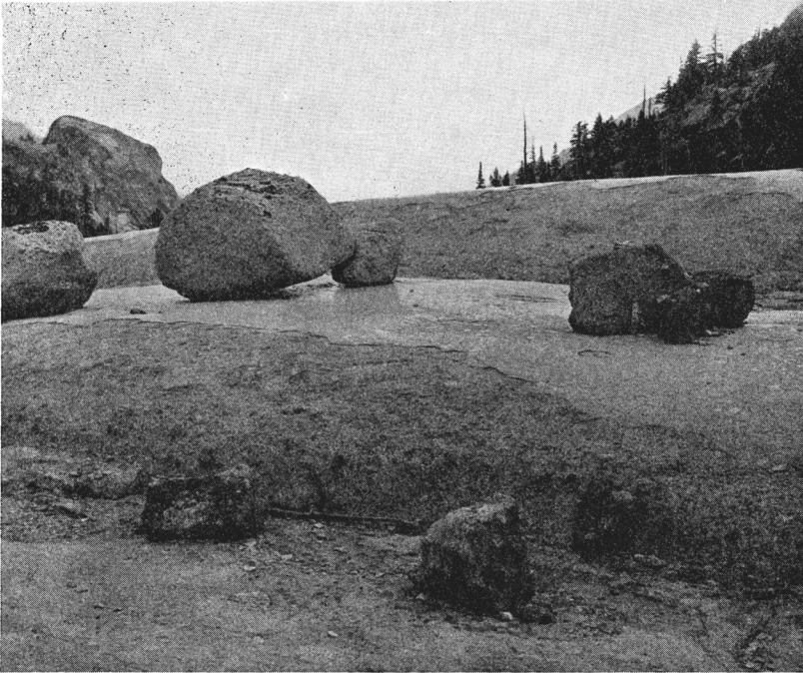
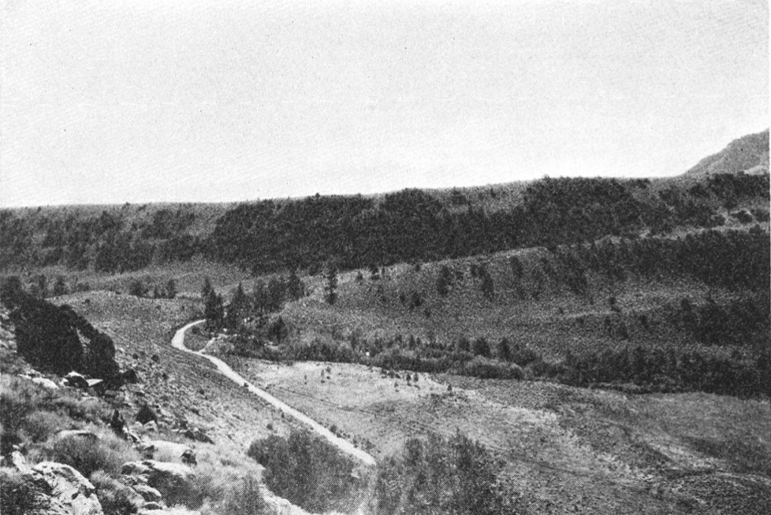
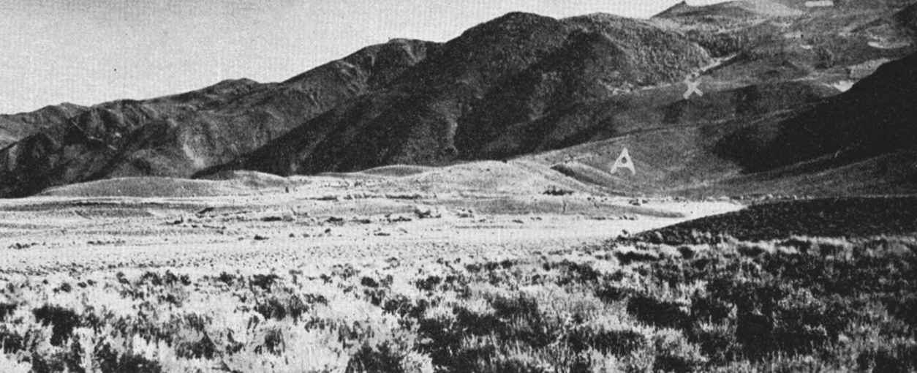
Glacial Periods
Tioga
- Serves as a basis for other stages
Original polished surfaces still intact
Terminal moraines are still intact
Lateral moraines stand out as bold embankments
Talus cones are few and small
Cirques are still large
Valleys have 50 to 300 ft deep
Ex// Fallen Leaf Lake is bounded by terminal loops
Many boulders are present
2000 boulders/acre
Little weathering except for that of forest fires
Glaciers arranged concentrically with
Tahoe moraines

Slide 5
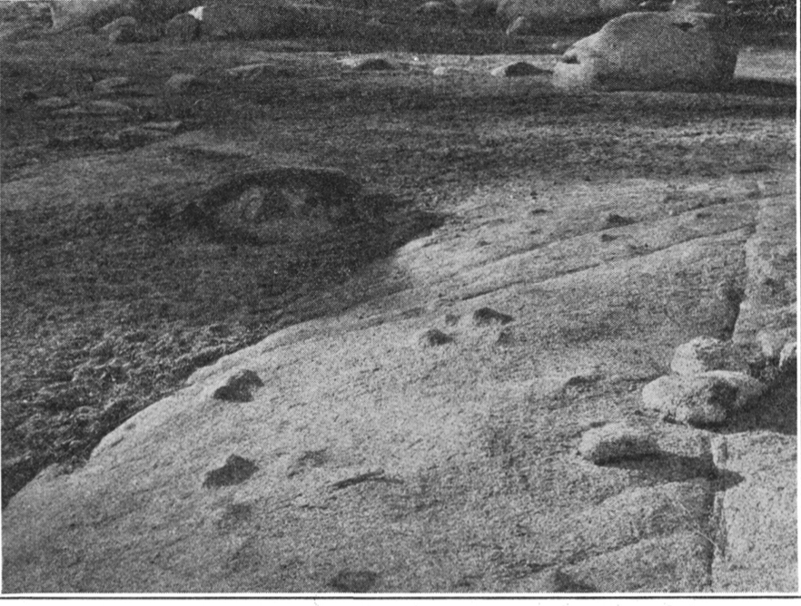
Glacial Periods
Tahoe
Name is from Lake Tahoe, west shore of Tahoe has several glaciers
Clearest moraines
Best seen in Big Pine, Pine Creek, and Owens Valley
Primary glacial features preserved but affected by weathering
Cirques that were excavated during the Tahoe stage were filled during the Tioga stage
Bare white/gray granite areas at high elevations are results of merging glacier heads
Little polished or striated surfaces present
Large moraines identifiable
All glacial lakes have disappeared
Boulders are less common
200 boulders per acre

Slide 6
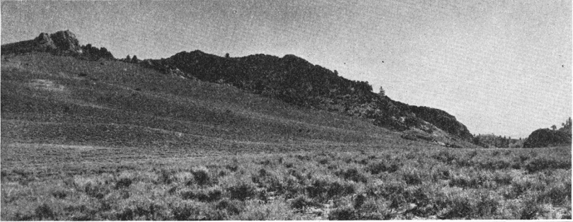
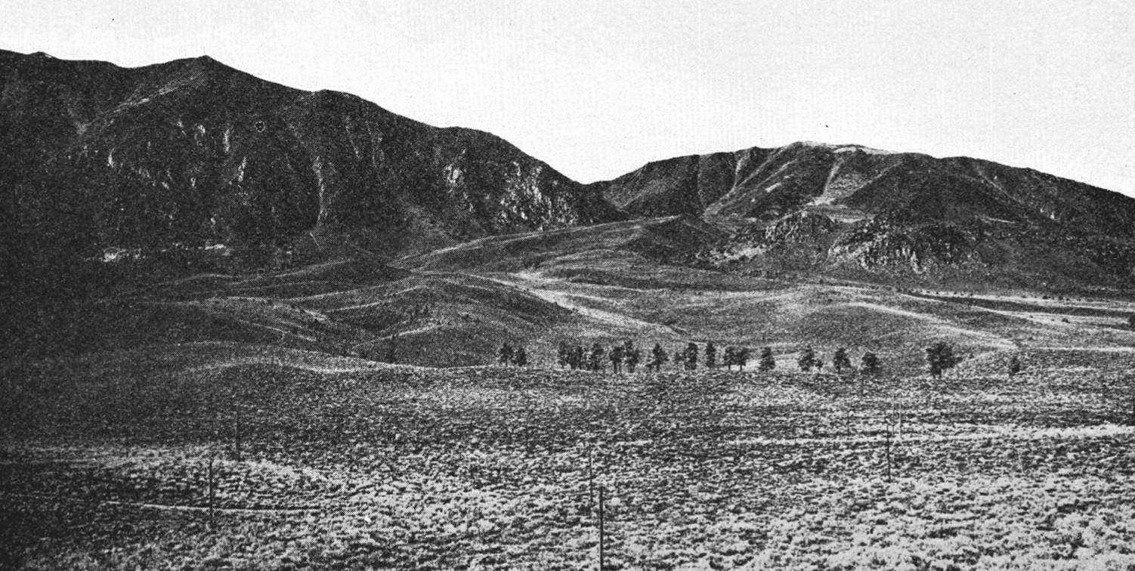
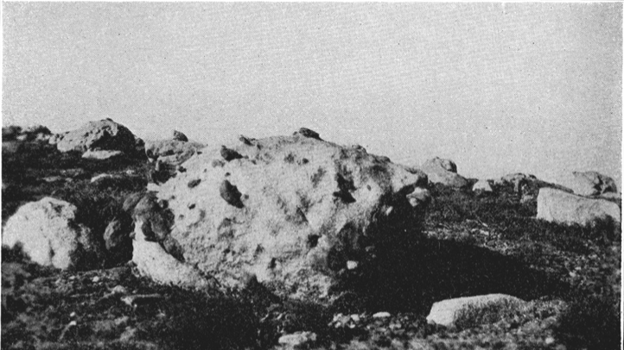
Glacial Periods
Sherwin
Topographical glacial features destroyed by stream erosion
No lakes, no cirques
lateral moraines are gone
Some evidence of terminal moraines remain
Boulders are weathered and rotten
Less common, 100 boulders per acre
Moraines are larges than Tioga and Tahoe
Evidence in old glacial till deposits
McGee
Earliest stage
Isolated areas of boulders
Mainly granitic materials
Topographic and physiographic relationship destroyed by erosion
Few areas provide reliable evidence

Slide 7
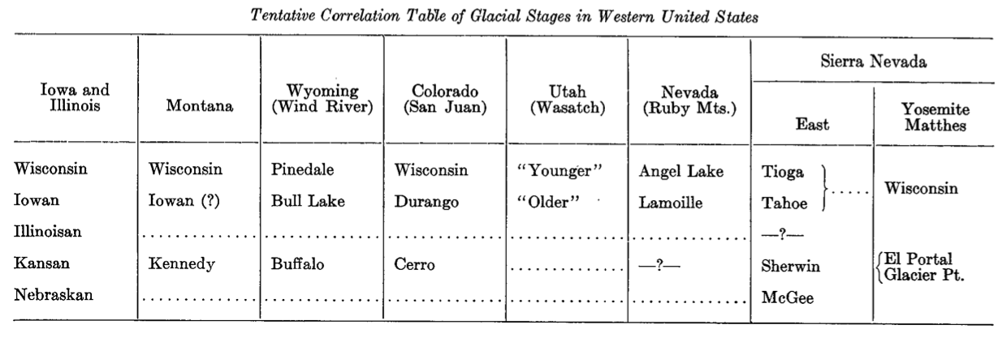
Correlation
Glacial phenomena of the eastern Sierra’s were compared to the rest of the Western U.S.
Standard section for comparison of Pleistocene glacial deposits are of Iowa, Illinois, and Wisconsin
Tioga is identical with Wisconsin stage
Tioga and Tahoe are sometimes combined
Primary glacial features associated with corresponding features of Tioga
Possible missing stage in between Tahoe and Sherwin
Obvious in the Illinoisan equivalents

Slide 8
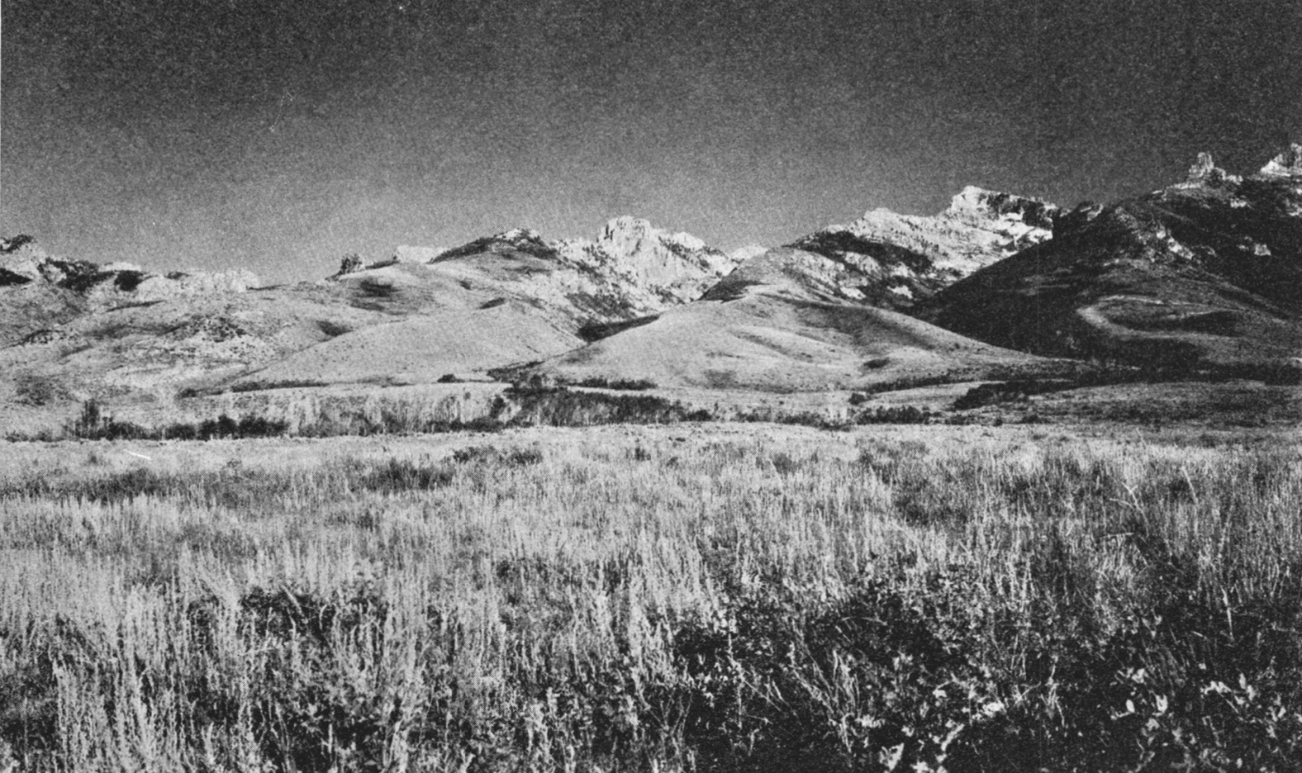
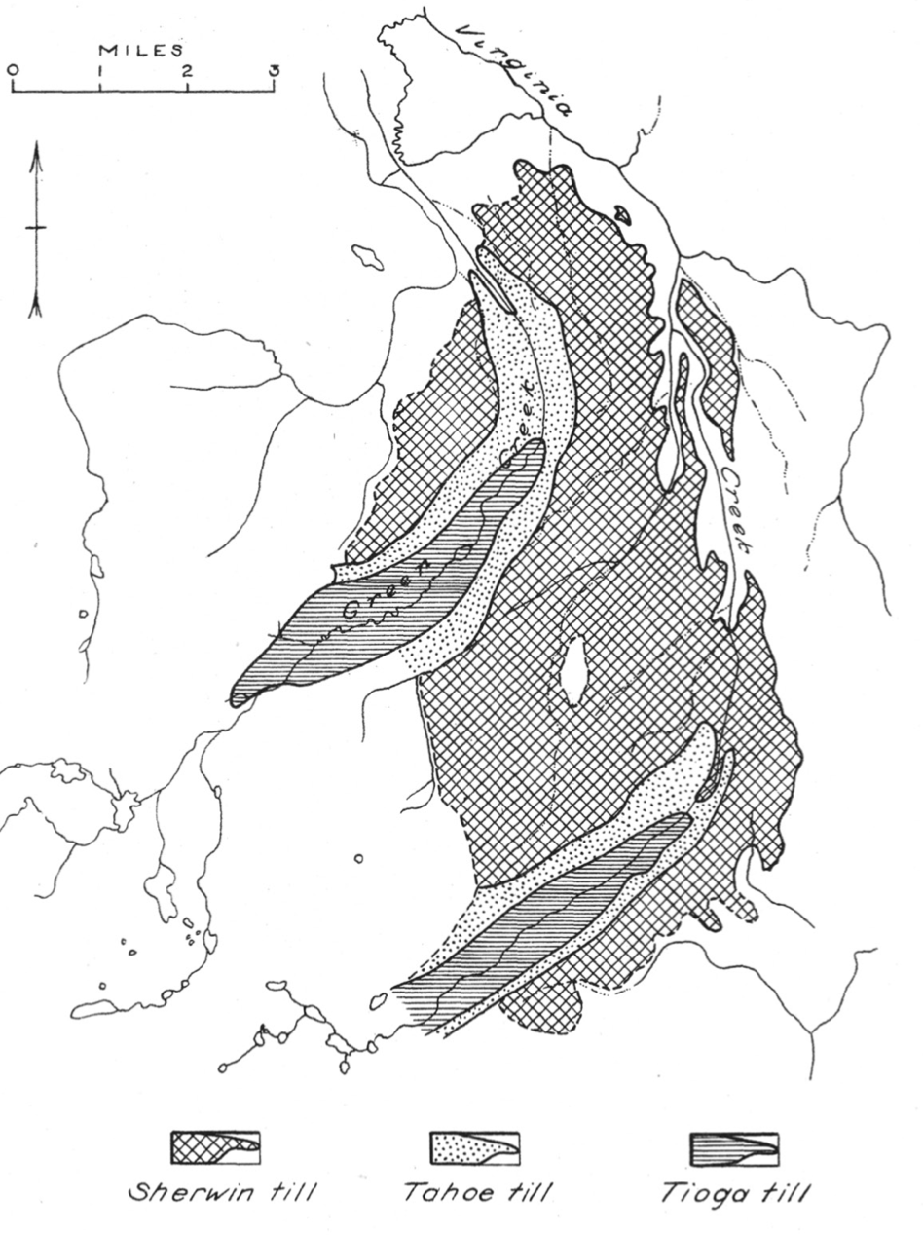
Conclusion
Glacial stages:
4. Tioga Stage
3. Tahoe Stage
2. Sherwin Stage
1. McGee Stage
Moraines of each stage were less extensive than the prior stage
Features are best preserved in the most recent Tioga Stage
Main goal is to reconstruct the Pleistocene history of the Cordilleran region
Best criteria to define this is physiographic
Further investigations are necessary in order to infer further constraints on these glacial periods

