Slide 1
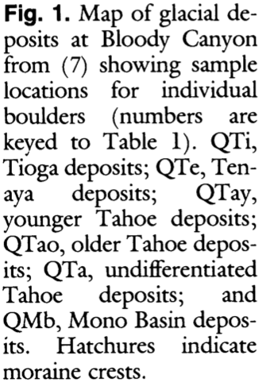
Cosmogenic Chlorine-36 Chronology for Glacial Deposits at Bloody Canyon, Eastern Sierra Nevada
Phillips et. al, 1990
Goals:
Analyze deposits from mountain glaciers
Deposits have proven to be difficult to date directly
Correlate timing of glaciations with peaks of global ice volumes inferred from the marine oxygen isotope record

Slide 2
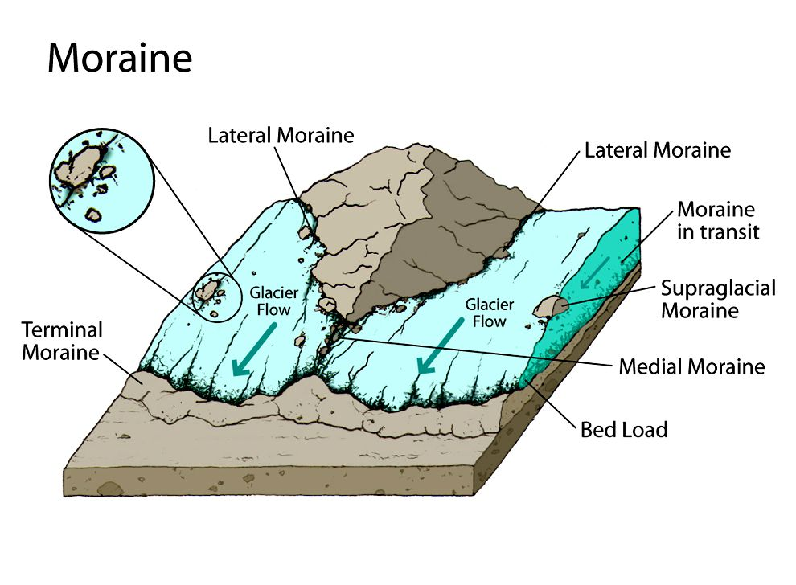
Background
Most dating methods measure the formation of minerals rather than the “age of geomorphic distribution”
Rock varnish ¹⁴C and cation ratio methods can provide limiting ages at the very least
Climate is not arid enough to develop enough varnish to adequately date boulders
A new method using ³⁶Cl cosmogenic nuclides was developed for dating glacial moraines as well as other geomorphic landforms
Dating model assumes complete shielding of the boulder followed by rapid exposure that continues without interruption until measurement
National Geographic Society

Slide 3
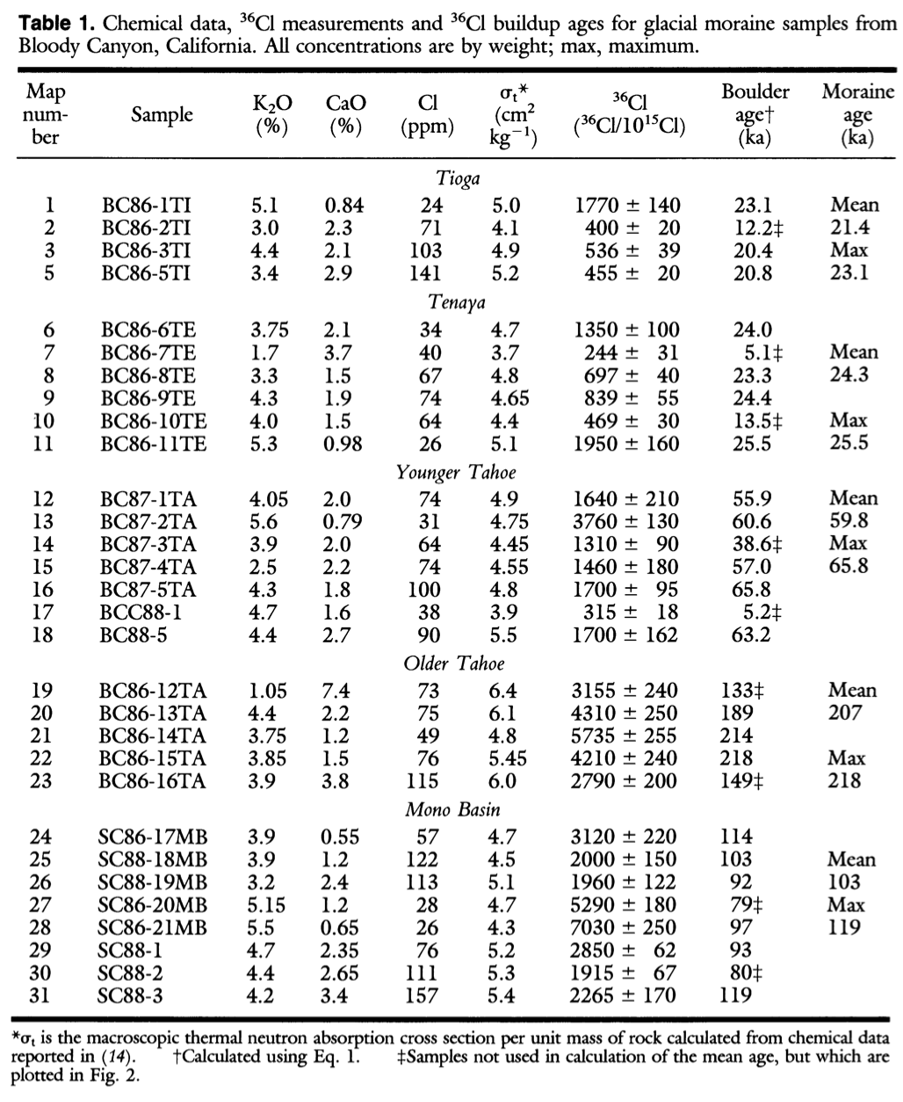
Methods
Bloody Canyon in the Mono Basin was selected for sampling because it has been well studied and a number of glacial moraines have been well-preserved there
Relative ages between moraines can be determined from topographical relationships
Measurement of Chlorine-16 accumulation produced by cosmic rays in boulders on moraine crests
Boulders at moraine crests were sampled – deemed least likely to have shifted or rolled during erosion
Tallest boulders were sampled – more likely to be exposed at the surface before erosion of the moraine crest, and their surfaces were more likely to be projected above the average snow depth
³⁶Cl/Cl ratios measured by accelerator mass spectrometry
QTi: Tioga | Qte: Tenaya
QTay: Younger Tahoe | QTao: Older Tahoe
QTa: Undifferentiated Tahoe | QMb: mono Basin

Slide 4
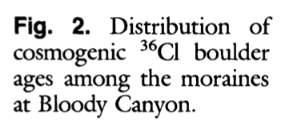
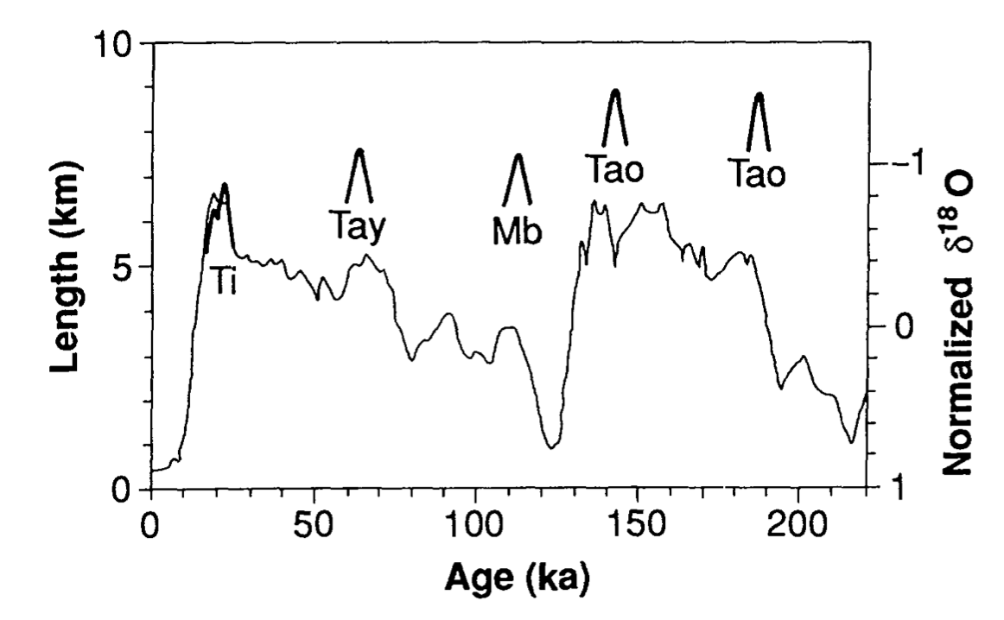
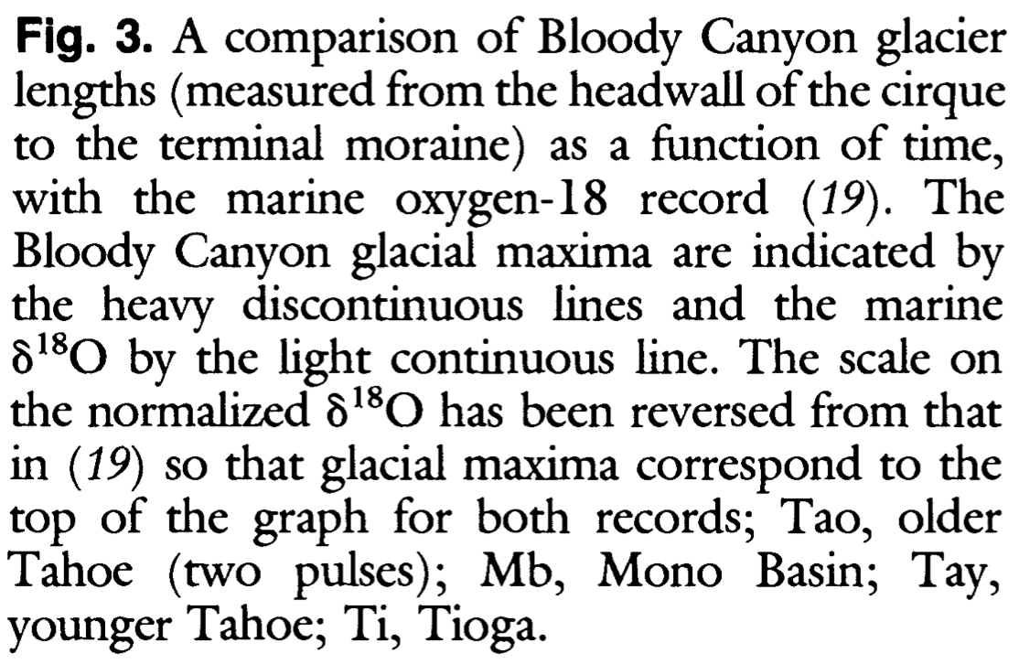
Boulder Ages and Glacial Maxima
Ages:
Tioga (Ti) near 20 ka – independent ¹⁴C dates
Tenaya (Tay) 24.3 +/- 0.9 ka
Younger Tahoe (Tao) 60 ka
Mono Basin (Mb) 110-120 ka
Older Tahoe (Tao) 140-200 ka
Marine Oxygen Isotope record correspondence:
The intervals 120-110 ka and 70-60 ka correspond to ice volume peaks during the Wisconsin
24-20 ka maximum global ice
Good agreement between timing in Bloody Canyon and global glaciation
No correspondence with magnitude – smaller moraines were deposited during maximum global ice
Conclusion:
Small mountain glaciers may respond more rapidly to global climate changes while larger ice sheets take longer to reach equilibrium with the global climate
Glacial Maxima

