Slide 1
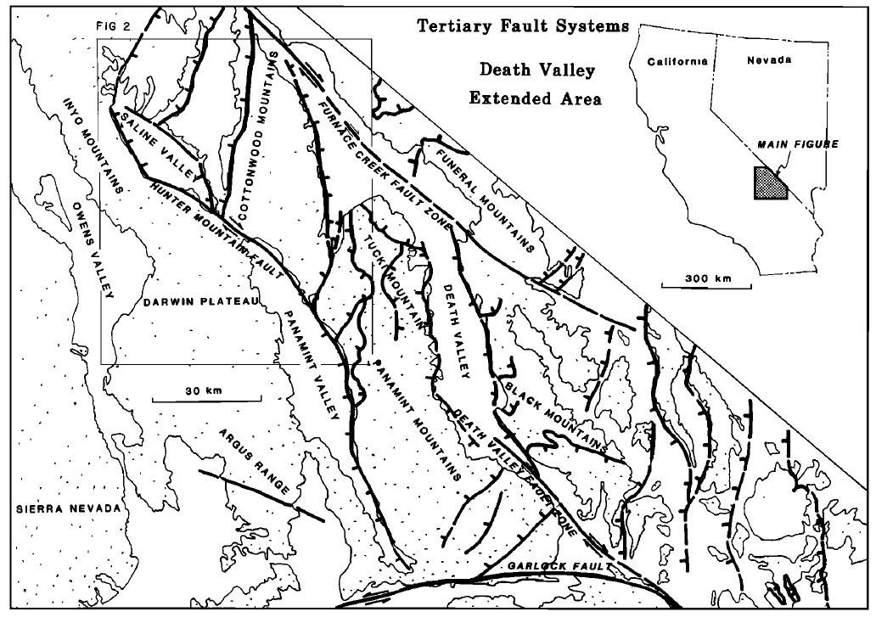
Atticus Proctor

Slide 2
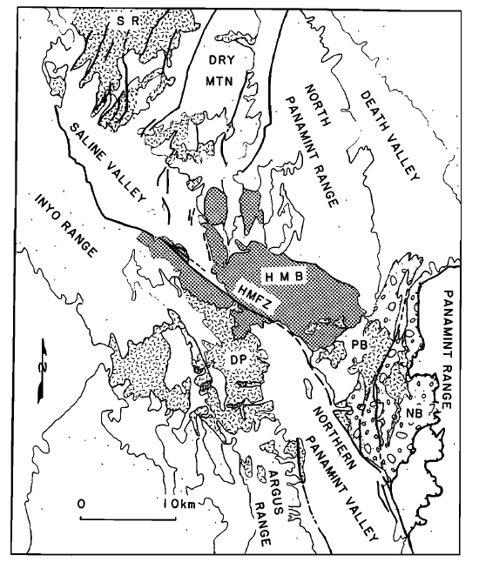
Younger Basalts
Pre –extension Basalts,
3.8-2.8 Ma
Jurassic Hunter Mountain Batholith
Hunter Mountain Fault Zone
Panamint Butte
Nova Fm basalts
Darwin Plateau
Mio-, Plio sed rx
Pre-Cenozoic rx
Nova Fm basalts
Pre-Cenozoic rocks
Nova Basin, relict older basin,
presently ‘stranded’ in the
Panamint Range

Slide 3
Authors contend the Panamint Valley and Saline Valley formed contemporaneously, supported by:
“HMFZ does not extend eastward beyond eastern boundary of Panamint valley, nor extend westward beyond western margin of Saline Valley”
No evidence for pre-late Cenozoic movement on the fault zone
Jurassic Hunter Mountain Batholith
Hunter Mountain Fault Zone
Panamint Butte
Nova Basin, relict older basin,
presently ‘stranded’ in the
Panamint Range
Darwin Plateau

Slide 4
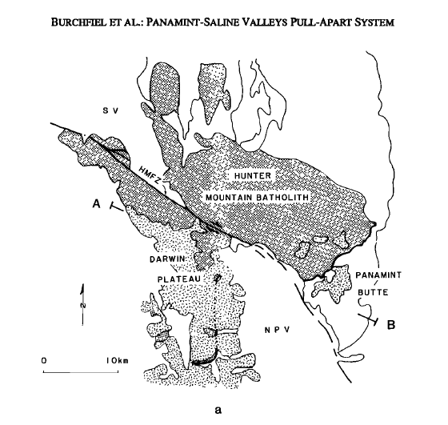
Younger Basalts
Pre –extension Basalts,
3.8-2.8 Ma→ max age of valley ~3.0 Ma
Displacement on the central part of the HMFZ is equal to the amount of extension in the northern Panamint Valley and Saline Valley.
Nova Fm basalts
Mio-, Plio sed rx
Pre-Cenozoic rx
Nova Fm basalts
Pre-Cenozoic rocks

Slide 5
Palinspastic reconstruction of northern Panamint Valley
8-10km of right lateral net slip and 0-2km of down-to-the-south normal slip
If Saline Valley and northern Panamint Valley extended contemporaneously, and the maximum age of the Saline Valley is 3.0 Ma, the slip rate on the fault is 2-3.2 mm/yr
Restoring the low-angle normal detachment fault puts similarly aged basalts, that are across the valley in present day, back together
Low angle detachment argument is reinforced by geophysics data and drill hole data that intercepted bedrock at 370ft in northern Panamint Valley

Slide 6
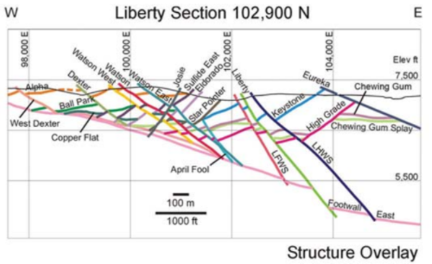
Interpretation
“No alternative reconstruction involving large-scale rotation of an initially high-angle structure produces and acceptable initial orientation of the volcanic units”
Northern Panamint Valley shows immense evidence for:
Lots of extension can be accommodated by low angle faulting in the Great Basin
Not all recent Basin and Range faulting is high-angle normal faulting
Saline Valley shows a different style of extension than the northern Panamint Valley, thus low angle faulting is only one means of Basin and Range extension.
Saline Valley geology actually precludes the detachment model there and favors closely spaced rotated faults
Figure 4b, from Seedorff et al., 2015

Slide 7
Works Cited
Burchfiel, B.C., Hodges, K.V. and Royden, L.H., 1987. Geology of the Panamint Valley - Saline Valley pull-apart system, California: Palinspastic evidence for low-angle geometry of a Neogene range-bounding fault. Journal of Geophysical Research, 92: 10422-10426.
Seedorff, E., Richardson, C. A., Maher, D. J., Pennell, W. M., & Garside, L. J. (2015, May). Fault surface maps: Three-dimensional structural reconstructions and their utility in exploration and mining. In New concepts and discoveries: Proceedings, Geological Society of Nevada Symposium (Vol. 2, pp. 1179-1206).

