Slide 1
Two phase westward encroachment of Basin and Range Extension into Northern Sierra Nevada
1
Surpless et al., 2002; Tectonics

Slide 2
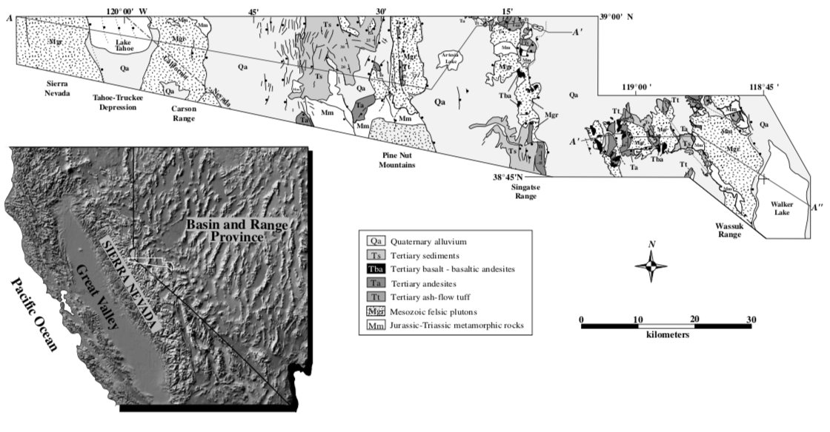
Research problem
2
Structural transition zone:
Northern Sierra Nevada
Northern Basin and Range
Extension + westward tilting increases W to E
No investigation of this zone’s structural and thermal evolution

Slide 3
Research goals
3
Describe:
Timing of fault block exhumation
Spatial-temporal distribution of normal faulting
Thermal structure of upper crust upon onset of normal faulting
Method: apatite fission-track thermochronology
33 quartz monzonite samples

Slide 4
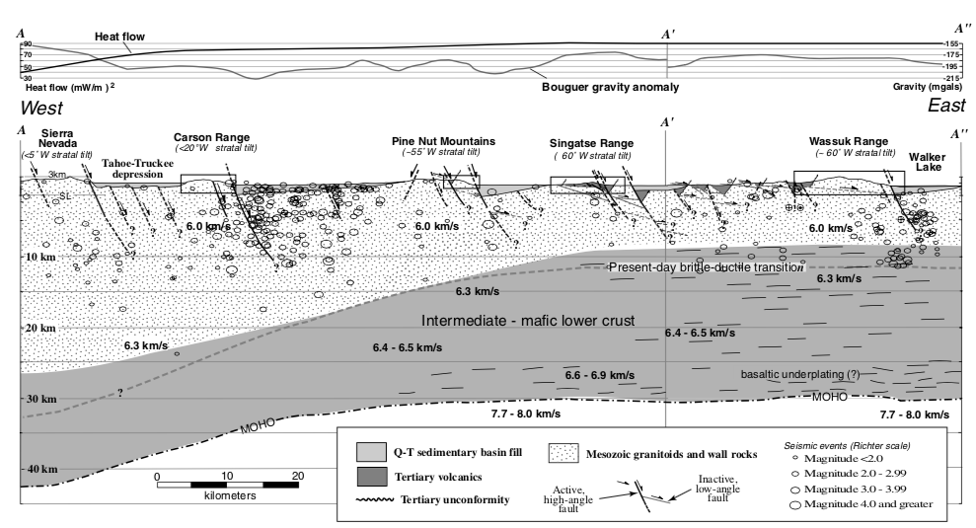
4
2
1

Slide 5
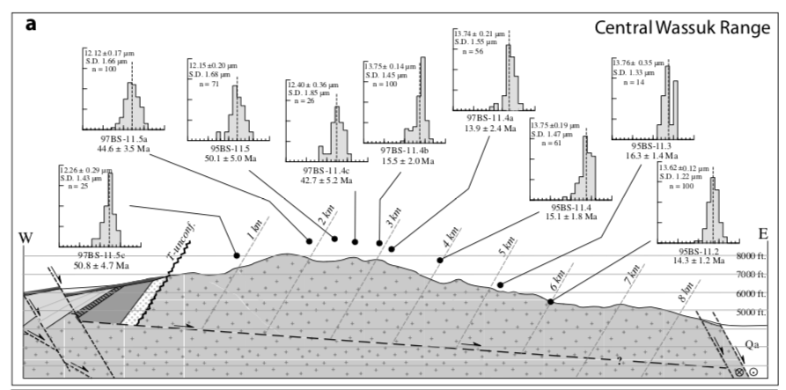
5

Slide 6
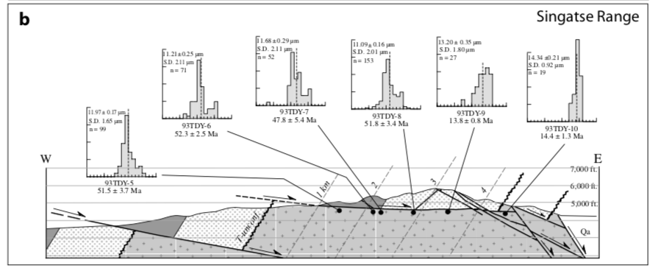
6

Slide 7
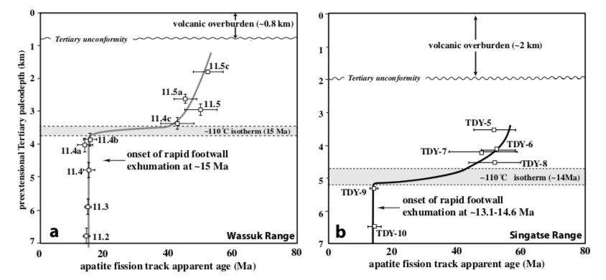
7

Slide 8
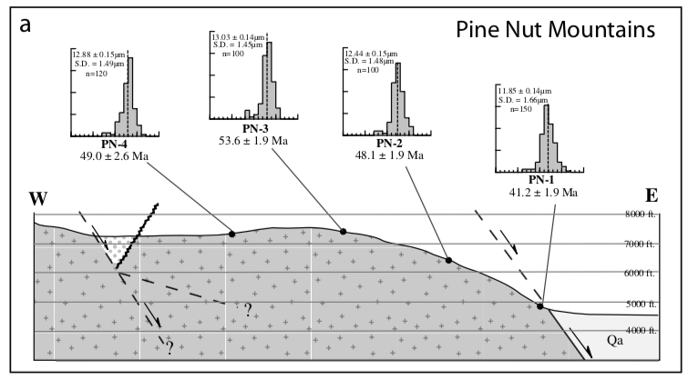
8

Slide 9
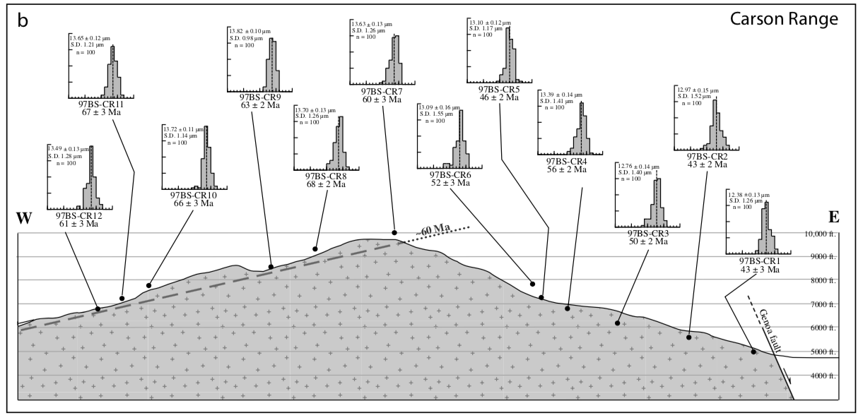
9

Slide 10
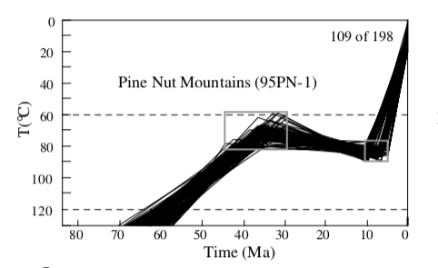
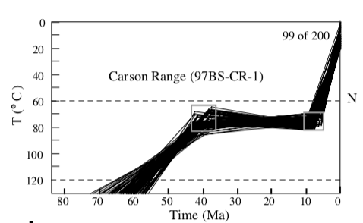
10

Slide 11
11
≤ 10 Ma (Late Miocene)
~14 – 15 Ma (Middle Miocene)

Slide 12
12
Westernmost Basin and Range Fault Block
*Significant takeaway: Basin and Range extensional deformation gradually migrating westward into Sierra Nevada
Normal faulting + westward tilting continues today; most recently documented since 0.5 Ma (Pleistocene)

