Slide 1
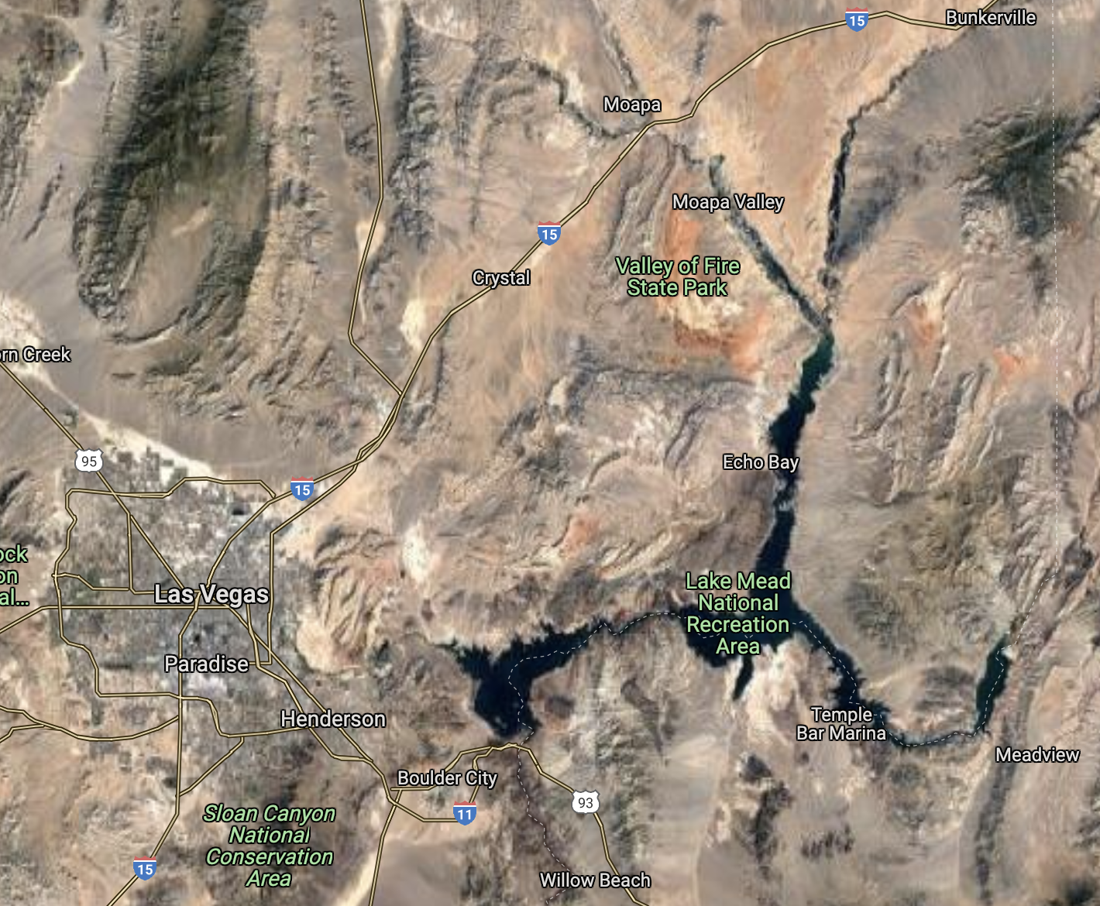
Kinematics and timing of Tertiary extension in the western Lake Mead region, Nevada
Duebendorfer and Simpson, 1994

Slide 2
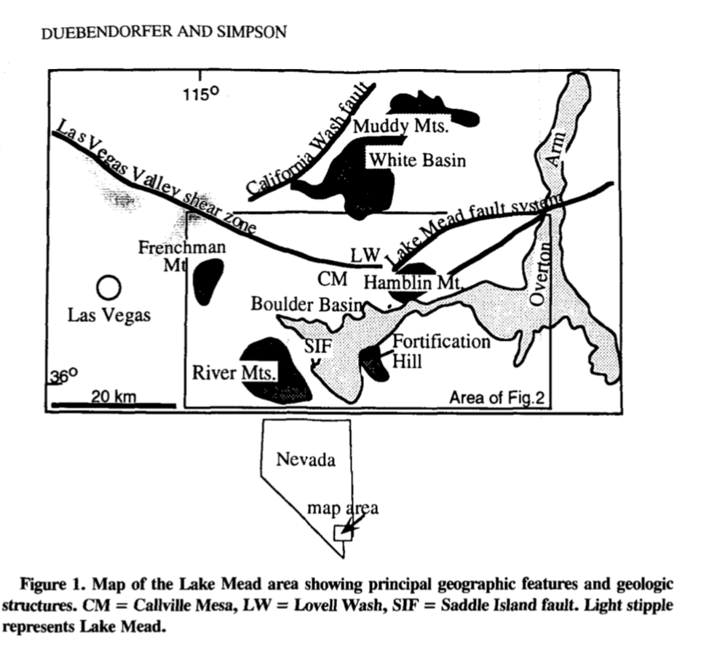
Main ideas/Goals
Evaluate kinematic compatibility of structures in the western Lake Mead area
Contains both extensional and contractional structures
Controversy exists regarding the origin or kinematic structures other than normal faults in extensional tectonic regimes
Strike-slip faults, reverse faults, and folds
Present an assessment of the Miocene extension direction
Previously reported as southwest extension or changing with time
Evaluate existing models for Miocene extensional tectonism
Current models focus on one or two structures or provide and incomplete explanation for the varied structures present
Models that attempt to explain the diverse structural assemblages assume that all structures are kinematically compatible and developed and operated at the same time
Propose an alternative tectonic model

Slide 3
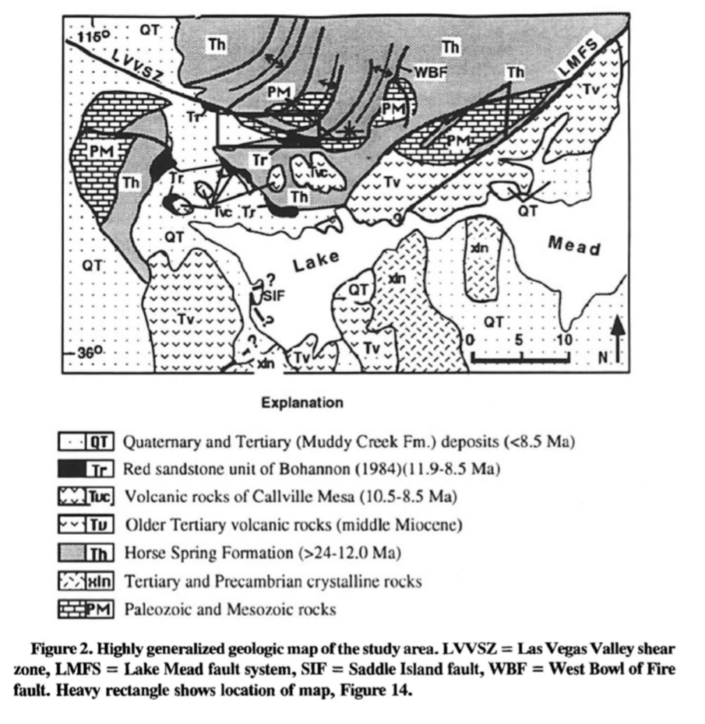
Tectonic Setting
Lake Mead Area
Contains core complex type detachment systems
Two of the largest strike-slip faults in the Basin and Range
Lake Mead Fault system
Northeast striking, left-slip faults that account for 20-65 km of slip between 17 and 10 Ma
Las Vegas Valley shear zone
Right-slip displacement of ~48 km
Appears to be younger than 15 Ma
It has been suggested that significant movement post dates 13 Ma.
Saddle Island fault
Low-angle fault
Contains characteristic elements of classic metamorphic core complexes
20 km of post-13.4 Ma westward translation of upper-plate rocks along the detachment

Slide 4
Methods
Study area was divided into three blocks of distinct structural and depositional history
Sense of slip on individual faults was determined by a combination of fault striae and stratigraphic separation, brittle kinematic indicators where available, and drag features.
Geologic mapping (fig.14) and geochronological data

Slide 5
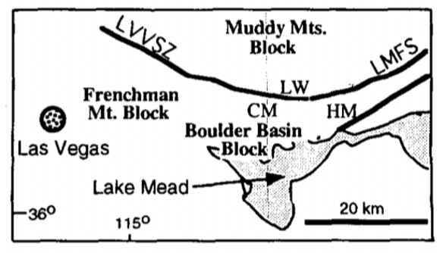
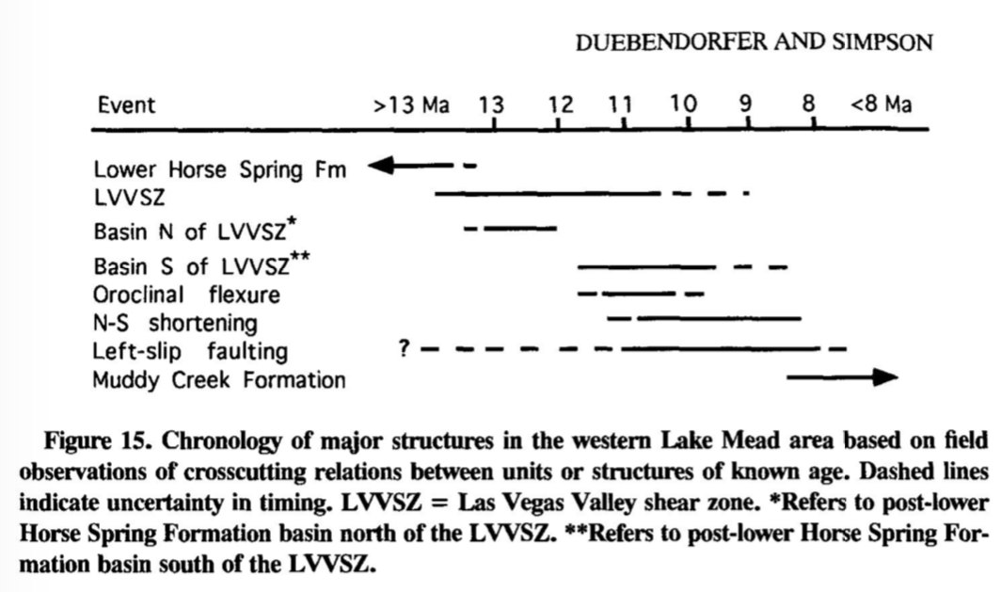
Discussion
Basement rocks on all blocks tilted less than ten degrees at the time that the basal tertiary units were deposited
Principal movement occurred after 17-13.5 Ma (deposition of the Thumb Member)
Differences in the stratigraphic record at 13.5-13.0 Ma signal the onset of extension in the western Lake Mead region
Normal faults
Right-slip faults
Reverse faults
Left-slip faults

Slide 6
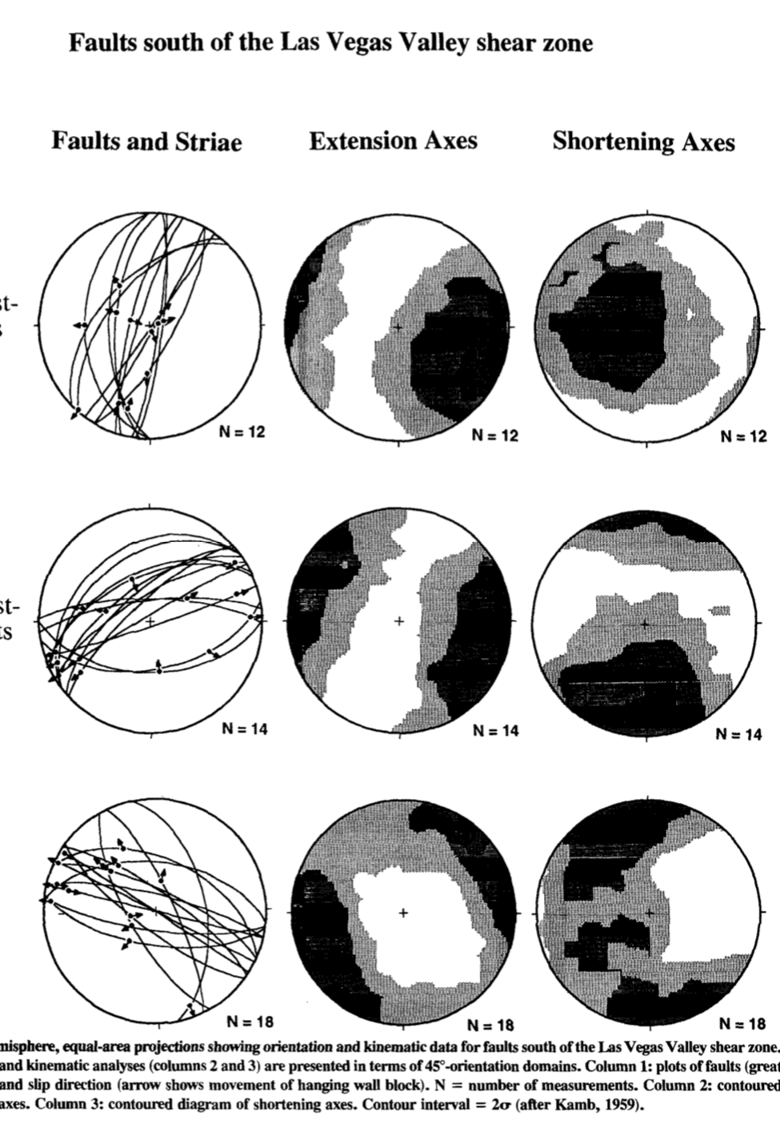

Slide 7
Previous Models
Model 1
Model 2
North-south directed compression
Requires all structures were formed and active at the same time
Unlikely:
data set suggests that north- south shortening clearly post-dated, rather than coincided with, large-magnitude east- west extension
cannot explain formation of north-northeast trending folds
Reorientation of principal stress directions
Unlikely:
does not incorporate the development of east-west-trending folds and reverse faults

Slide 8
Results
Model views north-south contraction as a response to large-magnitude extension
North-south contractional strain may be a consequence of extension rather than a cause
Extension between two regions can induce flow of crustal material toward the thinner and more highly extended terrain
north-northeast striking normal faults, associated extensional fault-bend folds, and right-slip faults - these structures operated in a kinematically coordinated fashion to accommodate approximately due east-west extensional strain between 13.0 and 10.0 Ma

