Slide 1
Diachroneity of Basin and Range extension and Yellowstone hotspot volcanism in northwestern Nevada
1
Colgan et al., 2004
Presented by Alex Holmwood

Slide 2
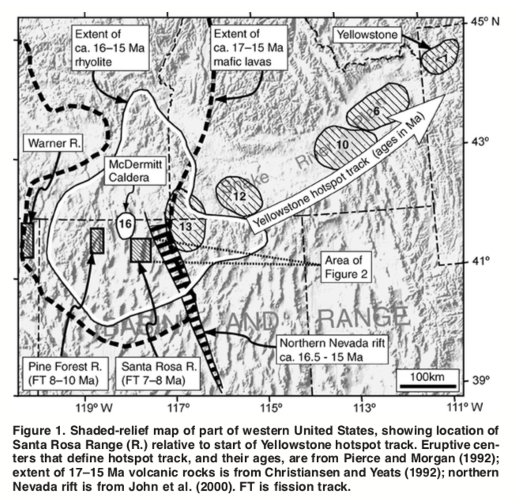
Background
2
Onset of Yellowstone hotspot volcanism: 17-15 Ma
Extension south of hotspot track in Nevada between 19-14 Ma
Did hotspot activity initiate or facilitate extension in NW Nevada?

Slide 3
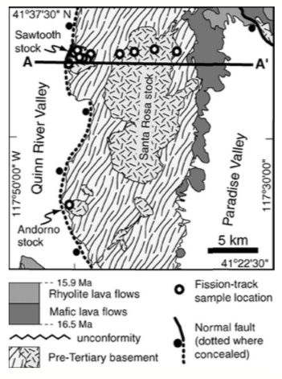
Methods
3
Reconstruction of faulting in Santa Rosa Range and other ranges using:
Regional geologic data
Apatite fission-track thermochronology
Apatite fission-track:
11 granite samples, E-W transect
Santa Rosa stock
Sawtooth Stock
Adorno Stock

Slide 4
Regional geology
4
Pine Forest Range:
Tertiary rocks older than 17 Ma overlain by basalt-rhyolite sequence
All Tertiary units cut + tilted ≤35º by normal faults
Santa Rosa Range:
Miocene volcanics over Mesozoic basement
Mafics ~16.4 Ma
Rhyolites ~15.9 Ma

Slide 5
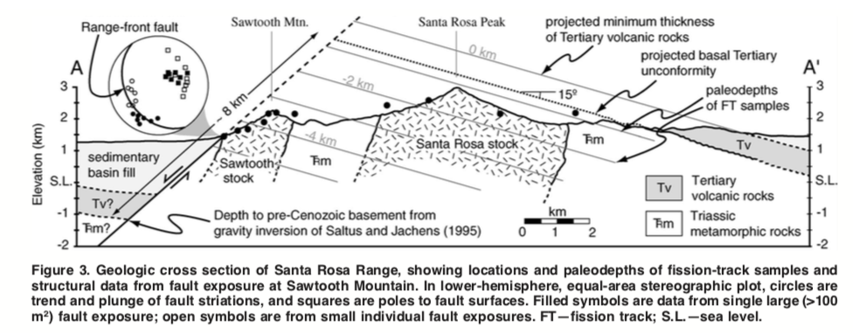
Regional geology
5
Santa Rosa block:
35-40º W-dipping range front fault
Initial dip of ~50-55º
Rotated ~15º to present orientation
~6 km of crustal extension

Slide 6
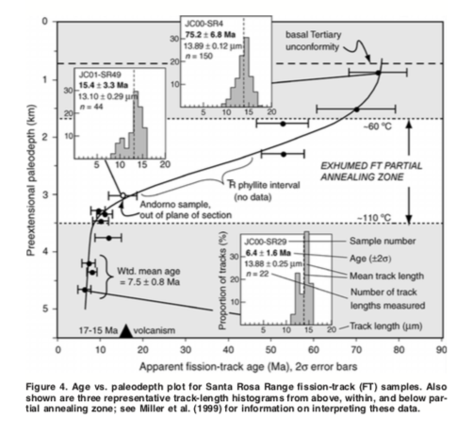
6
Thermochronology
Structurally deepest samples: weighted mean age of 7.5 ± 0.8 Ma
Samples resided at edge of PAZ; 10 Ma more conservative estimate
Pine Forest Range: high-angle faulting onset at 10-8 Ma

Slide 7
7
Discussion
~5 - 9 m.y. gap between volcanism and onset of high-angle range-forming faulting + extension
NW Nevada too cold or strong to undergo extension
Large temporal gap argues against extension resulting from hotspot activity

