Slide 1
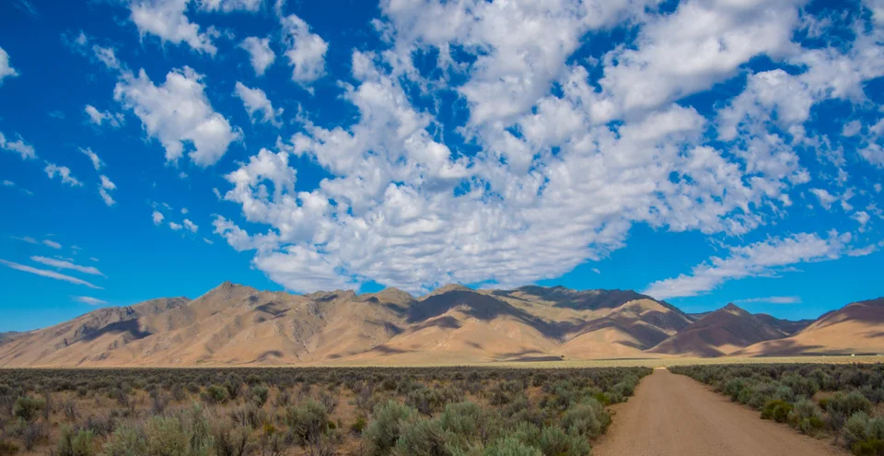
Timing of Cenozoic volcanism and Basin and Range extension in northwestern Nevada: New constraints from the northern Pine Forest Range
Colgan, J. P., Dumitru, T. A., McWilliams, M. and E. Miller, 2006, Timing of Cenozoic volcanism and Basin and Range Extension in northwestern Nevada, New constraints from the northern Pine Forest Range, Geological Society of American Bulletin, 118, 126-139.

Slide 2
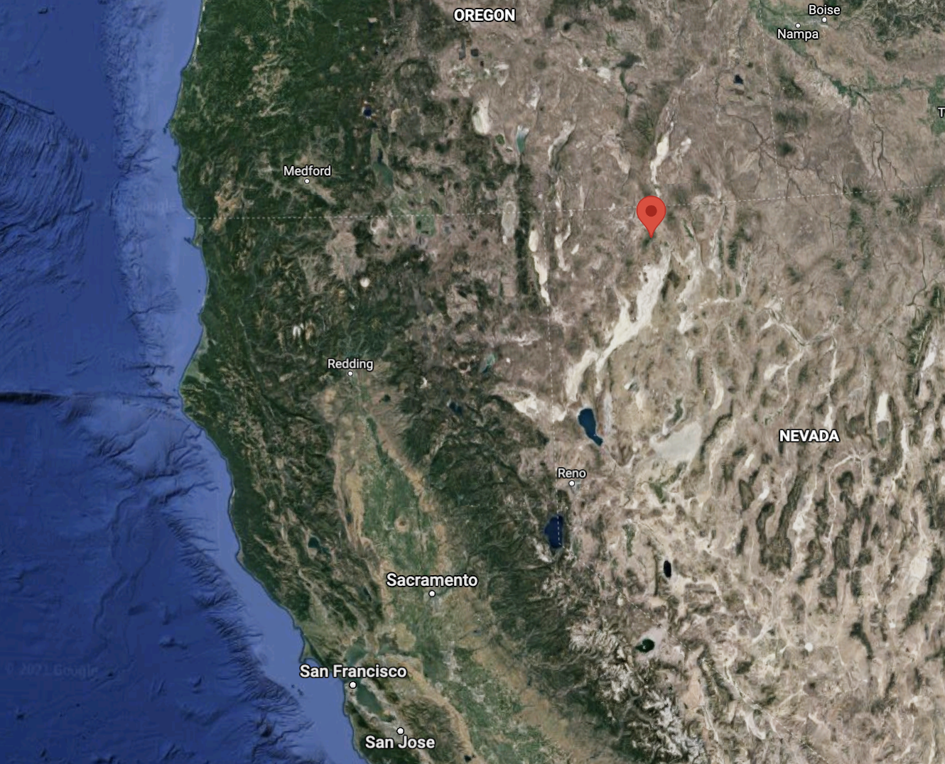
Introduction
Purpose:
To better constrain the timing of Basin and Range extensional faulting and Cenozoic Volcanism in NW Nevada
To seek evidence for extensional faulting and tilting that occurred before Miocene faulting event
Pine Forest Range has well preserved geologic relationships

Slide 3
Some geology of the area
Ranges in the central part of the northern Basin and Range province formed during a large episode of major normal fault slip
Recent Basin and Range extensional faulting has been concentrated at the eastern and western margins of the province
- involves more limited amounts of extension
Pine Forest Range
Pre-Tertiary:
Basement rocks contain Paleozoic to late Triassic Strata
Overlying Mesozoic strata consists of volcanogenic rocks
Early to Mid Jurassic:
Both strata were deformed during southeast-northwest shortening
Tertiary Units described by Noble et al. 1970
- Paired with ⁴⁰Ar/³⁹Ar samples/dates

Slide 4
Methods
⁴⁰Ar/³⁹Ar Dating
11 new ⁴⁰Ar/³⁹Ar dates identified
Trachyandesitic Intrusive Rocks
38 Ma
Older Basalt flows
Not enough ⁴⁰Ar/³⁹Ar
30 Ma
Tuff of Alder Creek
26 Ma
Based on stratigraphic position
Ashdown Tuff
26 Ma
Steens Basalt
16 Ma
Miocene Tuff
16 Ma

Slide 5
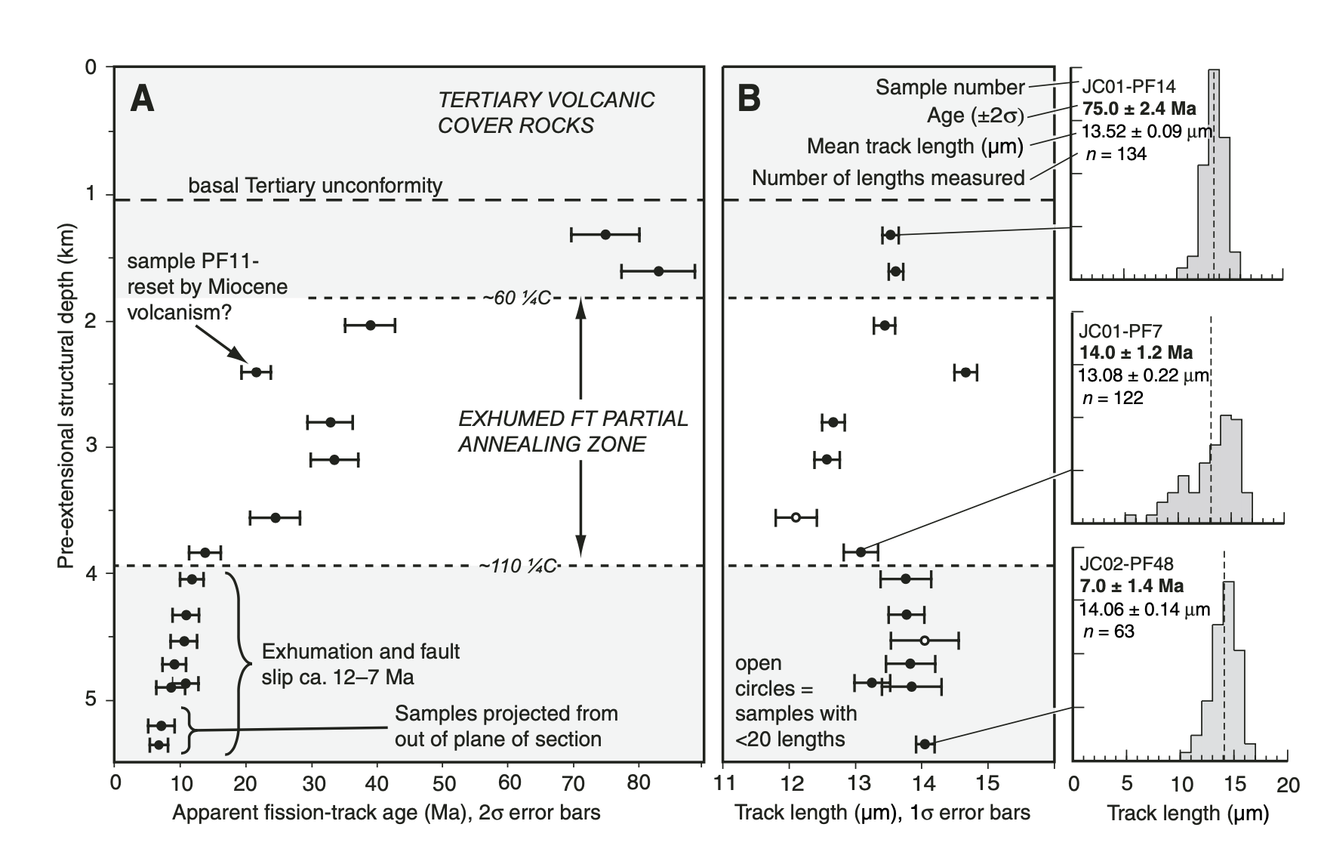
Methods
Fission-Track Dating
Used to date the timing of slip of normal fault systems
17 samples from the Pine Forest Range
Collected across the footwall to gain widest range of depths and temperatures
Before extension began
Fission-Track ages exhibit a systematic decrease with increasing depth

Slide 6
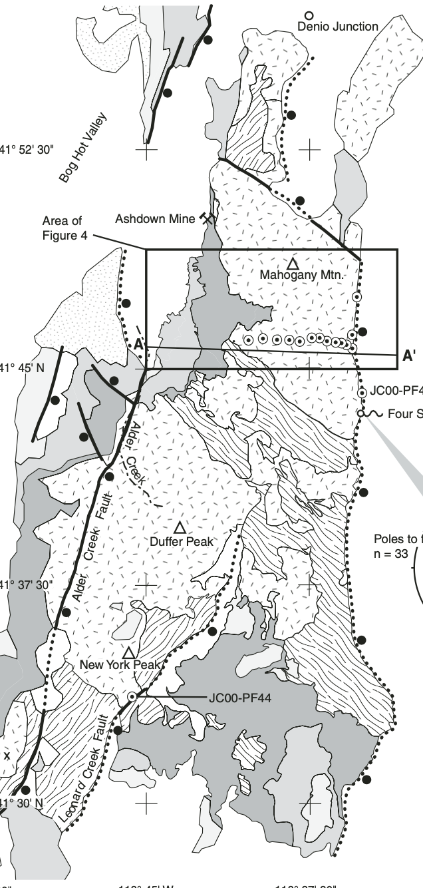
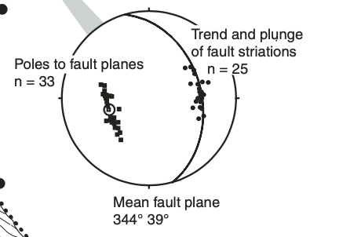
Tertiary Normal Faulting and Tilting
Determined by geologic mapping of previously mentioned units in the Vicksburg Canyon Quadrangle
At Four Spring, the range-front fault dips ~40°E,
well- developed striations indicating dip-slip motion
Pine forest range was tilted 30-35° during a single extensional episode
North: extension took place via a single fault
South: split by two north striking faults

Slide 7
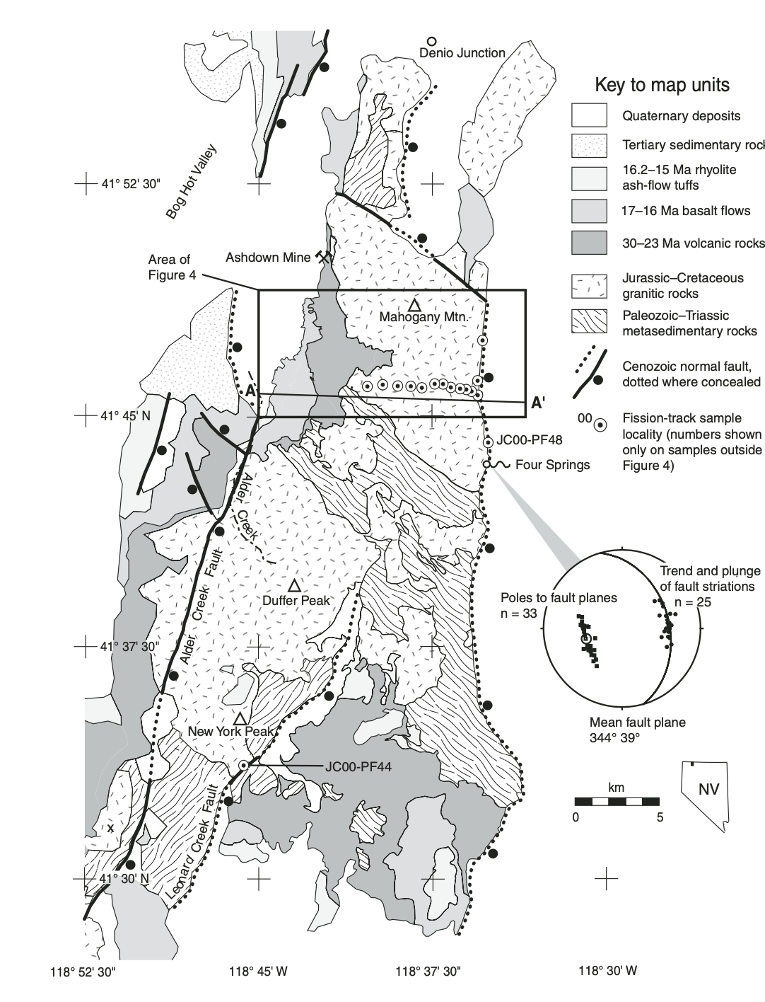
Timing
Identified 3 major episodes of activity
Late Cretaceous – Early cooling
Area exhumed by 83-75 Ma
Exposed Pre-Tertiary and Tertiary intrusive rocks – 38 Ma
Oligocene Volcanism
Area overlain by basalt and ash-flow tuffs – 30 Ma
Source of eruptions unknown
Steens Basalt Eruption
16.5 Ma
Conformable with Oligocene volcanics
Area inactive from 30-17 Ma

Slide 8
Summary
⁴⁰Ar/³⁹Ar and Fisson-Track Dating
Three periods of activity:
83-75 Ma
30 Ma
16 Ma
Pine Forest Range did not undergo significant extension before or during the large volcanic events
Basin and Range faulting in Northern Nevada did not begin before 12 Ma

