Slide 1
Miocene extension in the East Range, Nevada: A two-stage history of normal faulting in the northern Basin and Range
Fosdick and Colgan, 2008
East Range – northern Basin and Range extensional province – large east-tilted crustal block bound by west-dipping normal faults
detailed mapping of the Tertiary stratigraphy in the nearby Sou Hills
Apatite fission track and (U-Th)/He data from the East Range
to determine the timing and extension of normal faulting

Slide 2
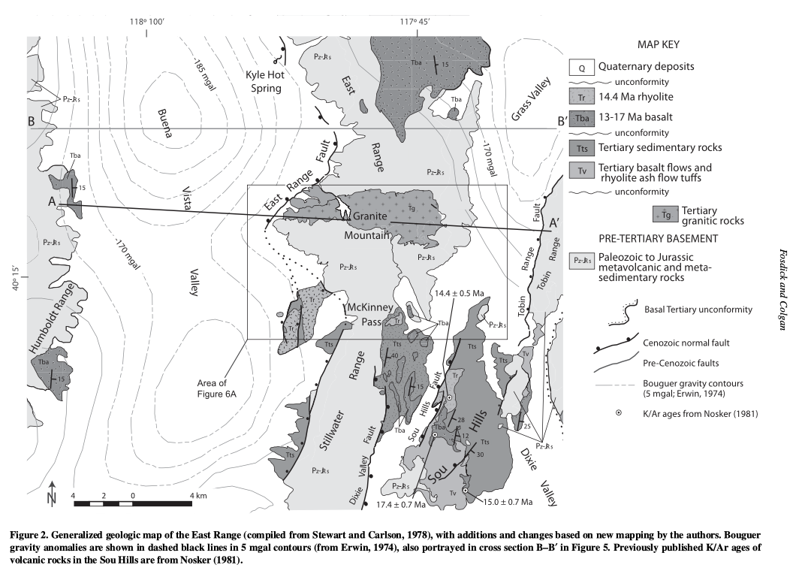
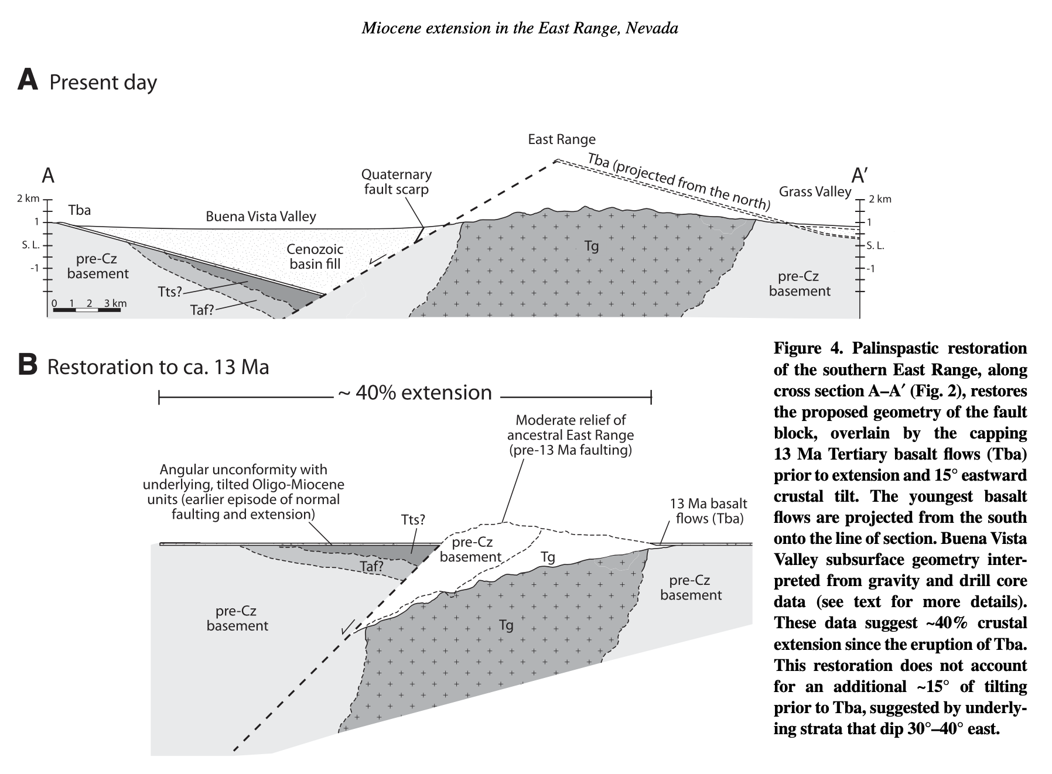

Slide 3
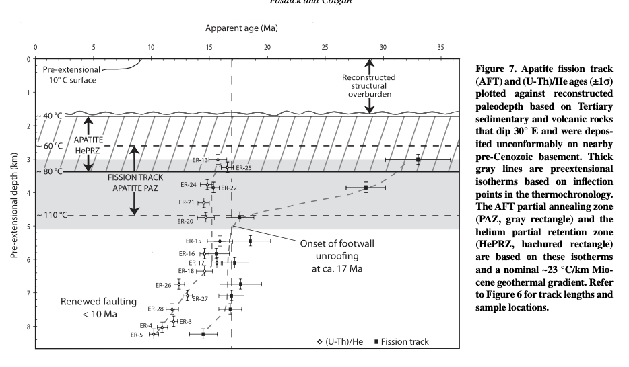
Apatite(U-Th)/He and fission track data
data documents middle to late Miocene exhumation and cooling of the East Range footwall block
rapid slip along normal faults from 17-15 Ma
Samples collected next to the range bounding fault record renewed exhumation by fault slip after 10 Ma

Slide 4
Discussion
rapid extension ~17-15 Ma exhumes part of footwall
followed by normal faulting around 10 Ma
Main points:
17-15 Ma extension in the East Range occurred at the same time as extension across the Basin and Range Province
Northwestern Nevada went essentially undeformed until the late Miocene – the East Range was close to this boundary
a second period of faulting began in the east range after 10 Ma – effected unextended areas of Nevada – representing westward “encroachment” of the Basin and Range
Did the northward propagation of the walker lane reactivate extension?
Does the late Miocene extension reflect plate boundary processes that began around this time?

