Slide 1
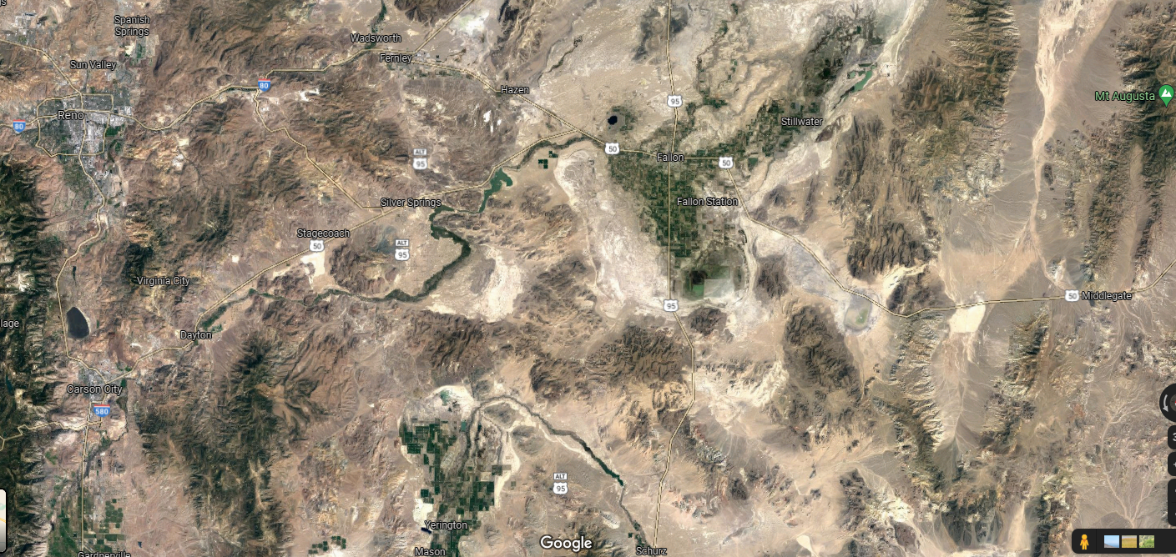
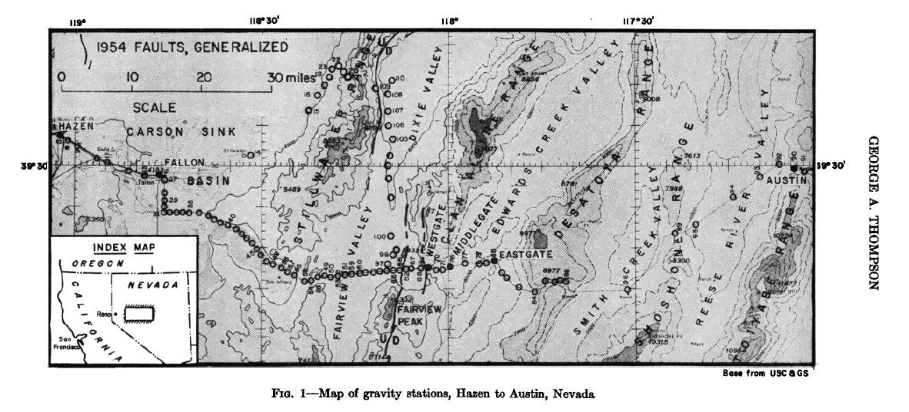
1959
Purpose of this gravity study is to understand the structural history of the area, specifically with regard to the 1954 earthquakes.
Did the 1954 earthquakes cause a measurable change in the gravity anomaly?
Atticus Proctor,
October 2021
July
Dec.

Slide 2
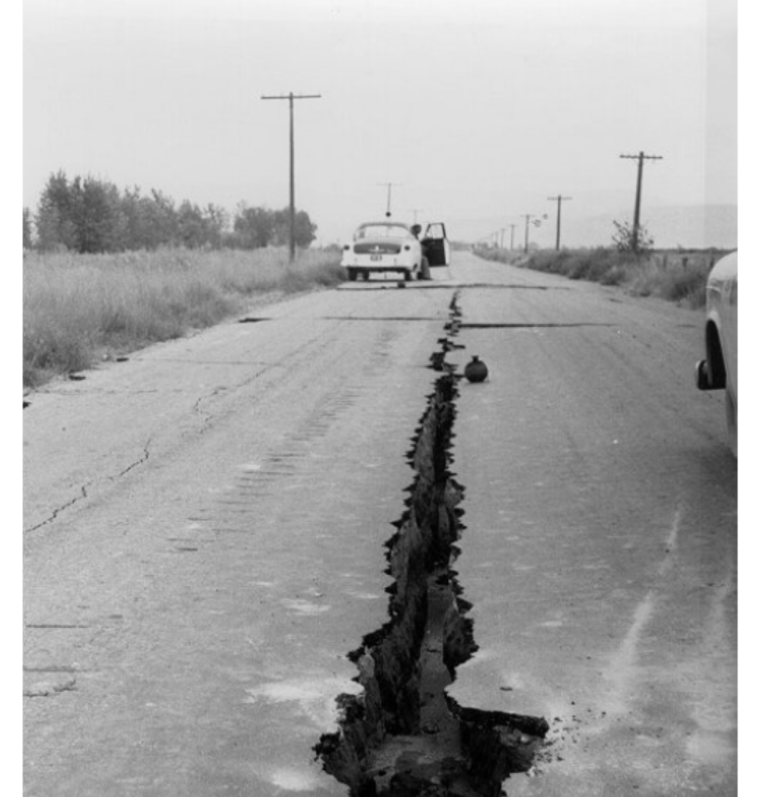
1954 Earthquakes
Series of earthquakes east of Fallon, NV that took place between July and December 1954
Two major shocks occurred in December 1954 and took place 4 minutes apart approximately 35 miles from each other.
Focal depth of southern earthquake 15km, M7.1
Focal depth of northern earthquake 40km, M6.9
July
Dec.
Image from the Churchill County Museum

Slide 3
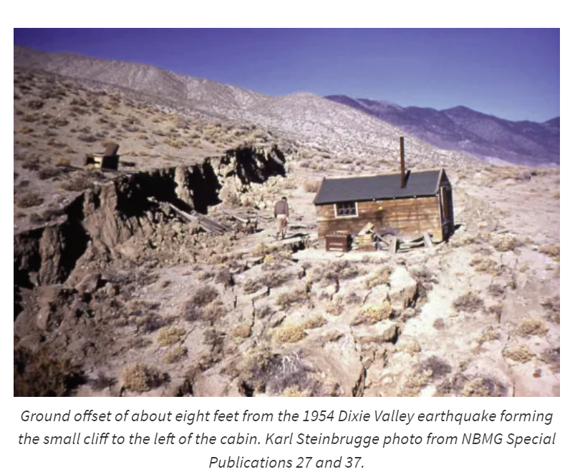
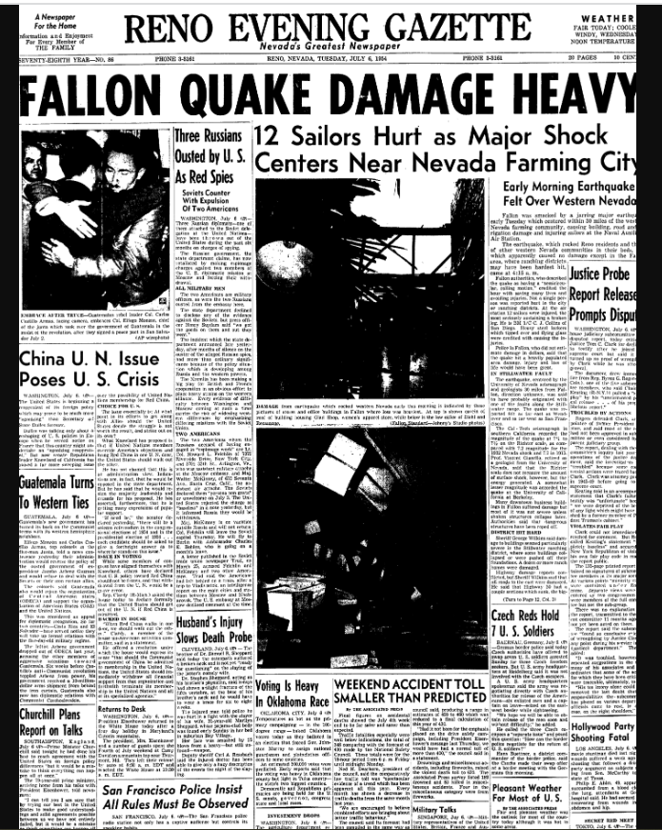

Slide 4
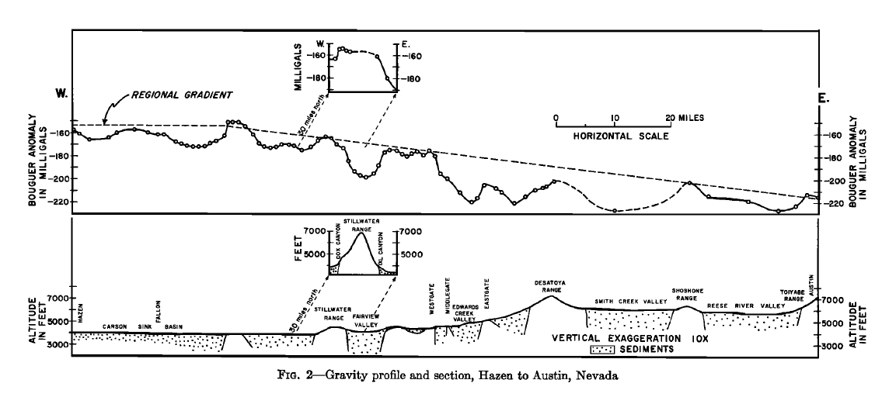
Gravity Data
1 Gal=cm/sec^2 unit generally used in gravity measurements
“The Bouguer anomaly is the measured gravity corrected for the known or modeled gravity effects at a planetary scale” Karcol et al., 2017.
Decrease in Bouguer anomaly from west to east across the study area. This variation is related to isostatic compensation.
Ranges show no evidence of local compensation. If there was local compensation the ranges would have negative Bouguer anomalies.

Slide 5
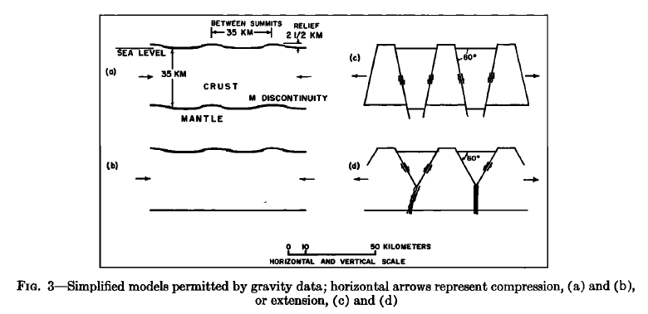
Models of compensation and structure of basins and ranges
Lack of local compensation rules out a hypothesis that requires compensating roots beneath the ranges.
Figure 3a shows warping in the upper and lower crust, though there is no conclusive evidence that the lower crust is warped, thus 3b is a reasonable alternative model.
Figure 3c shows mountain blocks ‘rising’ and valley blocks ‘sinking.’ The ‘roots’ in this model are too deep to be detected gravimetrically, thus 3d is an alternative.
In figure 3d the lower part of the crust behaves plastically, and the upper part is more brittle. Author believes this is the most accurate model of the actual structure.

Slide 6
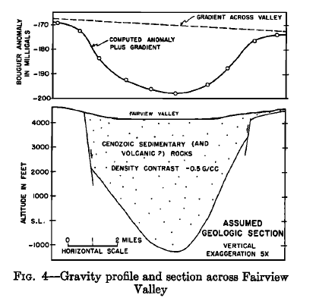
Using gravity data to infer basin depth
Using gravity data and average densities for rocks the author estimates the amount of fill in basins within the study area
Mountains adjacent to this basin are approximately 5000ft high and the basin is approx. 7 miles wide
This depth estimate leads to calculations done on the 1954 earthquakes’ impact on the gravity anomaly in the area
1954 earthquakes had negligible impact on the gravity anomaly

Slide 7
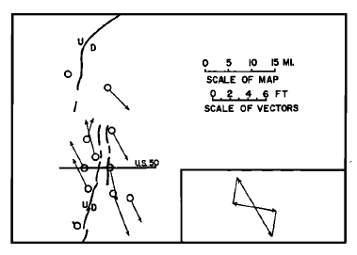
Figure 5
Conclusions
Gravity measurements show the region is in isostatic balance.
Valleys between the ranges can be quite deep, Fairview and Dixie Valleys have more than 5000ft of fill and the Edwards Creek Valley has more than 6000ft of fill
5ft of extension resulted from the 1954 earthquakes
1.5 miles of extension in the past 15 million years
Regionally 30 miles of extension in 15 million years, which averages to about 1ft/100 years
Horizontal component of dip slip movement is 5 feet on the 1954 faults

Slide 8
Works cited
Karcol, R., Mikuška, J., & Marušiak, I. (2017). Normal Earth Gravity Field Versus Gravity Effect of Layered Ellipsoidal Model. In Understanding the Bouguer Anomaly (pp. 63-77). Elsevier.

