Slide 1
¹The Rift Systems of the Western United States & ²Rate and Direction of Spreading in Dixie Valley, Basin and Range Province, Nevada ¹George A. Thompson ²George A. Thompson and Dennis B. Burke Gary McGaughey, GEOL 730
The Western Rift System
There are overlaps in deformation type, especially along the margins of the system.
Present seismic activity is not confined within the rift system.
Anomalously thin crust in the region roughly correlates with the rift system.
Volcanism and heat flow are correlated with the rift system.
Rifts may be underlain by shallow igneous intrusions.
Volume changes at the moment of large earthquakes are consistent with elastic rebound theory.
Dixie Valley
For the last 15 m.y. the basin has been spreading at an average of 0.4 mm/yr. For the last 12,000 years this rate has been higher at 1 mm/yr.
The Spreading direction is N 55° W – S 55° E

Slide 2
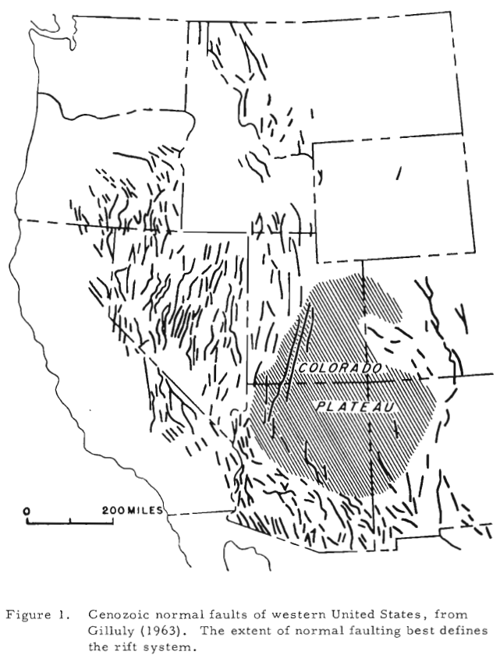
The Rift System
Region in the Western United States that is defined by its extensional component.
Analogous to:
Iceland
Oslo and Rhine Grabens
African Rifts
Strike-slip components are present, but are still accompanied by an extensional component not seen in the San Andreas

Slide 3
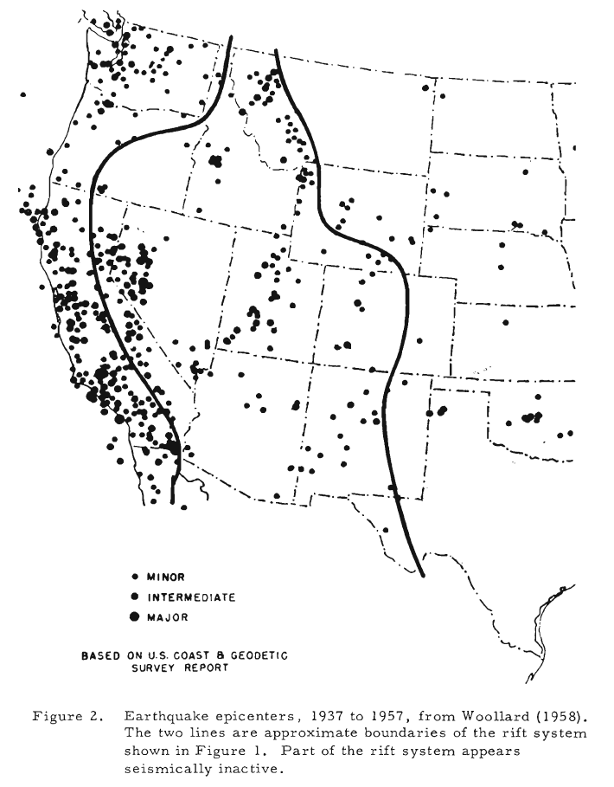
Rift System vs Modern Seismicity
Walker Lane

Slide 4
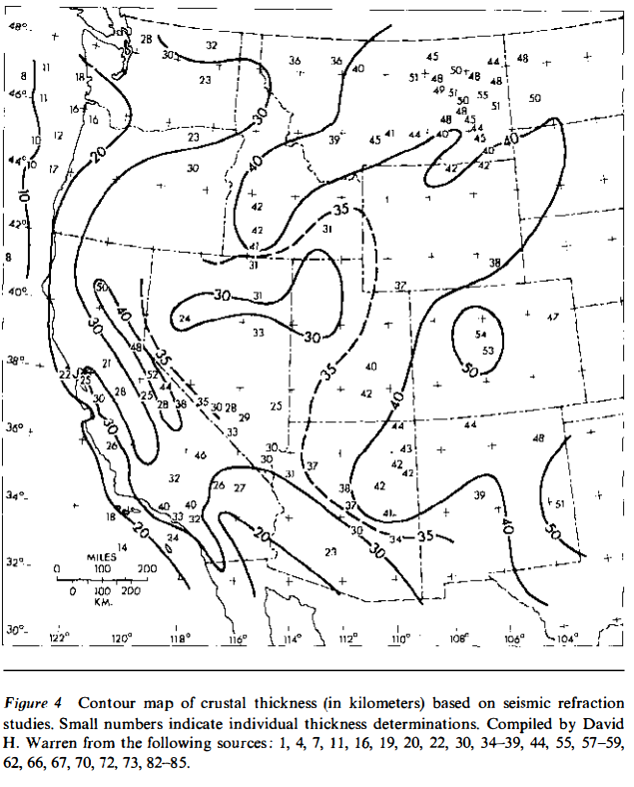
Anomalous Crust and Mantle
Geophysical studies show an anomalously thin crust and mantle velocity.
These anomalies spread outside the rift system across the seismically active West and are associated with the East Pacific Rise.
P_{n} Velocity < 8.0 km/sec
Thompson & Burke, 1974

Slide 5
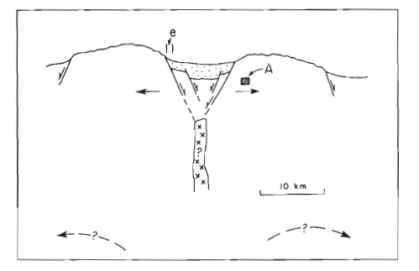
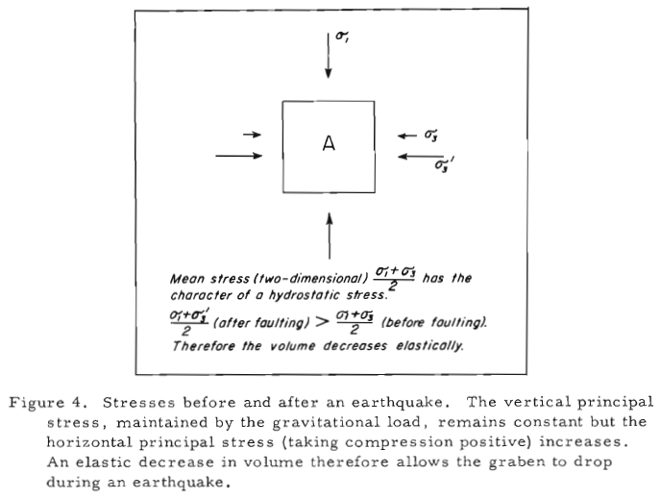
Volume Changes During Earthquakes
Geometry of faulting in the Basin and Range requires sizeable extension.
Space created can be accounted for by plastic flow of rock or igneous intrusions below the graben.
Author favors igneous intrusion but lacks evidence, though he argues these intrusions would not create a magnetic anomaly due to the felsic nature of the volcanics in the region.
The dropping of a graben in an earthquake is made possible by the sudden increase in mean stress causing a decrease in volume.

Slide 6
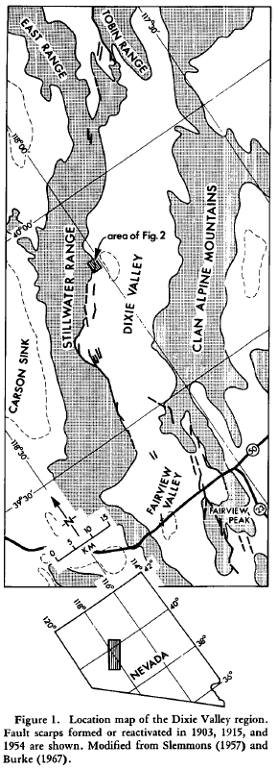
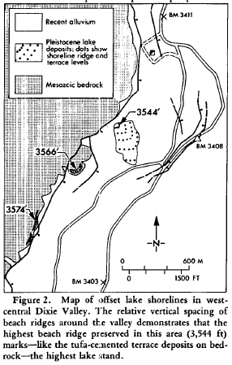
Dixie Valley
Paleoshorelines from ~12,000 years ago based on ¹⁴C dating.
Crosscut by faults showing 9 m of vertical displacement and a corresponding 10 m of horizontal displacement.
This gives an averaged rate of extension at just less than 1 mm/yr.
Basin geometry revealed by geophysical studies
Pre-fault topography reconstructions reveal 5 km of vertical displacement and a corresponding 6+ km of horizontal extension.
Average extension rate over 15 m.y. = 0.4 mm/yr

Slide 7
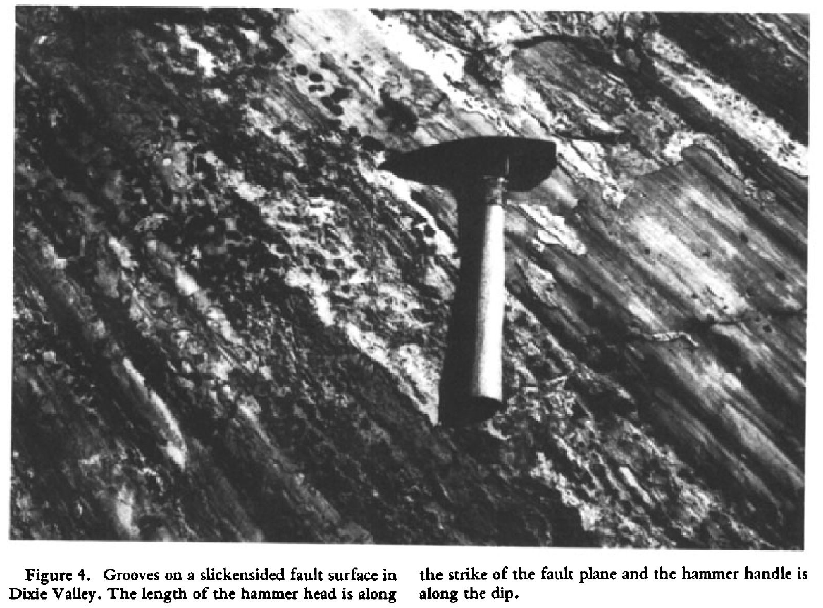
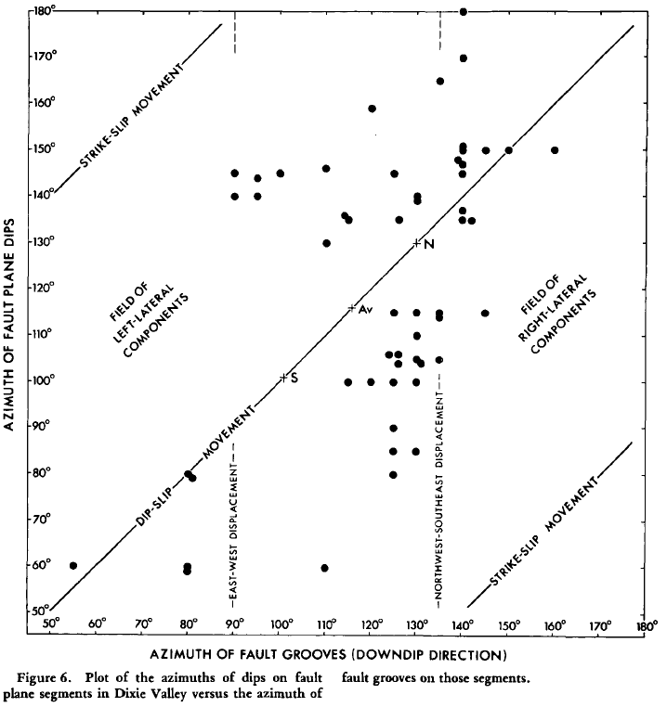
Slip Direction
Slip direction is based on grooves on slickensided fault surfaces and Geodetic work.
Plotting the azimuth of the fault grooves against the azimuth of the dips showed some strike-slip components.
This is expected due to the zigzagging nature of the faulting.
The average of the faults showed a slip direction of ~125°

Slide 8
Key Points and Takeaways
Check out Thompson and Burke, 1974 for a more detailed look at Dixie Valley and the Western Rift System!
The Western Rift System
The western rift system is defined by a component of extension but can feature strike-slip motion.
Seismic activity is not found throughout the rift system or confined to it. Similarly, thin crust and low mantle velocities are found throughout the region authors link to East Pacific Rise.
The system has experienced volcanism in the past and has high heat flow.
Rifts may be underlain by shallow igneous intrusions that account for the space created by extension
Large earthquakes show support for elastic rebound theory when looking at changes in volume at the moment of the earthquake.
Dixie Valley
The basin has been spreading for 15 m.y., but extension has increased from 0.4 mm/yr to 1 mm/yr in the last 12,000 years
The Spreading direction is N 55° W – S 55° E
Extrapolating the extension in Dixie Valley across the whole Basin and Range would give a total extension of 100 km.

