Slide 1
Magnitude of crustal extension in the southern Great Basin
1
Wernicke et al., 1982
Presented by Alex Holmwood

Slide 2
Problem & methods
2
Difficult to accurately determine amount of intracontinental extension
Authors: best method of estimating extension is by restoring offset of linear geologic features
Reconstruction along ~E-W transform faults in southern Great Basin (Las Vegas) to estimate minimum extension in Basin and Range province

Slide 3
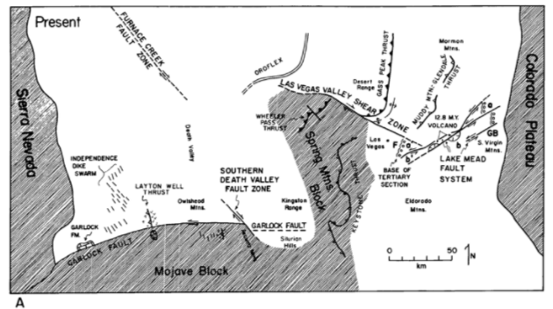
Garlock fault
3
Matching correlated features along Garlock fault (sinistral)
Dike swarms north and south of Garlock
Extensional faulting accommodated 60 km of slip along Garlock fault
Extensional faulting occurred over a transect ~115 km wide

Slide 4
Las Vegas Valley shear zone, Lake Mead fault system
4
Dextral slip along Las Vegas Shear Zone
Correlating thrust fault traces N and S of LVSZ
Wheeler Pass thrust
Gass Peak thrust
44-69 km of displacement
Lake Mead fault system
20 km sinistral offset of Hamblian-Cleopatra stratovolcano
Estimated total offset of system at ~65 km

Slide 5
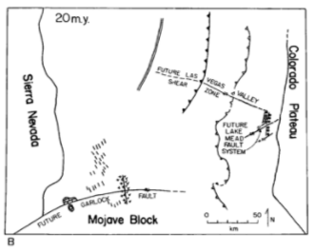
Results & discussion
5
65% extension (140 km) between southern Sierra Nevada and Colorado Plateau
Assumes no extension immediately N or S of fault traces (rigid)
Uncertainties may increase estimate of extension; 140 km is a safe minimum estimate

