Slide 1
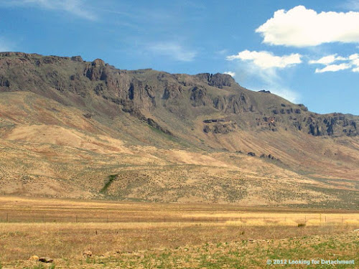
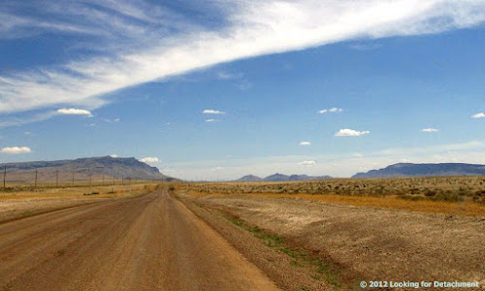
Basin and Range rifting in northern Nevada: Clues from a mid-Miocene rift and its subsequent offsets
Paleomagnetic evidence for counterclockwise block rotation in the north Nevada rift region
Zoback, M.L., Thompson, G.A., 1978. Basin And Range rifting in northern Nevada - Clues From A Mid-Miocene Rift and its subsequent offsets. Geology 6, 111-116.
Li, Y., Geissman, J.W., Nur, A., Ron, H., Huang, Q., 1990. Paleomagnetic evidence for counterclockwise block rotation in the North Nevada Rift region. Geology 18, 79-82.

Slide 2
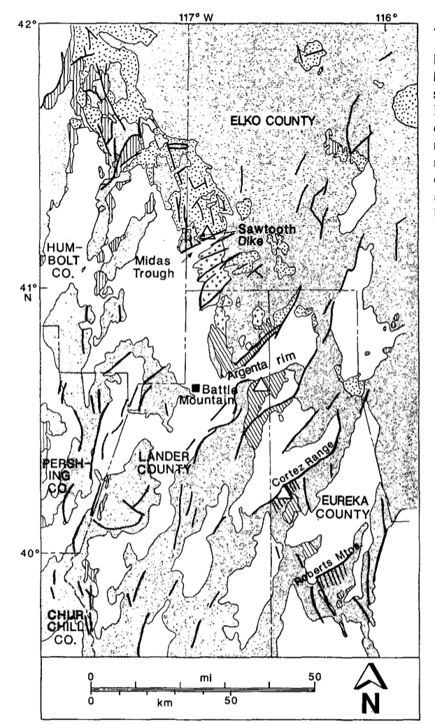
Introduction
Purpose:
- These papers aim to determine the extension direction and timing in north-central Nevada in mid-Miocene time
- Try to relate the direction to the later changes in the tectonic regime
Northern Nevada Rift
Inception of Basin and Range rifting
17 to 14 m.y. ago
Sawtooth Dike
Offset segments and paleomagnetic samples
Zoback came first
proposed a 45º clockwise change
- Geissman proposed a new explanation to Zoback’s hypothesis

Slide 3
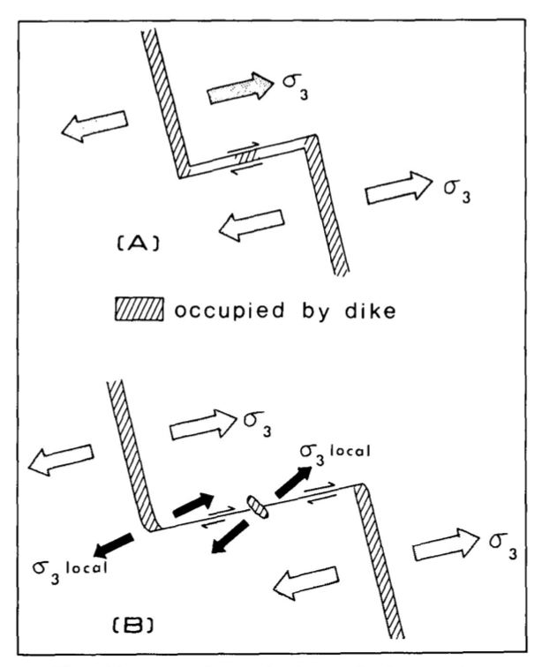
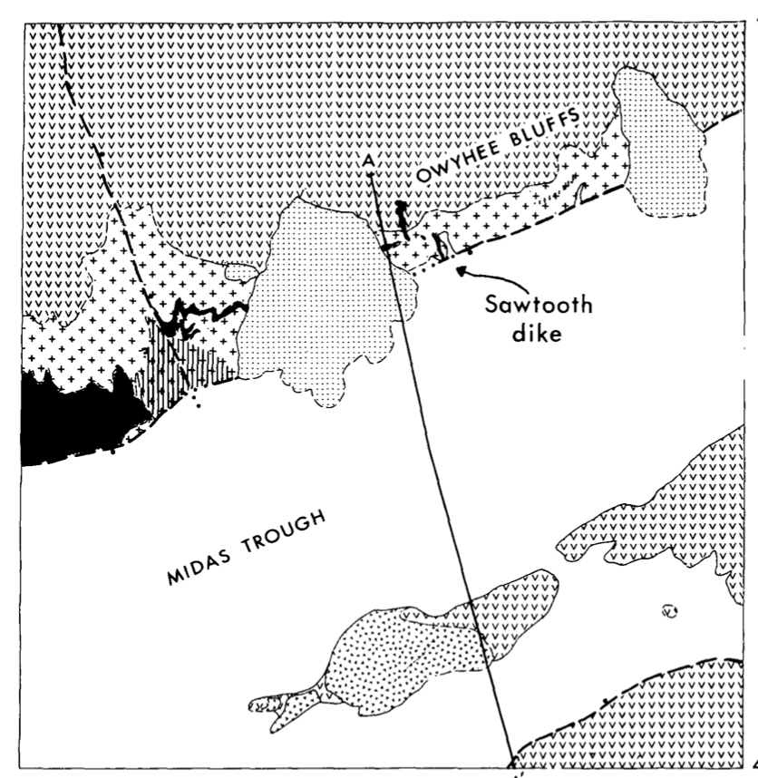
Zoback - Methods
Used geologic data, earthquake focal mechanisms, and in situ stress measurements
Positive aeromagnetic anomaly trending N-NW
Coincide with volcanic rocks, K-Ar dates between 13-16 m.y. old
- Sawtooth Dike – correlation of offset dike segments
- leaky transform fault with right-lateral slip
Cut to the south by NE trending fault
Basalt K-Ar dates between 15 and 6 m.y. old

Slide 4
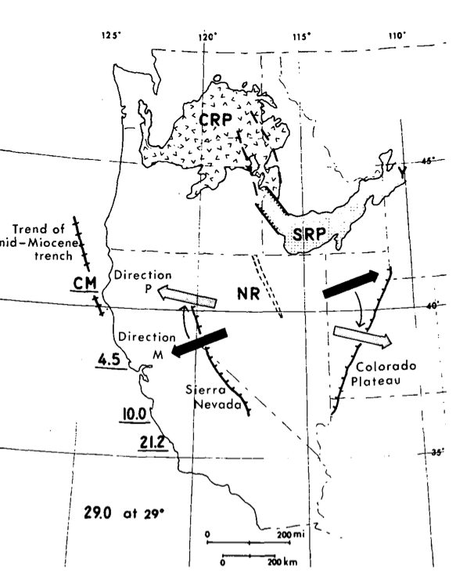
Zoback – Summary and Conclusions
Northern Nevada Rift Zone (and greater rift) formed 17 to 14 my ago
Convergent boundary turned unto a transform plate boundary
Geo-logic/physical data suggests N65ºW-S65ºE extension
clockwise change of 45º from original position within the past 14 m.y.
clockwise motion due to position relative to activation of San Andreas
Sawtooth dike structures indicate normal fault active by 6 m.y.

Slide 5
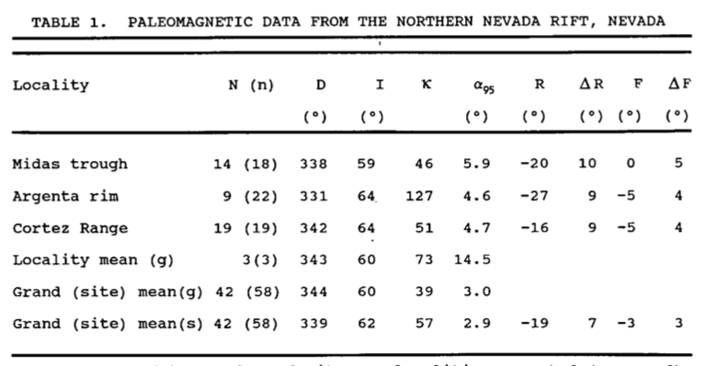
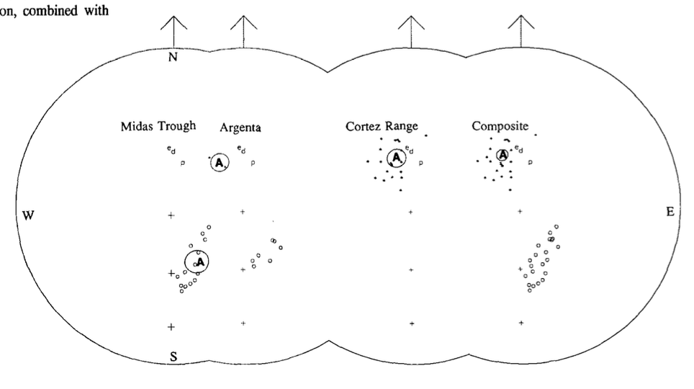
Geissman - methods
Geissman – Methods
New paleomagnetic data
Midas Trough:
Sawtooth dike: 11 sites
Basaltic Andesite Flows: 7 sites
Argenta Rim: 22 sites
Cortez Range: 19 sites
42 sites used
Dikes, flows, and pre-Miocene rocks at the three localities were rotated in a counterclockwise fashion about vertical axes
Different than expected mid-Miocene direction
Mean declination discordance = -19º

Slide 6
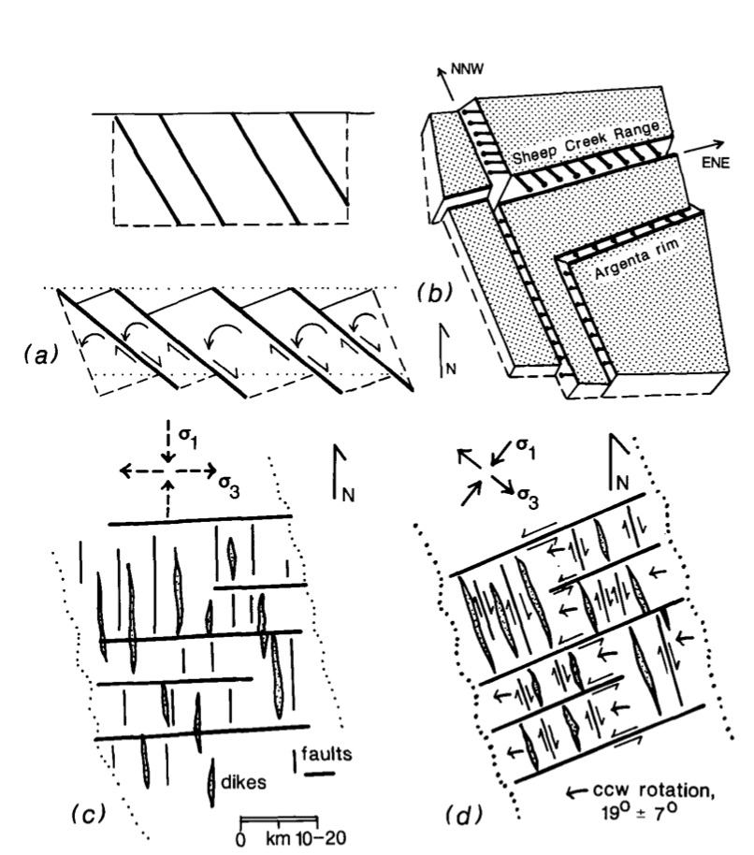
Geissman – Results and discussion
Zoback and Thompson proposed a 45º change
- If 19º of CCW motion occurred, then only 25º CW changes
Extension would be east-west
2D model explains crustal rotations associated with strike-slip faulting and extension
Right-lateral = CCW motion
2 oblique faults, N-NW trending
Timing of rotations not possible
Localized to the Nevada rift

Slide 7
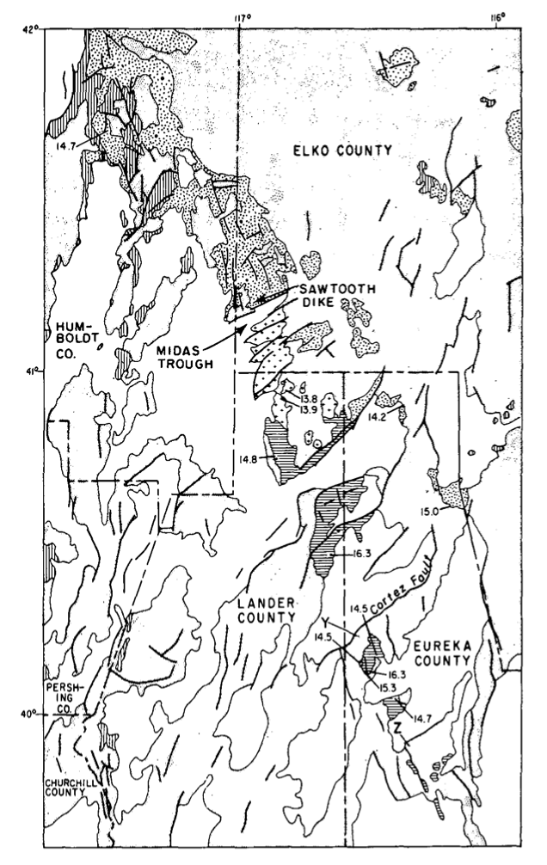
Summary
Basin and Range rifting began in northern NV 17 to 14 m.y. ago
Geissman gave no ages
Paleomagnetic data indicates crustal blocks rotated ~ 19º CCW
- Caused revision of Miocene extension direction
Geissman suggested a new rotational model to Zoback’s original hypothesis

