Slide 1
Quaternary volcanism in the western conterminous United States
Luedke and Smith, 1991
Brief review of Quaternary volcanism
Focus on descriptions of volcanic centers and regions
Volcanic loci/locus:
used to “designate volcanic vents or groups of vents that define spatial and/or temporal units of volcanism”
Methods:
grouped volcanic rocks into five major types based on silica content
divided ages into three time frames of about 5 m.y.
Using previous geologic maps and an earlier paper of theirs (Smith and Luedke, 1984)

Slide 2
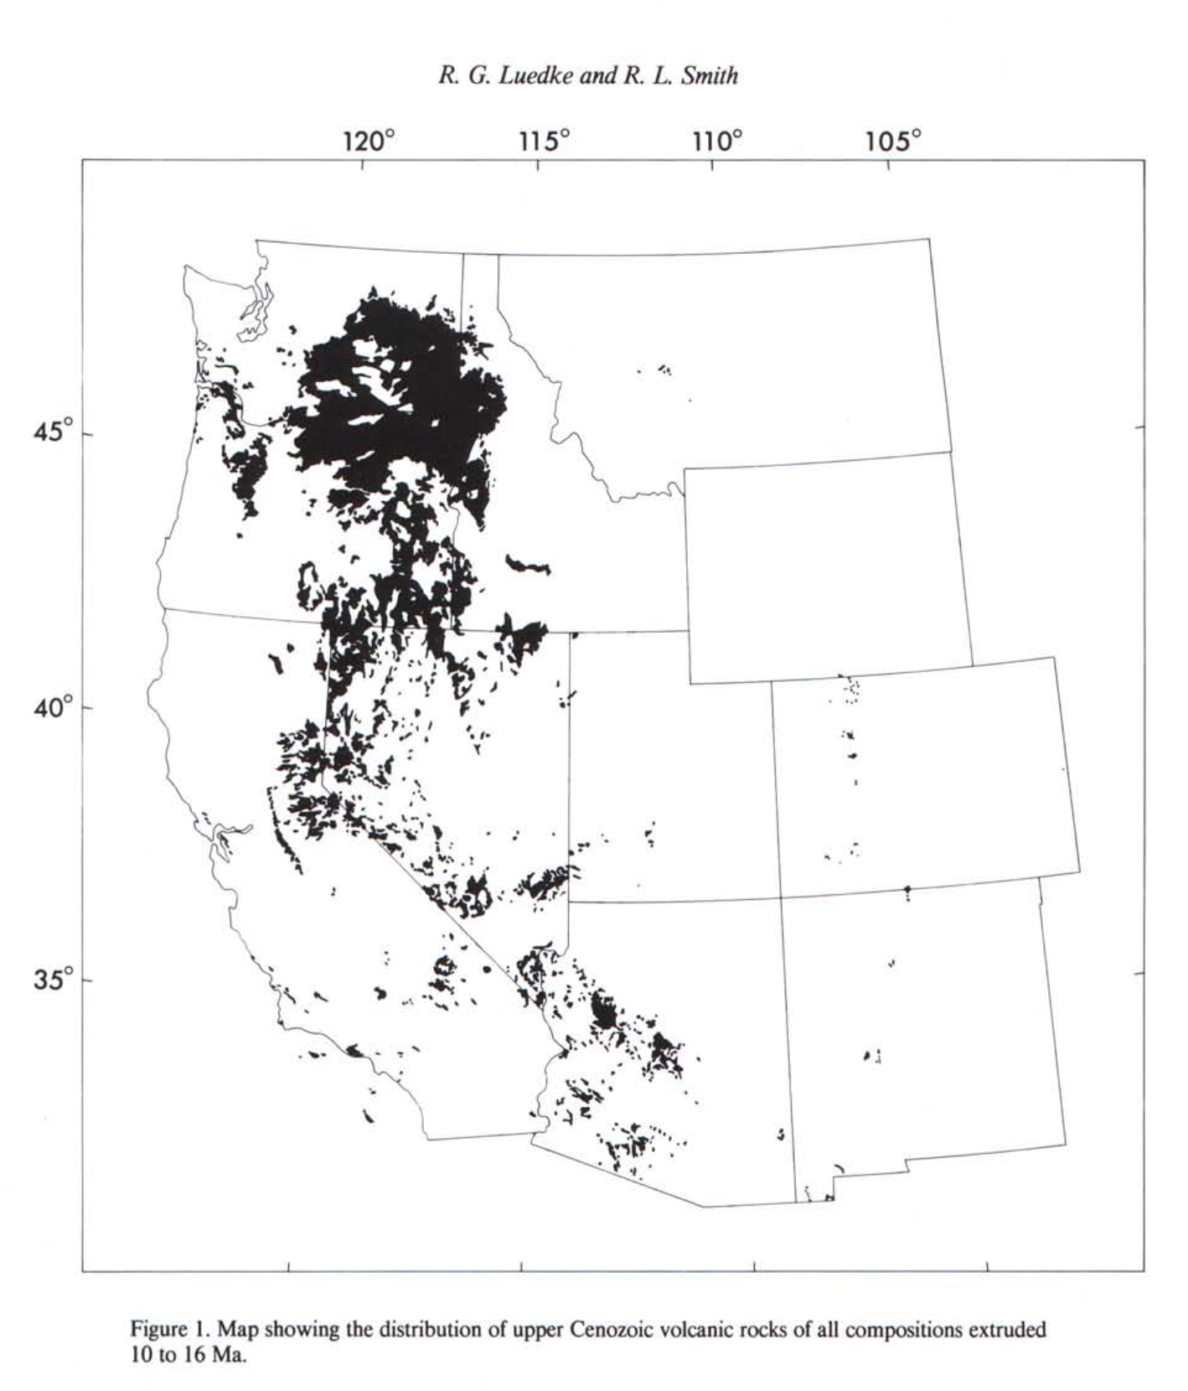
Pre-Quaternary Volcanism
Late Cenozoic volcanism began around 16 or 17 Ma
Followed a short period of volcanic and tectonic inactivity
A change in the style of volcanism
In addition, there was a compositional change from calcalkaline/intermediate rocks to more mafic volcanic rocks
Fig 1: volcanic loci of this time frame are obscure or randomly scattered

Slide 3
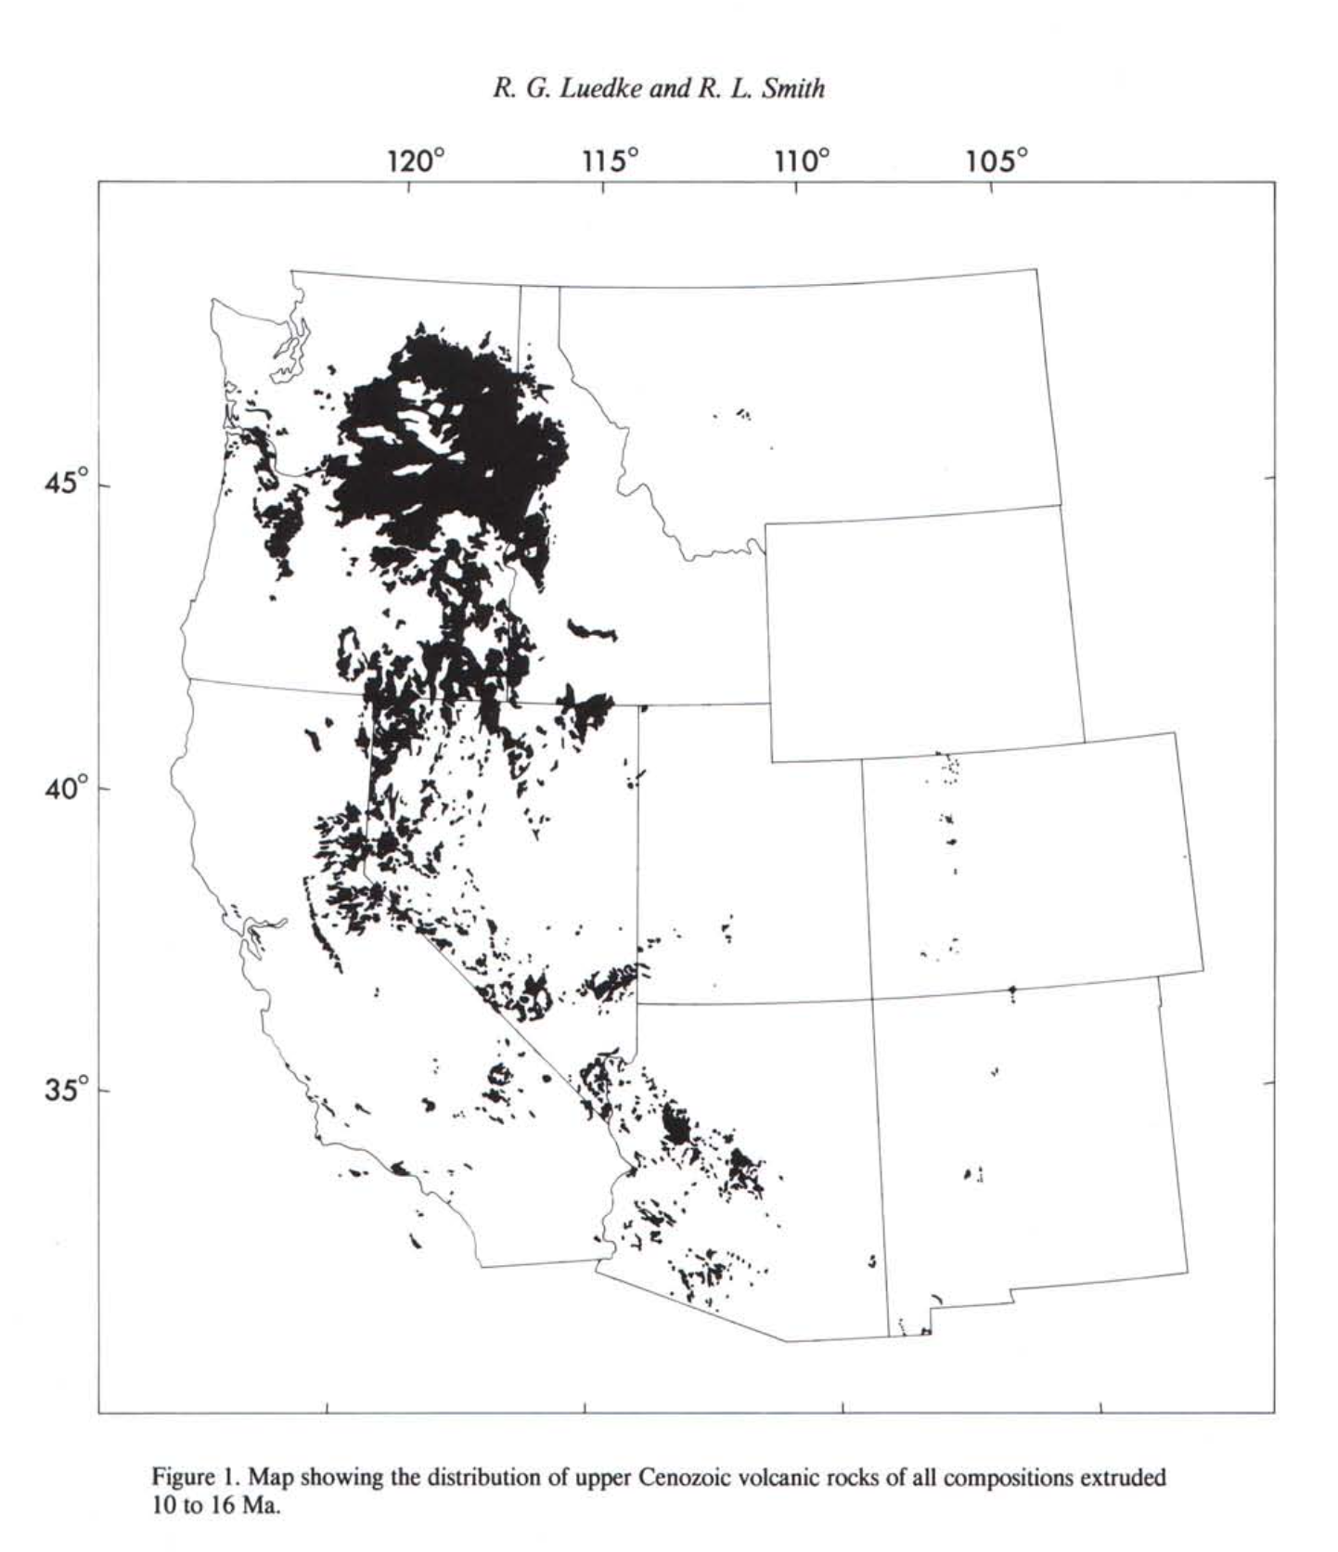
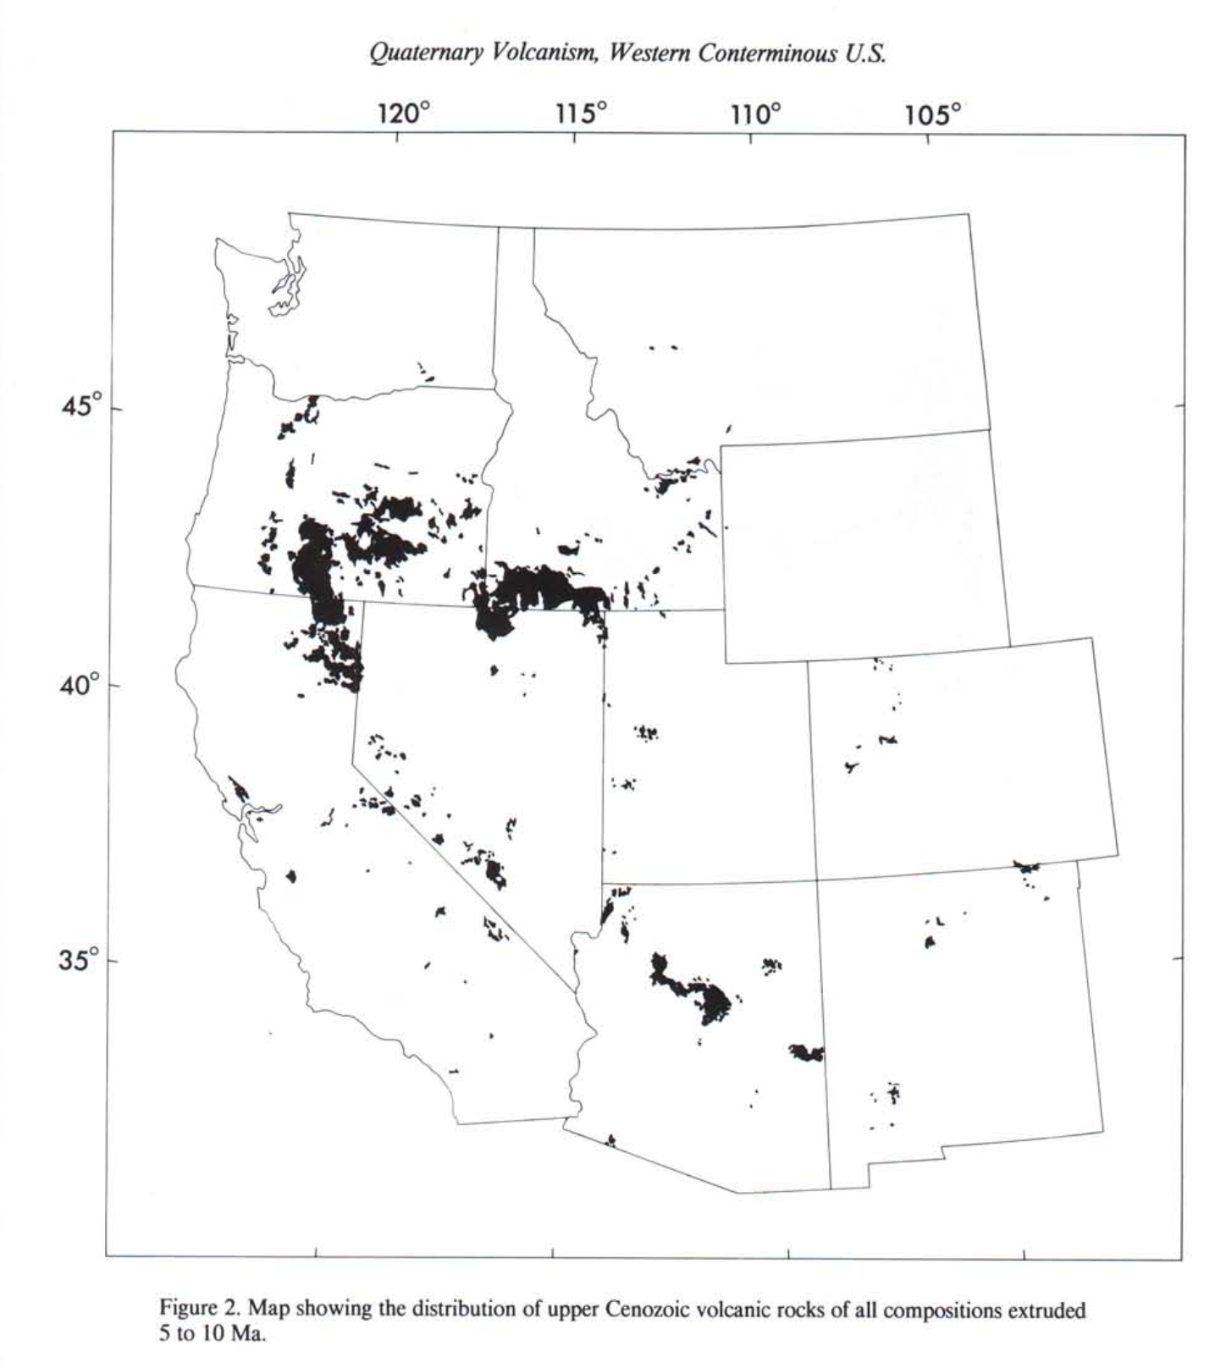
5-10 Ma Period
Not quite as extensive or as large as the eruptions of the previous time period
Volcanic loci became fixed to where they are in the present time
Linear distribution – not as random and scattered
Cascade range, Snake River Plain, Western margin of the Colorado Plateau
Basaltic compositions dominate this time period
Intermediate and silicic rocks were extruded in three large calderas – Long Valley California, Jemez Mountains New Mexico, and the Yellowstone Plateau

Slide 4
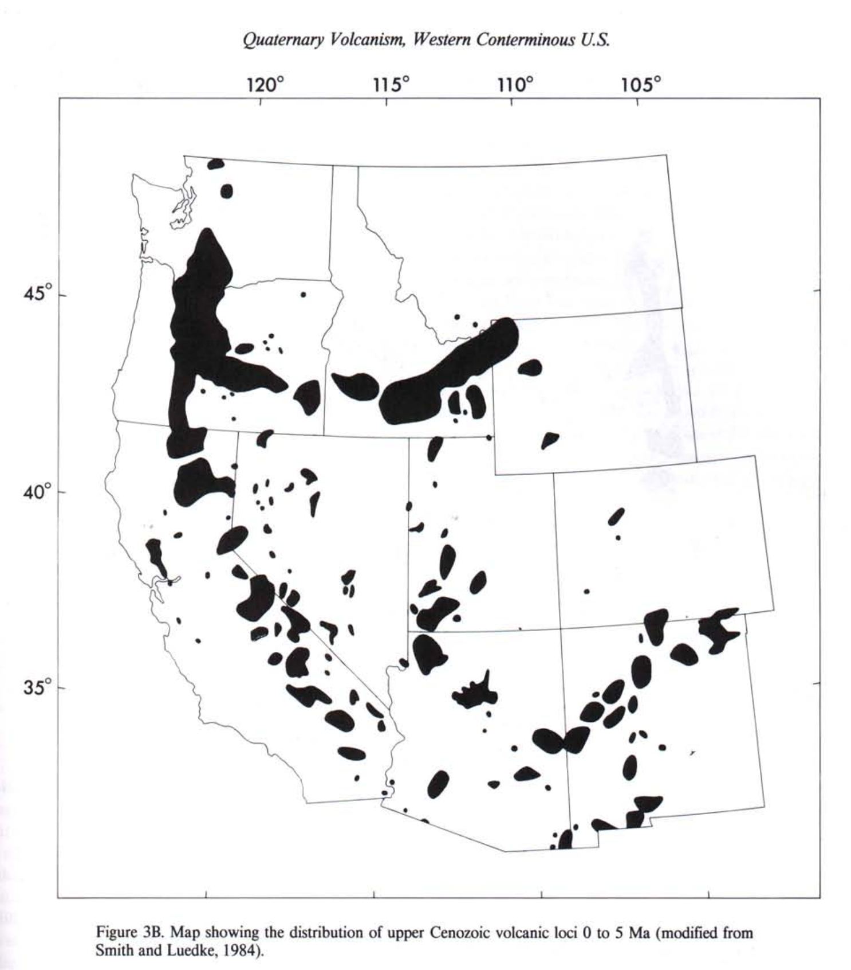
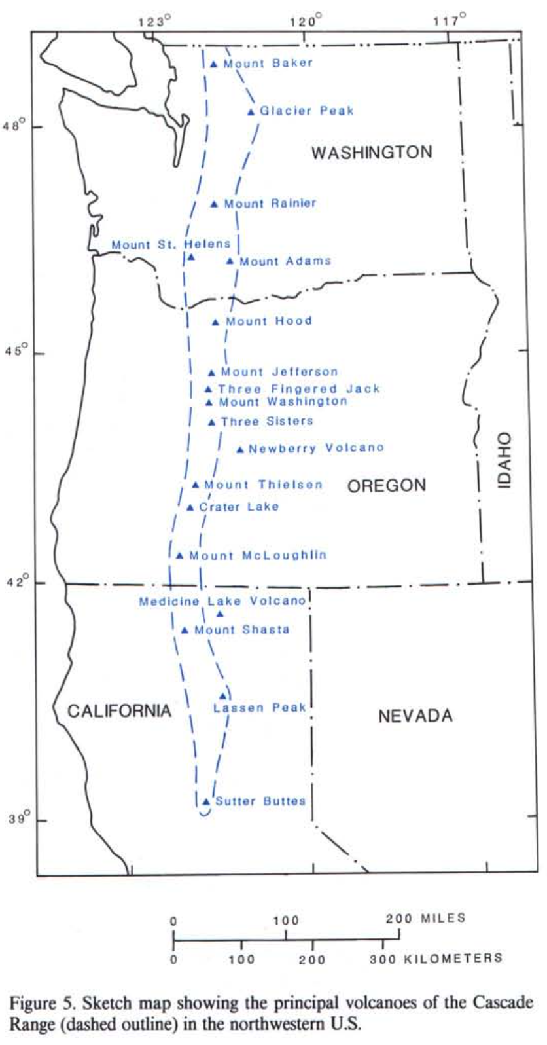
Quaternary Volcanism
Approximately 90 volcanic loci
Figure indicates possible tectonic control of the volcanic zones
Quaternary volcanism was a continuation of eruptive activity with in the previously established volcanic fields
Newberry volcano – probably genetically more aligned with extension tectonism of B&R
shield volcano with cinder cones, fissure vents, and rhyolitic domes and flows within the summit caldera
active for more than 500,000 years with youngest eruption 1,350 years ago

Slide 5
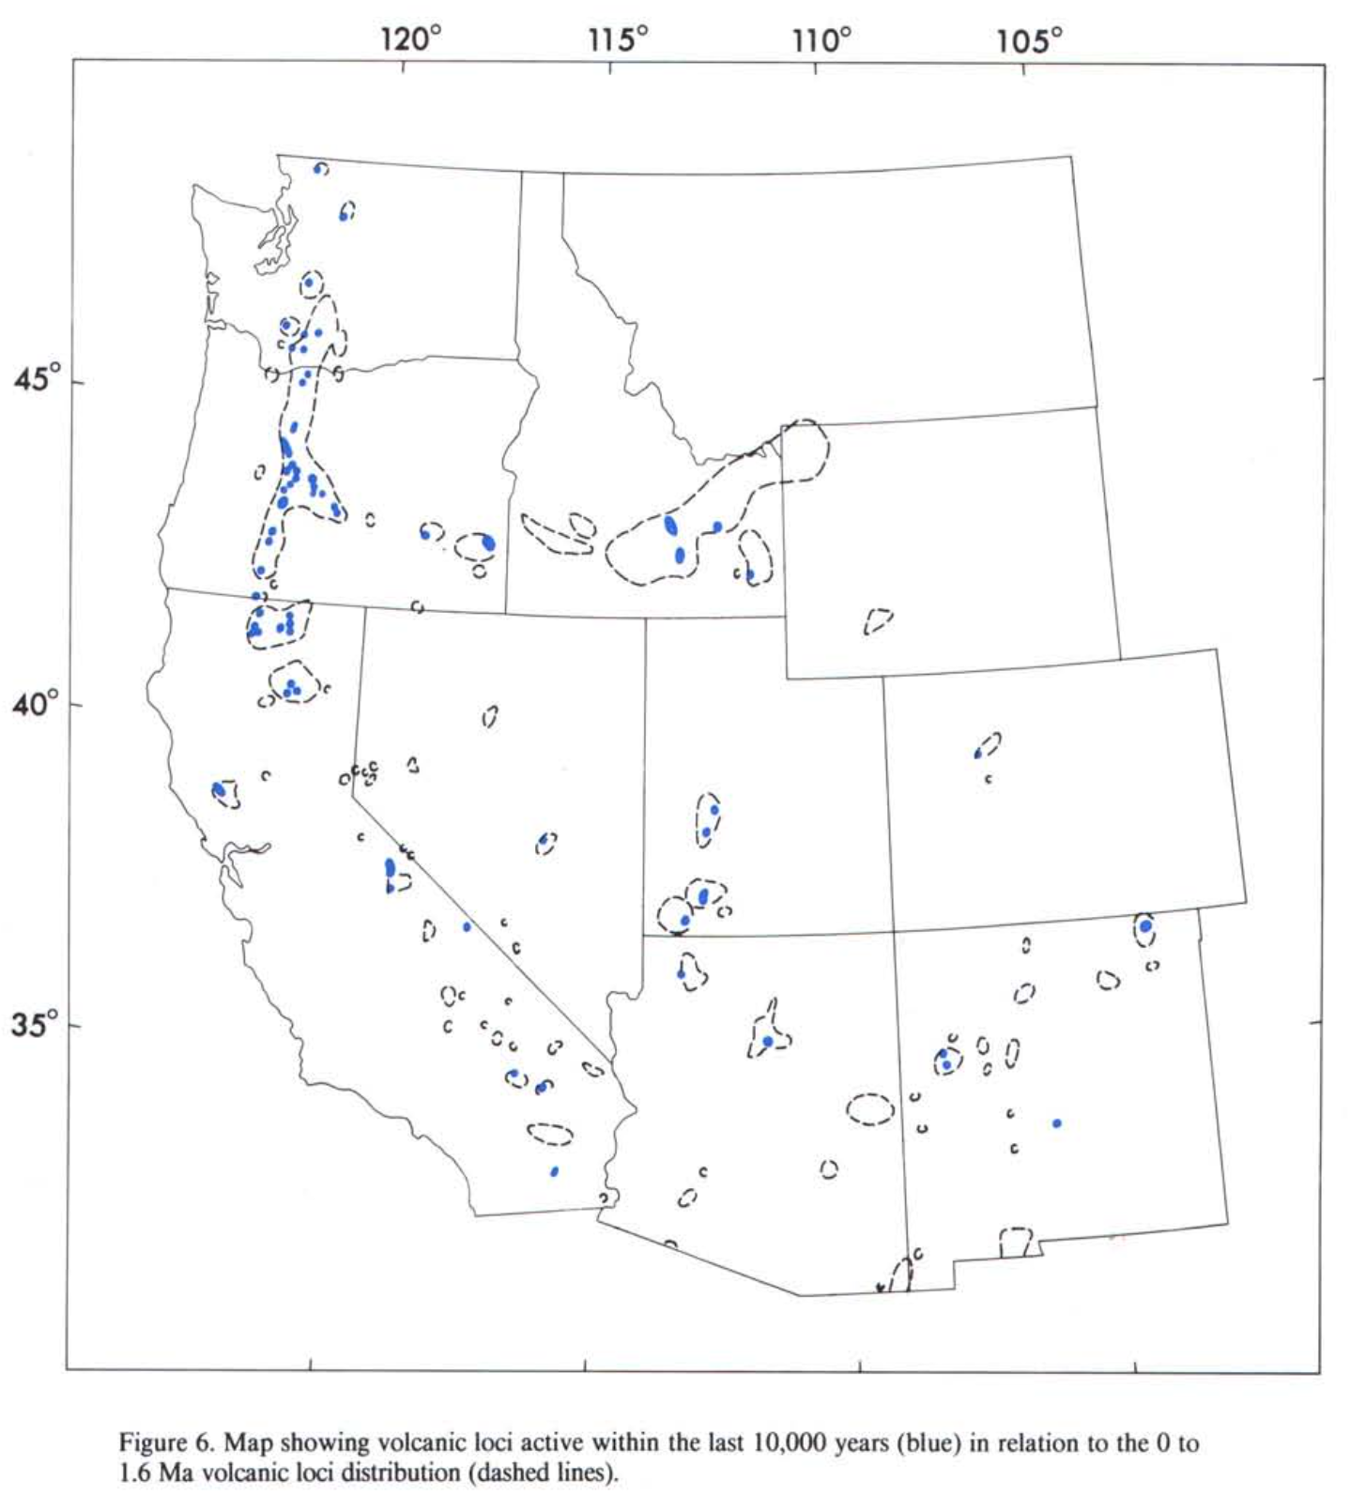
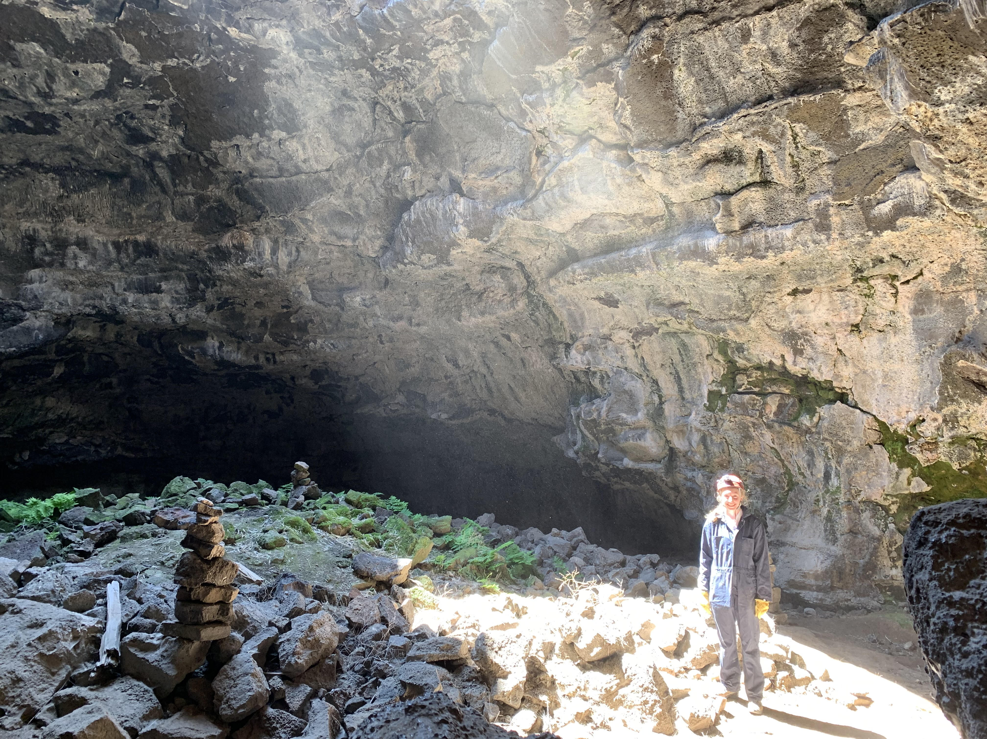
Western Interior Region
Extensional block faulting and silicic and mafic volcanism since 16 Ma.
Yellowstone
largest accumulation of silicic volcanic rocks in the world
3 principal eruptions at 2.0, 1.3, and 0.6 Ma
Basin/Range style faulting in the eastern Snake River Plain
Craters of the Moon – 2,000 years ago
greatest accumulation of Quaternary basalts within the conterminous U.S.
Big Southern Butte/East Butte – rhyolitic dome/flows

Slide 6
Conclusion
By 5 Ma, a pattern of volcanic loci and zones had been established
This pattern has remained mostly fixed
Zones reflect a deep-seated structural feature or boundaries of modern tectonic processes
They anticipate that future volcanic activity will follow this same pattern

